Slide 1
PPTAGENT: Generating and Evaluating Presentations
A generated deck - draft, not final
Notes:
Title slide. State the paper, then the one-sentence claim of the talk.

Slide 2
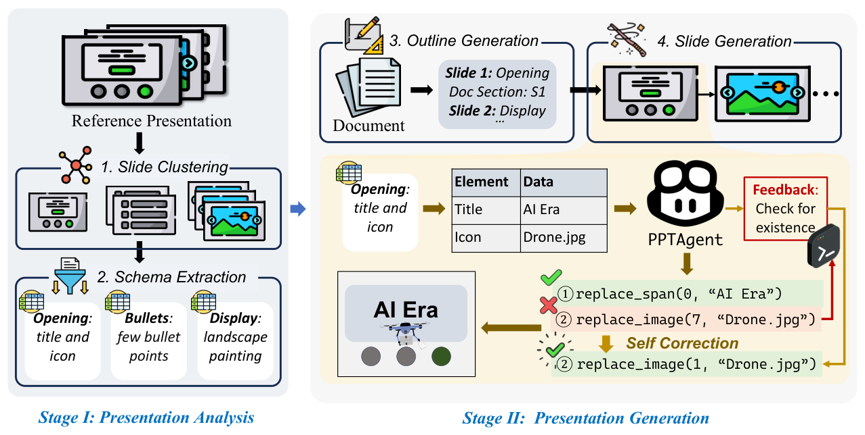
Abstract
- Automatically generating presentations from documents is a challenging task that requires accommodating content quality ...
- To address these limitations, we propose PPTAGENT, which comprehensively improves presentation generation through a ...
- Existing methods primarily focus on improving and evaluating the content quality in isolation, overlooking ...
- PPTAGENT first analyzes reference presentations to ex-tract slide-level functional types and content schemas, then ...
- To comprehensively evaluate the quality of generated presentations, we further introduce PPTEVAL, an evaluation ...
Figure 2: Overview of the PPTAGENT workflow. StageI: Presentation Analysis involves analyzing the input presentation to cluster slides into groups and extract their content schemas. Stage II: Presentation Generation gene
02
Notes:
This slide covers abstract. Open with: Automatically generating presentations from documents is a challenging task that requires accommodating content quality .... Then move to: To address these limitations, we propose PPTAGENT, which comprehensively improves presentation generation through a .... Target roughly 90 seconds here.

Slide 3
Introduction
- Slide Clustering Bullets: few bullet points Opening: title and icon Display: landscape painting 2
- Specifically, the generated editing actions are executed within a REPL1 environment
- An overview of our workflow is illustrated in Figure 2
- Outline Generation Stage Ⅰ: Presentation Analysis Reference Presentation 1
- As shown in Figure 2, we first analyze and cluster reference slides into categories ...
- Re-sults demonstrate that PPTAGENT generates high-quality presentations, achieving an average score of 3.67 for ...
03
Notes:
This slide covers introduction. Open with: Slide Clustering Bullets: few bullet points Opening: title and icon Display: landscape painting 2. Then move to: Specifically, the generated editing actions are executed within a REPL1 environment. Target roughly 90 seconds here.

Slide 4
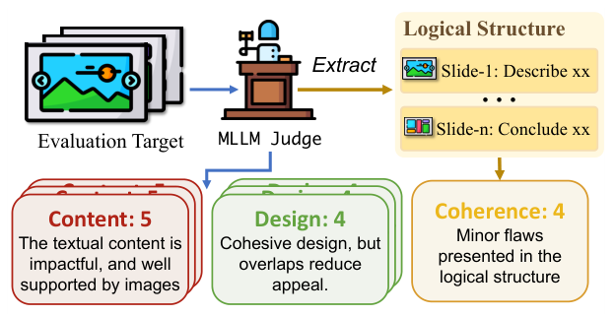
Evaluation Target
- Table 1: The scoring criteria of dimensions in PPTE- VAL, all evaluated in 1-5 ...
- The complete evaluation process is illustrated in Figure 3, with detailed scoring criteria and ...
- Dimension Criteria Content Text should be concise and grammatically sound, supported by relevant images
- Design Harmonious colors and proper layout ensure readability, while visual elements like geometric shapes ...
- Coherence Structure develops progressively, incorporating essential background information
- Coherence: 4 Minor flaws presented in the logical structure Logical Structure Slide-1: Describe xx ...
Figure 3: PPTEVAL assesses presentations from three dimensions: content, design, and coherence.
04
Notes:
This slide covers evaluation target. Open with: Table 1: The scoring criteria of dimensions in PPTE- VAL, all evaluated in 1-5 .... Then move to: The complete evaluation process is illustrated in Figure 3, with detailed scoring criteria and .... Target roughly 90 seconds here.

Slide 5
Experiment
- All open-source LLMs are deployed us-ing the VLLM framework on NVIDIA A100 GPUs
- Each configuration generates 50 presentations (5 domains × 10 input documents), as they do ...
- Specifically, we define configurations as combinations of a language model (LM) and a vision ...
- We have curated 10,448 presentations from this source and made them publicly available to ...
- The total computational cost for experiments are approximately 500 GPU hours
- In addition, we collected 50 documents from the same domains to be used as ...
05
Notes:
This slide covers experiment. Open with: All open-source LLMs are deployed us-ing the VLLM framework on NVIDIA A100 GPUs. Then move to: Each configuration generates 50 presentations (5 domains × 10 input documents), as they do .... Target roughly 90 seconds here.

Slide 6
Evaluation Metrics
- Further agreement evaluation is shown in Section 5.5
- Using Llama-3-8B , we calculate the average perplexity across all slides in a presentation
- Due to the limited sample size, we calculate the FID using a 64-dimensional output ...
- Most notably, PPTAGENT shows a significant enhancement in the coherence dimension (4.48 vs
- Compared to the rule-based baseline (DocPres), PPTAGENT exhibits substantial improvements in both the design ...
- Moreover, detailed performance of Qwen2.5LM+Qwen2-VLVM across various domains is illustrated in Table 8, underscoring ...
06
Notes:
This slide covers evaluation metrics. Open with: Further agreement evaluation is shown in Section 5.5. Then move to: Using Llama-3-8B , we calculate the average perplexity across all slides in a presentation. Target roughly 90 seconds here.

Slide 7
Analysis
- PPTAgent (a) DocPres KCTV PPTAgent (b) Figure 5: Comparative analysis of presentation generation across ...
- Although GPT-4o exhibits superior self-correction capabilities compared to Qwen2.5, Qwen2.5 encounters fewer errors in ...
- Table 5 shows the correlation of ratings between humans and LLMs
- All presented data of similarity exhibit a p-value below 0.05, indicating a statistically significant ...
- All experiments were conducted using the Qwen2.5LM+Qwen2-VLVM configuration
- Additionally, we observed that Qwen2-VL experiences errors more frequently and has poorer self-correction capabilities ...
07
Notes:
This slide covers analysis. Open with: PPTAgent (a) DocPres KCTV PPTAgent (b) Figure 5: Comparative analysis of presentation generation across .... Then move to: Although GPT-4o exhibits superior self-correction capabilities compared to Qwen2.5, Qwen2.5 encounters fewer errors in .... Target roughly 90 seconds here.

Slide 8
Conclusion
- Our ex-periments across data from multiple domains have demonstrated the superiority of our method
- Moreover, we propose PPTEVAL to provide quantitative metrics for assessing presentation quality
- This research provides a new paradigm for generating slides under unsupervised conditions and offers ...
- In this paper, we introduce PPTAGENT, which conceptualizes presentation generation as a two-stage presentation ...
08
Notes:
This slide covers conclusion. Open with: Our ex-periments across data from multiple domains have demonstrated the superiority of our method. Then move to: Moreover, we propose PPTEVAL to provide quantitative metrics for assessing presentation quality. Target roughly 90 seconds here.

Slide 9
Limitations
- While PPTAGENT demonstrates promising capabilities in presentation generation, several limitations remain
- First, despite achieving a high success rate (>95%) on our dataset, the model occasionally ...
- This manifests in occasional design flaws, such as overlapping elements, which can compromise the ...
- Ethical Considerations In the construction of Zenodo10K, we utilized the publicly available API to ...
- Future work should focus on enhancing the robustness, reducing reference dependency, and better incorporating ...
- Third, although PPTAGENT shows improvements in layout optimization compared to prior approaches, it does ...
09
Notes:
This slide covers limitations. Open with: While PPTAGENT demonstrates promising capabilities in presentation generation, several limitations remain. Then move to: First, despite achieving a high success rate (>95%) on our dataset, the model occasionally .... Target roughly 90 seconds here.

