Slide 1
DSAI4901 · CAPSTONE PROGRESS BRIEFING
From generating
to verifying
A reference-free measure of deck usability, used as a control signal in paper-to-slide generation
CHAN Yee Tung
Supervisor: Dr. Jibin Wu · 29 October 2026

Slide 2
WHERE THE FIELD STANDS
Two families, one missing instrument
Work | What it provides | What it leaves open
PPTAgent, SlideGen, SlideLab, ArcDeck | Strong generators; narrative planning | Whether any given deck is usable; local, mechanical failures
ReDeck, PPTPilot, SLIDEFORGE | Repair loops that read rendered feedback | Which class of defect responded to repair, and by how much
SlideAudit, DECKBench, PresentBench | Flaw taxonomy; deck-level scoring against a reference | Arrives after generation; needs a target deck or labels
Read together, the field is good at producing decks and good at scoring them afterwards, but it has not closed the loop in between.
The instrument arrives too late to steer generation, and it is not decomposable when it does arrive.
The gap: no instrument runs inside the loop, and none of them decomposes the score. A deck-level number cannot tell you which defect to fix.
02

Slide 3
WHY THIS DIRECTION
Three things the literature does not do
Attribution is missing
Measurement is post-hoc
Instruments need references
ReDeck and PPTPilot both repair, but a deck-level gain of ten points does not say which defect class responded.
SlideAudit and DECKBench score finished decks. A score that arrives after generation cannot steer it.
A target deck, or human labels on images. Neither can run on an arbitrary .pptx at generation time.
So the contribution is not another generator, and not a new taxonomy.
- It is a measurement layer that is reference-free, computed on the object model, and cheap enough to run inside the loop.
- And a study of what that measurement is worth - per violation class, against cost.
03

Slide 4
THE QUESTION
One gap, two research questions
“Slide quality can now be measured after the fact. What these instruments cannot answer is whether measurement can drive generation.”
RQ1
Can a small set of mechanical gates replace a reference deck or human labels, and still rank decks in the order a person would?
RQ2
What does using that signal inside the loop actually add - per violation class, and at what cost?
Both are answered by the same artefact: a deck, a score, and a repair log.
04

Slide 5
THE SYSTEM
Seven parts, four of which call a model
A generation - text layer, frozen once written
parse
AI
AI
AI
AI
claims
requirement
select
outline
bullets+notes
render
PDF -> sections,
figures, captions
assertions with
an evidence id
talk length and
audience -> table
keep or drop,
per claim
re-order into
an argument
compress, then
write the talk
native, editable
.pptx
B measurement - six gates on the .pptx object model, no rendering
G1 containment
G2 overlap
G3 font size
G4 contrast
G5 text fit
G6 density
SRR
ready?
1 measure
worst violation first
2 repair
cheapest reversible action
3 re-measure
gain per second and per dollar
Only the text layer is allowed to change the words. Repair may move, resize or recolour; it may never add content or change a number. That is what keeps “the loop improved the deck” from being confounded with “the loop rewrote the deck”.
05

Slide 6
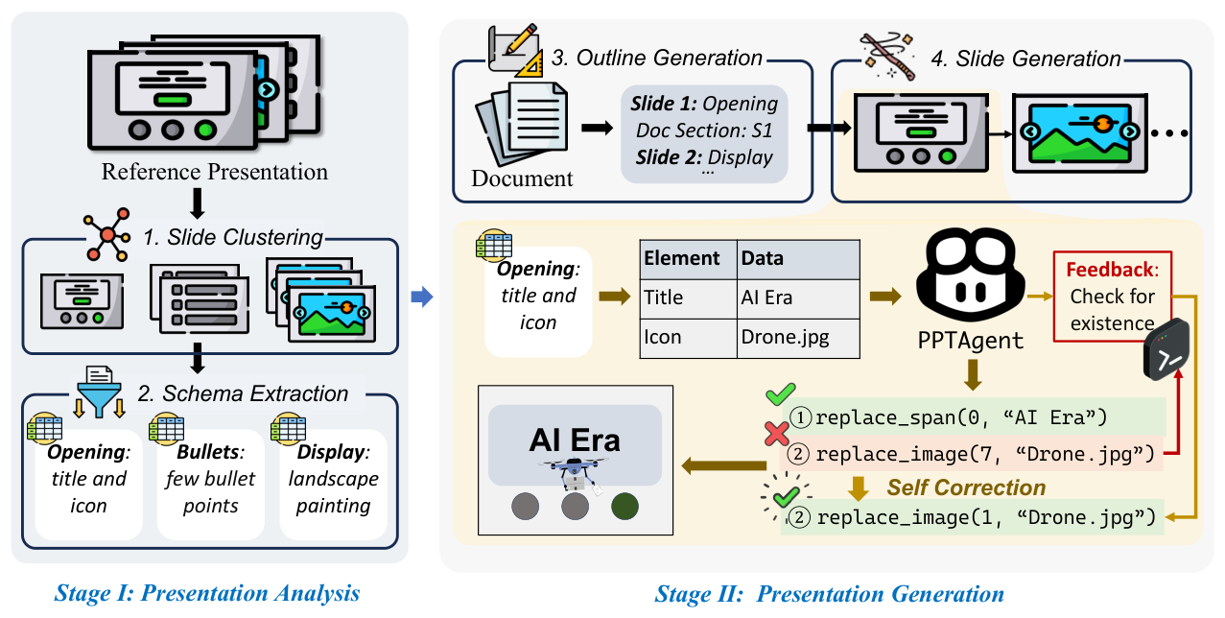
PART 1 · READING THE PAPER
Captions are re-rendered, not extracted
- Headings are found by font size and weight, not by a fixed list.
- Figures are vector art in this literature: pulling embedded images returns 32x32 icons. So each caption's region is clipped and rasterised at 200 dpi.
- The band stops at the nearest paragraph, not at any text block - a figure carries its own labels, and stopping at those cut the figure in half.
Figure 2 of PPTAgent, clipped from the PDF
12 of 32 captions in this paper produced a usable crop. The failures are tables whose caption sits above the table, and figures that span both columns. Both are fixable; the rule that produced the 12 is already the one the evaluation will use.
06

Slide 7
PART 2 · DECIDING WHAT TO SAY
Selection is a table, not a judgement
request | always kept | kept if room | dropped
5 min, general | results, conclusion | method (core only) | analysis, limitations
12 min, expert | results, conclusion, method, motivation, background, analysis | related work, setup | -
Every kept or dropped claim carries the id of the rule that decided it:
claim | section | imp. | decision | rule id | why
c3 | results | 3 | kept | hard:results | results are never dropped
c7 | setup | 2 | dropped | table:12:setup | not kept in a 12-minute talk
c9 | analysis | 1 | dropped | importance:cut2 | importance 1 < cutoff 2
The model appears at two boundaries only: it converts a free-text request into that table, and it extracts claims. The keep/drop decision in between is a lookup, so a second person can re-run it.
07

Slide 8
PART 3 · MEASURING
Four of six gates exist; two are next
gate | rule | threshold | state
G1 containment | every shape inside the slide | 0 pt | built
G2 overlap | text intersection over the smaller box | > 5 % | built
G3 font size | body and title, by slide role | role min | built (global)
G6 density | characters and bullets, by role | role max | built (global)
G4 contrast | WCAG 2.2 AA, fill against background | 4.5 : 1 | next
G5 text fit | rendered height over box height | <= 0.95 | next
SRR
SRR = Σ P / Σ J
J = checks that could be judged, P = those that passed. One weight per check; none is fitted.
unknown is not n/a
n/a: does not apply - one text box, so no G2 pair
unknown: applies but cannot be computed - image background
both leave the denominator, both carry a reason code
deck-ready = no failure anywhere, and every gate judged at least once. A title slide does not need G6; the deck does.
08

Slide 9
SCOPE
Sixty-five things you could measure. Six are worth it
candidate | n
A layout geometry | 14
B typography | 15
C colour and contrast | 7
D content and meaning | 12
E structure | 8
F rendering | 5
G audience | 4
total | 65
Five tests
What survives
- decidable without a reference
- deterministic: same file, same number
- a violation is worse, not different
- cheap enough to run in the loop
- explainable: shape, value, threshold
gate | from
G1 containment | A1
G2 overlap | A2
G3 font size | B1
G4 contrast | C1
G5 text fit | B7
G6 density | B5+B6
And what it cannot see: a bullet can be grammatical, the right length, the right size - and still nonsense. That is the boundary of a mechanical metric, and it belongs to the human study.
09

Slide 10
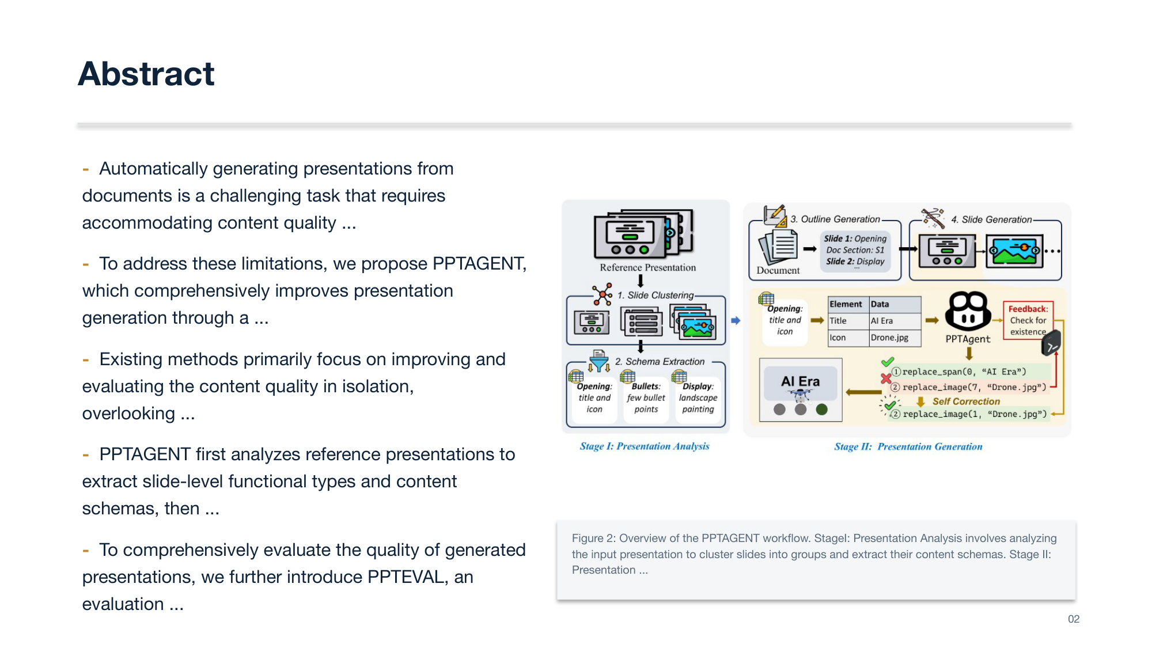
RESULTS SO FAR
Every generated slide fails at least one gate
 | PPTAgent | DOC2PPT
slides | 9 | 9
clean slides | 0 | 0
SRR (slide-level) | 0.00 | 0.00
violations | 33 | 32
slides failing G3 | 9 / 9 | 9 / 9
slides failing G6 | 8 / 9 | 8 / 9
This is the expected result, not a defect: the baseline generator ignores every gate. What matters is that the number is reproducible and the violations are named.
Slide 2 of the generated deck: figure placed, caption under it
10

Slide 11
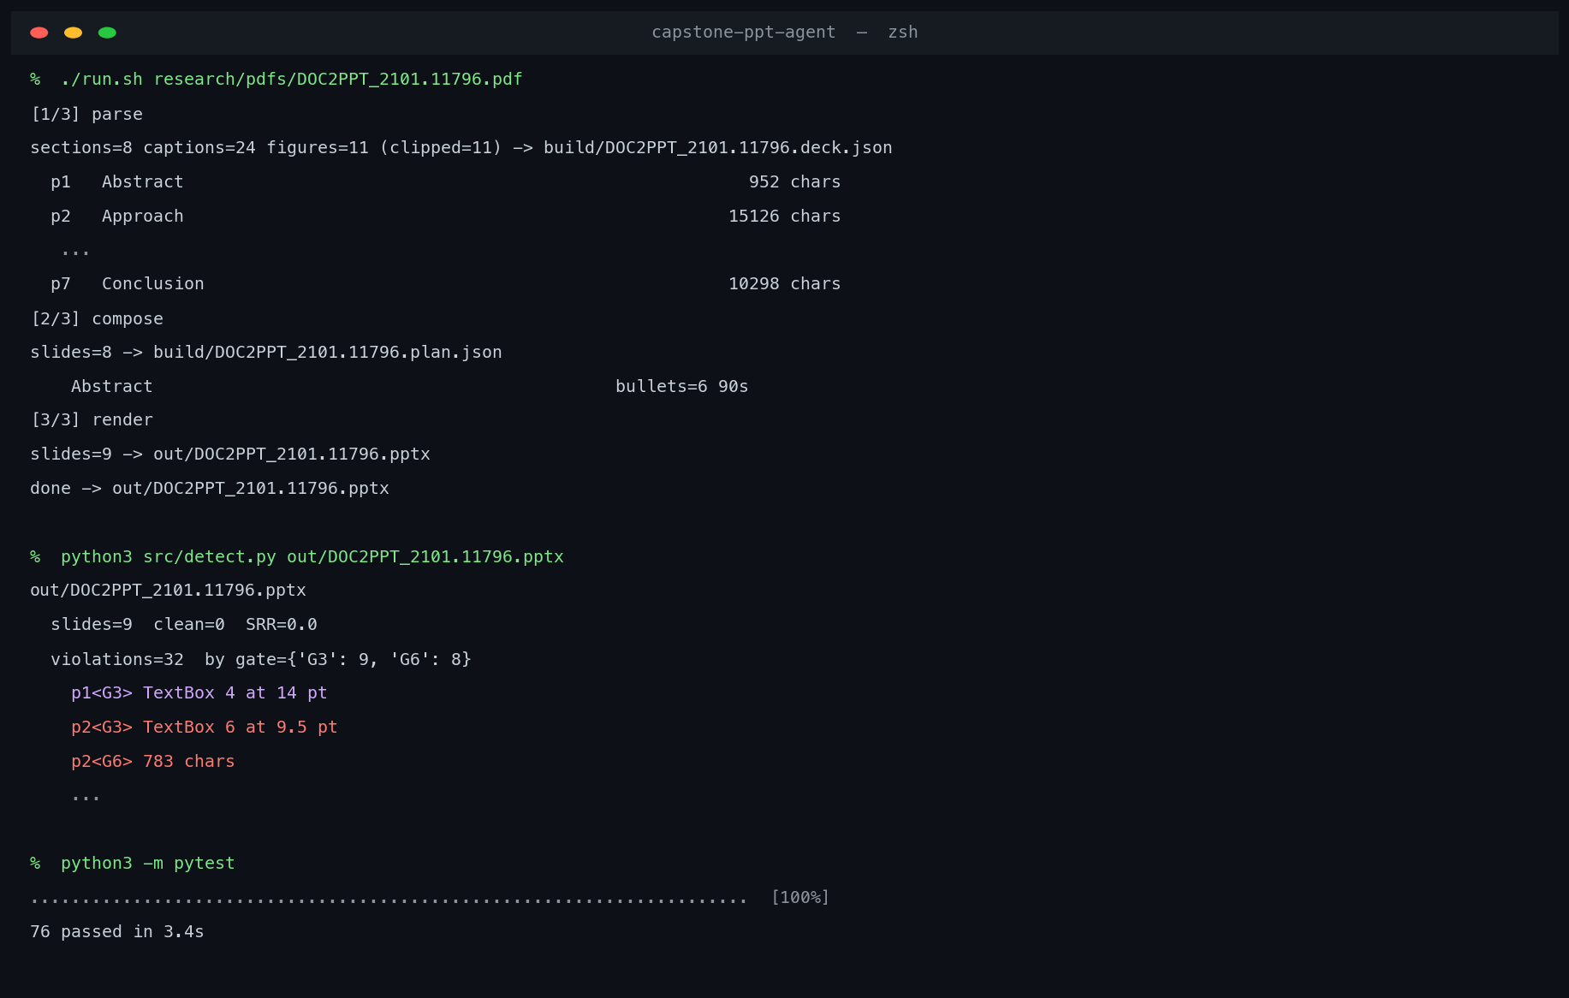
THE RUN
It runs end to end, and it fails honestly
parse
8 sections, 24 captions, 11 figures clipped
compose
8 slides, 90 seconds each
render
a 9-slide deck, native and editable
detect
32 violations, SRR 0.00
pytest
76 cases green
Real terminal output; rows in the middle are elided.
11

Slide 12
STATUS
What is built, what is next
Built and tested
Partially built
Not started
- parse: sections, figures, captions
- figure clipping, 12/32 on the sample
- render: native .pptx with speaker notes
- G1, G2, G3, G6 + SRR
- selection rule table, 55 test functions
- G3 / G6 still use one global threshold
- figure captions need a word-boundary trim
- claims are still extracted by heuristic
- G4 contrast, G5 text fit
- repair actions and the loop
- 110-slide test set and its labels
- human decks, baselines, the 2x2 experiment
76 test cases pass. The deck above was produced by this pipeline end to end.
12

Slide 13
PLAN
The experiment, and the calendar
The design: a 2 x 2 factor
 | no inspection | inspection on
base model | A1 | A2
fine-tuned | A1' | A2'
weeks | work | milestone
W1-2 | scope and literature | proposal, 5 Nov
W3-7 | rulebook, six gates, calibration | validity check
W8-11 | repair actions, 110-slide test set | interim report, 7 Jan
W12-18 | loop, ablation, 20-person study | preference correlation
W19-23 | report, demo, presentation | final, 8 Apr
A2 - A1 isolates what inspection adds. The fine-tuned row tests whether that gain survives a better generator.
The fine-tuned arm is conditional: it runs only if the main result is in and four weeks of buffer remain.
Two validity checks run before the study: decks must rank human > PPTAgent > naive, and SRR must track preference. The correlation is pre-registered and reported whatever it shows.
13

Slide 14
WHAT I NEED FROM YOU
Three decisions and one question
1
Human decks
Where can I get decks an author actually presented? They are the upper bound in the validity check, and I have none.
2
Scope
Single-column English papers, 10-12 slides, 8 held-out papers - is that narrow enough to finish, or too narrow to generalise?
3
Gate set
Six mechanical gates, with density and font size swept rather than fitted. Is that defensible, or should one be dropped?
And one question I would like your view on: is a deterministic detector seen as a strength here, or as a gap in the AI content of the project?
14

