Slide 1
Market Basket Analysis
Mizuki Kakei
27.05.2019

Slide 2
Index
What is Data analysis ?
Partnership with other companies
Conclusion
Application

Slide 3
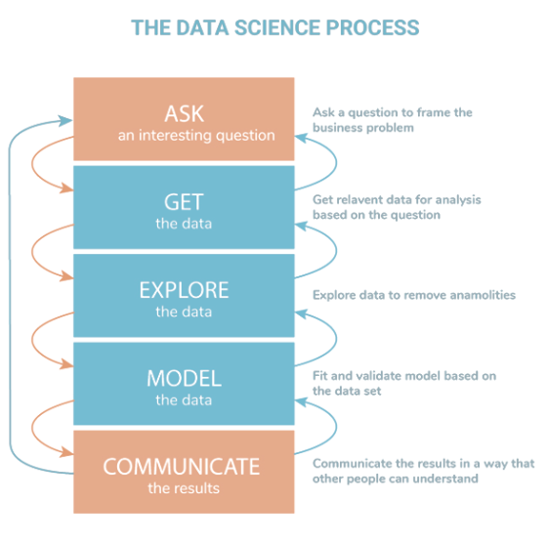
What is data analysis ?
Data analysis is a process of finding patterns from a big data set.

Slide 4
Partnership with companies
Should we have deeper strategic relationship with Sony or Acer ?
Sony

Slide 5
WHY?

Slide 6
Because 60% of our customers prefer sony

Slide 7
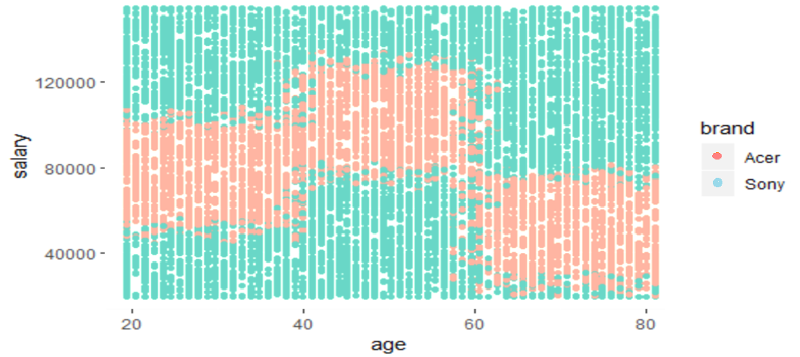
Richer and younger customers tend to prefer Sony

Slide 8

Should we acquire Electronidex ?
Yes. Blackwell Electronics and Electronidex
would be optimal partners.

Slide 9
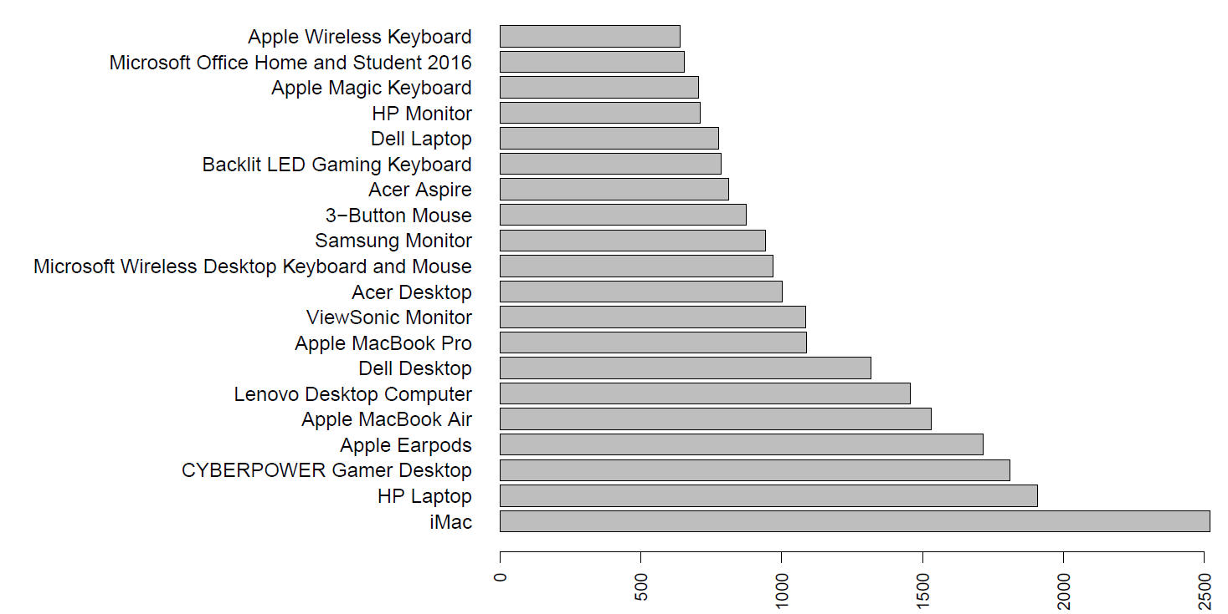
Electronidex’s purchasing patterns
Top 20 products which appeared in whole transaction includes :
5 PCs
5 Laptops
6 Accessaries
3 Displays
1 home device

Slide 10
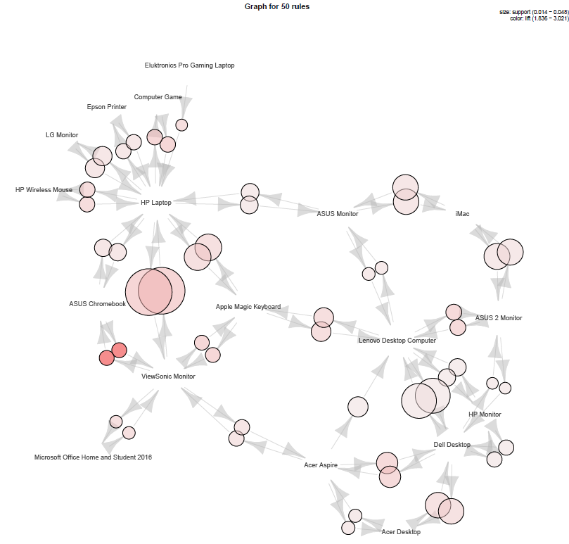
PCs and Desktops are purchased with other products

Slide 11
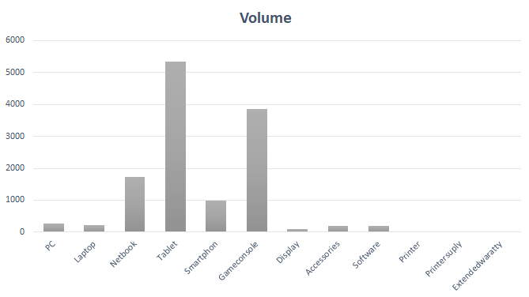
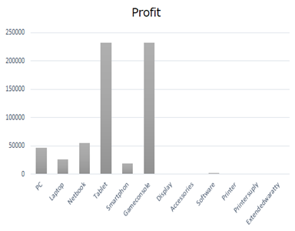
Predicted Sales volume and total profit

Slide 12
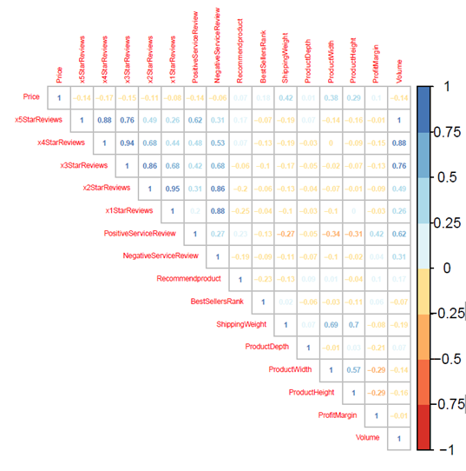
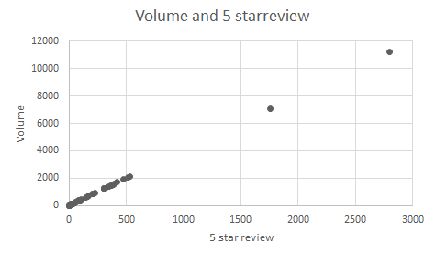
Interestingly, the sales volume and 5 star review has correlation coefficient 1

Slide 13
Conclusion and recommendation
We should have deeper strategic partnership with Sony since customers prefer Sony more than Acer.
We should acquire Electoronidex since their clientele purchase Laptop and Desktop with other items very often.
On the other hand, we can offer some products that we sell and they do not sell.

Slide 14
Future Business Application
Gaining the insight into companies by analyzing the data set.
Deciding the place to open new stores based on the information of customers and regions.
Making an advertisement by conducting Market basket analysis

Slide 15
Thank you

