Slide 1
Saving Energy Consumption in a household
Mizuki Kakei

Slide 2
Agenda
Background of this Project
Objects and Goals of analysis
Products Information
Recommendation

Slide 3
Project
We investigated 47 months of data as use case.
Conducted time series analysis and found some patterns
To empower smart homes, we concluded to make a dash board

Slide 4
Why dashboard ?
We would like tenants to reduce the electricity consumption so that they can save money
If the price of utility is low, it allows us to increase the cold rent of the houses.
Therefore we would like to visualize the electricity data to help to decrease the electricity consumption.

Slide 5
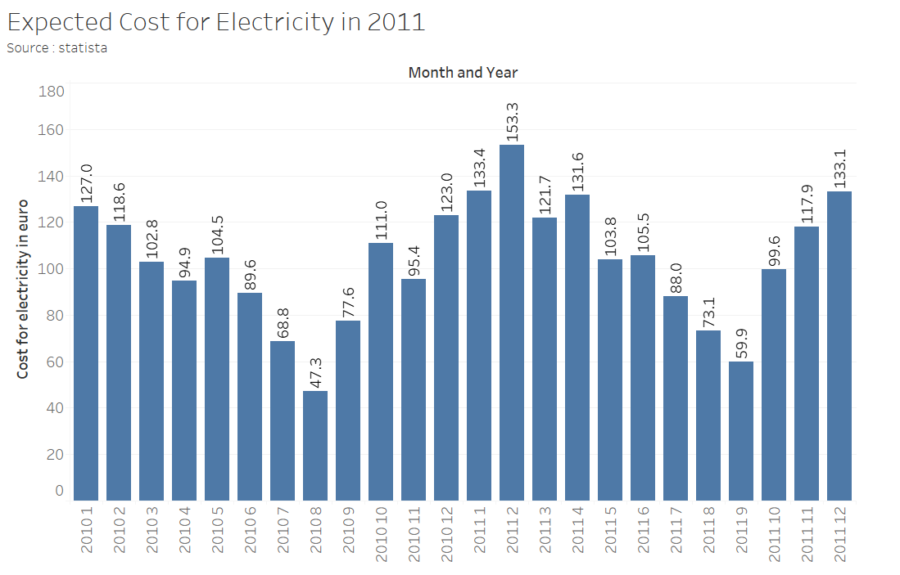
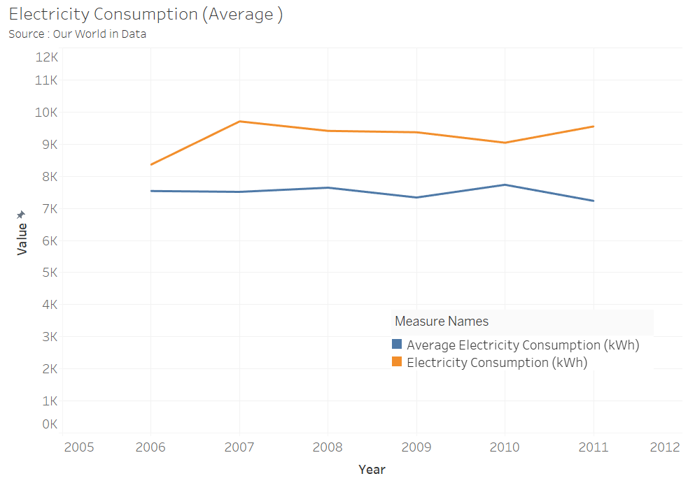
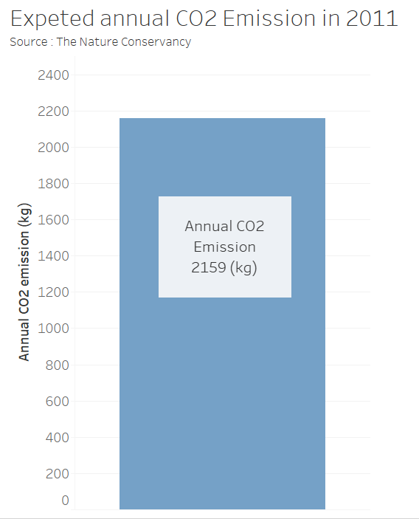
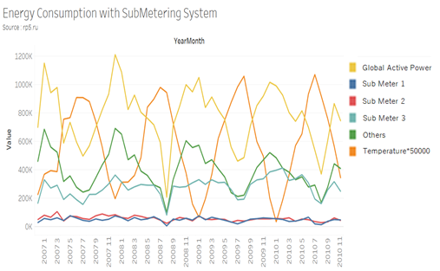
Dash board 1
Comparison of energy consumption in a household and average per capita
Energy consumption with sub-metering system and temperature
Annual CO2 emission
Expected cost for electricity consumption in 2011

Slide 6
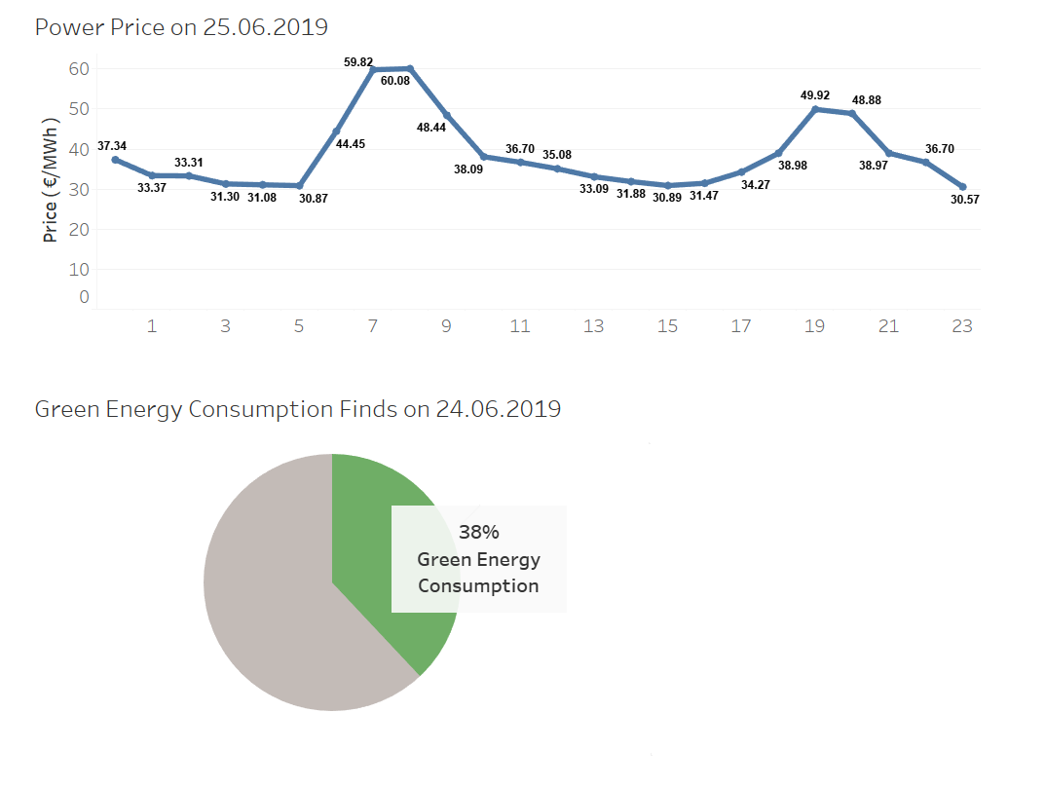
Dash board 2
Power price in a day
Green energy consumption yesterday

Slide 7
Comparison of energy consumption in a household and average energy consumption per capita in France
The actual energy consumption in a household and the average energy consumption per capita in France.
It gives annual energy consumption from 2006 to 2011 (The values in 12.2010 and 2011 are the expected energy consumption)

Slide 8
Energy consumption with submetering system and temperature
It gives monthly energy consumption from 12.2006 to 12.2011.
The values from 12.2010 to 12.2011 are the expected energy consumption
Temperature can be the option

Slide 9
Annual CO2 emission
It gives the amount of CO2 emission from electricity consumption.
It was calculated with
(the expected energy consumption in 2011) * 0.226 kg / kWh.

Slide 10
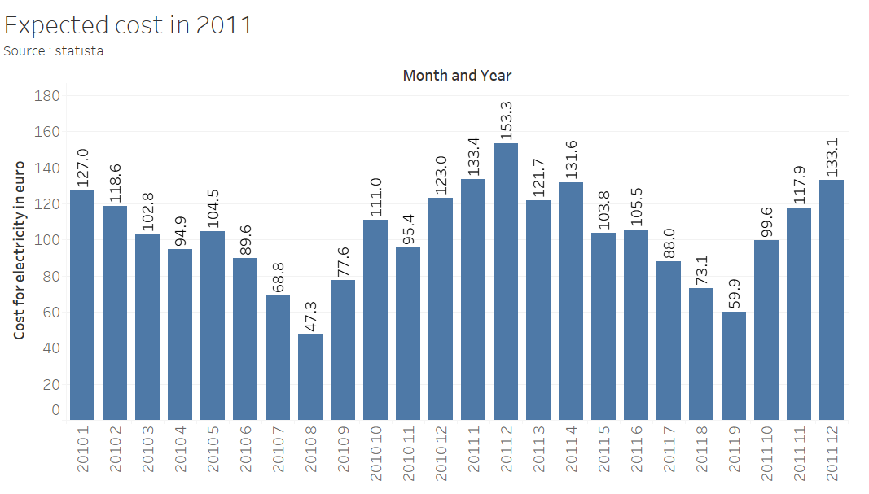
Expected cost for electricity consumption in 2011
The expected cost for electricity was calculated with (expected electricity consumption * 13.83 cent / kwh)

Slide 11
Green energy consumption
Green energy consumed the day before
The price of the energy. When the price of the energy is low, It produce the green energy.

Slide 12
Recommendation
To provide the dashboard to tenants
To make a team of data analysts and Web developers so that we can make this dash board more functional which is connect to the current energy consumption

Slide 13
Thank you !

