Slide 1
Products recommendation for Energy consumption
Mizuki Kakei

Slide 2
Agenda
Background of this project
Object and goals of data analysis
Data description
Data analysis
Recommendation and outlook

Slide 3
New project
Investigating a sub-metering system for power management in smart homes
Analyzing and visualizing energy consumption data in a house with a sub-metering system.
Recommending products related to the energy consumption to empower smart homes.

Slide 4

Use case
We analyzed a very big data set of a household in Sceaux (7 km away from Paris) from December 2006 to November 2010 as an example.
The purpose of doing this analysis is to understand the general energy consumption then we can apply to smart homes.

Slide 5
Data description
The data set includes 2,075,259 measurements for 47 months.
It includes:
Date and Time,
Global active power,
Global reactive, power,
Voltage,
Global intensity,
Submeter1(Kitchen),
submeter 2 (laundry),
submeter 3 (heater and air conditioner).

Slide 6
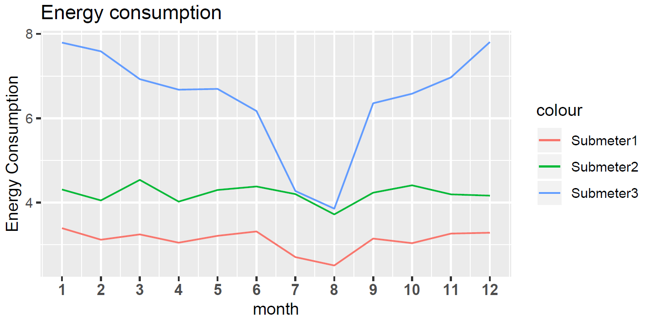
Energy consumption for each month

Slide 7
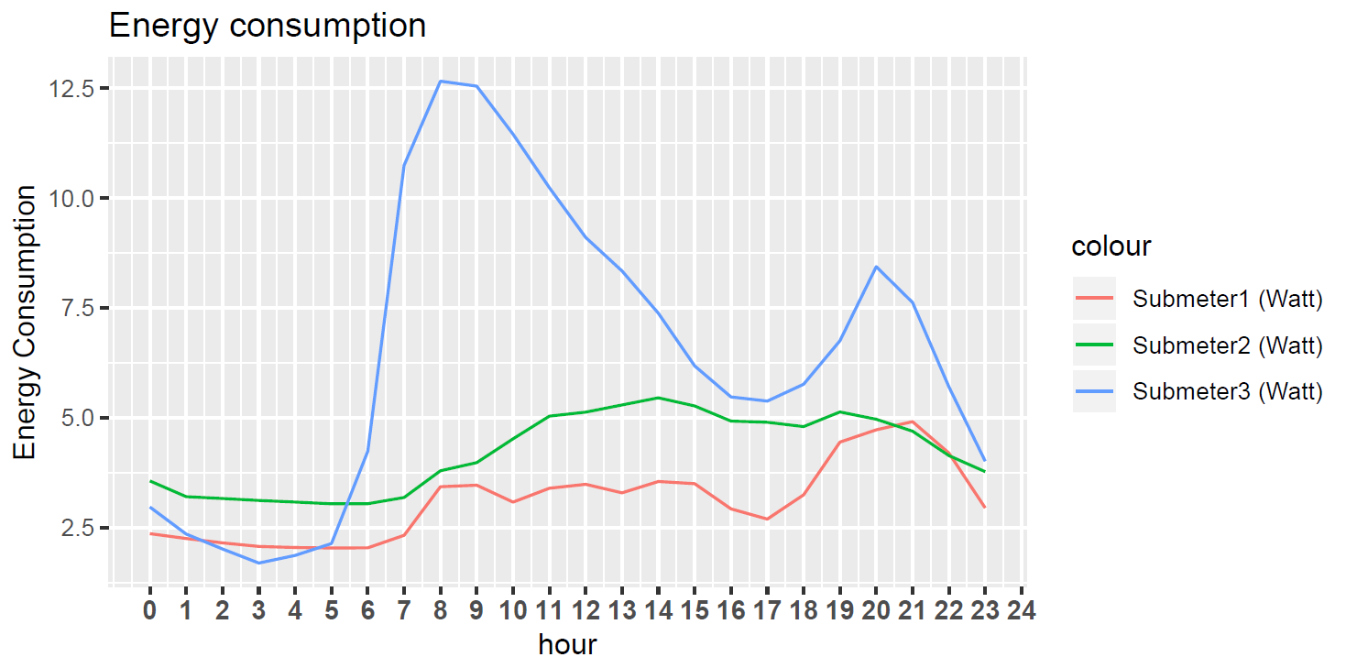
Energy consumption patterns for each hour

Slide 8
Recommendation and Outlook
１
Making a system with which tenants can check the energy consumption easily: a website or a dashboard
2
Making a security system to protect privacy
3
Installing sub-meters for individual rooms

Slide 9
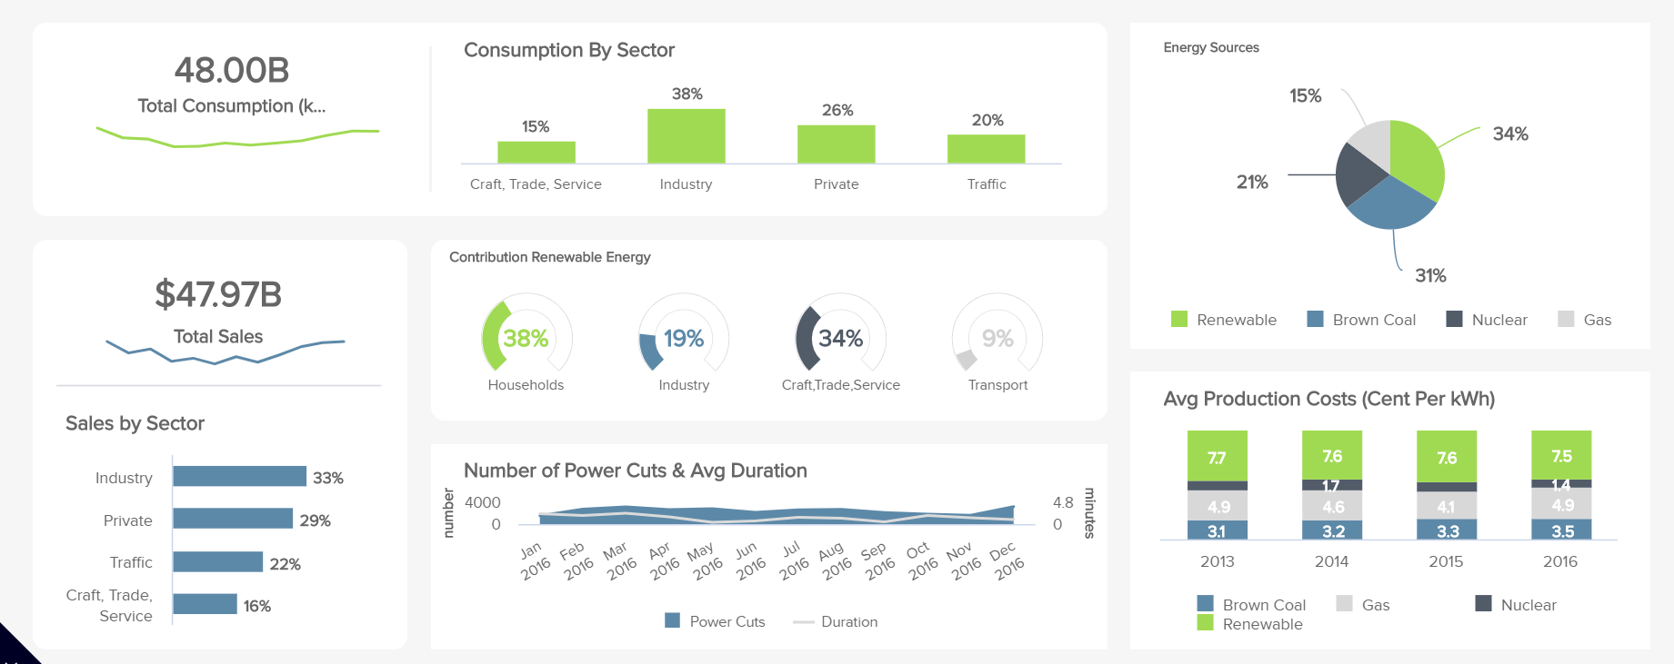
Making a system with which tenants can access to the energy consumption data
Making a Dashboard with which tenants can check the energy consumption
Hiring Web developer, designer, UI designer are needed
Sending a notification if the energy consumption is higher than usual
Picture is taken from https://www.datapine.com/dashboard-examples-and-templates/energy

Slide 10
Making security system
Installing a sub-metering system can provide the accurate data of energy consumption, however, it also might provide the information of the life style of tenants so the energy consumption data should be protected.
Hiring cyber security professionals is needed

Slide 11
Making different sub-metering system depends on their strategy
Each tenant has different style for living (family, sharing house and so on)
It is better to know the accurate price for utility when tenants in a house are financially independent
Usually adding one sub-metering system costs €100

Slide 12
Thank you

Slide 13
What is submetering system ?
Two different types of metering system :
2, Master metering : Utility supplies for whole building
★ Submeter system : Submetering system is used in Master metering building. It tells the energy consumption in specific location.
1, Direct metering : Utility supplies for each houses.

