Slide 1


Location Navigate system
Mizuki Kakei

Slide 2
Index
Executive summary
Objects and goals
Area Map
Data set
Principal component analysis
Methods of Analysis
Results
Summary and outlook

Slide 3

Executive Summary
Purpose and methods :
This report examines the navigation system inside the campus. The purpose of this report is finding the best machine leaning model which predicts the location i.e. longitude, latitude, floor and building based on Wifi finger print. As a method of analysis, We built 6 different models which included 2 different data Preprocessing (PCs and No PCs) and 3 different prediction model (KNN, SVM and Random Forest).
Findings and conclusions :
For the floor, building and latitude prediction, the best values were obtained for the model without PCA with random forest. It gave 90%, 99.5% of accuracy and 0.97 of R-squared respectively. For Longitude prediction, the model with PCA with random forest worked well. It obtained 0.992 R-squared.
Recommendations :
Creating apps with this location navigation system.
Adding the service in the app which can tell specific person’s location.
Best results

Slide 4
Objects and goals
This project is about creating system to navigate people inside the campus. Since GPS usually does not work well inside the building, we need to use other systems. Wifi finger print system can be one of the solution.
520 Wifi spots were set in this campus and people used phones to observe the signals with these multiple Wifi spots (WAPs).
The strong signal between phone and WAP also represents that the distance between phone and WAP is short. Thus by detecting the signals, the location can be predicted.
The goal of this work is finding the machine learning model with high accuracy for Longitude, Latitude, Floor and Building.

Slide 5
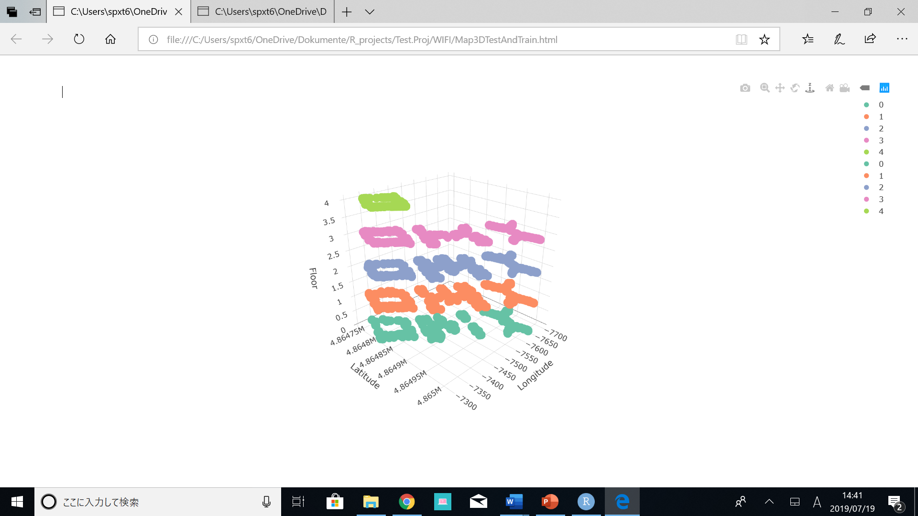
Area Map
This campus consists of 3 buildings (building 0, 1 and 2).
Building 0 has 5 floors (0 – 4th floor) and building 1 and 2 have 4 floors (0 – 3rd floor).
The image right shows the Map of this campus.

Slide 6
Data set
Two data sets of Training data and Validation data were provided. Training data obtained 19937 rows and validation data obtained 1111 rows. Both data set included 529 columns with
Location
- Floor, Longitude, Latitude, Building, Space ID, Relative position
with respect to Space ID
User Information
- User ID, Phone ID
Time Stamp

Slide 7
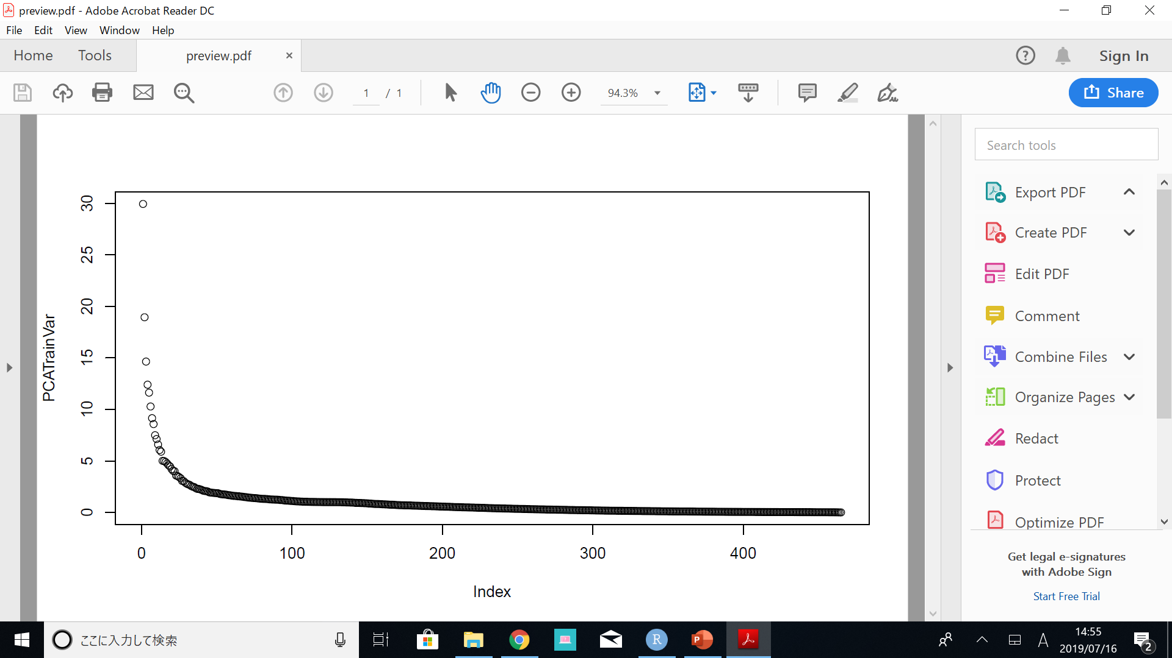
Principal Component Analysis
In the beginning of preprocessing of data set, 55 columns were excluded from Training data set since they did not have any detected values in their rows.
465 Principal components(PCs) were created based on the 465 WAPs data (520 WAPs – 55 WAPs).
206 columns which corresponded to 90 % of total variances of 465 PCs were extracted.
90%
206 columns

Slide 8
Methods of Analysis
6 ways of analysis were conducted.
There were 2 different preprocesses (PCAs and No PCAs). For the classification of floor and building and the regression of longitude and latitude, 3 prediction models (KNN, SVM and Random forest) were applied.
 | KNN | SVM | Random Forest
PCAs | Model1 | Model2 | Model3
No PCAs | Model4 | Model5 | Model6
Model
Preprocess

Slide 9

Results
Accuracy of floor prediction was quite low in general. The highest accuracy was obtained with Random forest without PCA. It gave 90 % of accuracy.
Building prediction was successful. Especially, random forest with PCA gave 99.5 % of accuracy.
SVM did not work well for the regression for both longitude and latitude prediction.
For longitude, Random forest with PCA provided highest R-squared value which was 0.992.
For latitude, Random forest without PCA worked well.

Slide 10
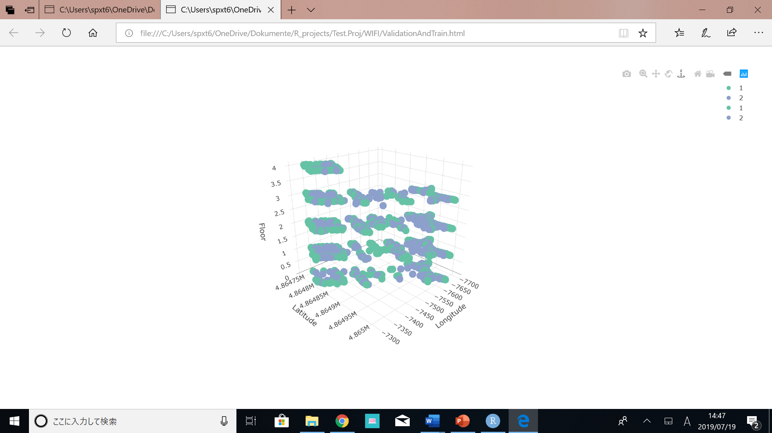
Best results of Accuracy and R-squeared
The image below right shows the difference between the prediction and validation data.
Green color represents validation data and blue color is for the prediction.
The accuracy and R-square of prediction was quite high.
However, if we see the image of the map, the error is still big.
 | Validation Accuracy | R-Squared
Floor (No PCs, RF) | 90% | -
Building (No PCs, RF) | 99.5% | -
Longitude (PCs, RF) | - | 0.992
Latitude (No PCs, RF) | - | 0.97

Slide 11
Summary and Outlook
Random forest performed the best results for all prediction of floor, building, longitude and latitude.
The accuracy of Floor and Latitude prediction should be improved.
For the next step, Outliers of the data should be detected.
Creating apps for this system.
Adding the function that user can search some specific person’s location.

