Slide 1
Visualization for Location detecting system with Wifi finger print

Slide 2
3D Area Map of Campus

Slide 3
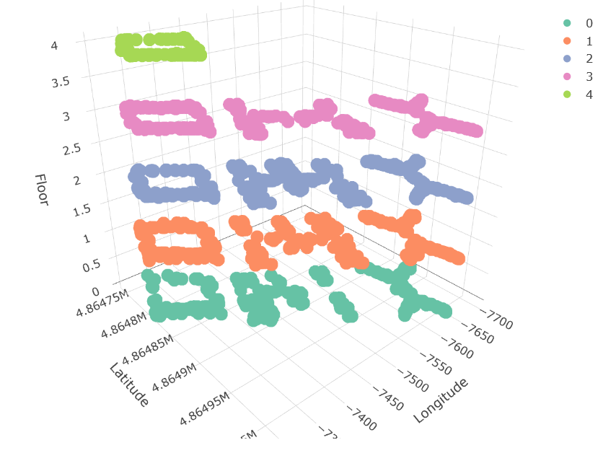

Slide 4
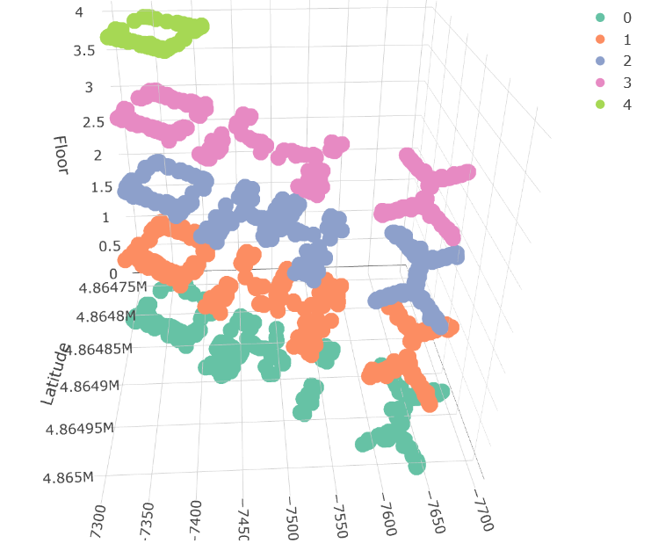

Slide 5
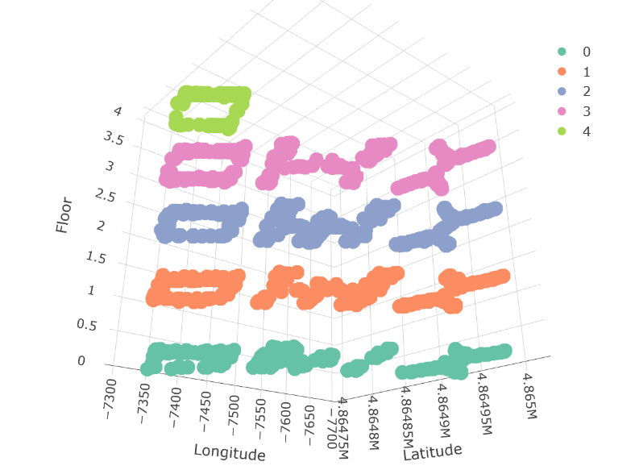

Slide 6
Comparison between real Campus Map and Predicted location

Slide 7
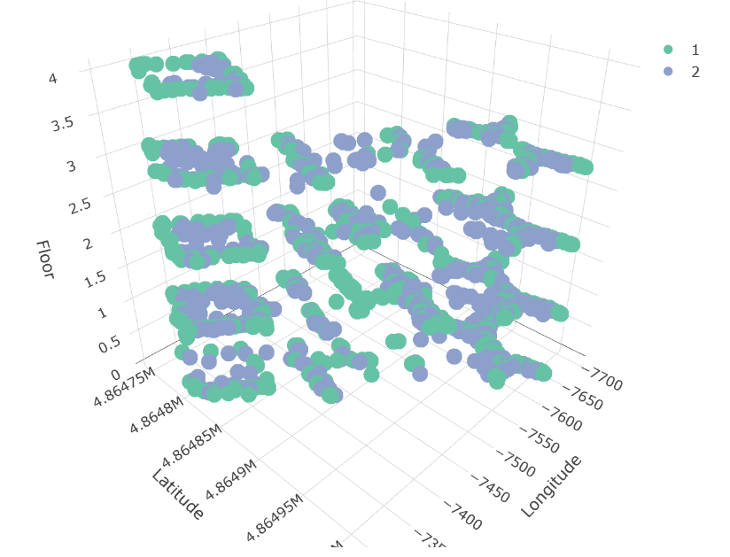

Slide 8
