Slide 1
Sentiment Analysis
Mizuki Kakei

Slide 2
Agenda
Objects
Approach
Data sets
Methods of analysis
Results
Summary

Slide 3
Objects
Choosing devices suited for the use of medical apps for aid workers in developing countries
Analyzing the sentiment scores for smart phones

Slide 4

Approach
Collecting the sentiments towards smartphones using Amazon Web Services

Slide 5
Data set
Data set
Small Data set (Modeling) with Columns :12000
Large Data set with Columns : 20000
Attributes
the relevancy of the webpage toward each device
the sentiment toward the operating system used on the phone,
the sentiment toward a phone’s camera,
the sentiment toward a phone’s display,
the sentiment toward a phone’s performance

Slide 6
Methods of analysis
Feature selection
Near Zero Variance
Modeling
Random forest

Slide 7
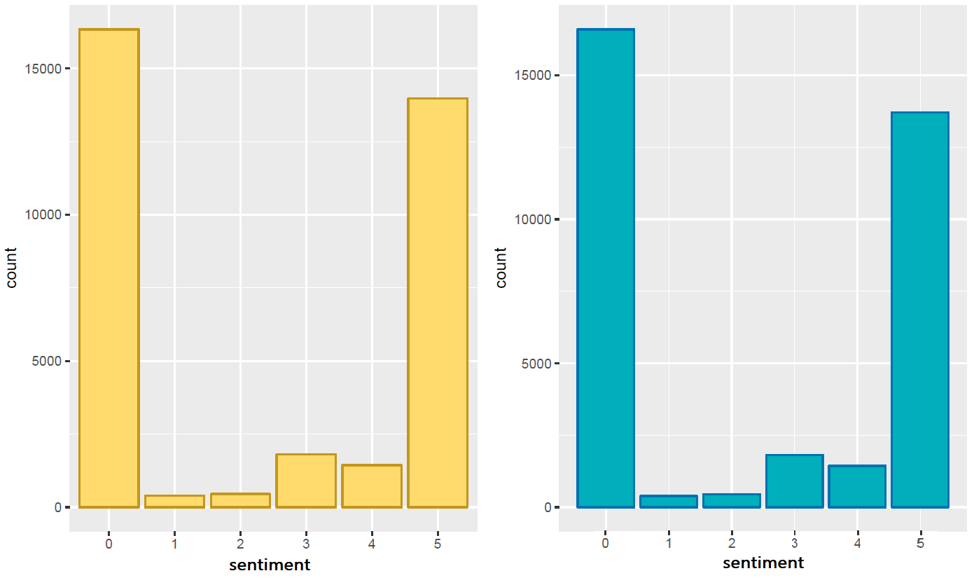
Results sentiment in Galaxy and Iphone are very similar
Galaxy : mean value = 2.393
Iphone : mean value = 2.355

Slide 8
Summary
Both Iphone and Galaxy gave almost the same results
Galaxy is relatively cheaper than Iphone
Galaxy can easily store the data
Other Android devices can be used for apps instead of Galaxy

Slide 9
Thank you

