Slide 1
Fridge Project
Mizuki
Tomomi
Calvin
Kayne

Slide 2


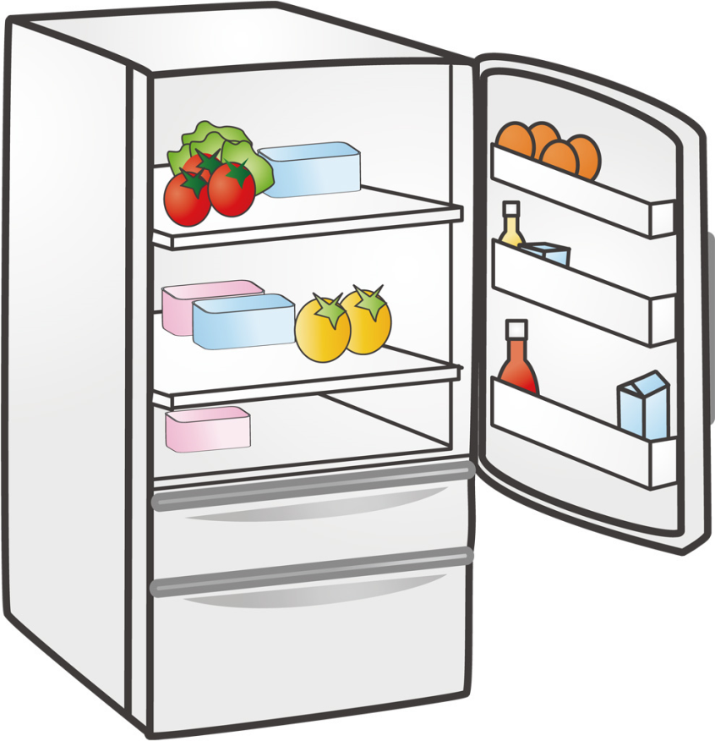

Problem
We want to make Japanese food, but we don’t know what dishes we could make with the ingredients we have!

Slide 3




Solution
We created an application which suggests recipes you can cook with the ingredients you have.
You can cook:

Slide 4
Development and technical solution
We first listed up 7 Japanese recipes
With those recipes, we listed up containing ingredients
We made3 classes – Fridge, Ingredient, Recipe
We created a workflow as following…

Slide 5

1. Greeting text
2. Menu – ask user what they’d like to do
i.e. “Would you like to cook Japanese food?”
Yes
No
3. Ask user what ingredients they have by prompting them to enter ‘y’ or ‘n’.
x. End of program, with a response “See you later!”

Slide 6






4. Store the answers into an array
5. Compare the answer array with recipe ingredients array
What the user has
What recipe needs (ex. Curry rice)
COMPARE
If matches
If no match
6. Show recipes
x. End of program, with response “No match!”

Slide 7
Technical Issues
One of the technical issues that had is that it’s unrealistic to make a proper meal if we didn’t have asked the user measurements or the amounts of a ingredient (e.g 2 whole eggs)
Each member has different levels of ability, we each coded the program individually to learn the processes. Because of that, it was also difficult to finalise the presentation.

Slide 8

QUESTIONS?

