Slide 1
My First PowerPoint

Slide 2
My First Slide
hello world!
here we are again

Slide 3
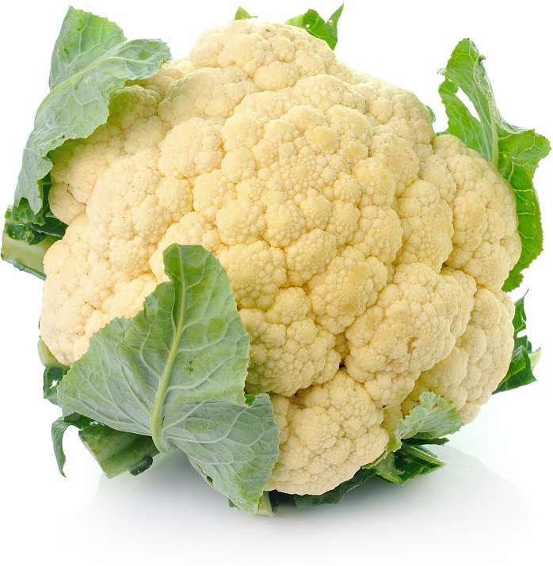

Look its a vegetable!

Slide 4
A Table
a | b | c
1 | 3 | 5
2 | 4 | 6

