Slide 1
Protein Model Prediction
Template based modeling Using a homology-based algorithm

Slide 2
Agenda
Introduction to Template Based Modeling
Template Selection
Cartesian vs Torsion
Modeling from Probability
Model Optimization (Stretch goal)
Model Assessment
Visualization
Work Distribution

Slide 3
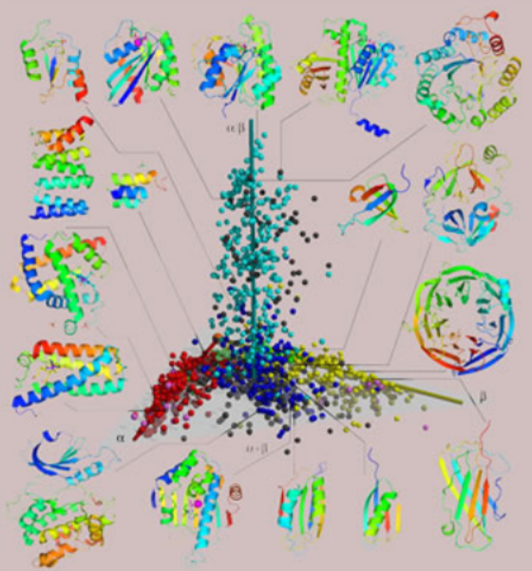
Intro. to Template Based Modeling
Protein prediction is very important in biology, chemistry, and medicine
There are millions of protein sequences, known and unknown
Proteins fit into one of a finite number of patterns
Similar proteins have similar structures
Sequence and structure determine function
By predicting structure we can predict function

Slide 4
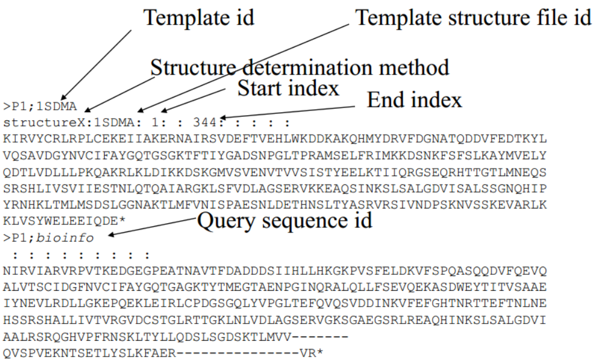
Template Selection
Similar sequences have similar structures
We can use alignment to find similar sequences
Sequences with high similarity are used as templates

Slide 5
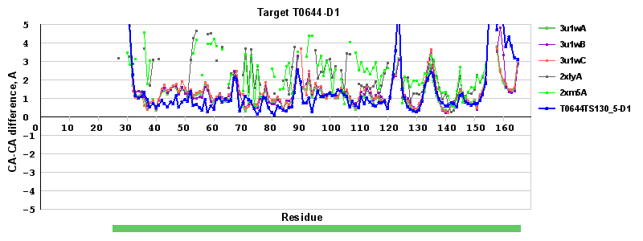
Template Selection
http://predictioncenter.org/casp10/tmplot.cgi?v_t=on&v_m=on&submit=Show&main_template=1&template=0&main_model=1&target=T0644-D1

Slide 6
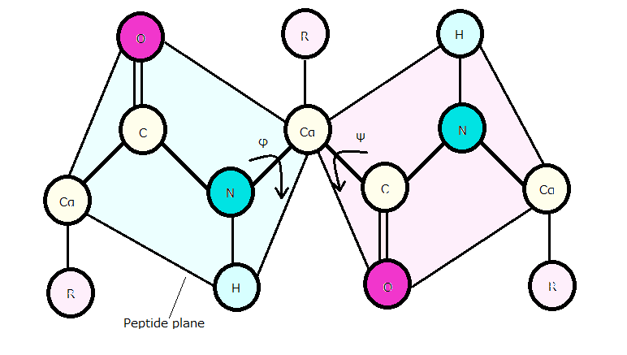
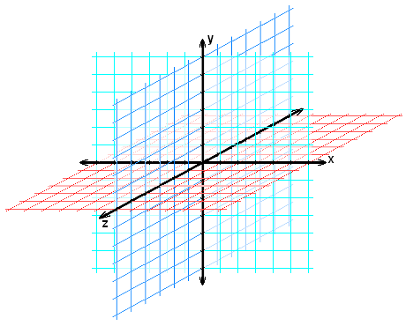
Cartesian vs Torsion
Models can be structured two ways
Cartesian coordinates (x, y, z)
Dihedral/Torsion angles (phi, psi)
Dihedral takes less memory and is origin independent

Slide 7
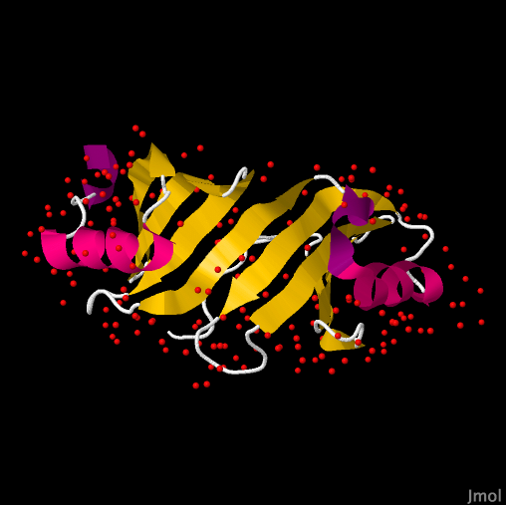
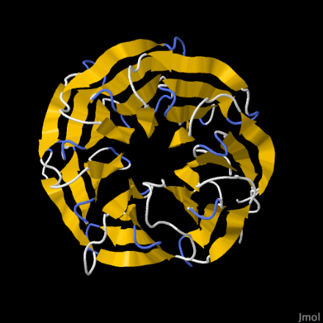
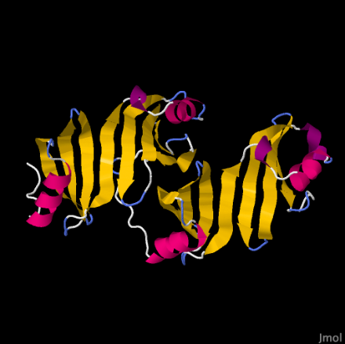
Modeling from Probability
?

Slide 8
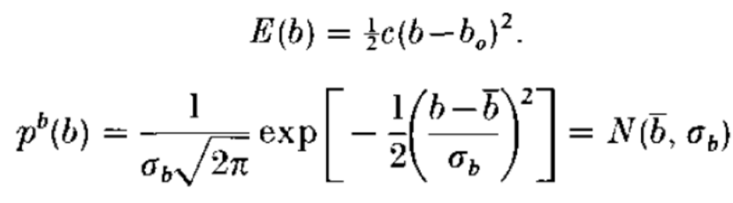
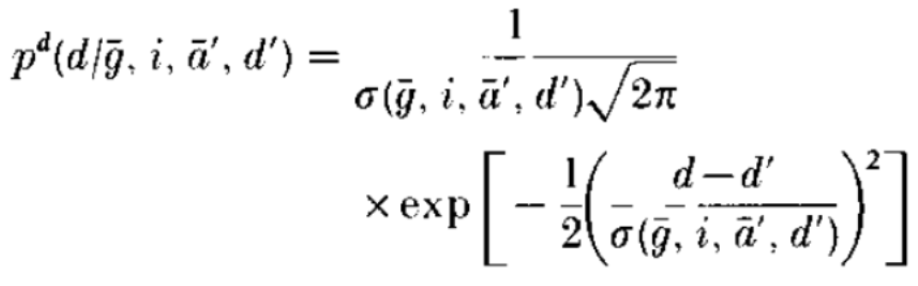
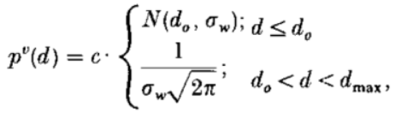

Modeling from Probability
Idea: Sample features from multiple similar models to build probability density functions. Use those probabilities to stochastically build possible models based on sequence.
Bond Length and Angles probability (harmonic model)
Van der Waals Repulsion (non-harmonic features)
C^{α}-C^{α} Distance Features
Combining the PDFs
1
2
3
4

Slide 9
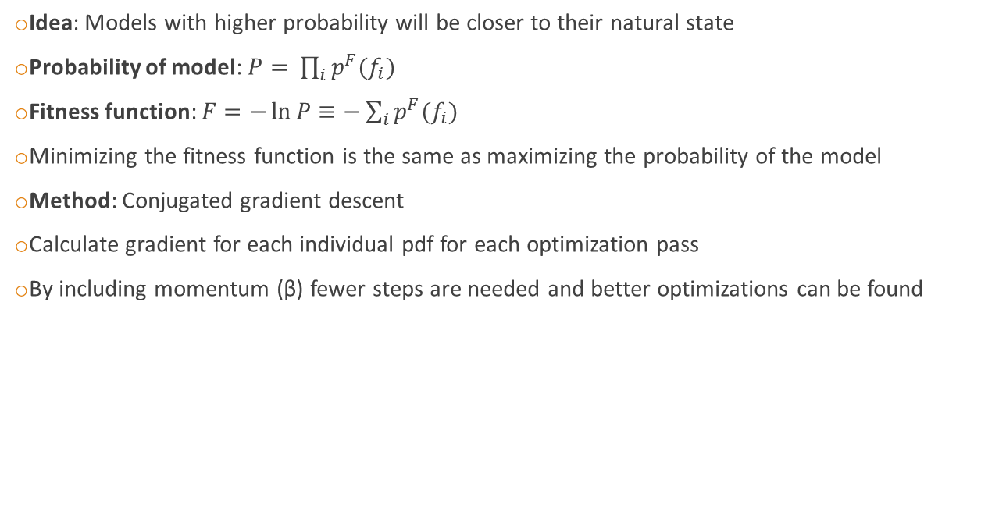
Model Optimization (Stretch goal)
Idea: Models with higher probability will be closer to their natural state
Probability of model: $P= \prod_{i}{p^{F}(f_{i})}$
Fitness function: $F=−\ln{P}≡−\sum_{i}{p^{F}(f_{i})}$
Minimizing the fitness function is the same as maximizing the probability of the model
Method: Conjugated gradient descent
Calculate gradient for each individual pdf for each optimization pass
By including momentum (β) fewer steps are needed and better optimizations can be found

Slide 10

Model Assessment
Idea: Higher entropy models have higher overall energy, so lower entropy models should be preferred
Entropy: $H\left(X\right)=−\sum{p_{i}\log{p_{i}}}$
High Entropy
Low Entropy

Slide 11
Visualization
We will use Pymol to visualize the final model

Slide 12
Work Distribution
Caiwei –
Haipei –
Puneet –
Sean –
Xiaokai –
Brett –

Slide 13
Assess quality of model:
Compare against PDB model
Compare overall energy of model (vs other generated models)

