Slide 1
Capstone Project: Valorant Weapon Balancing
Michael Jara

Slide 2
Motivation
Gaming is one of the biggest industries in the world, pulling in hundreds of billions of dollars in revenue every year
Popular competitive games such as Valorant (Riot Games), Call of Duty (Activision), and Apex Legends (Respawn) rely heavily on their games being updated regularly with new content and basic upkeep in order to keep players interested, playing, and spending money
One big part of this ecosystem is making sure the weapons within these games are well balanced to encourage a variety of gameplay styles and fair, rewarding competition
Companies such as Activision and Riot Games employ special teams of game developers and data analysts/scientists in order to make sure their games are well balanced

Slide 3
Project Goals
Research Question
To accomplish this
Can we use data relating to Valorant weapons such as Damage/Round, Kill Death Assist ratio (KDA), and others to classify weapons into distinct categories to assess the current state of the game?
Explore Valorant weapon data and observe common trends
Create a classification model that can classify a weapon as either balanced or unbalanced
Use Model on the most recent version of the game

Slide 4
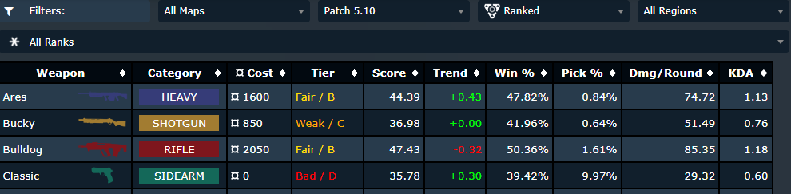
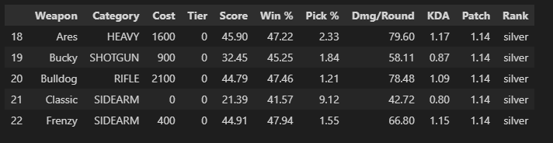
The Dataset
Data was scrapped from www.metasrc.com/valorant/stats/weapons
This website uses the official Valorant API to aggregate millions of player matches into the following columns, which are further portioned by player Rank and game version (Patch)
Weapons are placed into Tiers ranging from Bad (D) all the way to Strong (S) by assessing each weapons overall pick rate and player success with that weapon. This will become our label column

Slide 5
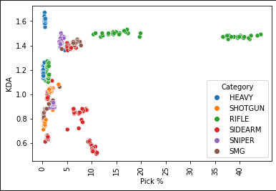
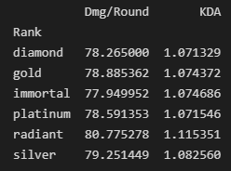
Exploratory Data Analysis
Note that these scatterplots were created per rank, but the distribution of how players pick their weapons remains incredibly consistent

Slide 6
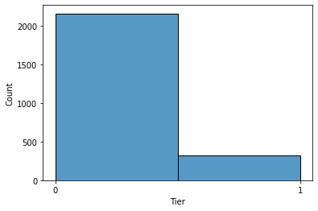
Exploratory Data Analysis
Class Imbalance for my label dataset
This indicates that for the most part, weapons tend to be at reasonable levels of strength

Slide 7
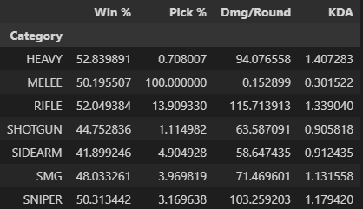
Exploratory Data Analysis
The lowest picked category of weapons, HEAVY, performs the best in terms of Win% and KDA, while doing less damage than more popular weapon types

Slide 8
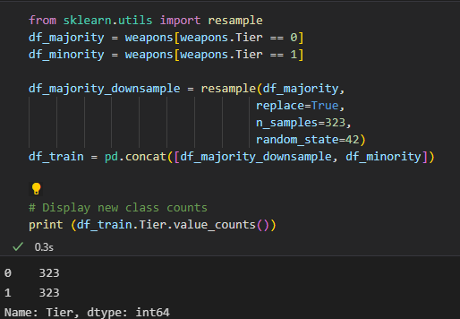
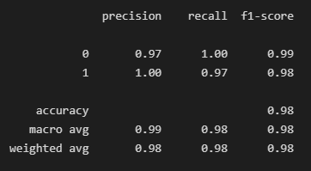
Model Building
To Deal with the class in balance mentioned earlier, I trained three different classification models (A Decision Tree, Random Forest, and Gradient Boosting Classifier) both over and under sampling
My best model turned out to be my Random Forest Classifier, chosen by the highest Recall Score
Reminder: Recall is the ratio between the number of Positive samples correctly classified as Positive to the total number of Positive samples.

Slide 9
Model Predictions for Current Valorant Patch
Weapons that should be further evaluated for weapon tuning :
Vandal (Rifle)
Marshal (Sniper)
Judge(Shotgun)

