Slide 1
Mainservice
Only one java class src/main/test/java/it/HealthEndpointIT.java

Slide 2
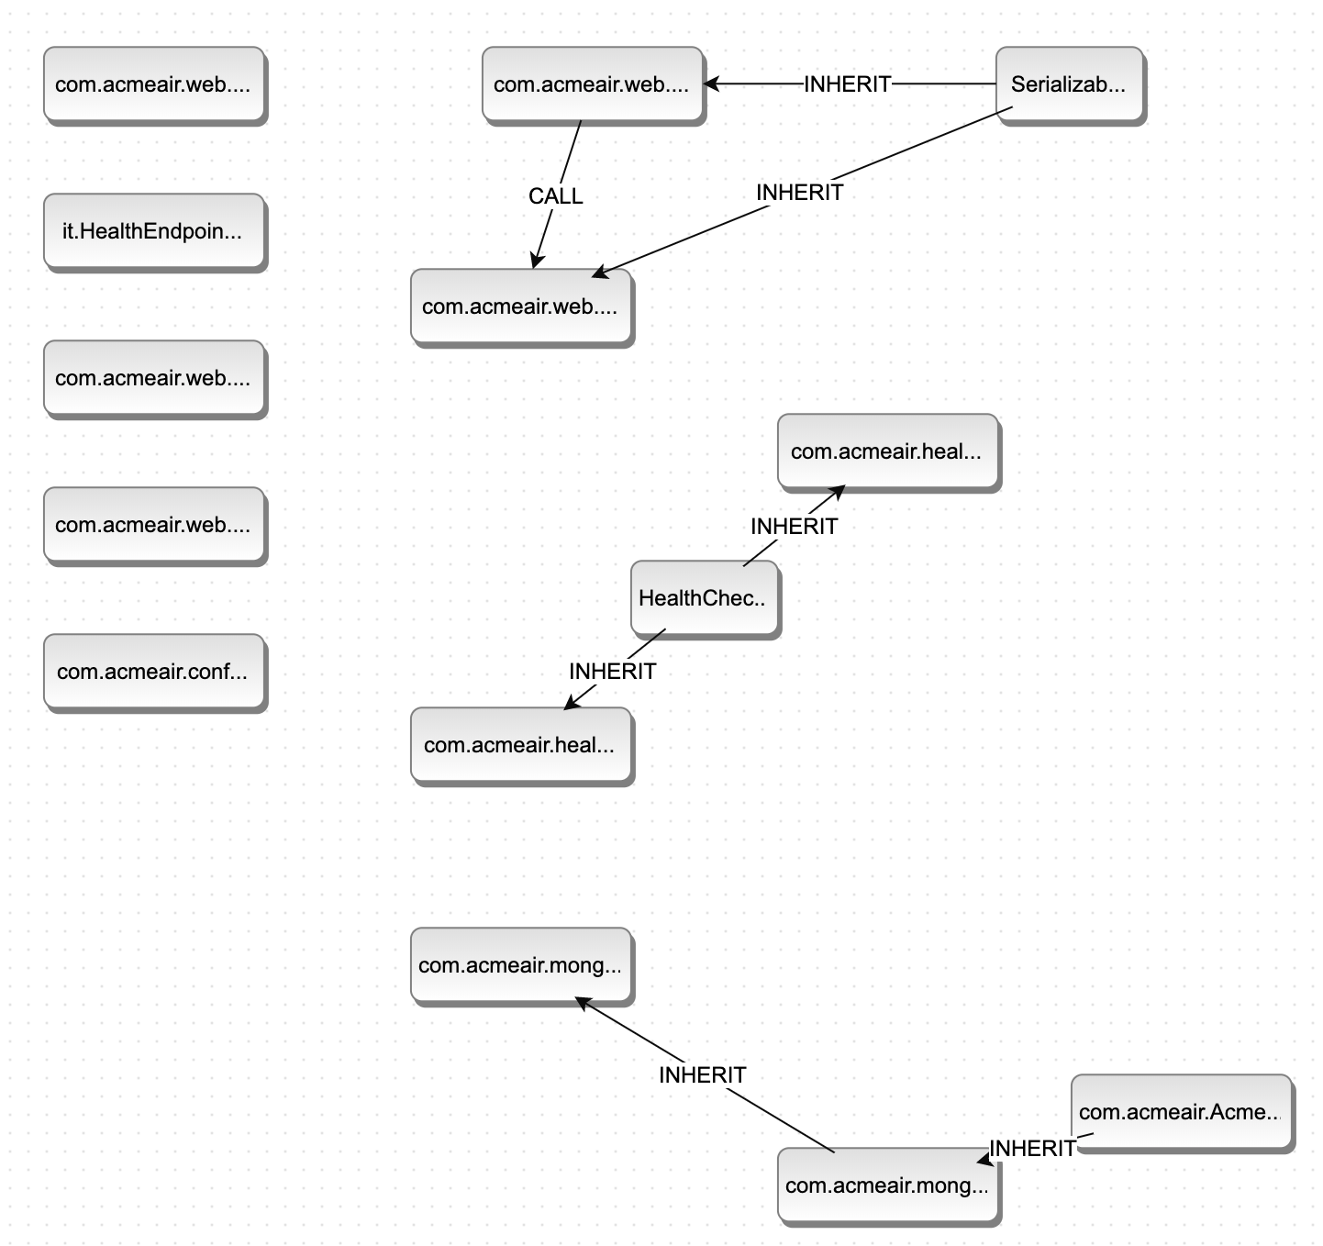
Flightservice
Check classes in the note.
Notes:
Mono:
com.acmeair.AirportCodeMapping com.acmeair.mongo.services.FlightServiceImpl com.acmeair.service.FlightService com.acmeair.config.AcmeAirConfiguration com.acmeair.service.ServiceLocator com.acmeair.web.FlightsREST
MS:
com.acmeair.AirportCodeMapping com.acmeair.mongo.services.FlightServiceImpl com.acmeair.mongo.ConnectionManager com.acmeair.mongo.MongoConstants com.acmeair.AcmeAirConstants com.acmeair.config.FlightLoaderRest com.acmeair.loader.FlightLoader com.acmeair.health.FlightLivenessHealthCheck

Slide 3
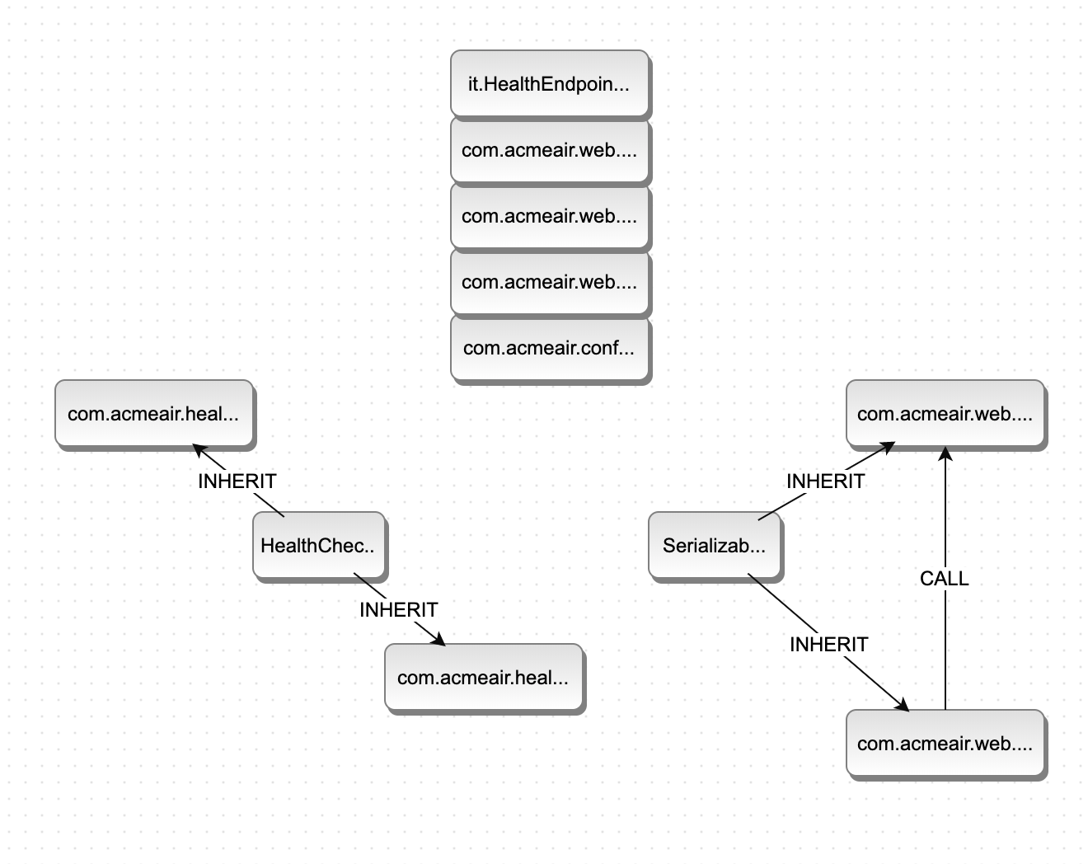
Customerservice
Check classes in the note.
Notes:
Mono:
com.acmeair.web.dto.CustomerInfo com.acmeair.web.dto.AddressInfo com.acmeair.mongo.services.CustomerServiceImpl com.acmeair.loader.CustomerLoader com.acmeair.service.CustomerService com.acmeair.web.CustomerREST
MS:
com.acmeair.web.dto.AddressInfo
com.acmeair.web.dto.CustomerInfo
com.acmeair.health.CustomerReadinessHealthCheck
com.acmeair.health.CustomerLivenessHealthCheck
com.acmeair.config.CustomerLoaderRest
com.acmeair.web.CustomerServiceRestInternal

Slide 4
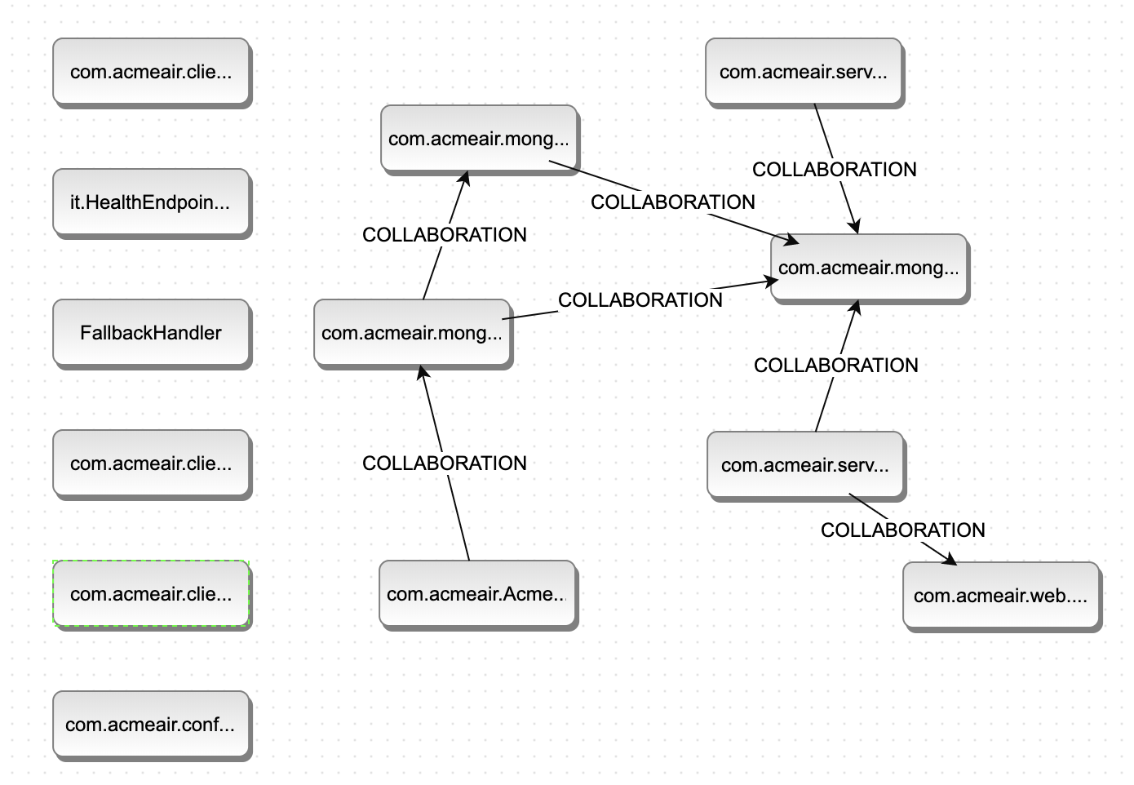
Bookingservice
Check classes in the note.
Notes:
Mono:
com.acmeair.AcmeAirConstants com.acmeair.mongo.MongoConstants com.acmeair.mongo.ConnectionManager com.acmeair.mongo.services.BookingServiceImpl com.acmeair.service.BookingService com.acmeair.loader.BookingLoader
com.acmeair.loader.Loader com.acmeair.config.LoaderREST com.acmeair.web.BookingsREST
MS:
com.acmeair.AcmeAirConstants com.acmeair.mongo.MongoConstants com.acmeair.service.KeyGenerator com.acmeair.mongo.ConnectionManager com.acmeair.mongo.services.BookingServiceImpl com.acmeair.service.BookingService com.acmeair.web.BookingServiceRest
com.acmeair.config.BookingLoaderRest
com.acmeair.client.FlightClient
com.acmeair.client.CustomerClient
com.acmeair.client.MilesResponse

Slide 5
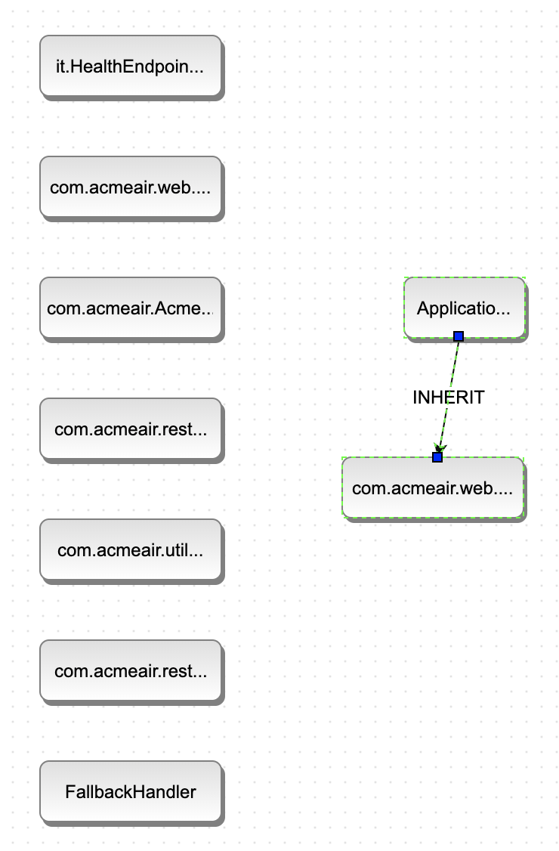
Authservice
Check classes in the note.
Notes:
Mono:
com.acmeair.mongo.services.AuthServiceImpl com.acmeair.web.LoginREST com.acmeair.service.AuthService com.acmeair.web.RESTCookieSessionFilter com.acmeair.loader.SessionLoader
MS:
com.acmeair.web.AuthServiceApp
com.acmeair.web.AuthServiceRest
com.acmeair.restclient.LoginResponse
com.acmeair.restclient.CustomerClient
com.acmeair.utils.SecurityUtils
com.acmeair.AcmeAirConstants

