Slide 1
RNA-Seq – Analysis
BI311F-1 20V Akvagenomikk og bioinformatikk
Robin Mjelle

Slide 2
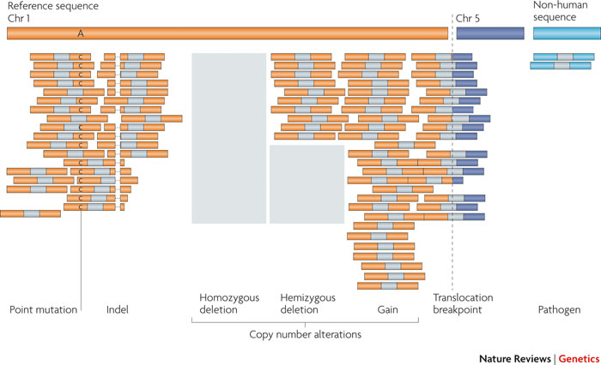
Sequence alignment
Given a sequence fragment, find the correct position of the sequence in the reference genome.
From where in the genome did this sequence originate?
Usually 25-50bp is enough to make most reads align unambigously to a genomic position
Many reads still align to multiple positions, even when they exceed 50 bp.
Meyerson, 2010, Nature
Notes:
Illustration is for DNA (even coverage)
Include
Mutation
Indel(short insertion)
Deletion and gain
Translocation (chromosomal rearrangement)
Pathogens (Non-human)

Slide 3
Alignment and Analysis challenges in RNA-Seq data
Splice Junctions
Including extensions to gene fusions and read-through transcripts
De novo transcripts (Non-coding RNA)
Differential expression of isoforms
Nucleotide substitusions (mutations, RNA-editing)

Slide 4
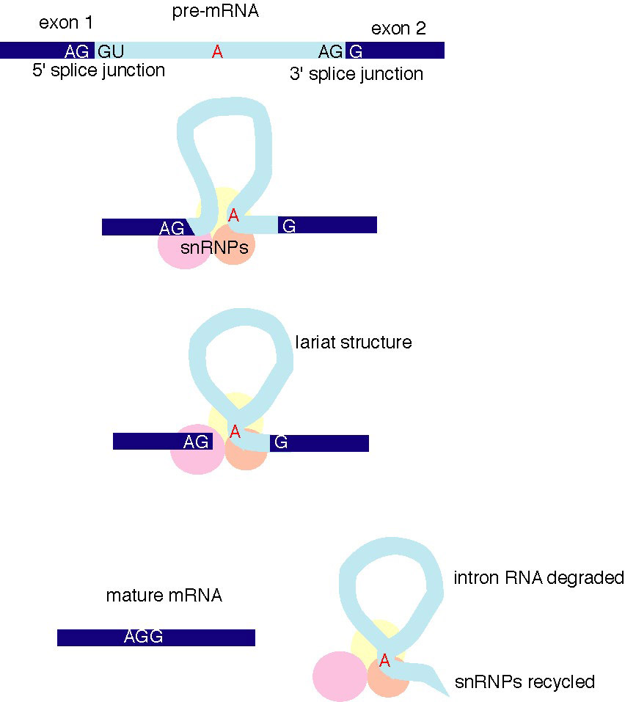
Splice Junction mapping – A challenge in RNA-Seq
Pan, 2008, Nature
Katz, 2010, Nature
TopHat1
A splice junctions is the connection point between two exons
Sequence reads aligning within exons align directly to the reference genome
Sequence reads covering junctions will not align to the reference genome
Solution Concept :
Include additional alignment to a catalogue of splice junctions
Notes:
Point: Exons are trivial: How do we handle the splice-junctions, the main challenge in RNA-Seq data?
We create catalogues of splice-junctions which we align to in addition to the genome!
Wikipedia: snRNPs (pronounced "snurps"), or small nuclear ribonucleic proteins, are RNA-protein complexes that combine with unmodified pre-mRNA and various other proteins to form a spliceosome, a large RNA-protein molecular complex upon which splicing of pre-mRNA occurs.

Slide 5
Splice-junction catalogues: 1. From transcriptome annotation
Many well annotated transcriptomes
Use experimentally verified splice-junctions from known isoforms in transcriptome annotation
Align sequence reads
first to transcriptome (with known isoforms)
remaining sequences to genome
Only known and verified isoforms are mapped
Notes:
So how do we make these catalogues (this is what much of RNA-Sequencing is about, and how it differs from DNA-sequencing)

Slide 6
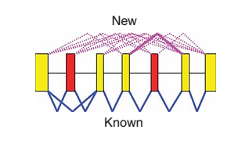
Splice-junction catalogues: 2. Theoretical junctions from transcriptome annotation
Use all possible combinations of exon-exon junctions from annotated genes to create a library of theoretical splice-junctions
Align read sequences to the theoretical junctions. Junctions with sufficient read support are accepted junctions.
Can discover novel junctions within the annotated exon framework

Slide 7

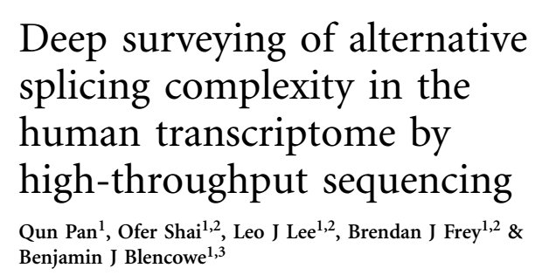
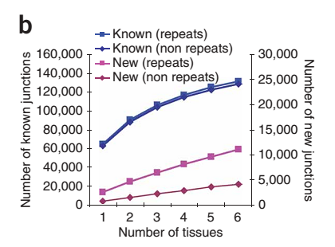
Splice-junction catalogues: 2. Theoretical junctions from transcriptome annotation
Pan, 2008, Nature
6 human tissues profiled
17-32 million 32nt reads pr. sample
Experimental: 15 702 genes containing 257 257 splice junctions
Theoretical junctions: 2 459 306
Detected: ~130 000 known junctions
Between 4000 and 11 000 new junctions
Observation:
Number of transcript variants increase linearly with the number of exons in a transcript.
Thus there are limiting factors for the isoform complexity in a gene.

Slide 8
Read-through gene fusions by theoretical splice junction mapping
Nacu, 2011, BMC-Med-Gen
Read-through genes: Merged transcripts from two adjacent genes
Extension of theoretical splice-junctions between genes within 200 000bp from neighbouring genes
Unlimited extension for all possible fusions is not feasable
combinatorial explosion of possible exon combination
IE = Intervening exon
Notes:
De-novo-junction discovery. Not using a reference annotation.
Not feasable for general gene-fusion discovery (only for proximal genes)

Slide 9
Splice-junction catalogues: 3. Novel transcripts and splice junctions from data
Starts with sequence alignment to the genome (no transcriptome annotation)
Use aligned sequences to build transcript structures and discover novel splice junctions.
Generate a list of splice-junction candidates
Accept junction candidates with sufficient support from remaining reads
Re-align using all reads, or only the reads that were unmapped after genome alignment.
Notes:
Note: There could be adbantegous to re-align all reads, since some reads may potentially have a better match to a newly discovered splice junctions than a previous genome alignment site.
Note: for some organisms, lncRNA annotation are becoming more and more comprehensive, ao annotation approaches may be a better choice here…

Slide 10
Splice-junction catalogues: 3. Novel transcripts and splice junctions from data
Can be used to discover novel transcripts and transcript classes with novel isoforms, for example lncRNAs and other non-coding RNA.
Strategies for de-novo discovery has evolved and changed as RNA-Seq technology has matured
Single-end, short read length (30-50bp)
Paired-end, short read length (50bp)
Paired-end, longer read length (100bp+)
Notes:
Note: There could be adbantegous to re-align all reads, since some reads may potentially have a better match to a newly discovered splice junctions than a previous genome alignment site.
Note: for some organisms, lncRNA annotation are becoming more and more comprehensive, ao annotation approaches may be a better choice here…

Slide 11

Single-end, short read length De-novo transcript discovery in TopHat 1 – exon-based coverage-search
Low coverage of splice junctions due to short read length:
Map non-junction reads using Bowtie(2) (a standard and fast alignment tool)
Non-mappable reads (including those mapping to splice junctions) are set aside for later use
Notes:
Low-complexity reads are discarded, reads with manyy repeats or many consecutive A’s and T’s etc.. Difficult to align unambiguosly

Slide 12
De-novo transcript discovery in TopHat 1
Exon assembly
Assemble sequences in contiguos islands
The sequences covered by the islands are collected as exons
Notes:
This strategy is still used by some workflows, like the Ensembl workflow for generating transcript models from RNA-Seq reads.

Slide 13
De-novo transcript discovery in TopHat 1
Exon assembly
Each exon-island will have fewer reads on the boundaries near splice-junctions (Due to that reads overlapping the junction are un-mapped)
Extend each exon-island by 45bp of flanking sequence to include splice donor/acceptor sequences (Sequences marking a splice event)
Gaps in low-coverage regions are merged into a single exon if the gap is shorter than 6bp. (Introns in mammalian genomes are rarely shorter than 70bp)

Slide 14

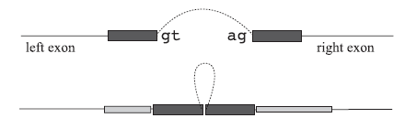
De-novo transcript discovery in TopHat 1
Identify potential splice junctions
Identify splice donor/acceptor sites within the exon islands
Pairing of sites between neighbouring (but necessarily adjacent) exons.
Align unmappable reads to junction candidates
Mapped splice junction reads must span at least k bases on each side of the junction (dark grey), and map properly to the sequence flanking the k bases (light grey)
Sufficiently enriched junctions are reported

Slide 15
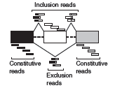
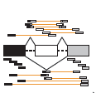
De-novo transcript discovery of paired-end reads with short and intermediate read-lengths (30-50bp)
Single-end short reads: Few reads cover splice junctions
Paired-end reads: More reads are indicative of splice junctions
Though paired-end reads can be used to indicate splice-events, they do not cover the exact splice junction
Additional methods needed to infer the exact junctions
Single end
Paired end
Notes:
Figure: Exclusion and Inclusion reads. More paired-end reads can be both inclusive and exclusive.
Paired-end reads with long genomic distances (much longer than the insertion site) and with sufficient support are indicative of a splice (or fusion)-event.
The upper-bottom yellow fragment would not say anything about splicing in the single-end case, but will be indicative in the paired-end case.

Slide 16


Identify splice-junction from paired-end reads
Sboner, 2010,
Genome Biology
Example from detecting gene-fusions , but principle also applies to exon-exon boundaries (Gene = Exons).
A set of paired-end reads likely to span an exon-exon boundary
Exact splice location (junction) cannot be identified directly from the paired-end reads
Use the paired-end reads to create a library of candidate junctions
Full combinatorial approach
Filter candidates using splice donor/acceptor sites
Gene = Exons
Notes:
The identification of the exact fusion point is generally a problem with paired-end reads. Also for finding the exact exon-exon junction point in paired-end sequencing.
This is an example from gene-fusion, but illustrates the problem

Slide 17
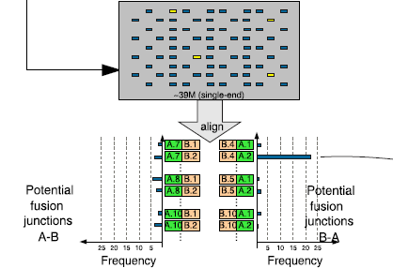
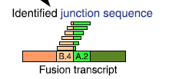
Identify splice-junction from paired-end reads
Map all reads to the library of candidate junctions
Rationale: A higher number of reads will map to the correct junction
The junction with the highest number of reads is selected as the likely fusion point
Computationally demanding, especially for gene-fusions.
exon-exon junction
Notes:
The identification of the exact fusion point is generally a problem with paired-end reads. Also for finding the exact exon-exon junction point in paired-end sequencing.
This is an example from gene-fusion, but illustrates the problem
Why gene-fusions are more demanding is probably becuase the number of fusion candidate sites are many more than for splice-variants.

Slide 18
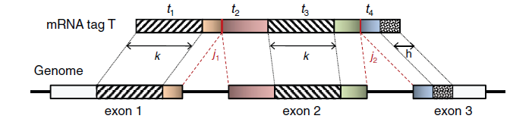
Fusion and isoforms by sequence segmentation (MapSplice and TopHat2)
Wang, 2010, NAR
Kim, 2013, Genome Biology
Takes advantage of the longer sequence reads in current RNA-Seq standards (75-150bp)
Sequences are split into segments (typically ~25 bp long) and mapped individually
Where the left and right reads map to the genome, but not the central read, you have encountered a junction.
The central read contain the sequence spanning the exact junction
Notes:
I think this works best with 75-100 bp reads which can be split in at least three segments. For reads that can be split into only two segments, you still need to apply splice-site sequence features. (See SpliceMap-program, Au-2010-NAR for a possible strategy)
Figure: A sequence fragment spanning 3’end of exon 1, exon 2, and 5’end of exon 3.
Could also be applied to gene fusions.
One can argue that longer sequences make paired-end infomation redundant.
Note that some algorithms may have problems with very long paired-end reads where sequences start to overlap from each end (100-200bp) ! 75bp standard illumina?

Slide 19
Fusion and isoforms by sequence segmentation (MapSplice and TopHat2)
Wang, 2010, NAR
Kim, 2013, Genome Biology
Not dependent on splice-site sequence features for de-novo splice site discovery.
This is becuase you have the in-between sequence, and can read the junction-site directly (for 100bp it is estmated to >30% of reads will span two exons!)
This is more difficult with short paired-end, where the in-between sequence is missing
Improved detection of splice-junctions, and all types of gene fusions (with paired end)
Notes:
I think this works best with 75-100 bp reads which can be split in at least three segments. For reads that can be split into only two segments, you still need to apply splice-site sequence features. (See SpliceMap-program, Au-2010-NAR for a possible strategy)
Figure: A sequence fragment spanning 3’end of exon 1, exon 2, and 5’end of exon 3.
Could also be applied to gene fusions.
One can argue that longer sequences make paired-end infomation redundant.
Note that some algorithms may have problems with very long paired-end reads where sequences start to overlap from each end (100-200bp) ! 75bp standard illumina?

Slide 20
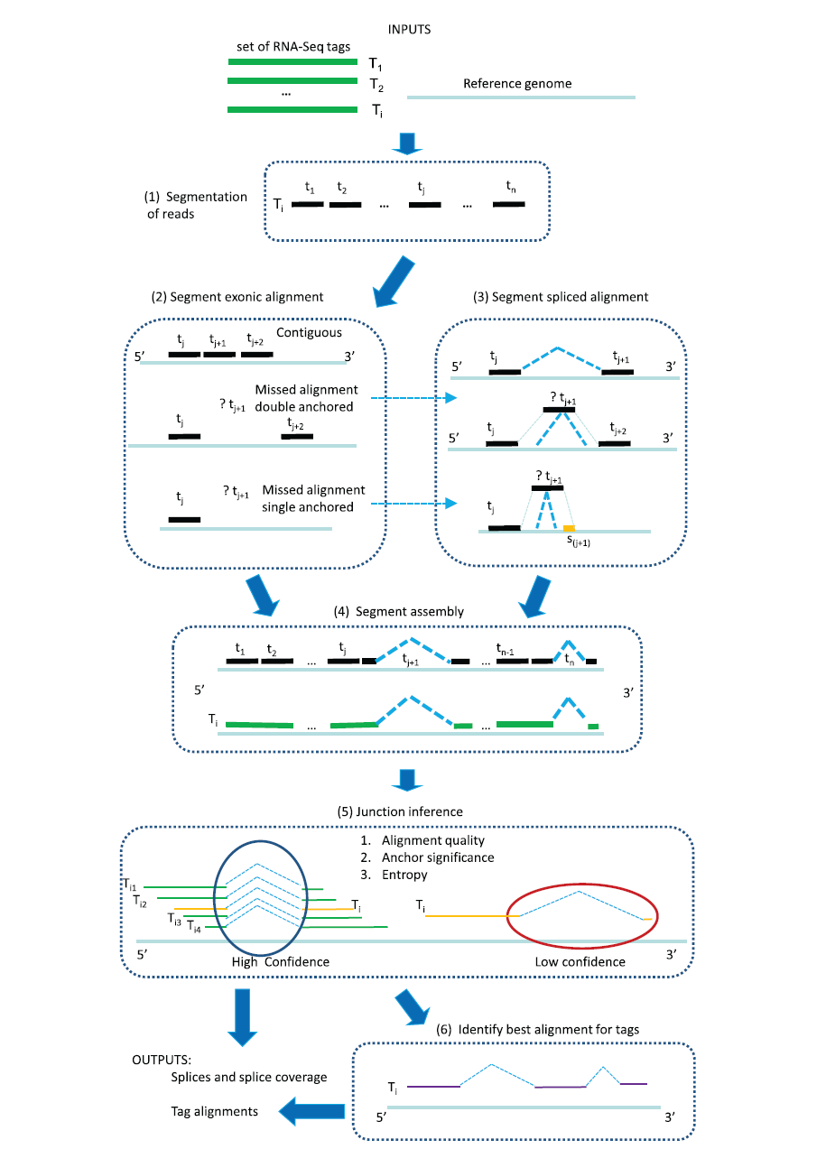
Notes:
From MapSplice. Program used by the The Cancer Genome Atlas.
Step 2-3: also have a strategy for single-anchored alignments (with no sequence splice-site features).
Step 6: Select alignments for each tag with the best quality score, and report result. (Remember, the goal is to find an alignment for each tag!)
Step 4: Assembly is straight-forward if all tags are uniquely aligned. However, not if a tag is ambigously mapped (map to several locations). (This seem to be more allowable in RNA-Seq than DNA and ChIP-Seq, where ambigous tags are mostly discarded)
Step5: Anchor quality: the presence of long sequence-mappings (anchors) of each side of the junction, Entropy: Diversity of splice-junction positions.

Slide 21
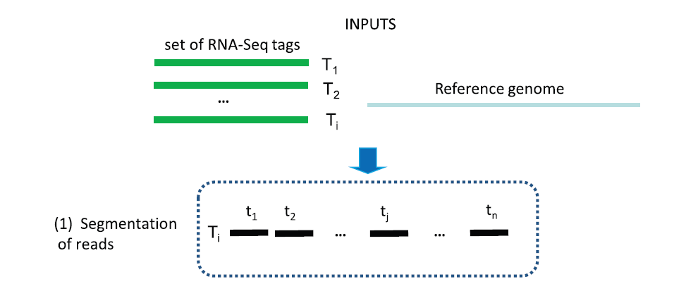
Sequence segmentation of longer reads (MapSplice)
Longer reads (75-200 bp) are split into n shorter concecutive segments
of same length (typically ~25 bp)
Notes:
50 bp is maybe a little short. Should be at least 75 bp?

Slide 22
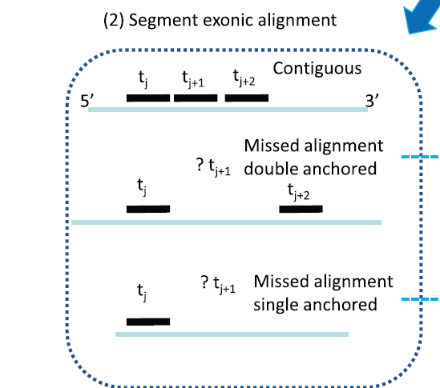
Sequence segmentation of longer reads (MapSplice)
Align segments to the genome
Three cases:
Segments align contiguously to the genome.
Missed segment alignment. Other segments align on both sides (double anchored).
Missed segment alignment. Other segment align on one side (single anchored)
1
2
3
Read do not cover splice-site
Possibility that read covers splice-site
Notes:
Segments must be segments from the same read

Slide 23
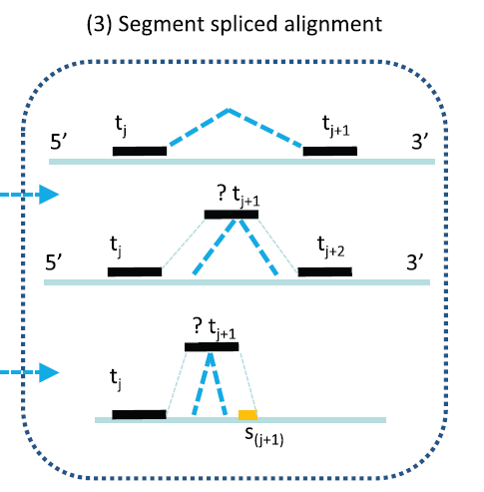
Sequence segmentation of longer reads (MapSplice)
If possibility of splice site:
Double anchored
Consider all posible splice junctions in the segment, and minimize alignment mismatch
Single anchored
Set maximum search distance (50 kbp)
Search for a match of the read-prefix s in the search region
Notes:
S is the read-prefix at the start/end of the read? (I think so at least)

Slide 24
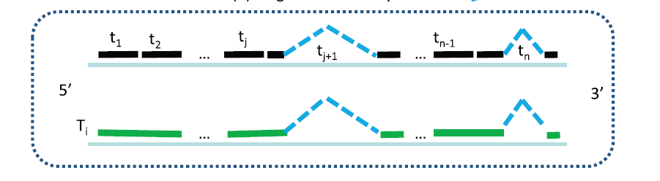
Sequence segmentation of longer reads (MapSplice)
Segment assembly
Unambiguous read alignment
each read-segment aligns uniquely and connects to neighbouring segments without gaps
Ambiguous read alignment
Segments align to multiple locations in the genome.
Search possible alignments for best overall read alignment

Slide 25
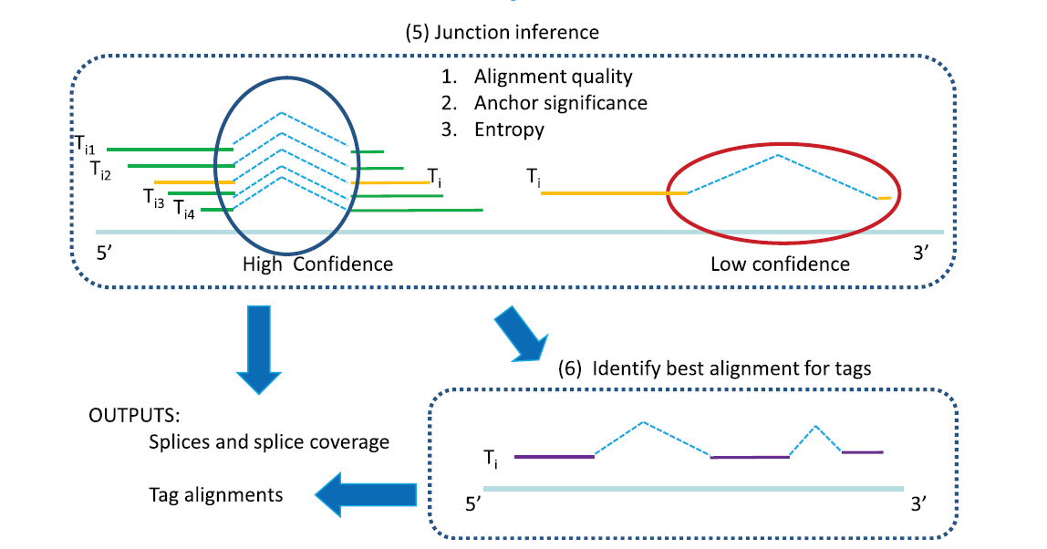
Sequence segmentation of longer reads (MapSplice)
Segment assembly
Assess junction quality
Decide overall best alignment for each read (based on both alignment and junction quality)
Notes:
Junction quality criteria described on next slide

Slide 26
How to find junctions with best support?
Criteria for scoring a junction candidate:
The number of reads mapping to a junction
The sequence quality of the reads mapping to a junction
Whether the junction is supported by mostly unique alignments or multiple/ambigous alignments
Gap according to expected read-length (paired-end)
Anchoring: How much of the sequence is covered on both sides of the junction by the different reads
Entropy: Junction reads show the same exon/exon junction transition point Select final candidate junctions based on scores
Re-align all un-mapped reads to the selected junctions….
….Or, re-align all reads using both genome and junctions
some reads that initially mapped to the genome may map better to a junction

Slide 27
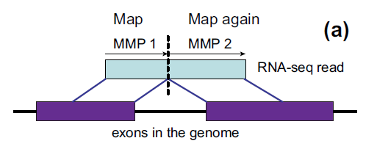
New and faster RNA-Seq aligners
Dobin, 2012, Bioinformatics
STAR (Spliced Transcript Alignment to Reference)
Process both long and short reads
also «third-generation» sequencing reads (several kilobases and full length transcripts)
Increased speed (up to 50 times faster?), but also increased memory usage.
Notes:
After this general principle is established, most efforts have been put to make clever ways of speeding up the process. One of the first improvements were STAR aligner.
Targeted split of read at point where no match is found improves speed over arbitrary split-points followed by seraches (KEY POINT!)
Window-sizes for assembly defined by expected intron-length. Reads are stiched together within windows based on anchor fragments (how are these defined? High confidence reads?). Window-sizes can be over-run if paired-end information is also available, and can be used for stitching.
STAR more effectively use more CPUs to speed up. TopHat do not always exploit all CPUs due to bottlenecks in the data-flow (even though you can define many CPUs, it doesn’t always help..)

Slide 28
New and faster RNA-Seq aligners
Dobin, 2012, Bioinformatics
MMP (Maximal Mappable Prefix) is the maximum part of a read that can be mapped to anywhere in the genome
Novelty: Read is split at the first mismatch point, and only the rest of the read is aligned elsewhere.
No arbitrary splits or junction libraries needed.
Assemble transcripts from windows around anchor-alignments, or based on paired-end information.
Notes:
After this general principle is established, most efforts have been put to make clever ways of speeding up the process. One of the first improvements were STAR aligner.
Targeted split of read at point where no match is found improves speed over arbitrary split-points followed by seraches (KEY POINT!)
Window-sizes for assembly defined by expected intron-length. Reads are stiched together within windows based on anchor fragments (how are these defined? High confidence reads?). Window-sizes can be over-run if paired-end information is also available, and can be used for stitching.
STAR more effectively use more CPUs to speed up. TopHat do not always exploit all CPUs due to bottlenecks in the data-flow (even though you can define many CPUs, it doesn’t always help..)

Slide 29
New and faster RNA-Seq aligners
Dobin, 2012, Bioinformatics
KEY POINT!
Targeted split of sequence at point where no match is found improves speed over arbitrary split-points followed by searches!
Notes:
After this general principle is established, most efforts have been put to make clever ways of speeding up the process. One of the first improvements were STAR aligner.
Targeted split of read at point where no match is found improves speed over arbitrary split-points followed by seraches (KEY POINT!)
Window-sizes for assembly defined by expected intron-length. Reads are stiched together within windows based on anchor fragments (how are these defined? High confidence reads?). Window-sizes can be over-run if paired-end information is also available, and can be used for stitching.
STAR more effectively use more CPUs to speed up. TopHat do not always exploit all CPUs due to bottlenecks in the data-flow (even though you can define many CPUs, it doesn’t always help..)

Slide 30
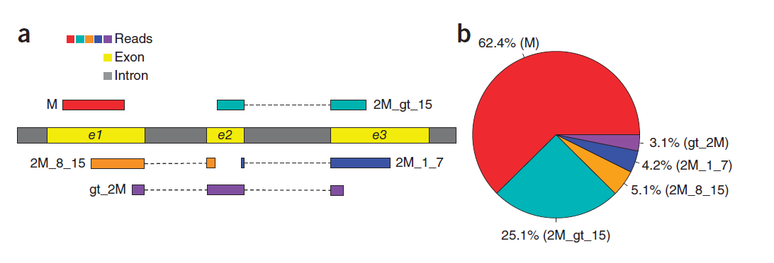
New and faster RNA-Seq aligners
Kim, 2015, Nature Methods
HISAT (Hierarchical Indexing for Spliced Aligment of Transcripts ).
Both fast and requires low memory
Problem. Short sequences from targeted splits do not map uniquely
Not so many reads, but takes up much of the computational time
Notes:
The figures shows that reads with short fragments on one side of the junction (purple/blue/orange/ that is, the split leave most of the sequence at one side of the junction, and a short fragment on the other side) are not that many (<15%), but these take up lot of computational time (in e.g. STAR). Thus introduce indexing and local alignment.

Slide 31
New and faster RNA-Seq aligners
Kim, 2015, Nature Methods
Novelty: Introduce local indexes to split up the genome in sub-genomes
Within each sub-genome, also short reads map uniqely.
Use the best aligned part of the read to indicate to which genome region the shorter part should align
Global search - local extension
Key concept: Move computational burden from alignment to indexing!
Notes:
Here we can clearly see a trend where one moves the computational focus to indexing the reference files (here genome), moving the computational burden away from the actual alignment.

Slide 32


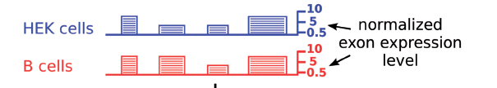
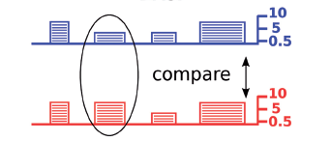
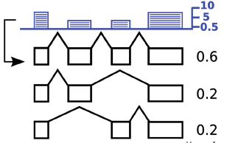
Isoform identifiaction, abundance estimation and differential expression from RNA-Seq
Exon mapping
Isoform model
Isoform abundance
Differential isoform
expression
Adapted from
Richards, 2010, NAR
Notes:
Illustration that show typical tasks an steps. Not all tools/programs/workflows have all steps, and there are many modifications and variants of the steps as well-
First: Identify exons (from data and/or from annotation)
Create isoform models (from data and/or from annotation)
Estimate abundance of different isoforms
Differential expression each isoform
4 exons, three alternative isoforms. One expresses all exons, while two have mutually exclusive exon 2 and 3. Exon 1 and 4 expressed by all isoforms.
(Identify whether exons follow a multinomial distribution or not (here: not))
(Identify which exons show deviating expression from expected)
Calculate the relative expression of the isoforms (or differential expression if two conditions)

Slide 33
Isoform identification and abundance etimation
Use aligned reads (from TopHat2, STAR, HISAT or other alignment program) as input
Identify the expressed isoforms in the sample, as well as the expression level of each isoform
Paired-end reads preferred, but also works for single end reads.
Challenge:
A sample may include reads from several isoforms of the same gene with different expression levels.
Construct a gene model which is best explains the sequencing data
Notes:
Question: From which isoform did this read originate?

Slide 34
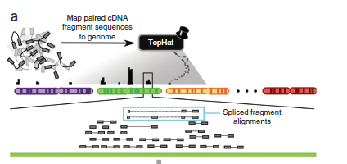
Isoform identification and abundance etimation in Cufflinks
Bundle
Bundle of paired-end reads mapped to the genome
Reads align to the genome with no gaps
Reads align with sequence gaps, indicative of splicing events
Task: Given the data. How do we find the different isoforms present, and their relative abundancies?
Notes:
Bundle is a cluster of overlapping reads from the alignment (identified by Cufflinks). These can be identified without using reference gene models (typically consist of one, or at most a few genes with their respective isoforms)

Slide 35
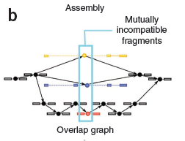
Isoform identification in Cufflinks
Create an overlap graph with links (edges) between all fragments (nodes) with sequence overlap
Some fragments will be «incompatible», meaning that they cannot possibly overlap. These must have originated from distinct spliced RNA isoforms.
Figure: Yellow, blue and red fragments incompatible. Grey transcripts could have originated from any of the isoforms
Transcripts isoforms are assembled from the overlap graph.
Notes:
This figure is difficult to interpret. But I think the idea is the following:
The two paired-ends are joined with a SOLID line. The dotted lines are gaps in the sequence compared to other sequences.
It is also possible that the grey transcripts next to the read to not share overlapping sequence with blue or yellow, and are thus not incompatible with respect to overlapping sequence (one must use (obvious) logic from the alignment to infer that they must be incompatible, but this is not done at this stage in the algorithm..)

Slide 36
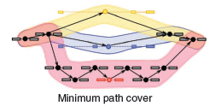
Isoform identification in Cufflinks
Identify a minimal set of paths which cover all fragments in the overlap graph.
These paths correspond to the different transcript isoforms
Apply Dilworth’s Theorem: The number of mutually incompatible reads is the same as the minimum number of transcripts needed to explain the fragments
Example: Can minimally be covered by three paths (yellow, blue and red)

Slide 37
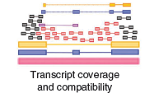

Isoform abundance estimation in Cufflinks
Match fragments to the identified transcript isoforms from which they could have originated
Yellow, blue and red: Could only originate their respective colored transcript isoforms
Purple: Could (theoretically)have originated from red or blue
Grey: Could have originated from any transcript isoform
The insert-length of the purple fragment makes it highly probable that it originates from the blue transcript
Assign transcripts to isoforms by a statistical model (Expectation Maximization – EM)
Determine the relative abundance of the transcript isoforms.
Notes:
Also use the expected fragment length to assign isoforms. Thus the purple fragment is more likely to originate from the blue than from the red isoform.
The programs do use transcript annotations (though this is possible). However, it utilises transcript-collection loci, that is, bundles of transcripts which do not overlap with other transcripts, and resolve tarnscripts within each bundle. One bundle can contain many genes though…
(Paired-end information used to rank alignments for each fragment in a final step)

Slide 38
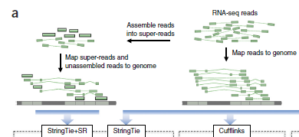
Isoform abundance estimation in StringTie
Pertea et al., 2015, Nature
Faster and more accurate(?) compared to Cufflinks
Combination og genome-guided and de-novo isoform/transcript discovery
Notes:
It is debated whether it is actually more accurate though….
Use another program called MaSuRCA to assemble super-reads. (Not important here…)
Input is aligned reads, as usual… (but also allow this super-reads. Will not focus on this…)

Slide 39
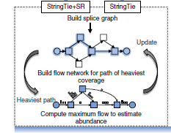

Isoform abundance estimation in StringTie
Idea: Also use isoform abundance (expression level)to guide isoform construction
Isoform construction and abundance estimated iteratively
Network flow algorithm originally developed in optimization theory.
Notes:
Cufflinks used pure graph theory to find isoforms present, but left the actual abundance of the reads out of the equation. StringTie utilize this information in prioritizing isoforms, and assign reads to isoforms as well.
Abundance creates flow network rather than a graph
Identify the isoform with the highest flow
Assign reads to this isoform
Subtract
Create new flow network for remaining reads
Select isoform with highest flow
Etc..
Maximum flow is a well known algoritm for optimization.

Slide 40
Isoform abundance estimation in StringTie
Build alternative splice graph from overlapping reads (similar to Cufflinks)
Identify most abundant path in terms of read coverage (the main transcript)
Estimate coverage of this transcript by the maximum flow algorithm
Remove all reads contributing to the main transcript
Repeat procedure for remaining reads.
Notes:
Cufflinks used pure graph theory to find isoforms present, but left the actual abundance of the reads out of the equation. StringTie utilize this information in prioritizing isoforms, and assign reads to isoforms as well.
Abundance creates flow network rather than a graph
Identify the isoform with the highest flow
Assign reads to this isoform
Subtract
Create new flow network for remaining reads
Select isoform with highest flow
Etc..
Maximum flow is a well known algoritm for optimization.

Slide 41
Transcriptome and isoform abundance estimation using k-mers (Sailfish and kallisto)
K-mer: A sequence of length K
Key-observation: Transcript coverage can be accurately estimated using counts of k-mers occurring in reads, instead of genomically aligned reads.
Speed up analysis considerably (kallisto can run on your laptop computer)
Omits genome mapping, but requires an annotated transcriptome. Can only be used to estimate abundancies of transcripts and isoforms in the annotation (no de-novo discovery)
Notes:
Will describe briefly equivalence classes later.

Slide 42
Transcriptome and isoform abundance estimation using k-mers (Sailfish and kallisto)
Key concepts:
Splitting reads into k-mers of fixed length.
Create proper index tables (hash) of k-mers in reference transcriptome and experimental reads, as well as effecient links (look-up tables) between transcripts, k-mers and reads.
Merge k-mers into equivalence classes to reduce the number of computations
Notes:
Will describe briefly equivalence classes later.

Slide 43
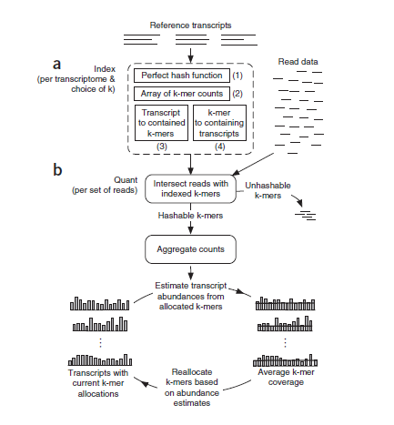
Sailfish
Patro, 2014, Nature
Introduced k-mer mapping to RNA-Seq
One parameter: K-mer length.
Program has two phases:
Indexing phase (a)
Quantification phase (b) (Transcript and isoform abundance estimation)

Slide 44
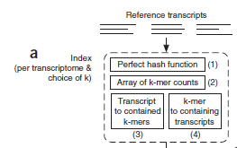
Sailfish
Indexing phase:
Convert reference trancriptome to k-mers and create three essential data structures:
k-mer hash (index table): Unique identifiers such that no k-mer share an identifier
Look-up table from k-mer to transcript: All transcripts in which a specific k-mer appears (i)
Look-up table from transcript to k-mer: All k-mers appearing in a specific transcript (ii)
Need to be re-created only for new reference or new choice of k.
K-mers with mis-matches can be discarded, while other error-free k-mers in the same read can be used.
i)
Transcript 1
k-mer
Transcript 2
Transcript 3
ii)
k-mer 1
Transcript
k-mer 2
k-mer 3
Notes:
Last point. Can still use the k-mer even though the complete read does not align. (Some of the read have poorer quality, contamination, adaptors etc)

Slide 45

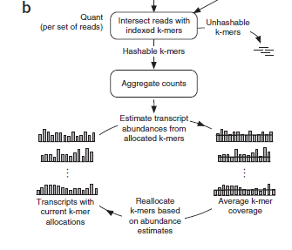
Sailfish
Quantification phase:
Intersect experimental read data with k-mer table from transcriptome reference
Aggregate counts
Estimate transcript abundancies from k-mer counts using an expectation-maximization (EM) procedure
Basic principle for EM:
Initially assign k-mers proportionally to their occurrence in the transcripts
Estimate the expected coverage for each transcript based on initial assignment
Use the expected coverage to alter k-mer assignment probabilities to transcripts
Iterate….
Notes:
Hashable: Those that fit the k-mer table
Unhashable: Those that doesn’t fit the k-mer table (discarded)
Assign k-mers propertionally: Meaning if a transcript has 2 of a k-mer, it is assign two times the k-mer coverage compared to a transcript with only 1 of the k-mer.
Then look at the transcriot as a whole and see how well the k-mer intensities fit the average transcript intensity.
Re-assign based on deviations from the average
Iterate until convergence

Slide 46
kallisto
Pure k-mer approaches discard important information on k-mers originating from the same read
Compromise accuracy for k-mer assignment
Use a similar approach as Sailfish, but also utlizes information on which k-mers originated from the same read
Modifies the k-mer focused assignment from Sailfish to a read-focused assignment in kallisto
Quickly became popular, even before it was published!
Bray, 2016, Nature
http://tinyheero.github.io/2015/09/02/pseudoalignments-kallisto.html
Notes:
Point 1. That is, each k-mer is regarded as independent, even when they truly are not (originating from the same sequence read)
Paper quite awkward to understand. Check the blog-link for a better explanation.

Slide 47
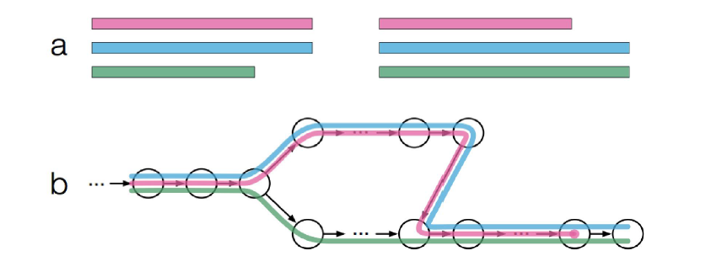
kallisto
De Bruijn graph used to connect overlapping k-mers for transcripts in the reference transcriptome
Example:
Three transcript isoform (pink, blue and green) with slightly different exons
De Bruijn graph of connected k-mers (black circles are k-mers)
Notes:
Note that the graph does not align directly with the transcript isoforms (for example, top-read 2 and 3 does not align with green in (b)!)
The green only k-mer could result from a splicing-event between the two green exon ends, which would not be contained in (compatible with) pink and blue.

Slide 48



kallisto
De Bruijn graph used to connect overlapping k-mers for transcripts in the reference transcriptome
Example:
Each k-mer is associated with a set of transcript, termed the k-mers k-compatibility class
The left most node has a k-compatibility class of all three transcripts
The three top-most nodes has a k-compability class of only blue and pink transcripts
The right-most node has a k-compability class of only blue and green
And so on…
Notes:
The point is that several k-mers generally share the same compatibility class!
(This is just similar to the lockup-table in Sailfish?) associating k-mers with transcripts. But here they call it a compatibility class. This is really no different than Sailfish?

Slide 49
kallisto
De Bruijn graph used to connect overlapping k-mers for transcripts in the reference transcriptome
Example:
Create a look-up table also including linked k-mer transcript information, and k-compatibility
classes
Notes:
Not exactly sure how this information is stored..
Unessecary slide. Just confirms that this is a k-mer transcript association table

Slide 50
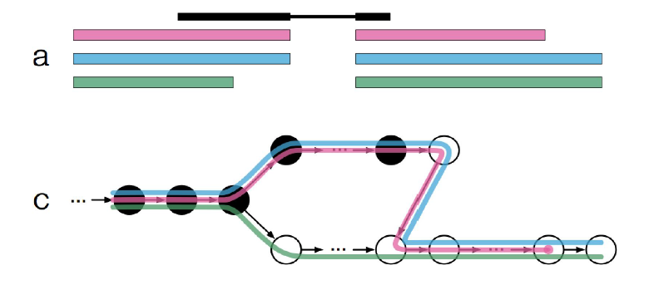
kallisto
Introduce an experimantal read (black, with exons in bold)
The k-mers compatible with the read are marked in black
We want to find the k-compability class of the read (rather than the k-mer)
Notes:
Only the black k-mers overlap with the read.
Include slide: important

Slide 51
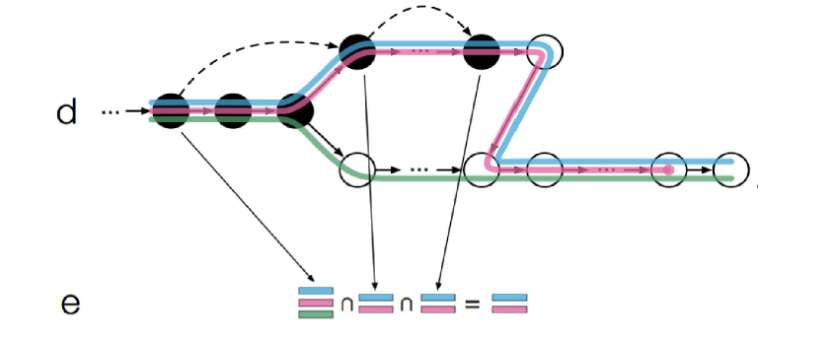
kallisto
Key outline:
Find the k-mers compatible with the read (black dots, d)
Find the transcripts compatible with these k-mers (red, green, blue, e)
Find the intersection of the transcripts compatible with each k-mer (red and blue, e)
The intersection is the k-mer compatibility of the read.
Notes:
Key point. You can find sets of k-mers which represent the exact same information (equivalence class) on your system. If you calculate (assign) one k-mer, the assignment automatically applies to all k-mers in the set (the equivalence class). This saves computational time, since you can reduce the number of calculations (can limit to number of equivalence classes).
1 is OK
2 is OK
Remove 3
4: The intersection of the transcript k-mers is the compatibility of the read (that is read-based lockup-table, rather than a k-mer based lockup-table)

Slide 52
kallisto
In this case, this is the pink and blue transcripts. This means that the read can have originated from either the pink, or the blue transcript in the annotation
EM is finally used to assign reads to transcripts
Notes:
Key point. You can find sets of k-mers which represent the exact same information (equivalence class) on your system. If you calculate (assign) one k-mer, the assignment automatically applies to all k-mers in the set (the equivalence class). This saves computational time, since you can reduce the number of calculations (can limit to number of equivalence classes).

Slide 53
kallisto
Equivalence class: Redundant information among the k-mers compatible with a read.
Example: The three leftmost k-mers all belong to the same k-compatibility class. These k-mers are said to belong to the same equivalence class.
Kallisto skips calculations on individual k-mers belonging to the same equivalence class (illustrated by the dashed arrows)
This speeds up computational time considerably.
Notes:
New improvements
Combine this and the previous slide.
Mentions that redundant information among the k-mers is used for calculations (but kallisto use redundant information about the reads? Sailfish on k-mers)
(The read focused approach speed up computational time?)
In kallisto this is referred to as equivalence classes
Uses EM to assign which reads belong to which transcripts
---------
Thought equivalence classes was the additonal feature of kallisto, but
Sailfish also make use of the equivalence class of k-mers to reduce computational time
--so what is actually the novelty of kallisto?
I think the point here is: Sailfish use compatibility classes of k-mers
BUT, kallisto transfers k-mer compatibility classes into compatibility classes for the reads. Speads up computational time, since only calculations of the equivalence class (based on the read redundancy assignments) needs to be performed once , and you kan skip individal calculations for other k-mers in the equivalence class.
Sailfish have equivalence classes of k-mers, but not transformed into read-assignments?

Slide 54
kallisto vs StringTie
Two different approaches
Kallisto (and sailfish) uses a reference transcriptome to create gene-models. Then they project the experimental data on these models
StringTie builds gene-models from experimantal data
kallisto is faster (and better) if you only want to use the reference transcriptome
If you want to build new models, you still have to use StringTie. This is still relevant, since many splicing patterns are yet tp be discovered for many organisms (including human)

Slide 55
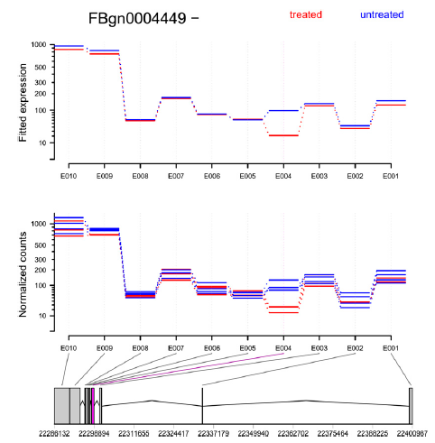
Isoform expression by analysing relative abundance of exons
Start with a transcriptome reference (annotated, built from data or both)
Map sequence reads to genes, exons and splice-junctions
Assume a model where reads are randomly mapped to exons in a transcript
If a gene do not express isoforms, all exons will be equally expressed
Asses deviations from equal exon expression through statistical tests.
Tool: DEXSeq (Anders, 2012, Genome Research)
Notes:
Again, explain how averaging over genes may lead to errors when comparing expression levels, if the genes are different isoforms (eg, if one condition expresses the full gene, and the other a shorter isoform in equal amounts, then averaging over the entire gene in both consitions may result in false positive differential expression!)
Can be useful for short reads and no paired-end. However, with recent sequencing standards, longer reads and paired-end, junction mapping is probably preferable (more reads, like 30%, may map junctions, due to average acon length of ~200-250 bp.
The Pearson test assess whether an exon-expression value differs significantly from the expression values in the other exons, (compared to exon variation expected by chance)
It tests a null hypothesis stating that the frequency distribution of certain events observed in a sample is consistent with a particular theoretical distribution. The events considered must be mutually exclusive and have total probability 1. A common case for this is where the events each cover an outcome of a categorical variable. A simple example is the hypothesis that an ordinary six-sided die is "fair", i. e., all six outcomes are equally likely to occur. (from Wikipedia).
Here the frequency distribution is a multinomial distribution: (the success probability is only dependent on (effective) exon length
In probability theory, the multinomial distribution is a generalization of the binomial distribution. For n independent trials each of which leads to a success for exactly one of k categories, with each category having a given fixed success probability, the multinomial distribution gives the probability of any particular combination of numbers of successes for the various categories.
Only annotated set, not de-novo discovery.

Slide 56
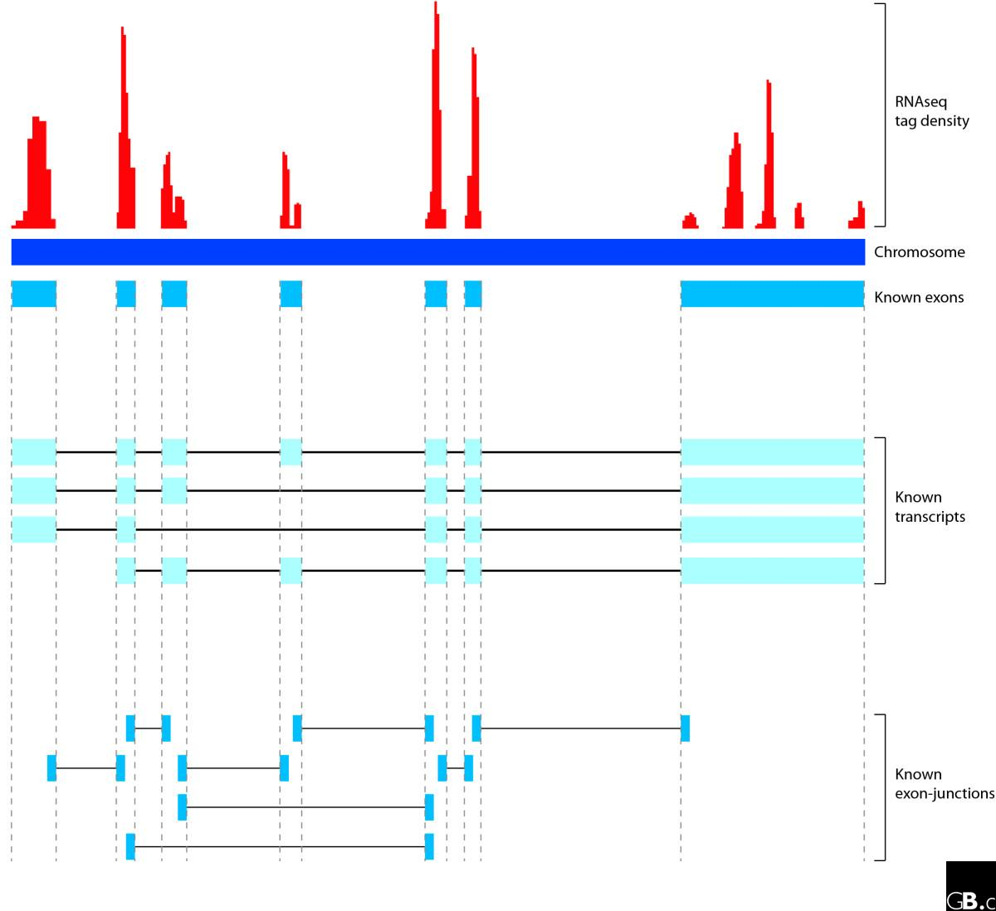
How to model differential expression?
Count the data. Count the number of aligned sequences for the type of transcript features you want to investigate.
In RNA-Seq, typical features are transcripts, genes,exons, and isoforms, however features like splice-junctions are also possible to model in the same way.
Goal: to find the features which are significantly differentially expressed between the two conditions
Notes:
Beware when «averaging» sequence tags over genes without taking isoforms into account!
The strategy may apply to exons and all other transcriptional features, as well as genes. Transcript entities can be counted and compared.
(Show on blackboard?) Variance between replicates follows the intensity (mean of replicates). Statistical significance can be achieved by comparing the distributions.

Slide 57
Count measures: RPKM/FPKM
Expression measurements unit – RPKM/FPKM
Reads/Fragments Per Kilobase of exon per Million fragments mapped.
Reads are generally used for single-end sequencing while fragments are used for paired-end (In Cufflinks FPKM is used in both settings)
Expression value which is normalised both according to the length of the transcript and the sequencing depth of the library.
Makes expression values comparable between transcripts and experiments
Note: Comparable for exons, but not always for genes (unless variation in isoform length is taken into account)

Slide 58
Isoform differential expression from RNA-Seq
Different isoforms may impair the expression level estimation of a gene
Averaging sequence intensity over the entire gene may lead to false positive differential expression if the two conditions compared express a different isoform with similar expression level
Many isoforms lead to gene-products with different functions, and is thus important to identify
Notes:
Again, explain how averaging over genes may lead to errors when comparing expression levels, if the genes are different isoforms (eg, if one condition expresses the full gene, and the other a shorter isoform in equal amounts, then averaging over the entire gene in both consitions may result in false positive differential expression!)
Can be useful for short reads and no paired-end. However, with recent sequencing standards, longer reads and paired-end, junction mapping is probably preferable (more reads, like 30%, may map junctions, due to average acon length of ~200-250 bp.
The Pearson test assess whether an exon-expression value differs significantly from the expression values in the other exons, (compared to exon variation expected by chance)
It tests a null hypothesis stating that the frequency distribution of certain events observed in a sample is consistent with a particular theoretical distribution. The events considered must be mutually exclusive and have total probability 1. A common case for this is where the events each cover an outcome of a categorical variable. A simple example is the hypothesis that an ordinary six-sided die is "fair", i. e., all six outcomes are equally likely to occur. (from Wikipedia).
Here the frequency distribution is a multinomial distribution: (the success probability is only dependent on (effective) exon length
In probability theory, the multinomial distribution is a generalization of the binomial distribution. For n independent trials each of which leads to a success for exactly one of k categories, with each category having a given fixed success probability, the multinomial distribution gives the probability of any particular combination of numbers of successes for the various categories.
Only annotated set, not de-novo discovery.

Slide 59
Isoform differential expression from RNA-Seq
Different isoforms may impair the expression level estimation of a gene
Condition 1 expresses the full gene, while condition 2 expresses a shorter isoform
Both conditions express its gene isoform in equal amounts
Averaging over the full gene in both conditions will consistently (and erroneously) assign a too low gene-expression value in condition 2
Result: a possible false positive in differential expression
Many isoforms lead to gene-products with different functions, and is thus important to identify
Notes:
Again, explain how averaging over genes may lead to errors when comparing expression levels, if the genes are different isoforms (eg, if one condition expresses the full gene, and the other a shorter isoform in equal amounts, then averaging over the entire gene in both consitions may result in false positive differential expression!)
Can be useful for short reads and no paired-end. However, with recent sequencing standards, longer reads and paired-end, junction mapping is probably preferable (more reads, like 30%, may map junctions, due to average acon length of ~200-250 bp.
The Pearson test assess whether an exon-expression value differs significantly from the expression values in the other exons, (compared to exon variation expected by chance)
It tests a null hypothesis stating that the frequency distribution of certain events observed in a sample is consistent with a particular theoretical distribution. The events considered must be mutually exclusive and have total probability 1. A common case for this is where the events each cover an outcome of a categorical variable. A simple example is the hypothesis that an ordinary six-sided die is "fair", i. e., all six outcomes are equally likely to occur. (from Wikipedia).
Here the frequency distribution is a multinomial distribution: (the success probability is only dependent on (effective) exon length
In probability theory, the multinomial distribution is a generalization of the binomial distribution. For n independent trials each of which leads to a success for exactly one of k categories, with each category having a given fixed success probability, the multinomial distribution gives the probability of any particular combination of numbers of successes for the various categories.
Only annotated set, not de-novo discovery.

Slide 60
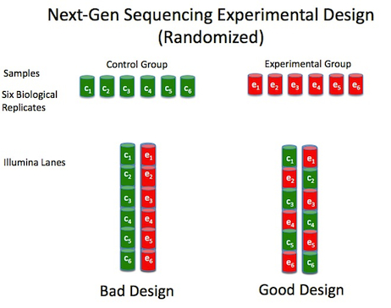
Differential expression analysis in RNA-Seq
Typical experiment has two conditions: Control and Experimental (for example samples from healthy and diseased individuals)
Technical replicate: Same biological sample in different runs
Biological replicate: Sample from different biological source (for example different patient) in different runs
Due to the good technical reproducability in RNA-Seq, biological replicates are more important than technical

Slide 61
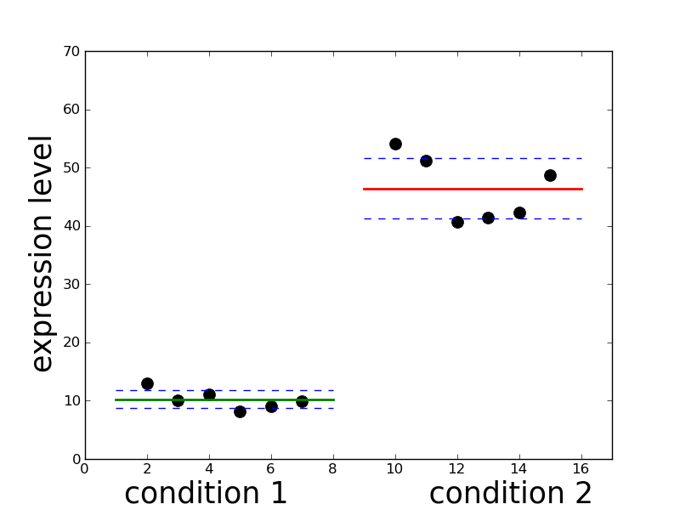
How to model differential expression?
Start with N samples in condition 1 (e.g. cancer) and M samples in condition 2 (e.g. normal).
Whether a feature (for example a gene) is differentially expressed between condition 1 and 2, depend on:
the difference in expression level between the conditions (the mean in each condition)
the variation in expression levels of the feature over all samples within each condition (the variance in each condition)
mean
variance
variance
mean
Notes:
Beware when «averaging» sequence tags over genes without taking isoforms into account!
The strategy may apply to exons and all other transcriptional features, as well as genes. Transcript entities can be counted and compared.
(Show on blackboard?) Variance between replicates follows the intensity (mean of replicates). Statistical significance can be achieved by comparing the distributions.

Slide 62
How to model differential expression?
Sufficient number of replicates: Calculate variance for each feature directly
Many RNA-Seq experiments with few replicates: Cannot calculate variance directly
How to circumvent this issue?
mean
variance
variance
mean
Notes:
Note: With decrease in sequencing costs, it has become more common to include more replicates!

Slide 63
How to model differential expression in situations with few replicates?
Basic observation: Incresed mean > increased variance
This pattern can typicalle be modelled by a Poisson distribution.
The Poisson distribution has the advantage that the mean and the variance are dependent (That is, if you know the mean, you also know the variance)
In this setting, to calculate the statistical significance of a feature is straightforward (Fisher’s exact test or t-test, adjusted for multiple hypothesis testing)
mean
variance
variance
mean
Notes:
Introduce the model. It can be observed that as the mean increases, the variance also increases. It could thus be possible to model the data with a statistical distribution which describes this pattern.
One possibility: Poisson distribution!

Slide 64
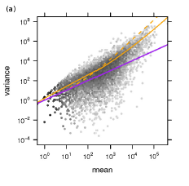
How to model differential expression?
Do RNA-Seq count data follow this model?
Technical replicates: Yes
Biological replicates: No
For biological replicates, the variance increases with epression level more than predicted by the Poisson model
Referred to as overdispersion
In these cases, the Poisson model will lead to increased false positive predictions
Notes:
Figure: When the mean increases, the variance also increases proportionally

Slide 65
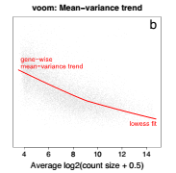
DESeq, edgeR and voom
Robinson, 2007, Bioinformatics
Robinson, 2010, Bioinformatics
Anders, 2010, Genome Biology
Law, 2014, Genome Biology
Solution to the overdispersion problem for datasets with few replicates
Use the Negative Binomial Distribution (NBD)
Problem: In the NBD the variance cannot be directly estimated from the mean!
Trick: Use the variance of other features in the dataset with similar expression level to estimate the variance for each feature to overcome this problem (Borrow variance from similar features)
Various ways to borrow variance:
DESeq: Variance estimated by local regression for samples with similar expression level
edgeR: Global variance estimation followed by local weighting of the global variance
voom: Regression spline (lowess fit)
Leads to more robust estimates of significance. Fewer false positives.
DSeq
edgeR
Poisson
Notes:
Note: Are the mean and variance indepndent in this type of analysis? i) If you use the gene itself, together with all genes with similar expression to calculate the variance they are not strictly independent. ii) However, are they independent if you exlude data from the gene in question? Strictly not, becuase you used the mean to select samples with similar mean. Thus this is not an entirely independent measure!
This has been done a long time for micro-arrays. These were the fisrt to do it for sequencing (RNA-Seq)
The trick is to use variance from similar samples, and use these as a kind of «pseudo-replicates»
edgeR use a global modal, but somehow also weights it towards a local model. Not exactly sure how this works..
Note: voom trend downward due to log-transform. Voom makes micro-array analysis available to RNA-Seq.

Slide 66
Borrowed variance
No significant differential expression
Condition 1
Condition 2
Borrowed variance
Mean

Slide 67
Borrowed variance
Outlier sample in data lead to significant differential expression
Condition 1
Condition 2
Replicate outlier
Mean with outlier
Borrowed variance
Mean
Notes:
Push up the mean, but without altering the variance sufficiently. Can lead to false positive predictions.

Slide 68
Replicates, Normalisation and Power
Normalisation with respect to coverage variation.
Total, mean or median?
Both DESeq and edgeR suggest median normalisation is better
Reason: Expression sometimes dominated by highly abundant genes
Increased statistical power:
Transcripts with low expression:
Increase sequencing depth
Targeted panels removing signal from abundant genes
Transcripts with high expression: Increase biological replicates
Notes:
Generally, the first should not be necessary, if you have a good design.
Note:
This is also maybe Strategies to handle «early problems». More sufficient replicate-setups more common now.
You can also see there are clear consequences for this approach..
Targeted panels is a more recent approach. Try to remove reads from abundant genes, to distribute more reads on less abundant genes

Slide 69
How good are the RNA-Seq pipelines?
Steijger, 2013, Nature
Engstrøm, 2013, Nature
Results from a large comparative evaluation of RNA-Seq alignment and transcript identification
Alignment:
Still challenges related to:
Splice-junction discovery
Less well annotated genomes
Using a transcriptome annotation (if available) helps
Transcript reconstruction:
Mapping to exons work fairly well for most programs
Still challenges in isoform reconstruction
Non-coding RNA may be difficult to identify due to less abundance
Challenging to compare methods directly due to the many possibilities and different approaches.

Slide 70
For the exercise

Slide 71
Counting reads according to genome feature annotations
Create count tables from alignments using a genome feature (transcriptome) annotation and a program which counts features
Here we will focus on gene and exon features (but in principle, any feature is possible)
Use the count-tables as input to programs which specialize in calculating differential expression from count-tables
Several programs may perform both of these tasks.
Here we use a tool called featureCounts from the Subread package to create count-tables, and Voom analysis in R for differential expression

Slide 72
1. Standard alignment, gene counts and differential expression
RNA Sequences
HISAT2 alignment
featureCounts
(gene-level)
Voom differential
expression
Pre-defined HISAT2 indexed genome (+transcriptome)
GTF transcript annotation
HISAT2 pre-indexed can be both genome-only and genome+transcriptome
Indexed transcriptome only need to be created once!
Additional workflow necessary to index new genomes transcriptomes:
Reference genome or sequences
HISAT2 indexed genome ( + transcriptome)
List of transcript exon junctions from GTF

Slide 73
2. Reference based de novo transcript discovery, isoforms and differential expression
HISAT2 alignment on each sample
HISAT2 provides output specifically tailored for StringTie
StringTie provide table-formats specifically tailored for Ballgown (option –B)
Ballgown not peer-reviewed!
StringTie isoform discovery on each sample
GTF transcript annotation
StringTie create new reference transcriptome
StringTie isoform abundance estimation
Ballgown differential isoforms

Slide 74
3. Isoform abundance estimation and differential expression from reference transcriptome
RNA Sequences
kallisto alignment and
isoform
abundance
kallisto indexed sequence- based transcriptome
Sleuth differential isoforms
Only for pre-defined kallisto reference transcriptomes
Produce differentially expressed isoforms (only annotated)
Sleuth should be used with kallisto, but not peer-reviewed!

Slide 75
4. Abundance estimation and and differential expression from completely de novo assembled transcriptome
Sequences
Trinity
RSem
Voom
Not used in exercise! (time consuming…)

Slide 76
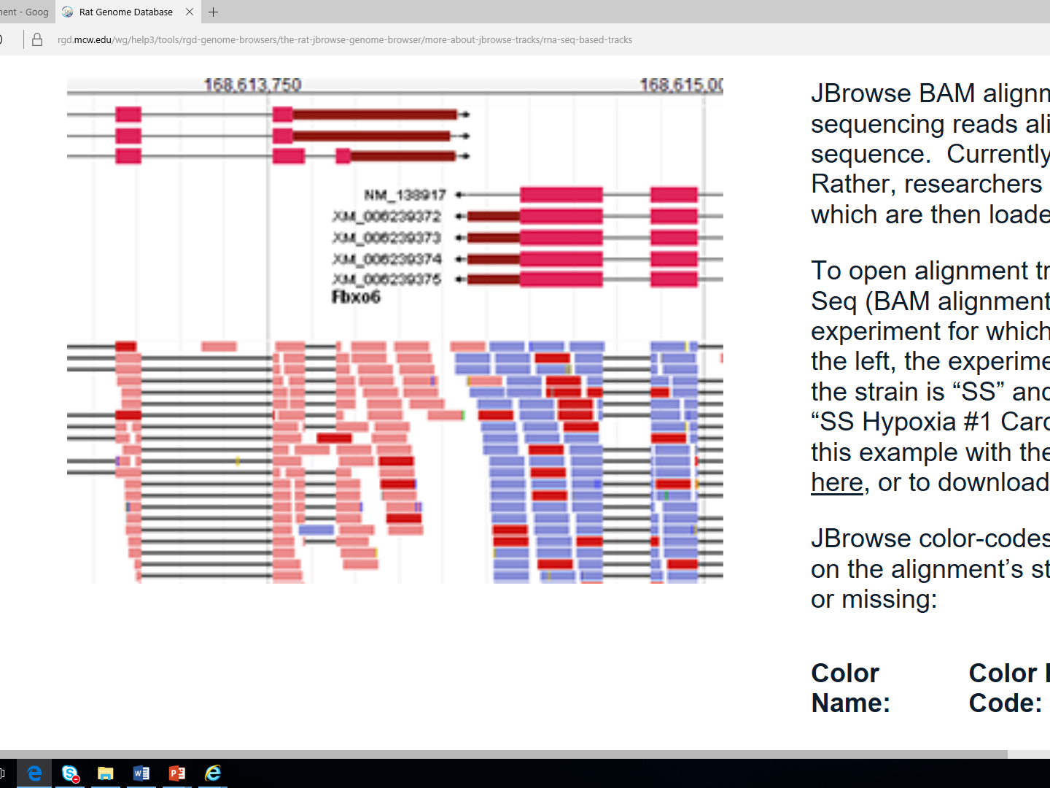
Notes:
https://rgd.mcw.edu/wg/help3/tools/rgd-genome-browsers/the-rat-jbrowse-genome-browser/more-about-jbrowse-tracks/rna-seq-based-tracks/
http://www.mi.fu-berlin.de/wiki/pub/ABI/GenomicsLecture12Materials/rnaseq1.pdf
See this presentation for a better explanation of cufflinks

