Slide 1
RNA-Seq, what do we actually find? ..and what is the biology behind it?
BI311F-1 20V Akvagenomikk og bioinformatikk
Robin Mjelle

Slide 2
Exciting times! Isoforms, gene fusions and chimeric transcripts – a gene is more than a gene!
50 – 90% of annotated genes produce isoforms
Isoforms: the generation of different protein products from the same gene
ENCODE 2012: Average 3.9 protein coding isoforms pr. gene (but some genes may have several thousand isoforms…)
Three main transcriptional causes of variation:
Alternative exon usage (alternative splicing)
Alternative use of transcription start site (TSS)
Alternative transcription termination/poly-adenylation site
Isoforms of the same protein often have different, or even opposing functions
Notes:
Expanded concept of a gene based on RNA entities. Exiting times in the early days of RNA-Seq! Lots of new discoveries and hypothesis.
I think the number may be somewhat higher now. More isoforms have been discovered

Slide 3
Exciting times! Isoforms, gene fusions and chimeric transcripts – a gene is more than a gene!
Variations caused by nucleotide substitutions (mutations and RNA-editing), deletions and insertions
Read-Through transcripts, genes borrowing exons from neighbouring genes
Gene-fusions. Fusions of distant transcripts by chromosomal allocations
Can be both intra and inter-chromosomal
«Chimeric transcript» is a term used for both gene fusions and read-through transcripts
Notes:
Expanded concept of a gene based on RNA entities. Exiting times in the early days of RNA-Seq! Lots of new discoveries and hypothesis.

Slide 4
Sobering times? ECCB18 – Athens September 2018
Most genes prefer to express only one of its isoforms
At least in a given context
Proteomics: Vast mojority of isoforms are not translated into protein
Are not able to properly fold and produce a structurally functional protein
Many identified «isoforms» may just be leftovers from ribosomal mRNA degradation during translation
The purpose of most isoform de-regulation in cancer may be to simply disrupt the expression of the gene.
Notes:
This has been an increasing «trend».Typical for all new fields. Separate the important from the hype!
Necessary correction to the field. Numerous reported transcripts and isoforms may not always be functional. Reduction of complexity? Important to identify those that are important.

Slide 5
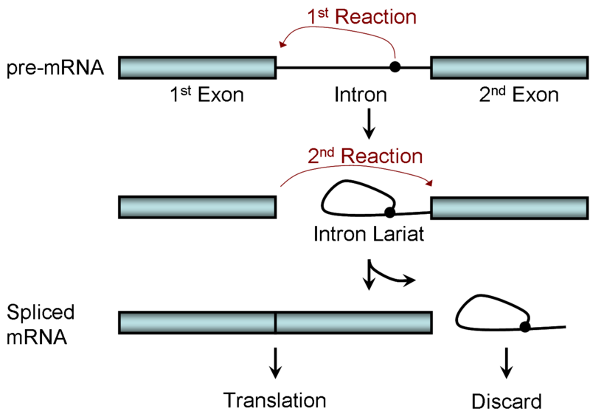
Alternative splicing – The model
Splicing machinery assembles co-transcriptionally, together with capping and poly-adenylation
Basic scheme for intron removal and exon joining:
A base(A) in the intron attacks the 1st exon-intron boundary, and binds the the 5’end of the intron
The free 3’end of 1st exon interacts with the 5’end of the 2nd exon and join them together
The intron lariat loop is usually degraded
Spliced mRNA ready for further processing, followed by export and translation
Notes:
(Recent research may indicate that the introns are not always degraded, but are actually functional (eg as miRNA precursors, or function lncRNA? They are RNA-edited, so why would they be if they didn’t have a function? Is intron RNA-editing consistent or random? )
Not all mRNA is exported and translated. Hugh variations (barcodes in the 3’UTR dertermines further processing)

Slide 6
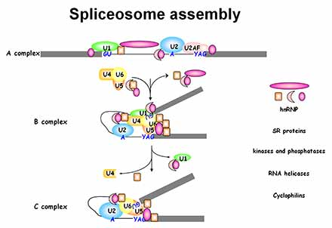
Alternative splicing – The reality
Key steps in RNA splicing are performed by RNA molecules and proteins in complexes
Spliceosome consist of:
snRNAs (small nuclear RNAs < 200nt, 5 or 6)
snRPS (small nuclear ribonucleoprotein, > 200)
Determines the splice-product and further fate of the mRNA (export, localisation, translation)
Sequential interactions between various , proteins, snRNA and pre-mRNA
through base-pairing in splice-specific nucleotide sequences.
One of the first processes where RNA molecules where established as key components
Notes:
The distance of the branch-point adenosine (attack-intron position) is typically much more shiftef towards the 3’ of the intron compared to the 5’end (but may still vary a lot)
5(6) RNA-molecules and as many as 200 proteins (does this include the enhancer proteins? NO) involved in the spliceosome process.
(Ensures both accuracy and flexibility… tja…)
Why splicing? Flexibility in gene evolution, combining existing functional domains (confirmed by common protein domains), increase the coding potential of the human genome.
The exact position of the adenosine-attack-site, 5’ and 3’ splice sites are determined by specific nucleotide sequences (but are variable and degenerate). (core sequences. But additional sequences, like enhancers and silencer determine where exactly the splicing takes place)
RNA-molecules involved here, unlike other processes, which mostly involve proteins. Though recent evidence may suggest that the RNA-component in other processes are more important than previously thought. But, at least here it is established.
Rearrangements also affects snRNA-snRNA interactions within the spliceosome
Will not go into the chemical details and the role of specific proteins. The figure just illustrate the sequential events of different snRNA and components of the snRNPs assemble and disassemble during the process.
The different snRNAs important at different steps in the process
U1 and U2 at the pre-mRNA
Addition of U4-6
Disposal of U1 and U4
The spliceosome may also function as a signal which target RNA for degradation (in the exosome complex?)
Which components that participate in a certain splaicing event may decide the further fate of the mRNA (transport, export, cellular localisation, translation..)
Take home message: The model is simple, but the process is complex, and likely small changes in the machinery may lead to different splice products and mRNA fate
hnRNP: Heterogenous nuclear ribonucleoproteins: Complexes of protein and RNA which binds to pre-mRNA (and mRNA?). (Wikipedia):
1. Prevent folding of pre-mRNA into secondary structures that may inhibit its interactions with other proteins.
2. May associate with the splicing apparatus.
3. Transport of mRNA out of the nucleus.

Slide 7
Alternative splicing – Take Home Message
The model is simple, but the process is complex
Small changes to the machinery likely leads to different splice products and mRNA fate
Notes:
The distance of the branch-point adenosine (attack-intron position) is typically much more shiftef towards the 3’ of the intron compared to the 5’end (but may still vary a lot)
5(6) RNA-molecules and as many as 200 proteins (does this include the enhancer proteins? NO) involved in the spliceosome process.
(Ensures both accuracy and flexibility… tja…)
Why splicing? Flexibility in gene evolution, combining existing functional domains (confirmed by common protein domains), increase the coding potential of the human genome.
The exact position of the adenosine-attack-site, 5’ and 3’ splice sites are determined by specific nucleotide sequences (but are variable and degenerate). (core sequences. But additional sequences, like enhancers and silencer determine where exactly the splicing takes place)
RNA-molecules involved here, unlike other processes, which mostly involve proteins. Though recent evidence may suggest that the RNA-component in other processes are more important than previously thought. But, at least here it is established.
Rearrangements also affects snRNA-snRNA interactions within the spliceosome
Will not go into the chemical details and the role of specific proteins. The figure just illustrate the sequential events of different snRNA and components of the snRNPs assemble and disassemble during the process.
The different snRNAs important at different steps in the process
U1 and U2 at the pre-mRNA
Addition of U4-6
Disposal of U1 and U4
The spliceosome may also function as a signal which target RNA for degradation (in the exosome complex?)
Which components that participate in a certain splaicing event may decide the further fate of the mRNA (transport, export, cellular localisation, translation..)
Take home message: The model is simple, but the process is complex, and likely small changes in the machinery may lead to different splice products and mRNA fate
hnRNP: Heterogenous nuclear ribonucleoproteins: Complexes of protein and RNA which binds to pre-mRNA (and mRNA?). (Wikipedia):
1. Prevent folding of pre-mRNA into secondary structures that may inhibit its interactions with other proteins.
2. May associate with the splicing apparatus.
3. Transport of mRNA out of the nucleus.

Slide 8
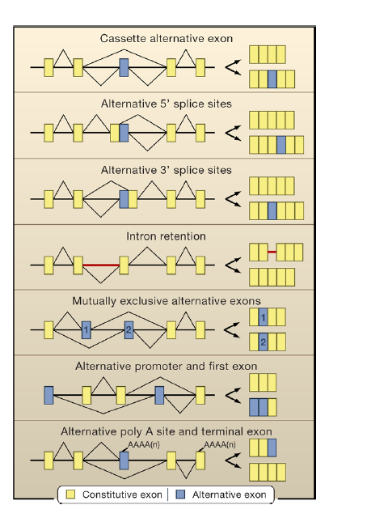
Modes of alternative splicing
~33%
~25%
Most rare
Notes:
Alternative 3’ and 5’ may only affect a single base, however, this can change the reading frame (frameshift) and result in a protein with completely different amino acid sequence (and likely also different function)
(Mutually exclusive binding is typical where exons are proximal, and where the spliceosome only have time to select one-or-the other)
The two latter mechanism show hoe alternative TSS and alternative TTS may correlate to first/last exon usage

Slide 9
Alternative splicing – «Fun» facts
Blencowe, 2006, Cell
Matlin, 2005, Nature
Introns vary in size from 10nt to over 100 000 nt, the longest known being 740 920 nt (gene HS6ST3).
Exon sizes are more comparable (have less variation).
A maximum intron length of 20 000nt includes 90% of human introns
Splice-sites can partly be determined by nucleotide sequence, however these sequences are degenerate and difficult to predict
Mutations in splice sites. May lead to exclusion of the splice-site or selection of an alternative splice site (actually quite common…)
Exon and intron enhancers/silencers: Sequence elements near exon/intron junctions which enhance/supress a spesific splicing event
Notes:
TSS is a dependency. TFs at TSS stick to Pol II and affect downstream splicing.
TTS effect correlation or dependency? Dependency when pre-mature TTS results in non-inclusion of downstream exons
There is also a theory that an exon may actually associate with Pol 2 and thus be «tranported» to the next exon over long genomic intron distances (don’t really see how this should work…)

Slide 10
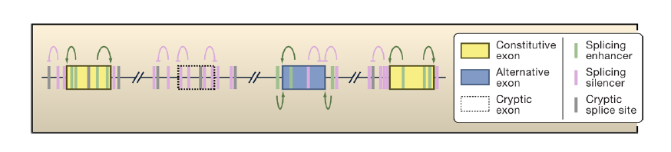
Splicing enhancers
Functional and non-functional splice-sites cannot be sufficiently distinguish by the site specific nucleotide sequence alone.
Additional sequence elements in introns and exons promote the selection of the correct site when bound by proteins
Exonic and intronic splicing enhancers and silencers (ESE, ESS, ISE, ISS)
Relative frequency of enhancers/silencers in a splice-region somewhat separates:
constitutive
alternatively used
cryptic exons.
Can activate and repress the interactions between RNA and the spliceosome
Blencowe, 2006, Cell
Notes:
Not only single enhancers/silencers and binding proteins, but often a complex combination of events lead to alternative splicing
SR-family of proteins: Family of arginine and serine-rich proteins (How many?) (30?). Don’t know why these are so good for RNA-binding though…). (RRM- RNA-recognition-motif in the N-terminal, SR-rich C-terminal tail)
Figure:
Constitutive exons – always used. Enhancers promoting the splice sites, and silencers repressing nearby cryptic splice-sites. Enhancers/silencers = high
Alternative exon: Enhancers which include, and silencers which suppress exon inclusion. Context specific, inclusion depend on which proteins and sites that have a binding preference. Enhancers/Silencers = equal amounts
Cryptic splice sites: Not used. Generally surrounded by silencers. Enhancers/Silencers = very low
Silencers are also enriched in the intronic “flanks” of constitutive exons (probably “fermenting” the correct exon, making sure it is stably and correctly spliced). This trend is more uncertain. Enhancers also found in flanking introns (but maybe that is for alternative exons+)
Use of enhancer sequences may be tissue-specific

Slide 11
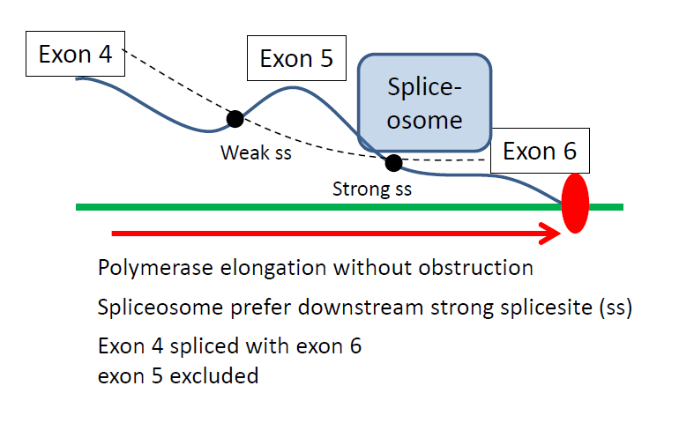
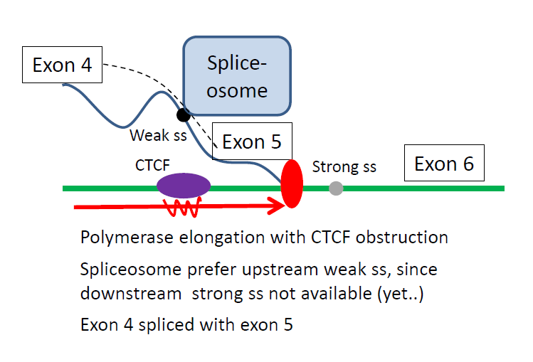
Exon skipping – an example
Situation 1
Exon skipping – the most common form of alternative splicing (~1/3 of all splicing events)
The decision to include an exon or not are determined by the ability of weak splice sites to effectively compete with strong splice sites for detection by the spliceosome
Pol II
Situation 2
Situation 2
Notes:
Maybe explain what differentiation means?
One could probably draw the process on the blackboard?

Slide 12
Exon skipping – an example
Situation 1
Example: Exon skipping caused by protein-DNA binding of CTCF
CD45 gene. Weak splice site in exon 5, and strong downstream splice-site
Pol II
Situation 2
Situation 2
Shukla, 2011, Nature
Notes:
Maybe explain what differentiation means?
One could probably draw the process on the blackboard?

Slide 13
Exon skipping – an example
Sitaution 1:
Unobstructed fast Pol 2 elongation.
both splice-sites (ss) available for spliceosome.
Spliceosome prefer strong ss. Weak ss is unbound
Result: Exon 4 and 6 is spliced, exon 5 is skipped
Situation 1
Pol II
Situation 2
Notes:
Maybe explain what differentiation means?
One could probably draw the process on the blackboard?

Slide 14
Exon skipping – an example
Situation 1
Pol II
Situation 2: Binding of CTCF protein to DNA
Slows down Pol II, decreasing exposure of strong ss
Splicesome bind weak ss instead.
Result: Exon 5 inclusion
Situation 2
Notes:
Maybe explain what differentiation means?
One could probably draw the process on the blackboard?

Slide 15
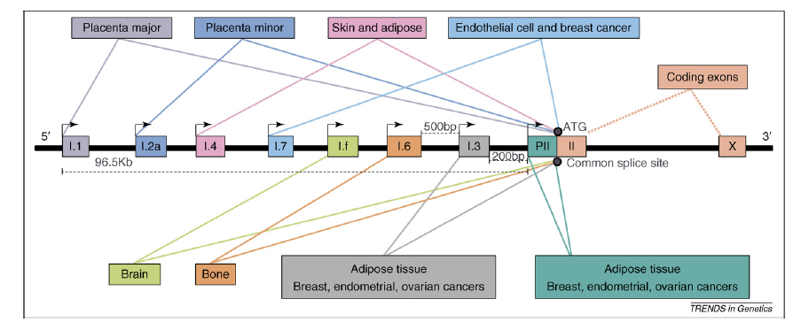
Alternative transcription start sites (TSS)
Davuluri, 2008, TIG
Sandelin, 2007, Nature
~50% of genes use alternative TSS
Alternative TSS in the same gene may be separated by hundreds og kb
May lead to different isoform if the alternative TSS jumps one or more exons
May also lead to identical isoforms with different 5’UTR, affecting post-transcriptional regulation and translation efficiency
The most precise technology for TSS mapping is CAGE. Micro-arrays are poor in detection, due to their preference for probing 3’-UTR.
Gene: CYP19A1
Notes:
50% was from 2008. May be higher today.
Use of alternative promoters are also linked to alternative splicing
Changes in 5’UTR (with the same coding sequence) may affect robosomal entry sites and secondary RNA structure (folding). Thus affect binding of post-transcriptional proteins. May also affect transport
CYP19A1: Involved in drug metabolism and cholesterol synthesis. Over-expressed in several cancers. NCBI states that two isoforms exist, but do not take into account the alternative TSS (leading to different 5’UTRs). Cancer expression depend on the alternative TSS.
Actual mechanism: The various 5’UTR (boxes) are spliced to the first coding exon. The boxes are not coding, but represents different 5’UTRs. 5’ and 3’ UTR can also be spliced and contain «exons», even if they are not coding.

Slide 16

FANTOM5
Functional annotation of the
mammalian genome
FANTOM Consortium., 2014, Nature
Most comprehensive study of human and mouse Transcription start sites to data
Apply CAGE to 975 human cell-lines, tissues and primary cells
Create the human «promoterome»: The most comprehensive map of human TSS and alternative TSS to date.
Identify a set of ~180 000 robust TSS in the human genome

Slide 17
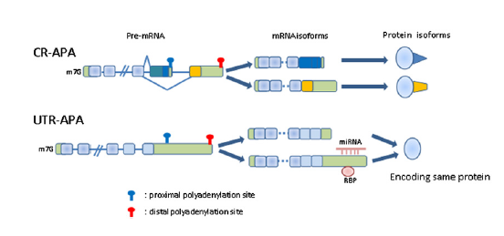
Alternative Poly-adenylation (APA)
Di Giammartino, 2011, Cell
Affecting ~50% of proteins
May lead to different isoforms if the alternative Poly(A) site is located upstream of the last exons
May also lead to identical isoforms with different 3’UTR,
Involves a complex machinery for selection of the appropriate poly(A) site, involving RNA recognition sequences and protein complexes.
Affect the fate of mRNA, isoform generation, RNA stability, export to cytoplasm, translation efficiency and regulation from micro-RNAs.
CR = Coding Region
RBP = RNA Binding Protein
Notes:
Especially export «barcode» signals are also prevalent in the 3’UTR. Largely determine the fate of the transcript later! (See Martin-2009-Cell, Review)
What happens: Pol2 carry end-processing proteins, which is transferred to the RNA 3’end processing sequence when this sequence is transcribed. (But how, then, do we explain the binding to weak and strong sites?) Other factors in addition? Can they bind without Pol2-transport?
Transcription thus happen through the 3’end, and the Polymerase may continue to transcribe
The RNA following the 3’end is not capped, and thus rapidly degraded.
Hypothesis: Ultimately, Pol2 is released from DNA when the degradation «reach» the polymerase.
The end-processing protein-complexes assemble more proteins on RNA
RNA is cleaved (new 5’end lacks capping), and a poly-A tail is added (~200nt)
CR-APA: Affecting last exon(s) leading to isoforms (proximal site, upstream). Do encounter a upstream exon-signal (binding factor, weak site)
UTR-APA: Affecting 3’UTR (downstream site), but encoding same protein. Do not encounter upstream weak site, but use downstream strong site
Other factors (comparable to enhancers or silencers) may regulate the choice of the site

Slide 18
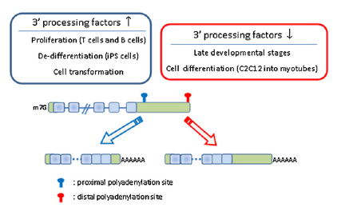
APA Dynamics and Proliferation
Observation 1: 3’UTR are shorter in proliferating cells (also in cancer)
Observation 2: Upstream APA sites are often weaker than downstream APA sites
Notes:
(Also less specific sub-cellular localisation in proliferation? Or is there a general «default» path, with more specification in less proliferating cells due to longer 3’UTRs?)

Slide 19
APA Dynamics and Proliferation
Explanation:
Upregulation of APA processing factors in proliferating cells
Leads to increased poly-adenylation of weak upstream sites (which, of course, means that the downstream sites are not polyadenylated)
Shorter transcripts leads to less downregulation by e.g micro-RNAs and increased translation rate, thus leading to more protein product.
This contributes to driving proliferation
Notes:
(Also less specific sub-cellular localisation in proliferation? Or is there a general «default» path, with more specification in less proliferating cells due to longer 3’UTRs?)

Slide 20
«Read-through» gene fusions
Parra, 2006, Genome Reserach
Occur when consecutive genes on a strand are spliced together
Occur without genomic rearrangements
Encodes a protein with exons from both genes
Affect (at least) 4-6% of genes
Two proposed schemes:
«Run-off» transcription of the upstream gene
Transcription continues through the upstream termination site, and only stops at the termination site of the downstream gene
Transcript with exons from the intergenic region between genes support this hypothesis for some transcripts
Trans-splicing of two proximal pre-mRNAs
Mechanisms generally not well known
Notes:
Must have the structure: promoter-terminationsite-promoter-terminationsite to qualify as a read-through
The «underestimate» is due to their experimental set-up, which was a little hard to get a full overview of…

Slide 21
Single nucleotide substitusions - Mutations
Mutations consist of single nucleotide substitusions in DNA, which are transcribed into RNA.
Synonymous mutations: Do not affect the protein sequence
Non-synonymous mutations: Do affect the protein product by changing the amino acid sequence
SNPs (Single nucleotide polymorphisms). Exist in a minimal frequency within a population
SNVs (Single nucleotide variants). May exist only in an individual
Can occur in many ways…
Notes:
The SNP-defintition depend on the population you study (it seems to me). Thus something defined as a SNP in one context need not be defined as a SNP in another context (it depends on the population. Eg. Compare large population-studies to studies of a specific family for examples)
Can anyone explain how this is dealt with in databases? Answer: There are more general acception criterias for a variant to be classified as a SNP, for example in dbSNP.
Will not og into details on how mutations can be generated in cancers.

Slide 22
Single Nucleotide Substituions – RNA editing
Overwriting, insertion or deletion of RNA at specific sites to generate transcripts different from their genomic templates
Type of editing is species specific
Mammals: A to I(G) conversions most abundant. C to U is observed, but rare.
Can happen co-transcriptionally or post-transcriptionally
Most abundant in introns and 3’UTRs. But also found in coding sequence where it can effect protein product and splicing.
Affect the function of a limited number of mammalian genes
MicroRNA genes have been shown to be important RNA editing targets
Notes:
A to I function like an A to G substitution (Becuase I behaves like a G in subsequent steps..)
microRNA precursor genes have been shown to be affected, but it is not known whether is also affects other ncRNA-classes. May affect the seed region of the miRNA

Slide 23
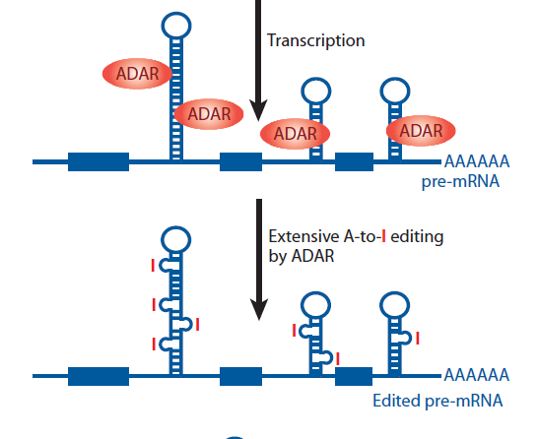
Single Nucleotide Substituions – RNA editing
A to I(G) conversions: Adenosines deaminated to Inosine(I) by the ADAR family of enzymes.
Recognise double-stranded RNA and can edit a single site or a cluster of sites.
Inosine appears as a G in reverse transcription for sequencing
(Thereby the term A to I(G))
Nishikura, 2010, ARB
ADAR = Adenosine Deaminase Acting on RNA
Notes:
Convert adenosines to inosines
Act on double-starnded RNA, that is RNA this has a folded in ds-structure due to they RNA-sequence. These regions often consist of repeats, and are mostly within the introns, 3’ or 5’ UTRs.
Figure: ADAR bind dsRNA structures.
May target a specfic adenosine, or a local cluster of adenosines.
(May continue to modify adenosines until it reaches a tolerance level where the RNA becomes unstable)

Slide 24
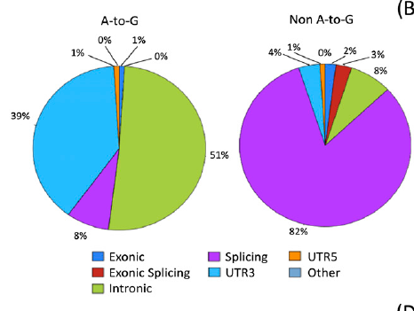
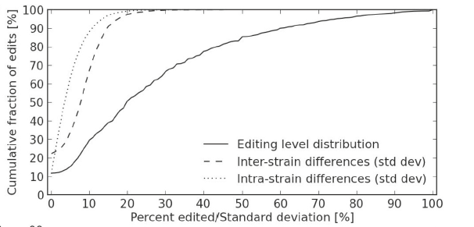
Single Nucleotide Substituions – RNA editing
Park, 2012, Genome Research:
DNA and RNA in 14 cell-lines from the ENCODE project.
Identified 5695 unique editing events in 1396 genes (80% A to I(G))
Most were intronic or 3’ UTR
Danecek, 2012, Genome Biology
Brain RNA and DNA from 15 strains of mice.
Identified 5579 (7389 with extension) events, of which 97.5% were A to I(G)
Editing levels of each site usually less than 60%
Edits conserved between strains
Notes:
Figure bottom: That is, less than 60% of reads aligning to this position display the edited base
Pie-charts: affect intronic and 3’UTR, and less splicing.
Park: Major point: The actual editing of a gene is more important than the editing of any individual site in the gene. The former are consistent, while the latter is not…
The more rare events actually affect splicing quite a lot (they also state this in the paper)
Different papers report different numbers, but it should be safe to say that 80-95% of editing events are A to G(I) (in human/animals)
Danecek: Find that the actual edits were shared between the mice strains, as opposed to in the ENCODE cell-lines from Park
The extension referred to is a procedure where they add A to I(G) sites in the proximity of identified sites (due to the clustering effect), even when they didn’t pass the stringent original calling threshold
Figure: Solid line curve: Percent of genes edited as a function of the cumulative fraction of edits. For most edited (genes= (steepest curve) the fraction of genes edited are from 10-40%.
The point is: Editing of a gene does not mean that all genes are edited:

Slide 25
Single Nucleotide Substituions – RNA editing
RNA-editing has an advantage over mutations in that it can be regulated, for example by expression levels of the ADAR enzymes
Need both genome and RNA data to separate mutation from RNA-editing events.
ExpEdit: Utilise the DARNED database, a collection of experimental human RNA-editing sites (~40 000, 2010)
Could be used to call possible RNA-editing events
Notes:
First point: Follow the conclusion from last slide.
For example, only a percentage (like 20% edited, the rest unedited) of the gene-products are edited in a specific condition
This number can be regulated by the concentration of editing proteins (like ADAR)
This is not possible with DNA-mutation (unless you explot allele-differences, which could be a plausible strategy, but the extent of this is not well known. Single-cell sequencing?)
Currently DARNED is based mostly on data from brain?

Slide 26
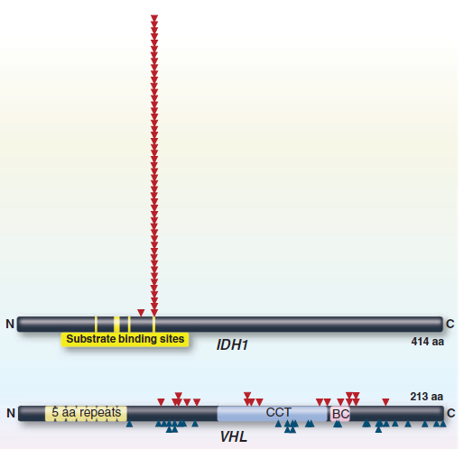
Effects of nucleotide substitusions
Disrupt the function of a protein
Loss of dunction (TSG – Tumor Suppressor Genes)
Gain of function (Oncogenes)
Affect splicing of a gene
Introduce premature termination codons (PTC).
No poly-A tail added
RNA becomes unstable, leading to degradation and gene silencing.
Affect binding sites for miRNA and other RNA-binding molecules
Important for processing, transport, translation, etc (RNA-fate)
Vogelstein, 2013, Science
Notes:
Function of mutation. TSG at variable sites (impaired function), oncogene at a single (or few) sites, gain of function
Some transcripts can be stable without polyadenylation, like ncRNA (circular is a good example). But I expect the ones with aberrant loss of poly-A to have less stable secondary structures and will thus be degraded.

Slide 27
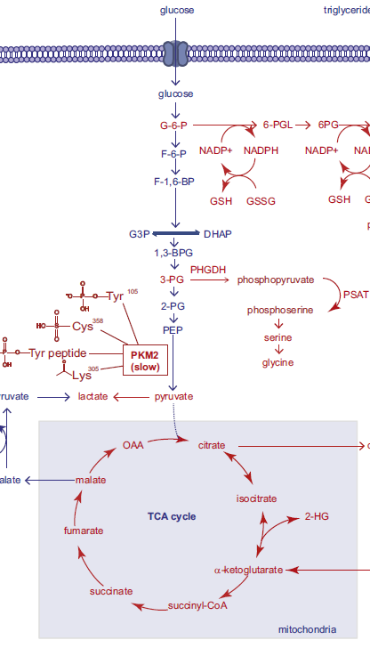
Cooperative effects of isoforms, expression changes and mutations – an example from cancer metabolism
Benjamin, 2012, Cell
Normal metabolic activity:
Glucose is converted to puryvate through a series of steps (glycolysis)
Puryvate enters the citrus (TCA) cycle for ATP energy production

Slide 28
Cooperative effects of isoforms, expression changes and mutations – an example from cancer metabolism
Benjamin, 2012, Cell
Cancer metabolic activity:
Glycolyses is diverted upstream of puryvate synthesis.
Intermediate diversions are used to produce cell-building blocks like amino acids and nucleotides through alternative pathways.
Metabolites are diverted from TCA cycle towards fatty acid synthesis.
Increased production of cell-membrane compounds and lipids for signaling.
Both processes help fuelling cell proliferation and cancer growth.
Diversion
Diversion
Notes:
This is the observations
New building blocks(amino acids, nucleotides, fatty acids etc..) are important for proliferation in cancer, so it makes sense that the cancer cell do this

Slide 29
Cooperative effects of isoforms, expression changes and mutations – an example from cancer metabolism
Benjamin, 2012, Cell
Two isoforms of PKM, PKM1 and PKM2.
Switch from PKM1 to PKM2 in cancer
PKM2 slows down the conversion from glucose to puryvate.
This leads to accumulation of intermediate products upstream of puryvate.
This enables utilization of intermediates for other purposes
PHGDH
PKM2
IDH1/2
Notes:
PKM2 probably decouples glycolysis from the TCA-cycle (recently appreviated mechanism for cancer metabolism. The TCA cycle is not abolished, but diverted!)

Slide 30
Cooperative effects of isoforms, expression changes and mutations – an example from cancer metabolism
Benjamin, 2012, Cell
Increased expression of PHGDH
diverts products in the glycolytic pathway to amino acid synthesis
Increased expression can be due to amplification of copy number
PHGDH
PKM2
IDH1/2
Notes:
Show how it is important to have all the information to get a comlpete picture. Only expression or mutation information is not sufficient! (in my opinion)

Slide 31
Cooperative effects of isoforms, expression changes and mutations – an example from cancer metabolism
Benjamin, 2012, Cell
IDH1 and IDH2is frequently mutated in cancer
Perturbs the pathway of metabolite conversions to in the TCA cycle
Increased fatty acid synthesis relative to forward TCA cycle
IDH1/2 mutations have also been shown to generate 2-hydroxyglutarate: an onco-metabolite, produced only in cancer cells
This oncometabolite have been shown to affect genome wide epigenetic signatures characteristic for cancer.
PHGDH
PKM2
IDH1/2
Notes:
Also adds epigenetics to the picture. Will present this pathway later?

Slide 32
Isoforms with opposing roles
Pal, 2012, Ph&Th
Isoforms may have overlapping, as well as distinct functions in a cell
Conflicting observations on whether a gene is a tumor supressor or oncogene often reported
Some of these conflicting observations can be due to isoforms
VEGF: Two isoforms. One isoform promotes angiogenesis (the formation of blood vessels, which is important for tumor growth). The second isoform prevents angiogenesis.
RASSF1: Two isoforms. RASSF1A is a tumor supressor, while RASSF1C has been shown to have tumor promoting effects in some cancers
Drugs should target isoforms, rather than the general gene?
Notes:
Though not all isoforms my be functional, at least some have been shown to have a function.

Slide 33
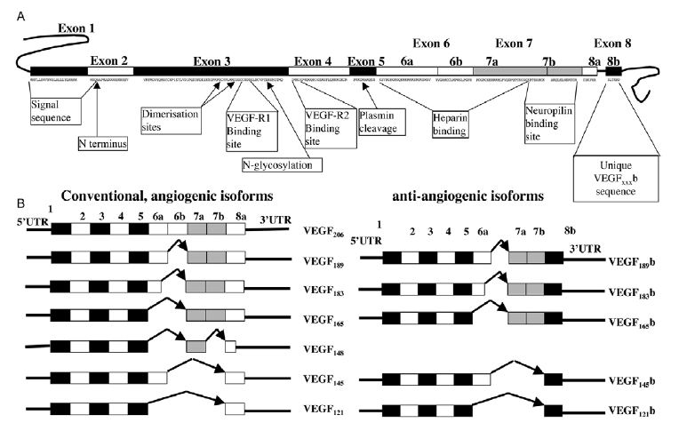
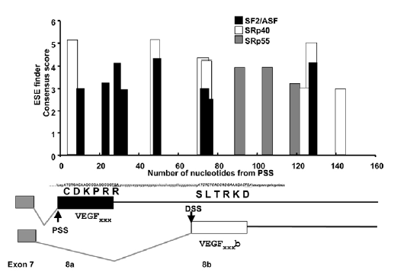
Regulation of VEGF isoforms
Nowak, 2008, JCS
Produce 12 isoforms, but pro- (ang+) and anti-angiogenic (ang-) activity is determined by difference in exon 8.
Regulation is determined by phosphorylation of proteins binding to splice enhancers
ASF2/SF2 promotes ang+
SRp55 promotes ang-
Mechanism: Binding by ang- blocks the angiogenesis signal normally relayed by ang+
Notes:
Binding of the enhancer proteins in the two cases correlates with inclusion/exlusion of the respective exons.
Actually 12 isoforms in total, but only the last exon 8 variants influence angiogenesis.
Figure: Show selection of exon 8 variants.
The bar-plot: Shows enhancers (cis-binding elements) around exon 8. See that the different enhancer-proteins bind to enhancers to promote either 8a or 8b.
It’s the phosphorylation which controls the activity of the enhancer factors
The chain of events: External stimuli – activation of kinases – phoshprylation of splice-enhancer proteins – binding to splice enhancers – alternative splicing of exon 8a/b
The b-variant is anti-angiogenic in that i binds the same receptor as the a-variant, but don’t relay the downstream angiogenic signal.
Does not say anything whether the selection of variant is due to selective phosphorylation of the SR-kinases, or due to differential expression of the splicing factors (with equal affinity for phosphorylation)

Slide 34
Gene fusions
Andrew, 2011, Genome Research
Liu, 2012, Cu-Op-Gen-Dev
Hastings, 2009, Nature
Lieber, 2008, Jrn-Biol-Chem
Combinations of exons from different genes in the same transcript.
Can result from «read-through» transcripts or chromosomal translocations, insertions, inversions and deletions
Especially prevalent in cancers, which often undergo considerable chromosomal rearrangements.
Typically caused by lesions in DNA, especially Double Strand Breaks (DSB)
Different mechanisms involving DNA-repair, replication and recombination. Many are complex and some are disputed.
Notes:
Very large field. Will only present a (selected) brief overview of the most common mechanisms

Slide 35
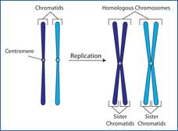
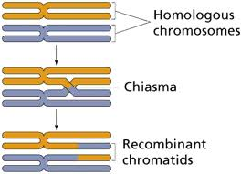
Homologous recombination (HR)
Repair double strand breaks
Involves alignment against a homologues sequence, and use this as a template to repair the damaged DNA.
Normally align to sister chromatid or homologous chromosome at the correct position, with no or little change to the chromosome
Restricted to late S and G2 phases in the cell cycle (replication dependent)
(Cross-over)
Notes:
Three terms: Sister chromatid: The replicated chromatid after replication. Should be similar.
Homologues chromosome: The same chromosome with a different parent of origin. (will be somewhat different becuase the parents are different)
LOH: Homologous chromosomes are different, for example one gene may be functional on one, and mutated on the other. They are thus heterozygous. However, if one of them is used as a template to repair the other, then the difference is lost!
Cross-over common at meiosis.

Slide 36
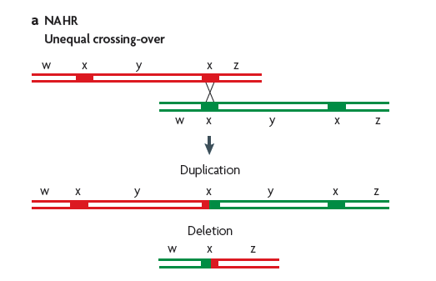
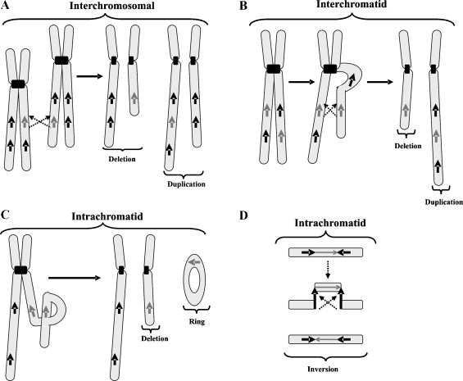
Non-allelic homologous recombination (NAHR)
Alignment of homologues sequences initiating at the wrong position
Will lead to duplication and deletion in the two chromatids involved
Homologous sequence in opposite direction > inversion.
Homologues sequence on a different chromosome > chromosomal rearrangement
Notes:
Continue from last: So, what happens when HR initiates at non-homologues sites (that is, aberrant sites)…
Figure a: Have two similar DNA-sequences, with sequence segments w-x-y-x-z (x is precent in two locations). If the first x on one chromatid aligns with the second of the other, and NAHR is performed, then the resulting chromosome changes (duplication and deletion) will be appearant.

Slide 37
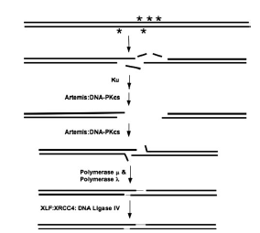
Non-Homologous End Joining - NHEJ
Can occur throughout the cell-cycle (replication independent)
Joins what remains on the DNA-ends after DSB
Three basic steps:
Removal of excess damage DNA at the DSB (nucleases)
Synthesis of new DNA (polymerases)
Joining of the newly synthesised ends (ligases)
Notes:
Microhomology optional. Not required.
Figure 1: removal, synthesis, ligation steps
Figure 2: Sequence heterogeneity caused by flexibility of enzyme use (many more than four possible)

Slide 38
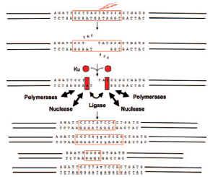
Non-Homologous End Joining - NHEJ
Flexible in the various enzymes (nucleases, polymerases and ligases) used to repair the DSBs.
Does not return DNA to the original sequence, and there is a wide range of «end-result» sequences
The combination of enzymes may produce different sequences at the fusion junction
Notes:
The sequence variation at the breakpoint is also how you can recognise them.
Microhomology optional. Not required.
Figure 1: removal, synthesis, ligation steps
Figure 2: Sequence heterogeneity caused by flexibility of enzyme use (many more than four possible)

Slide 39
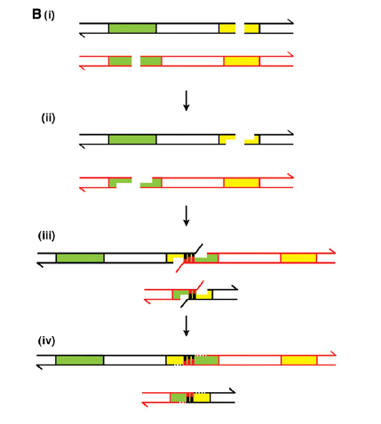
Non-Homologous End Joining - NHEJ
Chromosomal rearrangements caused by ligating DNA ends from different (nearby) DSBs

Slide 40
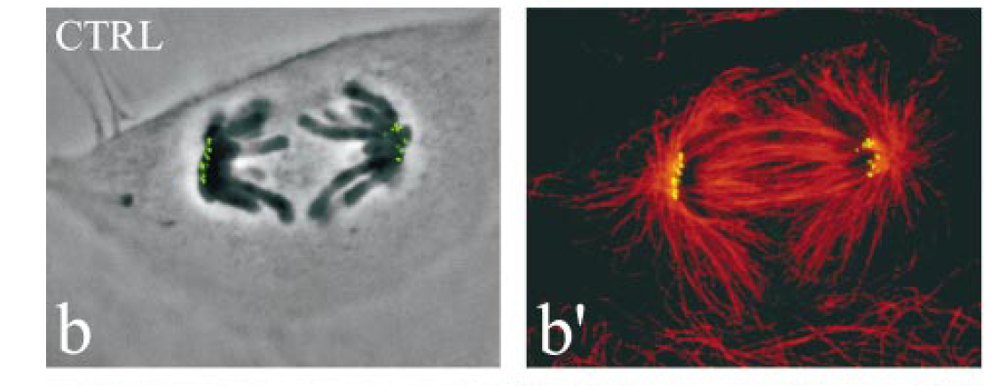
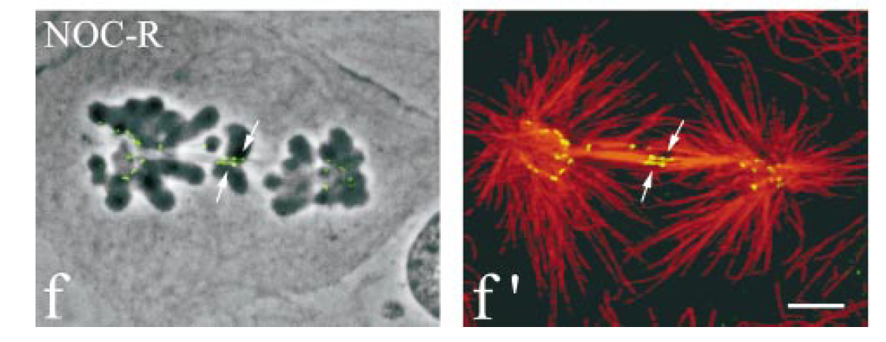
Aberrant expression of mitotic checkpoint genes
Normal cells
Altered cells
Unbalanced distribution of chromosomes to daughter cells
Cimini et al., 2001, Jrn Cell Biology
Notes:
Upregulation or mutation in mitotic checkpoint genes lead to aberranr segregation of chromosomes.

Slide 41
Other suggested mechanism
Replication independent
Single-strand annealing (SSA)
Microhomology-mediated end joining (MMEJ)
Replication dependent
Break-induced replication (BIR)
Microhomology-mediated break-induced replication (MMBIR).
Fork stalling and template switching (FoSTeS)
Which mechanisms that are most common are disputed (as well as their mechanisms of action)
Notes:
As I said, many mechanisms, some are disputed. These are just examples. I chose to present these becuase they were most easy to illustrate and were based on simple principles. Do not need to be the most common mechanisms.
(For example: TMPRSS2-ERG in prostate cancer, one of the most well known cancer fusions, is most likely due to NHEJ. They have found this by looking at sequence features at the break-points, and find that they most likely resemble rearrangements caused by NHEJ.
Chromotripsis: A massive rearrangement happening at the same time. Replication dependent. Massive stall in replication, cause replication complexes to start replicating at other chromosomes, whill still attached to the previous chromosome?

Slide 42
Genome Breakdown: Chromothripsis
Massive cancer-associated genomic rearrangements that occur in a very short time-interval (a «one-off» event)
Revealed by NGS studies, and reported to occur in a subset of cancers
May affect one or several chromosomes
Various mechanisms proposed, involving NHEJ or MMBIR
Notes:
Massive chromosomal translocations in cancers. Two examples of how they might occur: example 2:
Replication complex travels along the DNA, but stop (stalled) under stress. This leaves a dsDNA end
Additional note: Sometimes only one chromosome affected. Speculated that this can be caused by chromosomes entering micro-nuclei, where they are highly instable, get rearranged, and re-incoroprated into the nucleus. Highly speculative
Microhomology is in contrast to the extensive homology required for NAHR

Slide 43
Long non-coding RNA (lncRNA)
Are stabilised by capping, splicing as normal mRNA.
Length > 200nt (average 1000 nt, can be up to 100kb)
Various shapes (for example circular)
Can be poly-adenylated.
Are detectable by RNA-Seq
Some are transported to the cytoplasm, while others remain in the nucleus
Notes:
They are capped, spliced and poly-adenylated. In many ways, they look like normal mRNA, only that they are npt translated.
It has been speculated that many of the ORF-genes are actually more resembling lncRNA…

Slide 44
Long non-coding RNA (lncRNA)
Not translated into protein (though it has been shown that many translate short reading frames into peptides)
Complete catalogues do not exist yet, but current estimates suggest about 20-40 000 lncRNAs in human.
More cell-type specific expression patterns compared to coding genes
There are also many other classes of short and long ncRNA, however these are not always so easily detected by RNA-Seq, often because of low abundance.
Notes:
They are capped, spliced and poly-adenylated. In many ways, they look like normal mRNA, only that they are npt translated.
It has been speculated that many of the ORF-genes are actually more resembling lncRNA…

Slide 45
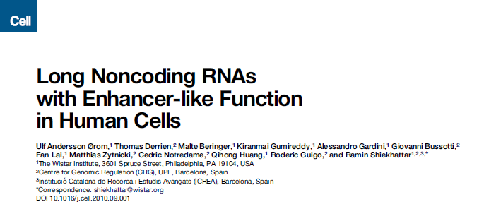
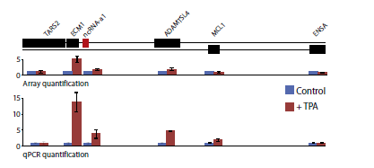
LncRNA affect expression of nearby genes
Ørom, 2010, Cell
Activating (enhancer) effect on nearby genes
May also repress nearby genes (imprinting, X-inactivation)
May also affect nearby genes in a sense/antisense manner (cis-effect)
May also show more long range effects, regulating distant genes on other chromosomes (trans-effect)
Effects may be context specific (e.g. different in various cell types)
Note: A transcript may act as a lncRNA in one context, but be protein-coding in another context.

Slide 46
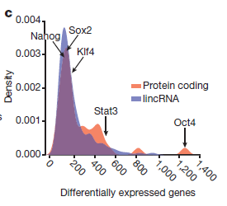
LncRNA – function: importance for Embryonic Stem Cell (ESC) State
Guttman, 2011, Nature
Loss-of-function studies for 147 lncRNAs expressed in Embryonic Stem Cells (mouse)
Has a strong effect on gene expression comparable to that of well-known ESC regulators
The effect is comparable both in number of genes affected, and on expression level changes
The effects are both activating and repressing in approximately equal amounts
Few lncRNAs showed only local effects. Most lncRNAs act in trans
Notes:
The figure show number of differentially expressed genes (genes affected) after knockdown of 40 stem-cell proteins and 147 lncRNA. Not sure what density is, but could be related to number of lncRNA/proteins affecting certain number of genes (more affect <600, and less affect >600)

Slide 47
Imprinting
Whitehead, 2009, B&B acta
Gene cluster which show parent-of-origin specific expression patterns
Non-coding RNAs are often found within these clusters
The ncRNA is only expressed on the paternal or maternal chromosome
Similar mechanism also implied for the full chromosomal imprinting of one of the X-chromosomes in females (X-chromosome inactivation)

Slide 49
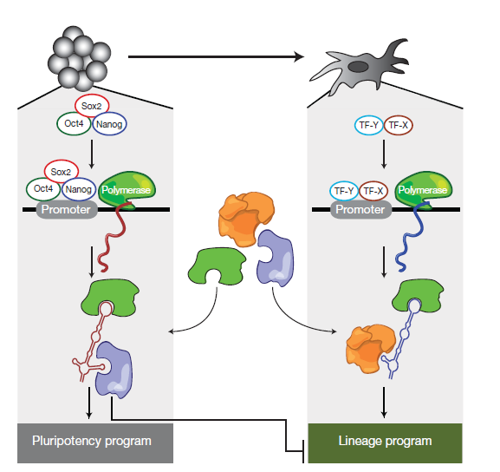
Various modes of lncRNA action (suggested)
Commonly agreed:
Work through epigenetic mechanisms
Form secondary structures which are probably important for their function and association to other proteins
lncRNA provide scaffolds for chromatin modifying enzymes in a context specific manner
May act both in cis (same molecule) and trans (different molecule, for example like a transcription factor)
May act on DNA through sequence homology/complementarity, or through associated scaffold proteins

Slide 50
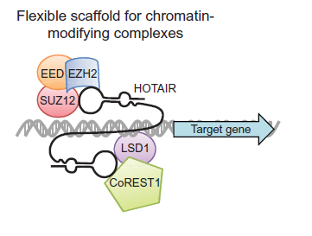
lncRNA scaffold - HOTAIR
Tsai, 2010, Science
Polycomb Repressive Complex 2 (PRC2) catalyses H3K27me3 (repressive modification)
LSD1 complex catalyses de-methylation of H3K4me (remove the active mark)
5’end domain of HOTAIR binds PRC2, while the 3’end domain binds LSD1
Efficient repression of targets by both active removal of H3K4me and deposition of H3K27me3.
PRC2

