Slide 1
RNA-Seq - Introduction
BI311F-1 20V Akvagenomikk og bioinformatikk
Robin Mjelle

Slide 2
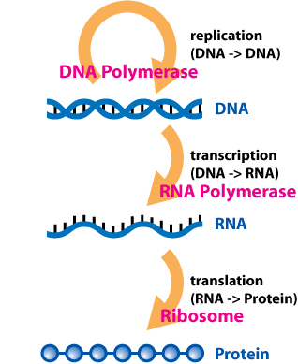
Central dogma of molecular biology
First stated by Francis Crick in 1958
DNA > RNA > Protein
Protein coding genes transcribed in the nucleus by RNA Polymerase 2 (Pol 2) using DNA as a template
Exported out of the nucleus to the ribosome for translation into protein

Slide 3
The transcript
pre-mRNA
5’ UTR
Intron
Intron
3’ UTR
5’ cap
Exon
Exon
Exon
AAAAAAAAAA
Poly-A tail
5’ cap: Modification to the 5’ end of transcripts produced by Pol 2. Happens immediately after transcription initiation.
5’ UTR: The untranslated region at the 5’ end of pre-mRNA and mRNA
Exons: Protein coding part of the pre-mRNA
Introns: Non-protein coding part of the pre-mRNA
3’ UTR: The untranslated region at the 5’ end of pre-mRNA and mRNA. Important for post-transcriptional regulation of mRNA.
Polyadenylation (poly-A) tail: 150-200 A’s added to the end of the transcript.
Both the 5’ cap and poly-A tail are important for the recognition of a proper transcript by protein complexes, and export from the nucleus for translation
Notes:
Capping happens after 25-30 nt of transcription.
Does anyone know when exons were discovered? (1977)
Also note: Introns are much longer than exons! (2% of genome (exons) vs 40% (exons and introns)

Slide 4
The transcript
Processed and spliced mRNA: Introns are removed
5’ cap
5’ UTR
3’ UTR
AAAAAAAAAA
Coding RNA
Poly-A tail
Capping, splicing and poly-A addition occurs co-transcriptionally. Processed, stable mRNA is abundant compared to pre-mRNA.
You may have stable mRNAs and other short RNAs that are not protein coding, in addition to ribosomal RNA (rRNA) and transfer RNA (tRNA)
Transcription happens from most of the genome (60-80%), but only ~2% is protein coding.
Facts:
Average 5-9 exons pr gene
Average exon length: 235 bp
Average pre-mRNA transcript length: 55 kb
Average protein-coding mRNA length: 2.2kb
Average number of transcripts from one gene in a single cell: 10-15
Question: How much of the total RNA produced by the cell is «proper» mRNA?
Notes:
Note: The previous slide display a model used for illustration. The pre-mRNA rarely look like this. Processing of pre-mRNA (like intron removal) happen already during transcrition. When the poly-A-tail is added, most of the transcript is already processed.
Protein coding with introns is ~40%
This is what you actually sequence
Ask: How much of the total RNA produced by a cell is «proper» mRNA?
This is actually what we sequence!
Some of the non-coding RNA species will have this form (point to the illustration), others will not (short miRNA, rRNA, tRNA)
The ribosomal part may have important implications for sequencing.

Slide 5
The transcript
Processed and spliced mRNA: Introns are removed
5’ cap
5’ UTR
3’ UTR
AAAAAAAAAA
Coding RNA
Poly-A tail
Capping, splicing and poly-A addition occurs co-transcriptionally. Processed, stable mRNA is abundant compared to pre-mRNA.
You may have stable mRNAs and other short RNAs that are not protein coding
Transcription happens from most of the genome (60-80%), but only ~2% is protein coding.
Facts:
Average 5-9 exons pr gene
Average exon length: 235 bp
Average pre-mRNA transcript length: 55 kb
Average protein-coding mRNA length: 2.2kb
Average number of transcripts from one gene in a single cell: 10-15
But, the far most abundant RNA in a cell is ribosomal RNA. Only 3-5% of RNA is properly processed mRNA. However, Ribosomal RNA is transcribed by Pol 1 and 3, and is thus not capped and poly-adenylated.
Notes:
The ribosomal part may have important implications for sequencing.

Slide 6
Transcriptomics
Understanding the transcriptome is essential for:
Interpreting the functional elements of the genome
Revealing the molecular constituents of cells and tissues
Understanding development and disease
The goal of transcriptomics is:
To catalogue all species of transcript, including mRNAs, non-coding RNAs and small RNAs
To determine the transcriptional structure of genes, in terms of their start sites, 5’ and 3’ ends, splicing patterns and other post-transcriptional modifications
To quantify the changing expression levels of each transcript during development and under different conditions.
Wang, 2009, Nature
Notes:
References are found in the reference list. I put them where they belong on the slides so it is easier for you to look

Slide 7
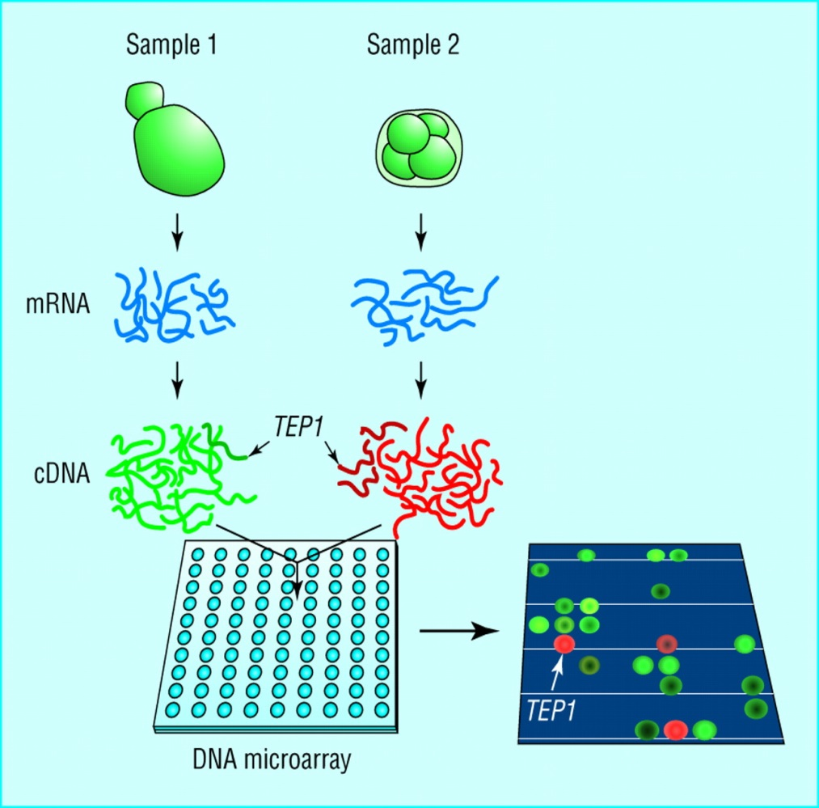
Microarrays
Previous gold standard for transcriptome analysis
Hybridization based on pre-defined probes
commonly 3’UTR is targeted
Mostly used for gene expression studies, though customised arrays for SNPs and splice-events also exist.
Notes:
How it was usually done..
SNP-arrays are still common (as einar probably said).
Though generally cheap, interrogation of splice-variants and more extensive genome mappings are more expensive (becuase they are larger and more specialized), and generally inconvenient.
Probes map to 3’UTR is common in microarrays (though you also have other arrays, like exon arrays)
Though RNA-Seq has «taken over» as a golden standard, a lot of previous data is available as microarray. This is important to integrate in bioinformatics studies. Several examples from ECCB18 in Athens. Important to know the relation between microarray and RNA-Seq based transcriptomics (even though arrays are today deprecated!)

Slide 8
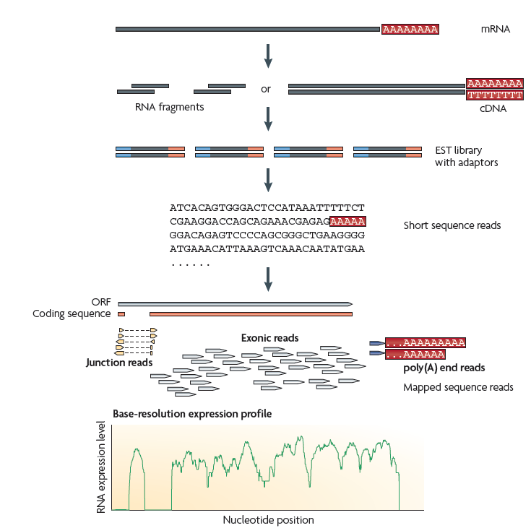
RNA-Sequencing (RNA-Seq)
Captured RNA
Fragmentation (200-500 bp), reverse transcription into cDNA, amplification
Sequencing (50-150 bp)
Alignment to reference genome
Analysis of read enrichment profile
Wang, 2009, Nature
Notes:
Poly-A ends cannot be aligned, of course.
Challenge: Junction reads cannot be aligned directly to the genome.
Sequencing length depending on technology. Most common: Illumina: Now typicalla up to 100 bp (paired-end)
An ORF (Open Reading Frame – The sequence from the start-codon to the stop-codon.) Is not the full length transcript, becuase it do not contain 3’ and 5’ UTR, but do contain the introns. (ORF-term mostly used for prokaryotes which have no introns)
The difference between cDNA and DNA: cDNA is constructed from RNA, and is thus not «real» DNA, but DNA that match to the transcriptome, and not the genome. The term means complementary-DNA (NOT coding DNA!)

Slide 9
Advantages with RNA-Seq
Analyse gene-expression and sequence features in the same run. MA: need different sets of probes for different features
Unbiased selection of sequences. MA: Dependent on pre-defined probes
Unlimited dynamic range of transcript expression. MA: Limited by saturation and background noise
Identification and annotation of novel transcripts: MA: Possible, but not very feasable
Profiling of entire transcript. MA: Probes target only a small portion of the transcript
Wang, 2009, Nature
Oszolak, 2011, Nature
Marioni, 2008, Gen. Res.
Notes:
For identification of new transcriptional features in MA, you will need quite many probes. Impractical.
Unbiased: Can be re-analysed for new biological quaestions.

Slide 10
Advantages with RNA-Seq
Good technical reproducability (at least better..) MA: More technical noise
Sequence variation can reveal allele specific expression: MA: Not possible
Can reveal novel splice-sites, gene starts and gene ends. MA: Not possible
Notes:
Q: Not talk about strategies for allele specific expression. Probably by looking at sequence variation?
Protocol differences hampers reproducability in RNA-Seq as well!

Slide 11
Problems with both technologies
Compare transcript levels within a sample from the same run. MA: Different efficiency of hybridization probes RS: Transcripts are not sequenced with equal probability.
Repeat regions in the genome. MA: Probes are not specific RS: Ambiguous sequence mapping.
Lowly expressed transcripts. MA: Not detectable due to background noise RS: Not detectable due to abundance of other transcripts
Notes:
First point: RNA-Seq is better at this. Can use counts as a pseudo for relative levels of transcripts within a coarse scale (like 100 vs 1000 vs 10 000)
Due to lack of information on what is actually the sequence bias in RNA-Seq programs usually assume equal sequence probability. This seems to work fairly well (and is reproducable), so could assume it?

Slide 12
Problems with both technologies
Reproducability between experiments MA: Difficult to compare experiments RS: Differences due to selection of sequencing protocols.
Notes:
Due to lack of information on what is actually the sequence bias in RNA-Seq programs usually assume equal sequence probability.

Slide 13
Advantages with microarrays(?)
Mature technology, and more standardised analysis. RS: 2019: RNA-Seq has also matured. Standardized and efficient analysis established (at gene level).
Cost of analysis. RS: For pure expression analysis which require less sequence reads, prices are now comparable.
Storage and processing time. RS: More data is also more information.
Microarray data not sensitive RS: Develop solutions to secure (or remove) the sensitive sequence data after processing
Notes:
P1: Standardized in terms of genes. Not yet in terms of isoforms and splicing
P4: Sensitive? No sequence information in MA, less reuirements of secure storage etc…

Slide 14
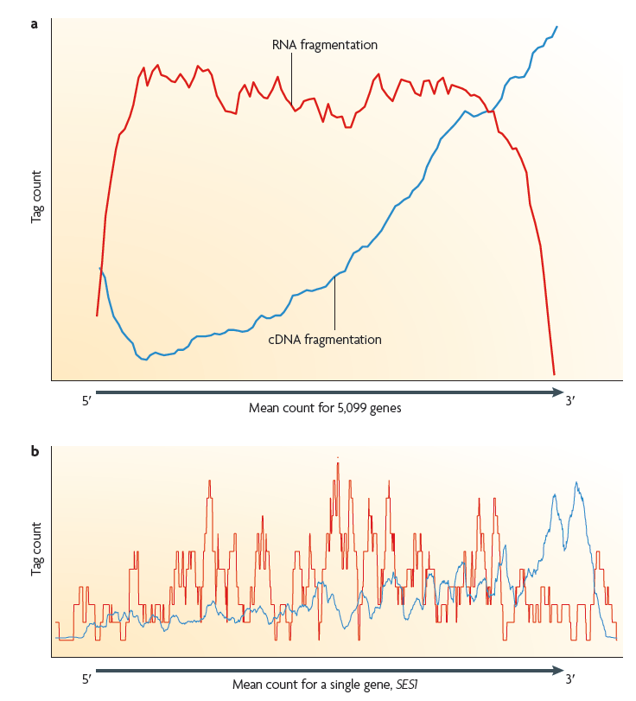
RNA-Seq callenges
Domination of abundant transcripts.
Kits that remove abundant transcripts are becoming more available.
Non uniform sequencing preferences across genes
Notes:
Depending on protocols. Depletion at 5’end of genes. Also variations in exon abundance.

Slide 15
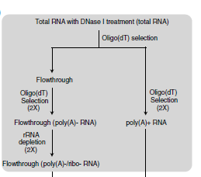
What to sequence? Poly-A selection vs ribosomal depletion
95% of RNA is ribosomal. How to enrich for proper mRNA?
Select for polyadenylated transcripts (poly(A)+ protocol)
A number of functional long transcripts are known to lack poly(A) tails.
Remove ribsomal RNA from the sample before sequencing
Notes:
Remember that ribosomal is not polyadenylated
Poly-A selection was common in the first RNA-Seq expriments
Ribosomal depletion is becoming the more standard method
Dnase I treatment is the fragmentation method
Oligo(dT) selection is a method to select specific RNAs (don’t have the details). Based on chromatography..?

Slide 16
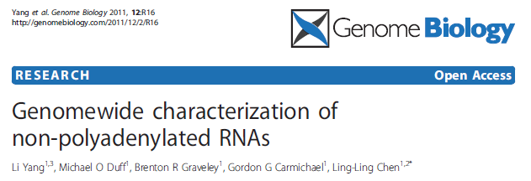
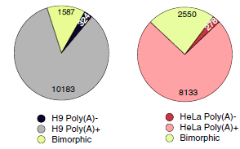
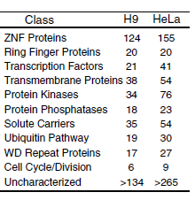
Polyadenylation
Most transcripts are poly(A)+
Some transcripts are bimorphic (can exist as both poly(A)+ and poly(A)-
Fewer transcripts are poly(A)-
Poly(A)- transcripts include some long non-coding RNAs, a few histones and intronic sequences
Bimorphic transcripts
Notes:
Based on this study, most RNA-entities are also captured by Poly-A+
PolyA(-) are over-represented in some functional categories (also bimorphic transcripts?)
By most transcripts we don’t mean most transcripts in general, but most unique transcripts (transcript identities)
(A significant amount of transcripts (25%?) may contain non-classical, shorter poly-A tails.
(Introns can be lncRNA, usually not poly-adenylated (but are they capped?))

Slide 17
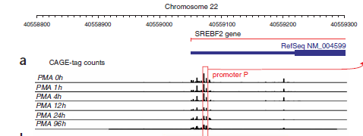
Cap Analysis of Gene Expression (CAGE)
Fantom Consortium, 2009, Nature
Sequencing of Transcription Start Sites (TSS)
Most transcribed RNA is modified (capped) at its 5’end, indicative of the point of transcript initiation.
Selection of capped RNA-fragments.
CAGE: Selection of capped RNA. Sequencing from the capped end in the direction of transcription, making the sequences strand specific.
Alignment of sequences to reference genome gives a genome wide map of TSS at single bp resolution for the cell line sequenced.
The number of aligned sequences at a given position indicative of the relative expression of the respective TSS.
Sensitive to alternative TSS and non-coding transcripts.

Slide 18
Strand specific protocols
Standard RNA-Seq approaches generally require double-stranded cDNA synthesis, which erases RNA-strand information
Three approaches:
Ligation of adaptors in a predetermined orientation to ends of RNAs or to first strand cDNA molecules
Direct sequencing of first strand DNA cDNA
Chemical marking of second strand cDNA synthesis products
Protocols may give different results

Slide 19
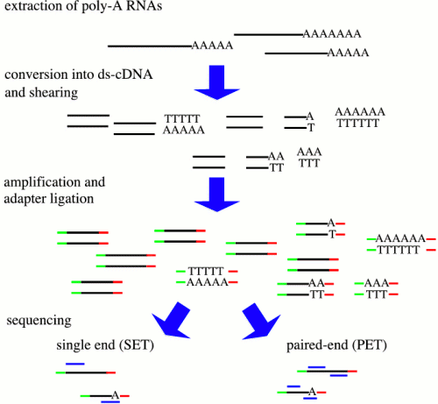
Paired-end Sequencing
Sequencing cDNA from both ends ranther than a single end
Recommended for splice-variants and gene fusions
RNA-Seq standard now: Paired-end 150bp (75 bp from each end)
More challenging to process and analyse, (but the software will usually handle this for you…)
Notes:
2019: Standard now 2x100 and 2x150

Slide 20
Sequencing depth
Coverage not straightforward in RNA-Seq, due to different abundance of transcripts
Depend on:
Expression of transcript
Protocol or assay used (for example removal of abundant transcripts)
Sequenced read length and mappability to reference genome
Sample material (homogeneous cell cultures versus heterogenous tissue samples?)
What you want to find!
Expression changes: 10-15 million reads
Isoforms and gene fusions: 30-50 million reads (or more)
Low-abundance transcripts and SNVs (??) – Consider targeted sequencing
Notes:
2019: targeted sequencing. Becomes more popular again. Higher abundance of the genes you want to study for a specific question.

Slide 21
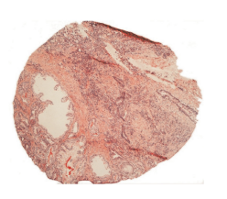
Sequencing depth
Example: Heterogenous prostate cancer tissue sample:
50% cancer tissue,
20% stroma
30% benign epithelium
Bertilsson,2010,Prostate
Sequence 50 million reads:
Mapping to reference genome: 80% (40 million reads)
Sample composition (50% cancer): 20 million cancer related reads
Notes:
Note. The estimate is old. And what is an expressed exon? Probably updated numbers of thid if you look for it…

Slide 22
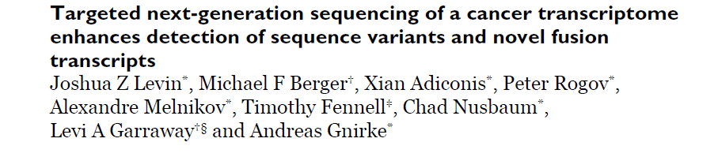
Targeted sequencing
Increase sequencing depth by only sequencing a selected subset of transcripts
Good approach if you know what you are looking for
Are becoming increasingly affordable
Levin et al. :
Selected 467 cancer related genes, and sequenced 8 million reads.
95-98% of reads mapped to the selected sequences, compared to 5% without selection
Achieve a sequencing depth for target genes many-fold higher than what is practically possible by full-transcriptome sequencing

Slide 23
Current and future developments of RNA-Seq
Smaller amount of sample material.
Single-cell RNA-Seq
Standardisation of processing and analysis pipelines for all aspects of transcript analysis.
Cheaper sequencing due to technology development
Continued development og new sequencing kits
Stranded sense/antisense protocols,
Better methods for ribosomal RNA depletion for selection of non-poly(A) species. (Especially important for prokaryotes)
Specialised protocols, for example ribosomal mRNA («translatome») or targeting classes of non-coding RNAs
Kits that offer several mRNA entities from the same sample
Customized gene panels
longer sequences, up to full length RNAs.
Notes:
Prokaryote mRNA not polyadenylated. Degradation signal.
Full-length and longer not standard yet. Suffer from long anundance

Slide 24
Gene expression and protein level/activity
Proteins and their activity status are mainly responsible for the phenotype and functionality in a cell
What does the expression level of RNA tell us about protein level or activity?
Notes:
Often see in paper that expression of a gene is automatically interpreted that the potein this gene procuses is active! Tempting to do in lack of other data

Slide 25
Gene expression and protein level/activity
General poor correlation between mRNA expression and protein levels (~0.4)
A single mRNA can produce many proteins
Post-transcriptional regulation of mRNA, for example by micro-RNAs
Longer half-lifes of proteins than mRNA. They may persist and function, even if new proteins are not produced.
Including translation rate has shown to improve the correlation
Even poorere correlation between expression level and protein activity:
Largely influenced by Post-translational modifications as well as other factors
Notes:
PTMs. Do not affect the actual protein-level directly (though certain PTM can target protein for degradation) but comsidrably influence the effect of the protein (in term of phenotypic effect)

Slide 26
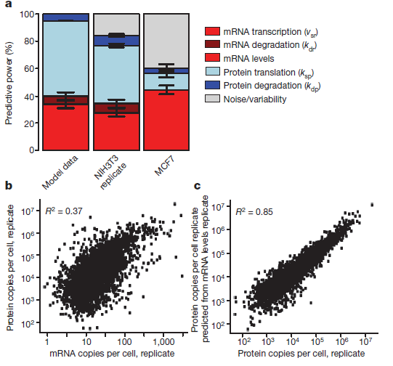
Gene expression and protein function
Schwannhausser, 2011,Nature
Notes:
mRNA transcription and mRNA levels (red) account for a large part of the protein levels, while translation rates are maybe the most important (ligh blue) mRNA (dark red) and protein degradation (dark blue) accounts for only a small part of the correlation. A significant part of the variation is still unexplained.. (grey).
NIH3T3 is experimental cell-line (mouse fibroblasts)
In the MCF7 cell-line the used the translation rates derived from the NIH3T3 cell line in another cell-line (MCF7). MCF7 is a human breast cancer cell line, so this also show the transfer of translation rates to orthologues genes in another organism and cell-type (and cancer.. Can’t be much more different.. Normal mouse to human cancer in different tissue)
Improved correlation when translation rate is included

Slide 27
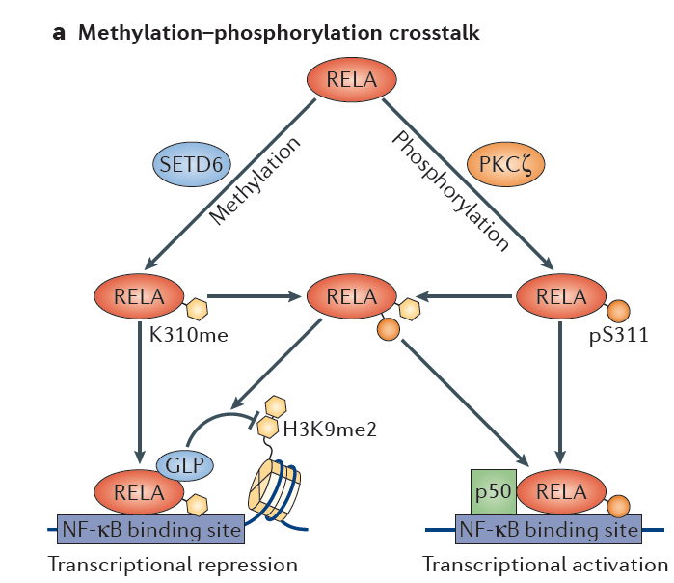
Protein level and activity
Adapted from Biggar, 2015, Nature
Notes:
RELA part of the NFkB-complex involved in immune response.
RELA can be methylated at K310 by SETD6, for which it binds iwth GLP and repress activation of downstream gene
RELA can be phosphorylated at S311 by PKCgamma, for which is associates with p50 and activates transcription. Different activity, but same level of protein (and mRNA?)

Slide 28
Why mRNA?
mRNA levels are reproducable and easy to measure compared to proteomes, translation rates etc..
The most accessible «surrogate» to protein expression levels.
RNA has been studied for a long time
Lots of data available
Functional annotations and genesets from RNA widely available
RNA is the «hub» wich link your data to huge public resources.
Always include RNA in your experiment if you can!

