Slide 1
Verifying Current Sensing
ADC: 6.666 kSa/s
logic analyzer: 31.25kSa/s

Slide 2
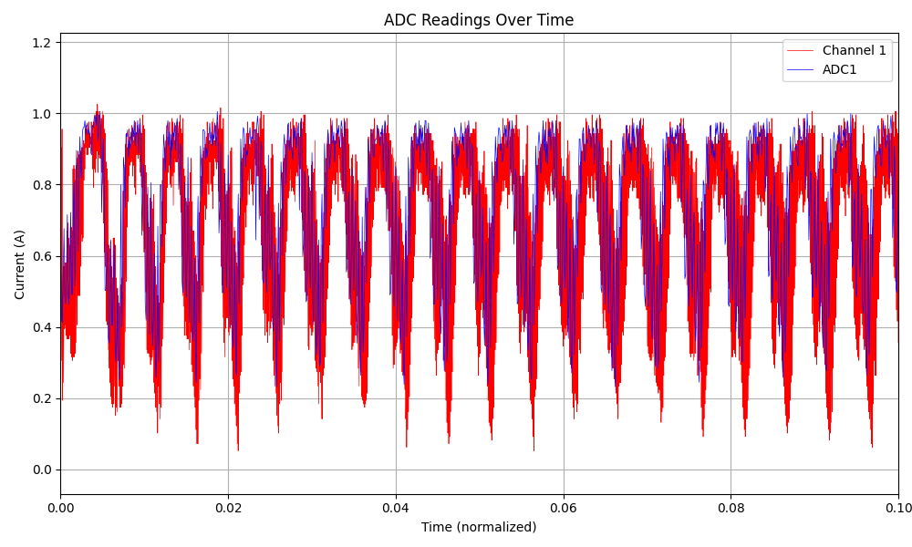
ADC and Scope Comparison

Slide 3
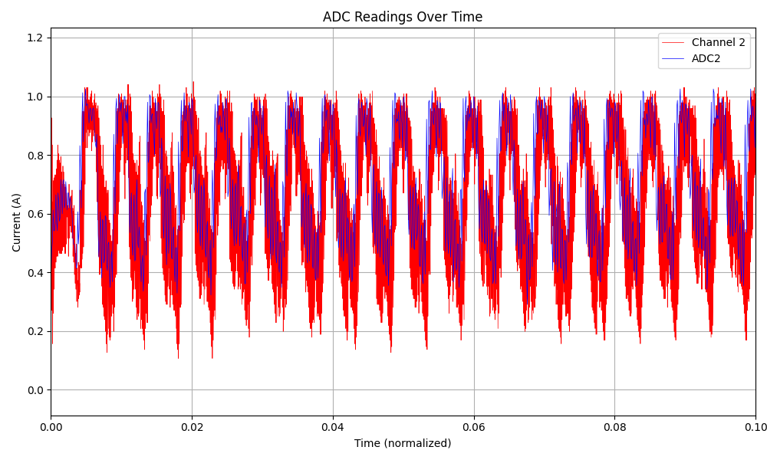
ADC and Scope Comparison

Slide 4
Verifying FOC Current Control
All data collected from teensy 4.0 streamed out over UART after collection

Slide 5
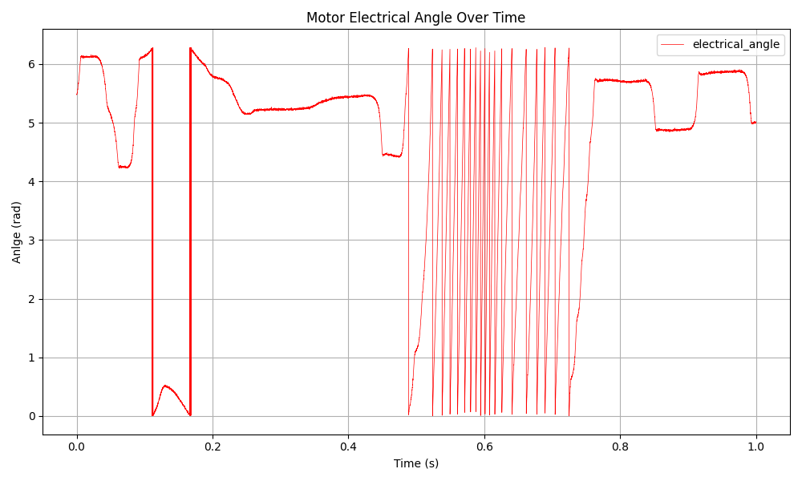
Motor Electrical Angle

Slide 6
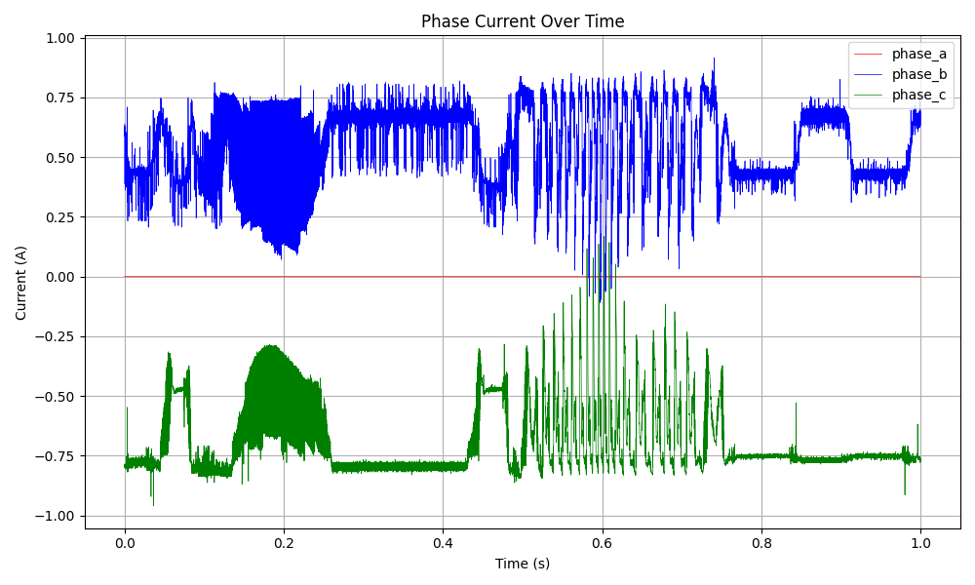
Phase Currents

Slide 7
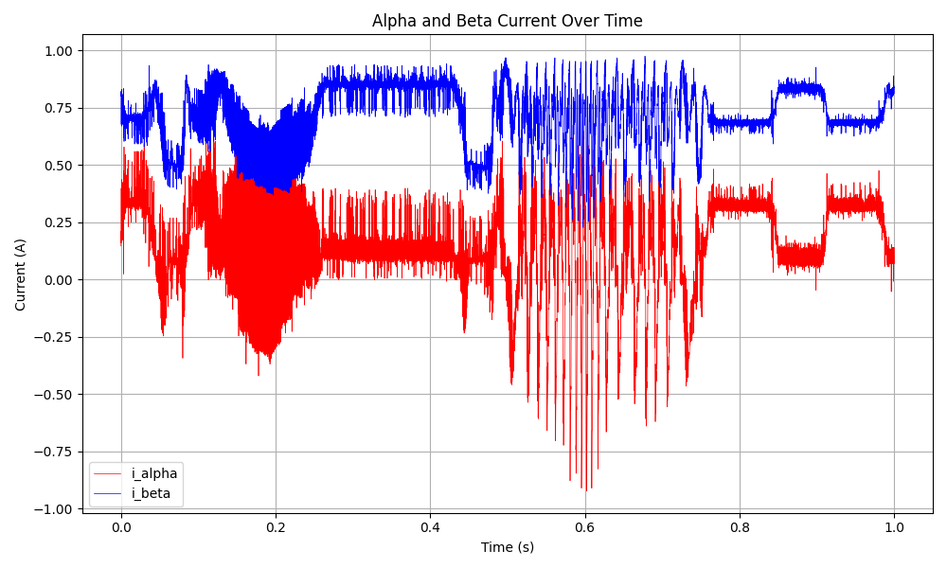
Alpha and Beta Currents

Slide 8
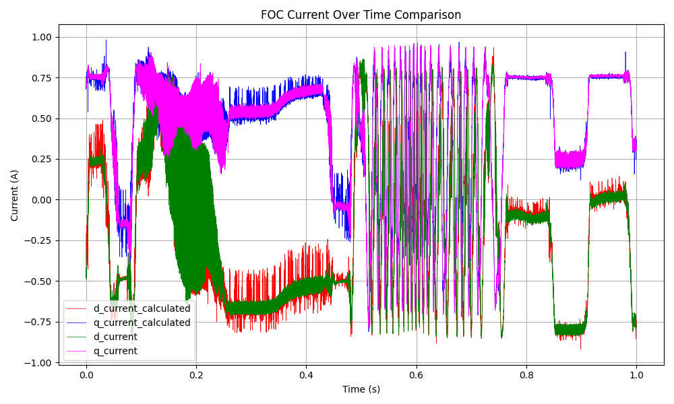
FOC Currents Comparison

Slide 9
Conclusions
FOC transformations are correct in library
FOC current control is clearly working when the motor is held still

Slide 10
Testing simpleFOC library position control
All data collected from teensy 4.0 streamed out over UART after collection

Slide 11
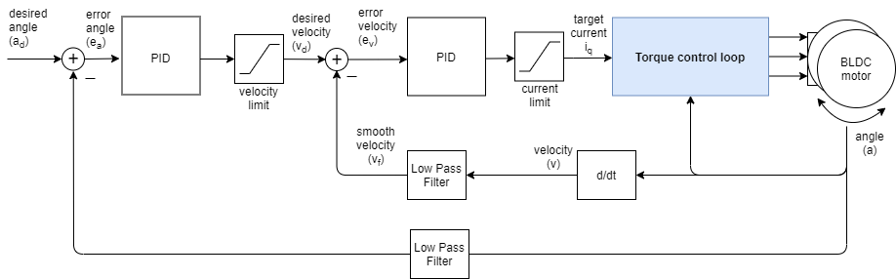
Does the library allow you to use FOC current control?

Slide 12
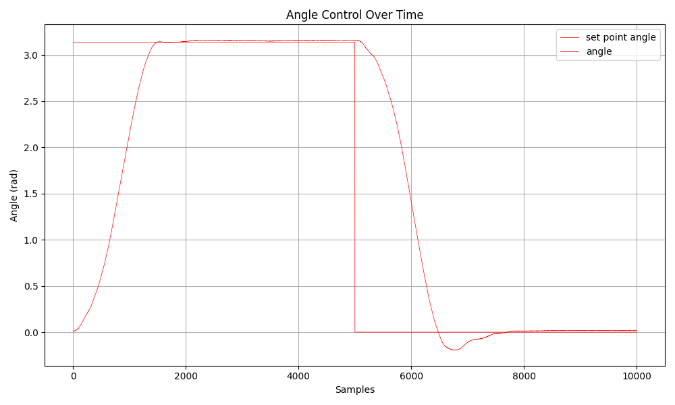
Angle

Slide 13
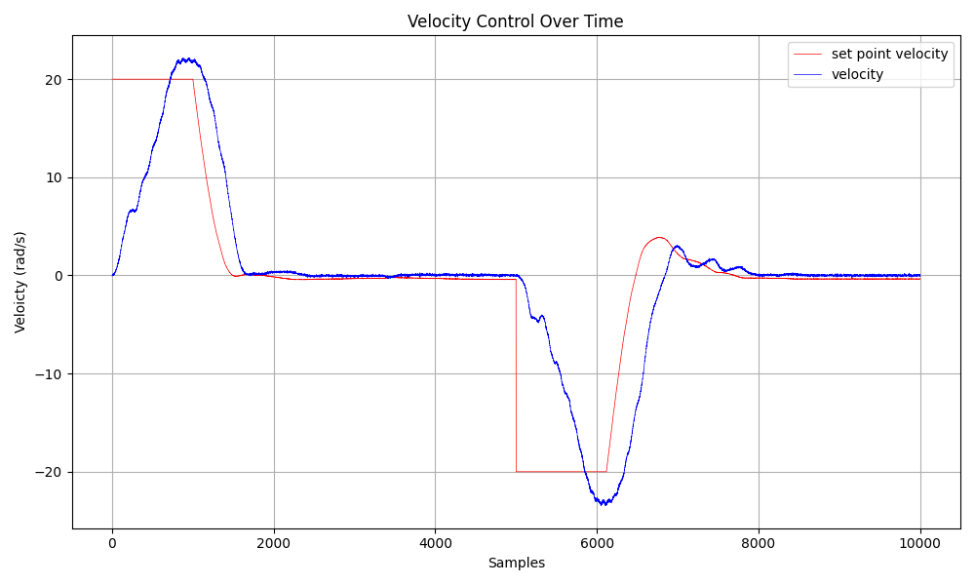
Velocity

Slide 14
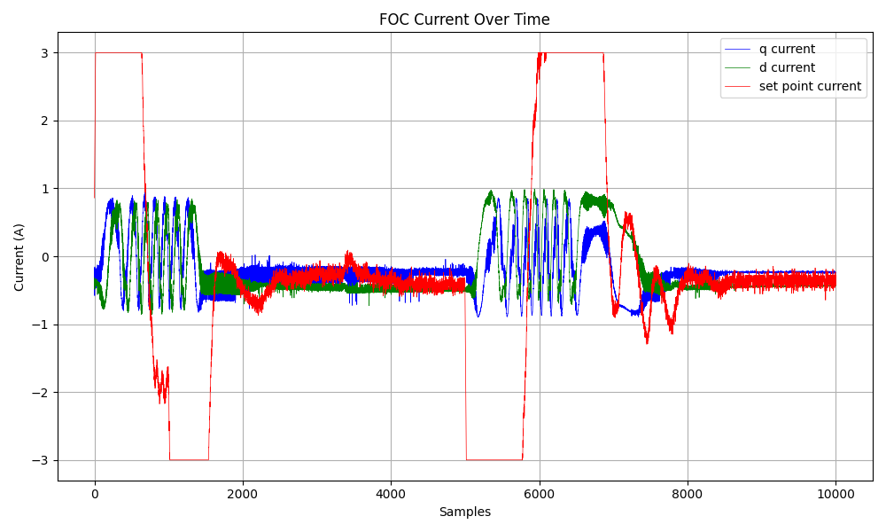
FOC Current

Slide 15
Conclusions
Library does allow you to use the FOC current control within the position controller

Slide 16
Mechanical Design Updates

Slide 17
Battery Selection and DC/DC Converter Selection

Slide 18
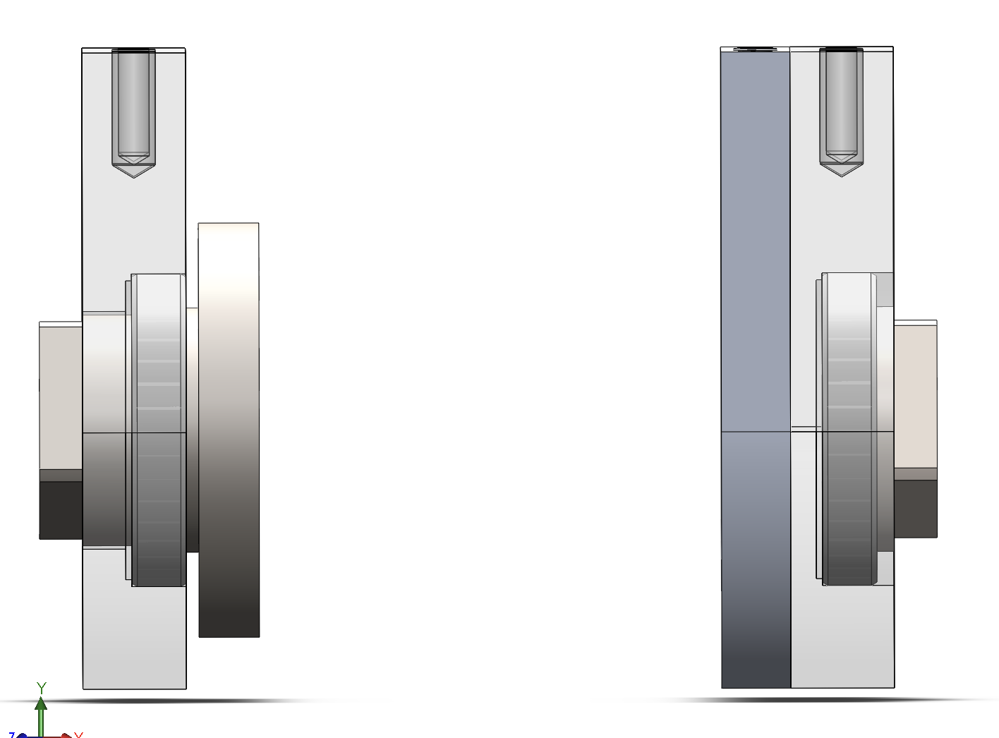
Updated Bearing and Shaft Interfaces

Slide 19
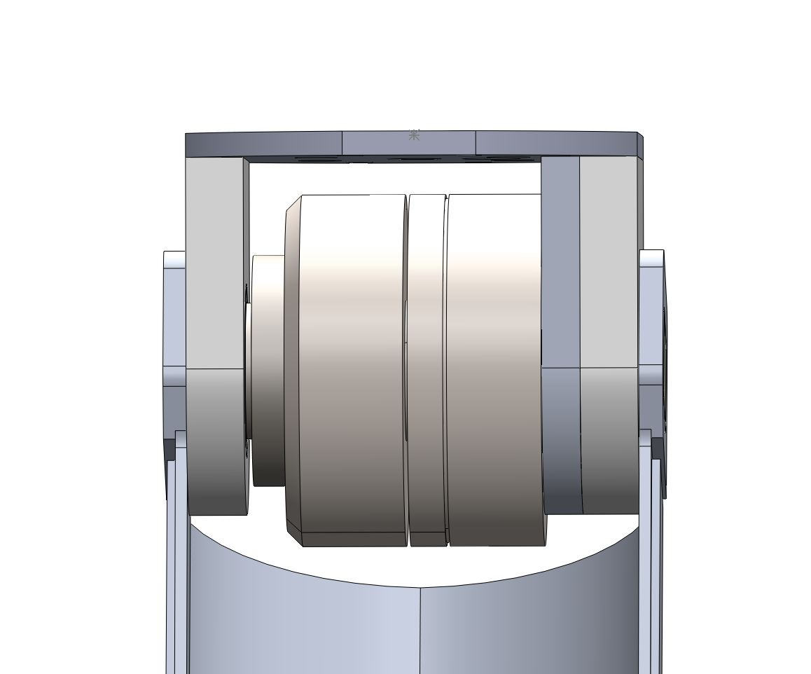
Updated Clearance Inside Housing

Slide 20
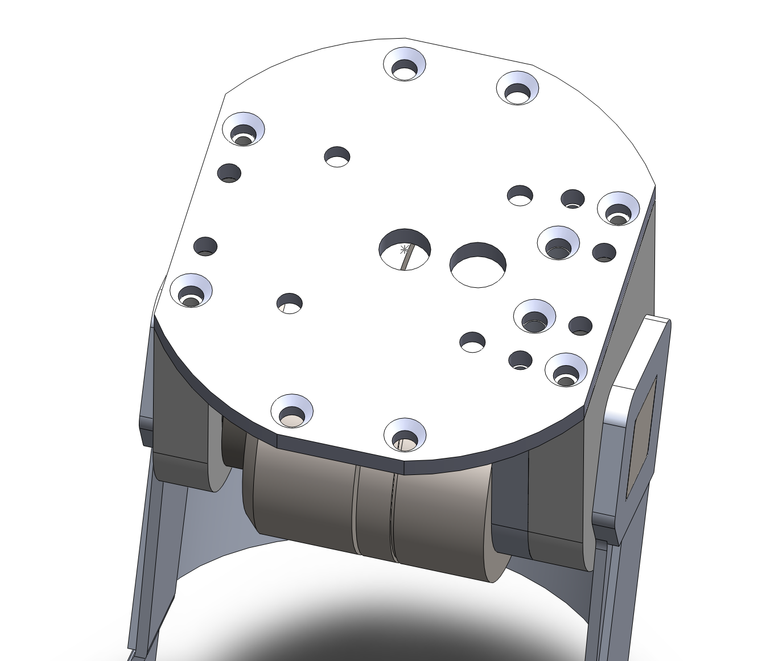
How can we allow the screw to interface with many different sockets?

Slide 21
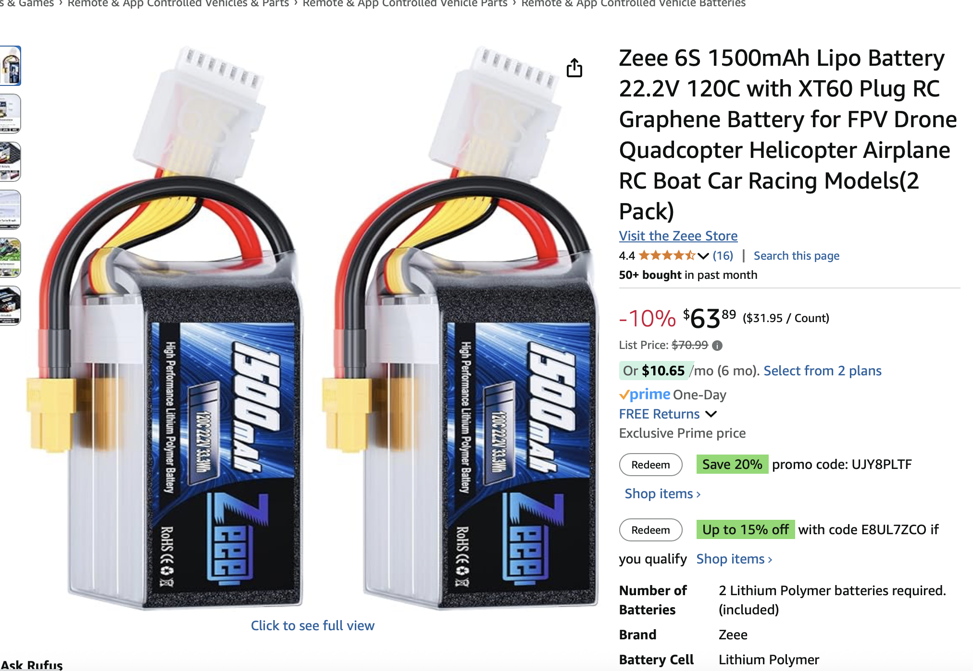
Battery
Lifespan: 0.72 hours
Weight: 240g
sheets

Slide 22
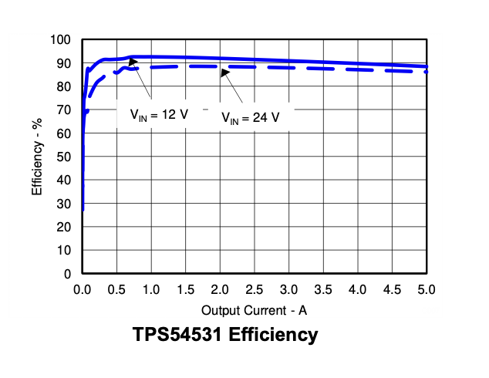
DC/DC Converter 1
Buck Switching Regulator IC Positive Adjustable 0.8V 1 Output 5A 8-PowerSOIC (0.154", 3.90mm Width)

Slide 23
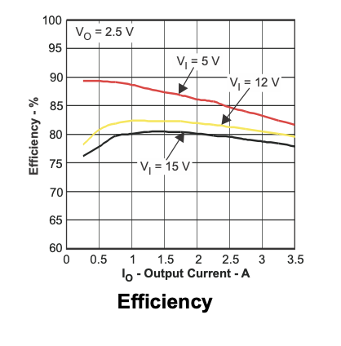
DC/DC Converter 2
Buck Switching Regulator IC Positive Adjustable 0.8V 1 Output 3.5A 8-PowerSOIC (0.154", 3.90mm Width)

Slide 24
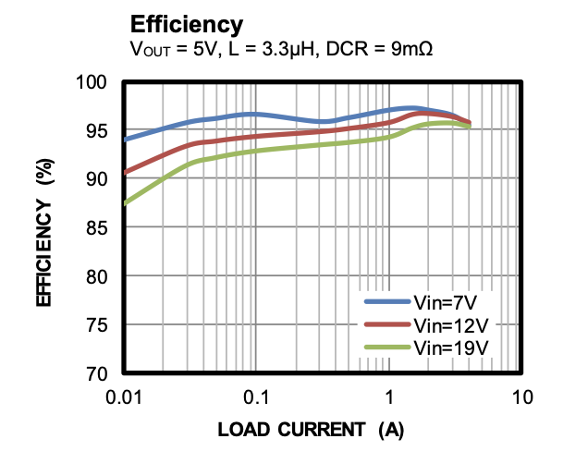
DC/DC Converter 3
Buck Switching Regulator IC Positive Adjustable 0.6V 1 Output 4A 11-VFQFN

Slide 25
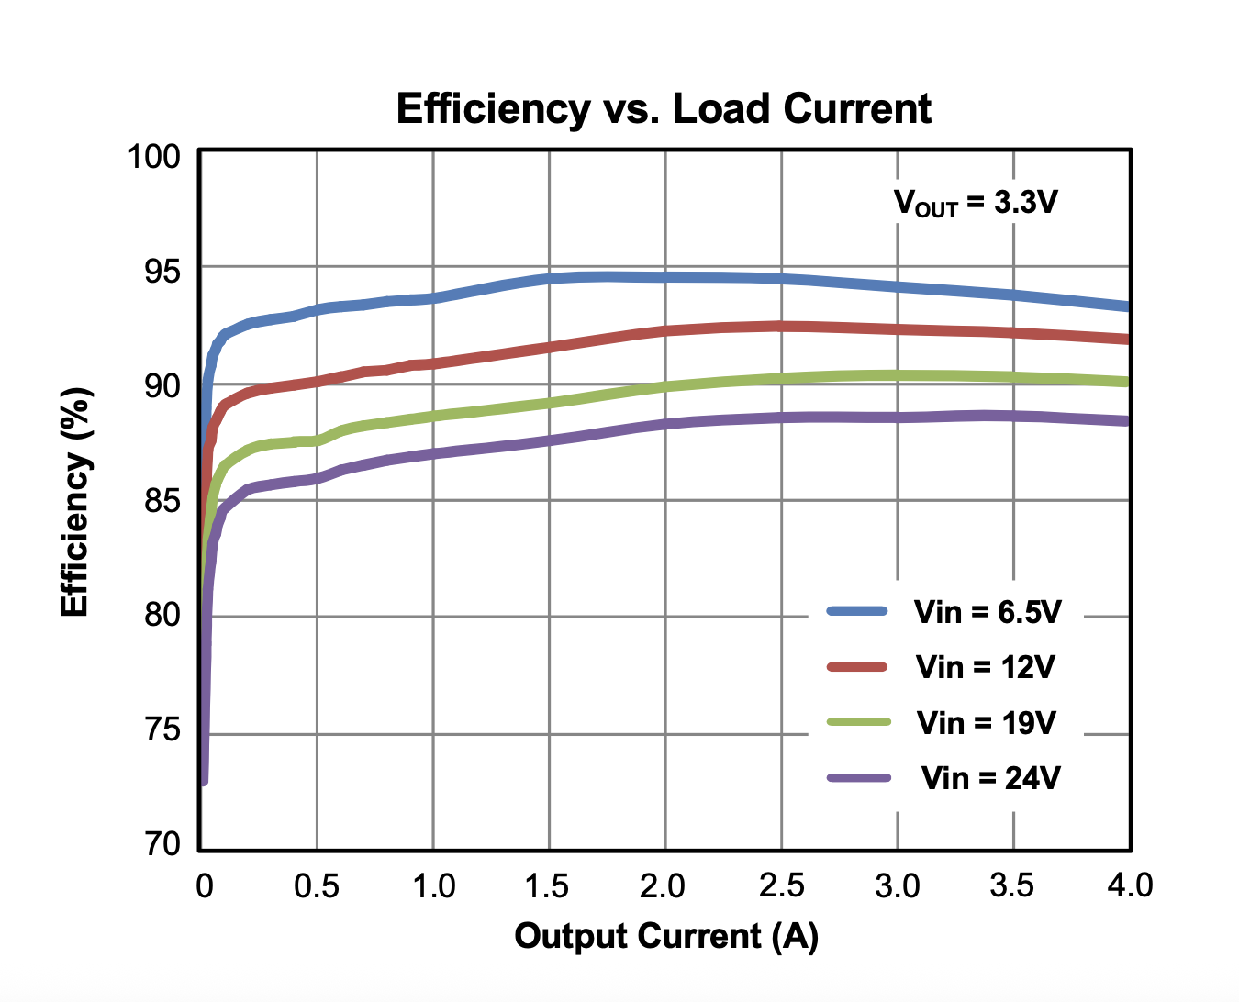
DC/DC Converter 4
Buck Switching Regulator IC Positive Adjustable 4V 1 Output 4A 18-PowerWFQFN

Slide 26
Next Steps
Update schematic with Teensy, voltage regulator, voltage monitoring circuit
Create PCB
Manufacturing

