Slide 1
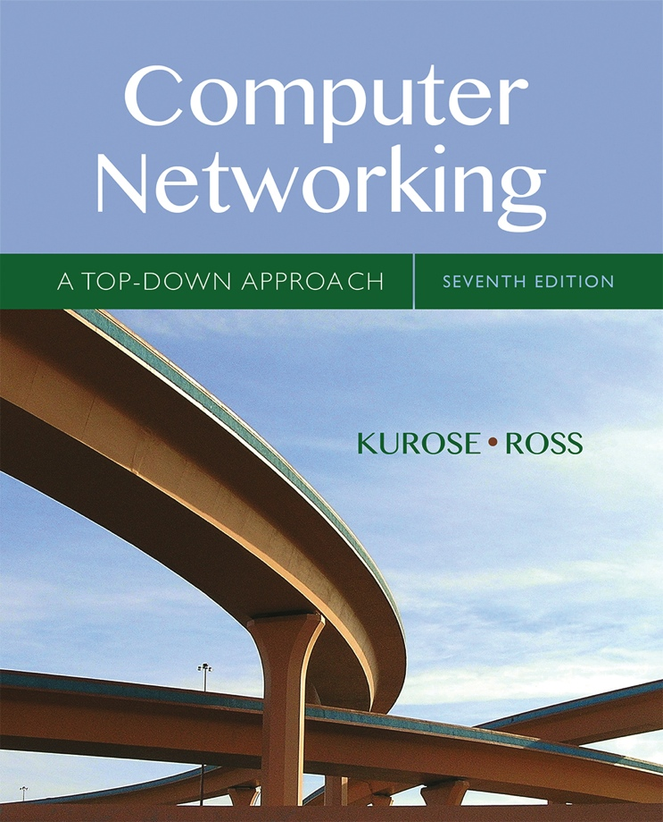

Chapter 7 Wireless and
Mobile Networks
A note on the use of these Powerpoint slides:
We’re making these slides freely available to all (faculty, students, readers). They’re in PowerPoint form so you see the animations; and can add, modify, and delete slides (including this one) and slide content to suit your needs. They obviously represent a lot of work on our part. In return for use, we only ask the following:
Computer Networking: A Top Down Approach
If you use these slides (e.g., in a class) that you mention their source (after all, we’d like people to use our book!)
If you post any slides on a www site, that you note that they are adapted from (or perhaps identical to) our slides, and note our copyright of this material.
Thanks and enjoy! JFK/KWR
All material copyright 1996-2016
J.F Kurose and K.W. Ross, All Rights Reserved
7th edition Jim Kurose, Keith Ross Pearson/Addison Wesley April 2016

Slide 2
Ch. 6: Wireless and Mobile Networks
Background:
# wireless (mobile) phone subscribers now exceeds # wired phone subscribers (5-to-1)!
# wireless Internet-connected devices equals # wireline Internet-connected devices
laptops, Internet-enabled phones promise anytime untethered Internet access
two important (but different) challenges
wireless: communication over wireless link
mobility: handling the mobile user who changes point of attachment to network

Slide 3
Chapter 7 outline
7.1 Introduction
Wireless
7.2 Wireless links, characteristics
CDMA
7.3 IEEE 802.11 wireless LANs (“Wi-Fi”)
7.4 Cellular Internet Access
architecture
standards (e.g., 3G, LTE)
Mobility
7.5 Principles: addressing and routing to mobile users
7.6 Mobile IP
7.7 Handling mobility in cellular networks
7.8 Mobility and higher-layer protocols

Slide 4



















Elements of a wireless network
network
infrastructure

Slide 5



Elements of a wireless network
wireless hosts
laptop, smartphone
run applications
may be stationary (non-mobile) or mobile
wireless does not always mean mobility
network
infrastructure

Slide 6

Elements of a wireless network
base station
typically connected to wired network
relay - responsible for sending packets between wired network and wireless host(s) in its “area”
e.g., cell towers, 802.11 access points
network
infrastructure

Slide 7
Elements of a wireless network
wireless link
typically used to connect mobile(s) to base station
also used as backbone link
multiple access protocol coordinates link access
various data rates, transmission distance
network
infrastructure

Slide 8
Characteristics of selected wireless links
1300
802.11 ac
450
802.11n
54
802.11a,g
802.11a,g point-to-point
5-11
802.11b
4G: LTWE WIMAX
4
3G: UMTS/WCDMA-HSPDA, CDMA2000-1xEVDO
Data rate (Mbps)
1
802.15
.384
2.5G: UMTS/WCDMA, CDMA2000
.056
2G: IS-95, CDMA, GSM
Indoor
10-30m
Outdoor
50-200m
Mid-range
outdoor
200m – 4 Km
Long-range
outdoor
5Km – 20 Km

Slide 9
Elements of a wireless network
infrastructure mode
base station connects mobiles into wired network
handoff: mobile changes base station providing connection into wired network
network
infrastructure

Slide 10
Elements of a wireless network
ad hoc mode
no base stations
nodes can only transmit to other nodes within link coverage
nodes organize themselves into a network: route among themselves

Slide 11
Wireless network taxonomy
single hop
multiple hops
host connects to
base station (WiFi,
WiMAX, cellular)
which connects to
larger Internet
host may have to
relay through several
wireless nodes to
connect to larger
Internet: mesh net
infrastructure
(e.g., APs)
no base station, no
connection to larger
Internet. May have to
relay to reach other
a given wireless node
MANET, VANET
no
infrastructure
no base station, no
connection to larger
Internet (Bluetooth,
ad hoc nets)

Slide 12
Chapter 7 outline
7.1 Introduction
Wireless
7.2 Wireless links, characteristics
CDMA
7.3 IEEE 802.11 wireless LANs (“Wi-Fi”)
7.4 Cellular Internet Access
architecture
standards (e.g., 3G, LTE)
Mobility
7.5 Principles: addressing and routing to mobile users
7.6 Mobile IP
7.7 Handling mobility in cellular networks
7.8 Mobility and higher-layer protocols

Slide 13
Wireless Link Characteristics (1)
important differences from wired link ….
decreased signal strength: radio signal attenuates as it propagates through matter (path loss)
interference from other sources: standardized wireless network frequencies (e.g., 2.4 GHz) shared by other devices (e.g., phone); devices (motors) interfere as well
multipath propagation: radio signal reflects off objects and ground, arriving at destination at slightly different times
…. make communication across (even a point to point) wireless link much more “difficult”

Slide 14

Wireless network characteristics
Multiple wireless senders and receivers create additional problems (beyond multiple access):
A
B
C
C
A’s signal
strength
C’s signal
strength
B
A
Hidden terminal problem
B, A hear each other
B, C hear each other
A, C can not hear each other means A, C unaware of their interference at B
space
Signal attenuation:
B, A hear each other
B, C hear each other
A, C can not hear each other interfering at B

Slide 15
Code Division Multiple Access (CDMA)
unique “code” assigned to each user; i.e., code set partitioning
all users share same frequency, but each user has own “chipping” sequence (i.e., code) to encode data
allows multiple users to “coexist” and transmit simultaneously with minimal interference (if codes are “orthogonal”)
encoded signal = (original data) X (chipping sequence)
decoding: inner-product of encoded signal and chipping sequence

Slide 16
CDMA encode/decode
channel output Z_{i,m}
Z_{i,m}= d_{i}.c_{m}
data
bits
d₀ = 1
1
1
1
1
1
d₁ = -1
1
1
1
-
-
-
-
1
-
-
-
1
-
1
1
1
1
1
sender
1
1
slot 1
channel
output
slot 0
channel
output
1
1
1
1
1
code
1
1
-
-
-
1
-
1
1
1
-
-
-
1
-
1
1
1
slot 1
slot 0
M
D_{i} = Σ Z_{i,m}.c_{m}
m=1
M
received
input
1
1
1
1
1
1
1
1
d₀ = 1
-
-
-
-
1
-
-
-
1
-
1
1
1
1
1
1
d₁ = -1
1
slot 1
channel
output
slot 0
channel
output
1
1
1
1
1
code
1
1
-
-
-
1
-
1
1
1
-
-
-
1
-
1
1
1
receiver
slot 1
slot 0

Slide 17
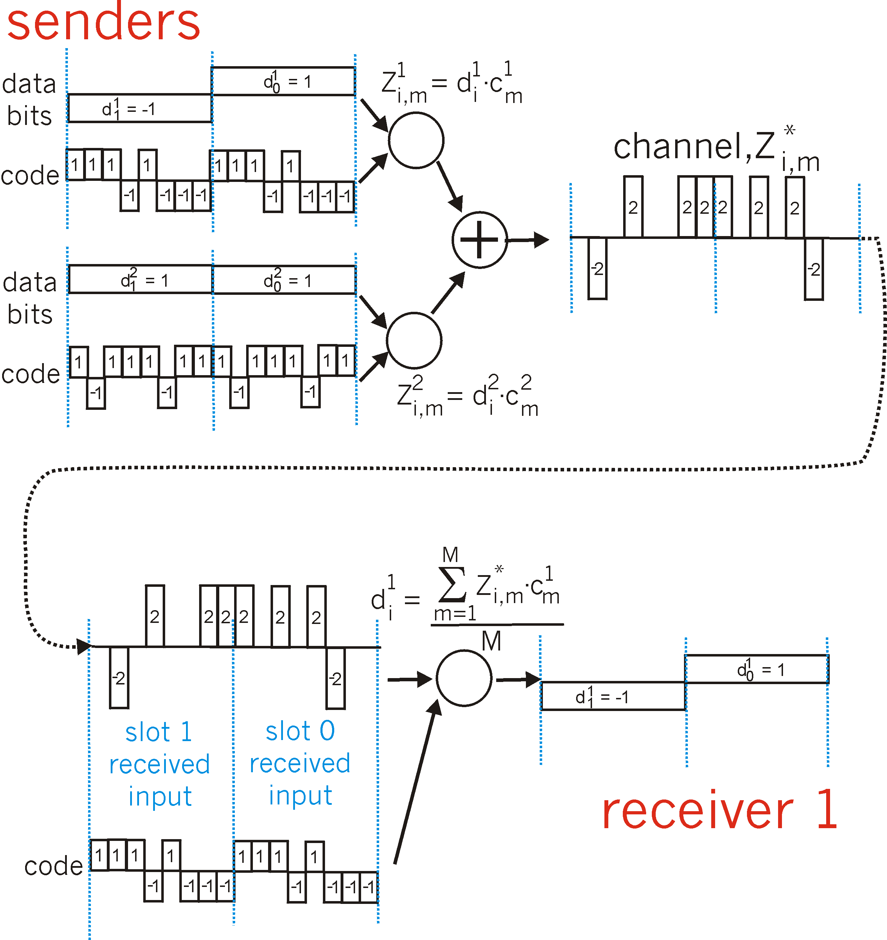
CDMA: two-sender interference
channel sums together transmissions by sender 1 and 2
Sender 1
Sender 2
using same code as sender 1, receiver recovers sender 1’s original data from summed channel data!

Slide 18
Chapter 7 outline
7.1 Introduction
Wireless
7.2 Wireless links, characteristics
CDMA
7.3 IEEE 802.11 wireless LANs (“Wi-Fi”)
7.4 Cellular Internet Access
architecture
standards (e.g., 3G, LTE)
Mobility
7.5 Principles: addressing and routing to mobile users
7.6 Mobile IP
7.7 Handling mobility in cellular networks
7.8 Mobility and higher-layer protocols

Slide 19
IEEE 802.11 Standards
Standard | Frequency Range | Data Rate
802.11b | 2.4GHz | Up to 11 Mbps
802.11a | 5GHz | Up to 54 Mbps
802.11g | 2.4GHz | Up to 54 MBps
802.11n | 2.5Ghz and 5GHz | Up to 450Mbps
802.11ac | 5GHz | Up to 1300 Mbps

Slide 20




802.11 LAN architecture
wireless host communicates with base station
base station = access point (AP)
Basic Service Set (BSS) (aka “cell”) in infrastructure mode contains:
wireless hosts
access point (AP): base station
ad hoc mode: hosts only
Internet
hub, switch
or router
BSS 1
BSS 2

Slide 21
802.11: Channels, association
802.11b: 2.4GHz-2.485GHz spectrum divided into 11 channels at different frequencies
AP admin chooses frequency for AP
interference possible: channel can be same as that chosen by neighboring AP!
host: must associate with an AP
scans channels, listening for beacon frames containing AP’s name (SSID) and MAC address
selects AP to associate with
may perform authentication [Chapter 8]
will typically run DHCP to get IP address in AP’s subnet

Slide 22
802.11: passive/active scanning
BBS 1
BBS 2
BBS 1
BBS 2
1
AP 2
AP 1
1
1
AP 2
AP 1
2
2
2
3
3
4
H1
H1
passive scanning:
beacon frames sent from APs
association Request frame sent: H1 to selected AP
association Response frame sent from selected AP to H1
active scanning:
Probe Request frame broadcast from H1
Probe Response frames sent from APs
Association Request frame sent: H1 to selected AP
Association Response frame sent from selected AP to H1

Slide 23




IEEE 802.11: multiple access
avoid collisions: 2⁺ nodes transmitting at same time
802.11: CSMA - sense before transmitting
don’t collide with ongoing transmission by other node
802.11: no collision detection!
difficult to receive (sense collisions) when transmitting due to weak received signals (fading)
can’t sense all collisions in any case: hidden terminal, fading
goal: avoid collisions: CSMA/C(ollision)A(voidance)
A
B
C
C
B
A’s signal
strength
C’s signal
strength
A
space

Slide 24
IEEE 802.11 MAC Protocol: CSMA/CA
802.11 sender
1 if sense channel idle for DIFS then
transmit entire frame (no CD)
2 if sense channel busy then
start random backoff time
timer counts down while channel idle
transmit when timer expires
if no ACK, increase random backoff interval, repeat 2
802.11 receiver
- if frame received OK
return ACK after SIFS (ACK needed due to hidden terminal problem)
sender
receiver
DIFS
data
SIFS
ACK

Slide 25
Avoiding collisions (more)
idea: allow sender to “reserve” channel rather than random access of data frames: avoid collisions of long data frames
sender first transmits small request-to-send (RTS) packets to BS using CSMA
RTSs may still collide with each other (but they’re short)
BS broadcasts clear-to-send CTS in response to RTS
CTS heard by all nodes
sender transmits data frame
other stations defer transmissions
avoid data frame collisions completely
using small reservation packets!

Slide 26

Collision Avoidance: RTS-CTS exchange
A
B
AP
RTS(B)
RTS(A)
reservation collision
RTS(A)
CTS(A)
CTS(A)
DATA (A)
defer
time
ACK(A)
ACK(A)

Slide 27
802.11 frame: addressing
2
2
6
6
6
2
6
0 - 2312
4
frame
control
duration
address
1
address
2
address
3
seq
control
address
4
payload
CRC
Address 4: used only in ad hoc mode
Address 1: MAC address
of wireless host or AP
to receive this frame
Address 3: MAC address
of router interface to which AP is attached
Address 2: MAC address
of wireless host or AP
transmitting this frame

Slide 28
802.11 frame: addressing
Internet
H1
R1
router
R1 MAC addr H1 MAC addr
dest. address
source address
802.3 frame
AP MAC addr H1 MAC addr R1 MAC addr
address 1
address 2
address 3
802.11 frame

Slide 29
802.11 frame: addressing
Internet
H1
R1
router
H1 MAC addr R1 MAC addr
dest. address
source address
802.3 frame
H1 MAC addr AP MAC addr R1 MAC addr
address 1
address 2
address 3
802.11 frame

Slide 30
802.11 frame: more
frame seq #
(for RDT)
duration of reserved
transmission time (RTS/CTS)
2
2
6
6
6
2
6
0 - 2312
4
frame
control
duration
address
1
address
2
address
3
seq
control
address
4
payload
CRC
2
2
4
1
1
1
1
1
1
1
1
Protocol
version
Type
Subtype
To
AP
From
AP
More
frag
Retry
Power
mgt
More
data
WEP
Rsvd
frame type
(RTS, CTS, ACK, data)

Slide 31

802.11: mobility within same subnet
H1 remains in same IP subnet: IP address can remain same
switch: which AP is associated with H1?
self-learning (Ch. 5): switch will see frame from H1 and “remember” which switch port can be used to reach H1
BBS 1
H1
BBS 2

Slide 32
802.11: advanced capabilities
Rate adaptation
base station, mobile dynamically change transmission rate (physical layer modulation technique) as mobile moves, SNR varies
10⁻¹
10⁻²
10⁻³
BER
10⁻⁴
10⁻⁵
10⁻⁶
10⁻⁷
10
20
30
40
SNR(dB)
1. SNR decreases, BER increase as node moves away from base station
QAM256 (8 Mbps)
QAM16 (4 Mbps)
2. When BER becomes too high, switch to lower transmission rate but with lower BER
BPSK (1 Mbps)
operating point

Slide 33
802.11: advanced capabilities
power management
node-to-AP: “I am going to sleep until next beacon frame”
AP knows not to transmit frames to this node
node wakes up before next beacon frame
beacon frame: contains list of mobiles with AP-to-mobile frames waiting to be sent
node will stay awake if AP-to-mobile frames to be sent; otherwise sleep again until next beacon frame

Slide 34
Chapter 7 outline
7.1 Introduction
Wireless
7.2 Wireless links, characteristics
CDMA
7.3 IEEE 802.11 wireless LANs (“Wi-Fi”)
7.4 Cellular Internet Access
architecture
standards (e.g., 3G, LTE)
Mobility
7.5 Principles: addressing and routing to mobile users
7.6 Mobile IP
7.7 Handling mobility in cellular networks
7.8 Mobility and higher-layer protocols

Slide 35
What is mobility?
spectrum of mobility, from the network perspective:
no mobility
high mobility
mobile wireless user,
using same access
point
mobile user, connecting/ disconnecting from network using DHCP.
mobile user, passing through multiple access point while maintaining ongoing connections (like cell phone)

Slide 36



Mobility: vocabulary
home network: permanent “home” of mobile
(e.g., 128.119.40/24)
home agent: entity that will perform mobility functions on behalf of mobile, when mobile is remote
wide area network
permanent address: address in home network, can always be used to reach mobile
e.g., 128.119.40.186

Slide 37
Mobility: more vocabulary
permanent address: remains constant (e.g., 128.119.40.186)
visited network: network in which mobile currently resides (e.g., 79.129.13/24)
care-of-address: address in visited network.
(e.g., 79,129.13.2)
wide area network
foreign agent: entity in visited network that performs mobility functions on behalf of mobile.
correspondent: wants to communicate with mobile

Slide 38

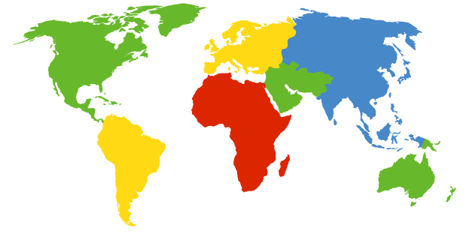

How do you contact a mobile friend:
Consider friend frequently changing addresses, how do you find her?
I wonder where Alice moved to?
search all phone books?
call her parents?
expect her to let you know where he/she is?
Facebook!

Slide 39
Mobility: approaches
let routing handle it: routers advertise permanent address of mobile-nodes-in-residence via usual routing table exchange.
routing tables indicate where each mobile located
no changes to end-systems
let end-systems handle it:
indirect routing: communication from correspondent to mobile goes through home agent, then forwarded to remote
direct routing: correspondent gets foreign address of mobile, sends directly to mobile

Slide 40
Mobility: approaches
let routing handle it: routers advertise permanent address of mobile-nodes-in-residence via usual routing table exchange.
routing tables indicate where each mobile located
no changes to end-systems
let end-systems handle it:
indirect routing: communication from correspondent to mobile goes through home agent, then forwarded to remote
direct routing: correspondent gets foreign address of mobile, sends directly to mobile
not
scalable
to millions of
mobiles

Slide 41
Mobility: registration
visited network
home network
1
2
wide area network
mobile contacts foreign agent on entering visited network
foreign agent contacts home agent home: “this mobile is resident in my network”
end result:
foreign agent knows about mobile
home agent knows location of mobile

Slide 42

Mobility via indirect routing
foreign agent receives packets, forwards to mobile
home agent intercepts packets, forwards to foreign agent
visited
network
home
network
3
wide area network
2
1
correspondent addresses packets using home address of mobile
4
mobile replies directly to correspondent

Slide 43



Indirect Routing: comments
mobile uses two addresses:
permanent address: used by correspondent (hence mobile location is transparent to correspondent)
care-of-address: used by home agent to forward datagrams to mobile
foreign agent functions may be done by mobile itself
triangle routing: correspondent-home-network-mobile
inefficient when
correspondent, mobile
are in same network

Slide 44
Indirect routing: moving between networks
suppose mobile user moves to another network
registers with new foreign agent
new foreign agent registers with home agent
home agent update care-of-address for mobile
packets continue to be forwarded to mobile (but with new care-of-address)
mobility, changing foreign networks transparent: on going connections can be maintained!

Slide 45


Mobility via direct routing
foreign agent receives packets, forwards to mobile
correspondent forwards to foreign agent
visited
network
home
network
3
1
2
4
correspondent requests, receives foreign address of mobile
mobile replies directly to correspondent

Slide 46




Mobility via direct routing: comments
overcome triangle routing problem
non-transparent to correspondent: correspondent must get care-of-address from home agent
what if mobile changes visited network?
3
1
2
4

Slide 47


Accommodating mobility with direct routing
anchor foreign agent: FA in first visited network
data always routed first to anchor FA
when mobile moves: new FA arranges to have data forwarded from old FA (chaining)
foreign net visited
at session start
anchor
foreign
agent
wide area network
2
1
4
5
3
new
foreign
network
correspondent
agent
new foreign
agent
correspondent

Slide 48
Wireless, mobility: impact on higher layer protocols
logically, impact should be minimal …
best effort service model remains unchanged
TCP and UDP can (and do) run over wireless, mobile
… but performance-wise:
packet loss/delay due to bit-errors (discarded packets, delays for link-layer retransmissions), and handoff
TCP interprets loss as congestion, will decrease congestion window un-necessarily
delay impairments for real-time traffic
limited bandwidth of wireless links

