Slide 1


Chapter 4 Network Layer:
The Data Plane
These slides have been adapted from the Pearson slides and Prof Rexford @ Princeton.
A note on the use of these Powerpoint slides:
We’re making these slides freely available to all (faculty, students, readers). They’re in PowerPoint form so you see the animations; and can add, modify, and delete slides (including this one) and slide content to suit your needs. They obviously represent a lot of work on our part. In return for use, we only ask the following:
Computer Networking: A Top Down Approach
7th edition Jim Kurose, Keith Ross Pearson/Addison Wesley April 2016
If you use these slides (e.g., in a class) that you mention their source (after all, we’d like people to use our book!)
If you post any slides on a www site, that you note that they are adapted from (or perhaps identical to) our slides, and note our copyright of this material.
Thanks and enjoy! JFK/KWR
All material copyright 1996-2016
J.F Kurose and K.W. Ross, All Rights Reserved

Slide 2
Chapter 4: outline
4.1 Overview of Network layer
data plane
control plane
4.2 What’s inside a router
4.3 IP: Internet Protocol
datagram format
fragmentation
IPv4 addressing
network address translation
IPv6
4.4 Generalized Forward and SDN
match
action
OpenFlow examples of match-plus-action in action

Slide 3
Chapter 4: network layer
chapter goals:
understand principles behind network layer services, focusing on data plane:
network layer service models
forwarding versus routing
how a router works
generalized forwarding
instantiation, implementation in the Internet

Slide 4
















Network layer
transport segment from sending to receiving host
on sending side encapsulates segments into datagrams
on receiving side, delivers segments to transport layer
network layer protocols in every host, router
router examines header fields in all IP datagrams passing through it
application
transport
network
data link
physical
network
data link
physical
network
data link
physical
network
data link
physical
network
data link
physical
network
data link
physical
network
data link
physical
network
data link
physical
network
data link
physical
network
data link
physical
application
transport
network
data link
physical
network
data link
physical
network
data link
physical

Slide 5
Protocol Layers: Host vs Router
host
host
HTTP message
HTTP
HTTP
TCP segment
TCP
TCP
router
router
IP packet
IP packet
IP packet
IP
IP
IP
IP
Ethernet
interface
Ethernet
interface
SONET
interface
SONET
interface
Ethernet
interface
Ethernet
interface
5

Slide 6
Protocol Layers: Encapsulation
Ethernet
IP
TCP
HTTP
HTTP Body

Slide 7
Two key network-layer functions
network-layer functions:
forwarding: move packets from router’s input to appropriate router output
routing: determine route taken by packets from source to destination
routing algorithms
analogy: taking a trip
forwarding: process of getting through single interchange
routing: process of planning trip from source to destination

Slide 8
Network layer: data plane, control plane
Data plane
local, per-router function
determines how datagram arriving on router input port is forwarded to router output port
forwarding function
Control plane – Routing
network-wide logic
determines how datagram is routed among routers along end-end path from source host to destination host
accomplished by routing algorithms implemented in routers
Control plane – Network Layer
Internet Control Management Protocol (ICMP)

Slide 9

Per-router data and control plane
Individual routing algorithm components in each and every router interact in the control plane
Individual router forwards from input port to output port
Routing
Algorithm
control
plane
data
plane
values in arriving
packet header
0111
1
3
2

Slide 10
Routing versus Forwarding
Routing
Responsible for finding path(s) to destination host
Routing algorithm populates a routing table
Instantiates the forwarding table
Forwarding
Router consults the forwarding table
Examines network prefix of destination IP address in IP header
Uses forwarding table to determine outgoing link
Destination Address | Output Interface
128.96.0.0/16 | 0
128.96.3.0/24 | 1
192.168.0.0/16 | 2

Slide 11
Network service model
Q: What service model for “channel” transporting datagrams from sender to receiver?
example services for individual datagrams:
guaranteed delivery
guaranteed delivery with less than 40 msec delay
example services for a flow of datagrams:
in-order datagram delivery
guaranteed minimum bandwidth to flow
restrictions on changes in inter-packet spacing

Slide 12
Datagram Networks
Packet carries Destination Address
No setup; routers maintain no state information
Routers:
Use the destination address to forward the packet
Forwarding table maps destination address to output link

Slide 13
Network layer service models
Network
Architecture
Internet
ATM
ATM
ATM
ATM
Service
Model
best effort
CBR
VBR
ABR
UBR
Guarantees ?
Congestion
feedback
no (inferred
via loss)
no
congestion
no
congestion
yes
no
Bandwidth
none
constant
rate
guaranteed
rate
guaranteed
minimum
none
Loss
no
yes
yes
no
no
Order
no
yes
yes
yes
yes
Timing
no
yes
yes
no
no

Slide 14

Best-effort Service
Best-effort delivery
Packets may be lost
Packets may be corrupted
Packets may be delivered out of order
source
destination
IP network
14

Slide 15
Best-effort: Simplicity
Never having to say you’re sorry…
Don’t reserve bandwidth and memory
Don’t do error detection and correction
Don’t remember from one packet to next
Easier to survive failures
Transient disruptions are okay during failover
Easier to support on many kinds of links
Important for interconnecting different networks

Slide 16
Best-Effort: Good Enough?
Packet loss and delay
Sender can resend
Packet corruption
Receiver can detect, and sender can resend
Out-of-order delivery
Receiver can put the data back in order
Packets follow different paths
Doesn’t matter
Network failure
Drop the packet
Network congestion
Drop the packet

Slide 17
Chapter 4: outline
4.1 Overview of Network layer
data plane
control plane
4.2 What’s inside a router
4.3 IP: Internet Protocol
datagram format
fragmentation
IPv4 addressing
network address translation
IPv6
4.4 Generalized Forward and SDN
match
action
OpenFlow examples of match-plus-action in action

Slide 18
Hierarchical Addressing in U.S. Mail
Addressing in the U.S. mail
Zip code: 08540
Building: 35 Olden Street
Room in building: 306
Name of occupant: Jennifer Rexford
Forwarding the U.S. mail
Deliver to the post office in the zip code
Assign to mailman covering the building
Drop letter into mailbox for building/room
Give letter to the appropriate person
???

Slide 19
IP Addressing
IP addresses are 32 bits expressed in dotted decimal notation
Example: www.njit.edu 128.235.251.25
Each network interface has an IP Address
Hosts may have more than one interface and hence IP address e.g. Ethernet and WiFi
Routers have one IP address per interface
128
235
251
25
10000000
111010111
11111011
00011011

Slide 20
IP Addressing: Route Aggregation
IP addresses are 32 bits = 2³² addresses
We can’t have a forwarding table with 2³² entries (4,294,967,296) entries!
IP addresses cannot be assigned randomly
IP addresses are structured hierarchically
Assign groups of addresses to an organization
Example: NJIT allocated 128.35.0.0/16
High-order 16 bits indicates NJIT
Low-order 16 bits managed by NJIT (and may be structured into further levels of hierarchy)
Route aggregation: One prefix used by ISP to route to all networks and machines at NJIT

Slide 21
Scalability Challenge
Suppose hosts had arbitrary addresses
Then every router would need a lot of information
…to know how to direct packets toward every host
1.2.3.4
5.6.7.8
2.4.6.8
1.2.3.5
5.6.7.9
2.4.6.9
host
host
...
host
host
host
...
host
LAN 1
LAN 2
router
router
router
WAN
WAN
1.2.3.4
1.2.3.5
forwarding table

Slide 22
Subnet Mask or Prefix
Subnet mask or Prefix
A bit mask with 1’s in the network number position
Address & netmask strips away host bits
Different length prefixes or masks may be used at different levels of routing hierarchy
For NJIT, the subnet mask is 16
16 bits - network
16 bits - host
11111111
111111111
00000000
00000000

Slide 23
Subnet Mask or Prefix (cont)
Many organizations have multiple internal networks and allocate IP addresses accordingly
Example: afsaccess1.njit.edu, the subnet mask is 25 bits
Eth1: Link encap:Ethernet HWaddr 00:50:56:B4:47:FF inet addr:128.235.208.201 Mask:255.255.255.128
25 bits - network
7 bits - host
11111111
111111111
11111111
10000000

Slide 24
Scalability Improved
Number related hosts from a common subnet
1.2.3.0/24 on the left LAN
5.6.7.0/24 on the right LAN
1.2.3.4
1.2.3.7
1.2.3.156
5.6.7.8
5.6.7.9
5.6.7.212
host
host
...
host
host
host
...
host
LAN 1
LAN 2
router
router
router
WAN
WAN
1.2.3.0/24
5.6.7.0/24
forwarding table

Slide 25
Easy to Add New Hosts
No need to update the routers
E.g., adding a new host 5.6.7.213 on the right
Doesn’t require adding a new forwarding-table entry
1.2.3.4
1.2.3.7
1.2.3.156
5.6.7.8
5.6.7.9
5.6.7.212
host
host
...
host
host
host
...
host
LAN 1
LAN 2
router
router
router
host
WAN
WAN
5.6.7.213
1.2.3.0/24
5.6.7.0/24
forwarding table

Slide 26
Special IP Addresses
Special IP Addresses | Description
0.0.0.0 | “this host”. Rarely used.
Network = 0, Host | Host on “this” network
255.255.255.255 | Local Broadcast
Network, Host = all one’s Example: 128.235.208.255 | Directed Broadcast
127.0.0.1 | Loopback address
General Rule: All zeroes means “this”; all one’s means “all”

Slide 27

IP addressing: Hosts and Routers
223.1.1.1
IP address: 32-bit identifier for host, router interface
interface: connection between host/router and physical link
router’s typically have multiple interfaces
host typically has one or two interfaces (e.g., wired Ethernet, wireless 802.11)
IP addresses associated with each interface
223.1.2.1
223.1.1.2
223.1.1.4
223.1.2.9
223.1.1.3
223.1.3.27
223.1.2.2
223.1.3.1
223.1.3.2
223.1.1.1 = 11011111 00000001 00000001 00000001
223
1
1
1

Slide 28
Subnets
223.1.1.0/24
223.1.2.0/24
IP address:
subnet part - high order bits
host part - low order bits
what’s a subnet ?
device interfaces with same subnet part of IP address
can physically reach each other without intervening router
223.1.1.1
223.1.1.2
223.1.2.1
223.1.1.4
223.1.2.9
223.1.2.2
223.1.1.3
223.1.3.27
subnet
223.1.3.1
223.1.3.2
223.1.3.0/24
network consisting of 3 subnets

Slide 29
Subnets
223.1.1.2
how many?
223.1.1.1
223.1.1.4
223.1.1.3
223.1.9.2
223.1.7.0
223.1.9.1
223.1.7.1
223.1.8.1
223.1.8.0
223.1.2.6
223.1.3.27
223.1.2.1
223.1.2.2
223.1.3.1
223.1.3.2
Subnet mask 24 bits

Slide 30
IP Addressing: Hierarchical Structure
“Public” Network Mask(x bits)
“Site” Subnet Mask (y bits)
Host Mask (32 bits)
0
x
y
31
Network ID
SubNet ID
Host ID
Assigned to Site
Allocated by Site
Allocated by Site

Slide 31
IP Addressing: Hierarchical Structure Example: 223.1.0.0/24
Subnet | Prefix
0 | 223.1.0.0/24
1 | 223.1.1.0/24
2 | 223.1.2.0/24
3 | 223.1.3.0/24
… | …
255 | 223/1.255.24
“Public” Network Mask(16 bits)
“Site” Subnet Mask (24 bits)
Host Mask (32 bits)
0
16
24
31
Network ID
SubNet ID
Host ID
Assigned to Site
Allocated by Site
Allocated by Site

Slide 32
IP Addressing: Hierarchical Structure Example: Site = 192.168.42.0/24
Subnet | Prefix
0 | 192.168.42.0/27
1 | 192.168.42.32/27
2 | 192.168.42.64/27
3 | 192.168.42.128/27
… | …
7 | 192.168.42.224/27
“Public” Network Mask(24 bits)
“Site” Subnet Mask (27 bits)
Host Mask (32 bits)
0
24
27
31
Network ID
SubNet ID
Host ID
Assigned to Site
Allocated by Site
Allocated by Site

Slide 33
IP Addressing: Hierarchical Structure Example: 128.235.0.0/16
Subnet | Prefix
0 | 128.235.0.0/25
1 | 128.235.0.128/25
2 | 128.235.1.0/25
3 | 128.235.1.128/25
… | …
512 | 128.236.255.128/25
“Public” Network Mask(16 bits)
“Site” Subnet Mask (25 bits)
Host Mask (32 bits)
0
16
25
31
Network ID
SubNet ID
Host ID
Assigned to Site
Allocated by Site
Allocated by Site

Slide 34
Address Allocation
IANA
http://www.iana.org/assignments/ipv4-address-space
AfriNIC
APNIC
ARIN
LACNIC
RIPE
Allocate blocks to Tier 1 ISPs and Large Organizations
Prefixes
Increase
with
depth
of
hierarchy
Allocate sub-blocks to Tier2 SPs
Your computer
or Gateway

Slide 35
IP addresses: how to get one?
Q: how does network get subnet part of IP addr?
A: gets allocated portion of its provider ISP’s address space
ISP's block 11001000 00010111 00010000 00000000 200.23.16.0/20
Organization 0 11001000 00010111 00010000 00000000 200.23.16.0/23
Organization 1 11001000 00010111 00010010 00000000 200.23.18.0/23
Organization 2 11001000 00010111 00010100 00000000 200.23.20.0/23
... ….. …. ….
Organization 7 11001000 00010111 00011110 00000000 200.23.30.0/23

Slide 36
Hierarchical addressing: route aggregation
hierarchical addressing allows efficient advertisement of routing
information:
Organization 0
200.23.16.0/23
Organization 1
200.23.18.0/23
“Send me anything
with addresses
beginning
200.23.16.0/20”
Organization 2
200.23.20.0/23
.
Fly-By-Night-ISP
.
.
.
.
Internet
Organization 7
.
200.23.30.0/23
ISPs-R-Us
“Send me anything
with addresses
beginning
199.31.0.0/16”

Slide 37
Hierarchical addressing: more specific routes
ISPs-R-Us has a more specific route to Organization 1
Organization 0
200.23.16.0/23
“Send me anything
with addresses
beginning
200.23.16.0/20”
Organization 2
200.23.20.0/23
.
Fly-By-Night-ISP
.
.
.
.
Internet
Organization 7
.
200.23.30.0/23
ISPs-R-Us
“Send me anything
with addresses
beginning 199.31.0.0/16
or 200.23.18.0/23”
Organization 1
200.23.18.0/23

Slide 38
IP addressing: the last word...
Q: how does an ISP get block of addresses?
A: ICANN: Internet Corporation for Assigned
Names and Numbers http://www.icann.org/
allocates addresses
manages DNS
assigns domain names, resolves disputes

Slide 39
History of IP Address Allocation

Slide 40
Classful Addressing
In the olden days, only fixed allocation sizes
Class A: 0*
Very large /8 blocks (e.g., MIT has 18.0.0.0/8)
Class B: 10*
Large /16 blocks (e.g,. NJIT has 128.235.0.0/16)
Class C: 110*
Small /24 blocks (e.g., AT&T Labs has 192.20.225.0/24)
Class D: 1110* for multicast groups
Class E: 11110* reserved for future use
This is why folks use dotted-quad notation!

Slide 41
IP addressing: CIDR
CIDR: Classless InterDomain Routing
subnet portion of address of arbitrary length
address format: a.b.c.d/x, where x is # bits in subnet portion of address
subnet
part
host
part
11001000 00010111 00010000 00000000
200.23.16.0/23

Slide 42
Classless Inter-Domain Routing (CIDR)
Use two 32-bit numbers to represent a network.
Network number = IP address + Mask
IP Address : 12.4.0.0 IP Mask: 255.254.0.0
Address
00001100
00000100
00000000
00000000
Mask
11111111
11111110
00000000
00000000
Network Prefix
for hosts
Written as 12.4.0.0/15

Slide 43
Hierarchical Address Allocation
Hierarchy is key to scalability
Address allocated in contiguous chunks (prefixes)
Today, the Internet has about 400,000 prefixes
12.0.0.0/16
12.1.0.0/16
:
:
:
12.3.0.0/24
12.2.0.0/16
12.3.1.0/24
12.3.0.0/16
:
:
:
:
:
12.0.0.0/8
12.3.254.0/24
12.253.0.0/19
12.253.32.0/19
:
:
12.254.0.0/16
12.253.160.0/19

Slide 44
Obtaining a Block of Addresses
Internet Corporation for Assigned Names and Numbers (ICANN)
Allocates large blocks to Regional Internet Registries
Regional Internet Registries (RIRs)
E.g., ARIN (American Registry for Internet Numbers)
Allocates to ISPs and large institutions
Internet Service Providers (ISPs)
Allocate address blocks to their customers
Who may, in turn, allocate to their customers…

Slide 45
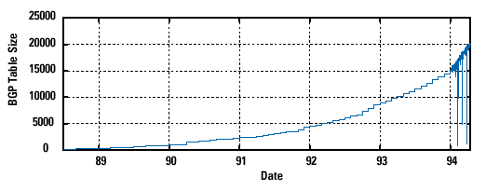
Pre-CIDR (1988-1994): Steep Growth
Growth faster than improvements in equipment capability

Slide 46
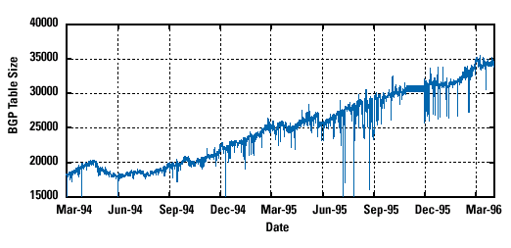
CIDR (1994-1996): Much Flatter
Efforts to aggregate

Slide 47
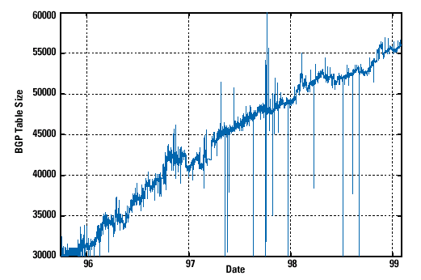
CIDR Growth (1996-1998): Roughly Linear
Good use of aggregation, and peer pressure!

Slide 48
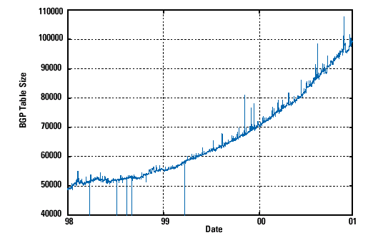
DotCom Boom (1998-2001): Steep Growth
Internet boom and increased multi-homing

Slide 49
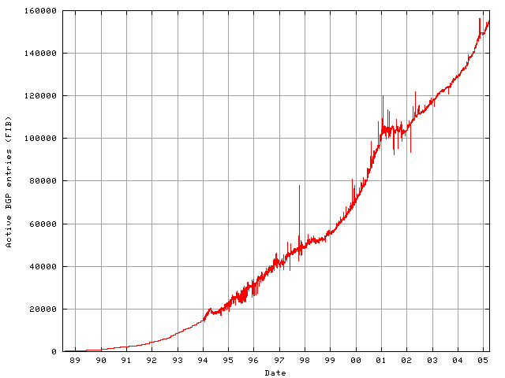
Long Term (1989-2005): Post-Boom
Today we are up to ~400,000 prefixes

Slide 50
Chapter 4: outline
4.1 Overview of Network layer
data plane
control plane
4.2 What’s inside a router
4.3 IP: Internet Protocol
datagram format
fragmentation
IPv4 addressing
network address translation
IPv6
4.4 Generalized Forward and SDN
match
action
OpenFlow examples of match-plus-action in action

Slide 51
Router architecture overview
high-level view of generic router architecture:
routing, management
control plane (software)
operates in millisecond
time frame
routing
processor
forwarding data plane (hardware) operttes in nanosecond timeframe
high-seed
switching
fabric
router input ports
router output ports

Slide 52
Input port functions
lookup,
forwarding
queueing
line
termination
link
layer
protocol
(receive)
switch
fabric
physical layer:
bit-level reception
data link layer:
e.g., Ethernet
see chapter 5
decentralized switching:
using header field values, lookup output port using forwarding table in input port memory (“match plus action”)
goal: complete input port processing at ‘line speed’
queuing: if datagrams arrive faster than forwarding rate into switch fabric

Slide 53
Input port functions
lookup,
forwarding
queueing
line
termination
link
layer
protocol
(receive)
switch
fabric
physical layer:
bit-level reception
decentralized switching:
using header field values, lookup output port using forwarding table in input port memory (“match plus action”)
destination-based forwarding: forward based only on destination IP address (traditional)
generalized forwarding: forward based on any set of header field values
data link layer:
e.g., Ethernet
see chapter 5

Slide 54
Longest prefix matching
longest prefix matching
when looking for forwarding table entry for given destination address, use longest address prefix that matches destination address.
Destination Address Range
11001000 00010111 00010*** *********
11001000 00010111 00011000 *********
11001000 00010111 00011*** *********
otherwise
Link interface
0
1
2
3
examples:
DA: 11001000 00010111 00010110 10100001
which interface?
DA: 11001000 00010111 00011000 10101010
which interface?

Slide 55
Input port queuing
fabric slower than input ports combined -> queueing may occur at input queues
queueing delay and loss due to input buffer overflow!
Head-of-the-Line (HOL) blocking: queued datagram at front of queue prevents others in queue from moving forward
switch
fabric
switch
fabric
output port contention:
only one red datagram can be transferred. lower red packet is blocked
one packet time later: green packet experiences HOL blocking

Slide 56
Output ports
datagram
buffer
queueing
switch
fabric
link
layer
protocol
(send)
line
termination
buffering required when datagrams arrive from fabric faster than the transmission rate
scheduling discipline chooses among queued datagrams for transmission
Datagram (packets) can be lost due to congestion, lack of buffers
Priority scheduling – who gets best performance, network neutrality

Slide 57
Output port queueing
switch
fabric
switch
fabric
at t, packets more
from input to output
one packet time later
buffering when arrival rate via switch exceeds output line speed
queueing (delay) and loss due to output port buffer overflow!

Slide 58
How much buffering?
RFC 3439 rule of thumb: average buffering equal to “typical” RTT (say 250 msec) times link capacity C
e.g., C = 10 Gpbs link: 2.5 Gbit buffer
recent recommendation: with N flows, buffering equal to
.
RTT C
N

Slide 59
Scheduling mechanisms
scheduling: choose next packet to send on link
FIFO (first in first out) scheduling: send in order of arrival to queue
real-world example?
discard policy: if packet arrives to full queue: who to discard?
tail drop: drop arriving packet
priority: drop/remove on priority basis
random: drop/remove randomly
packet
arrivals
packet
departures
queue
(waiting area)
link
(server)

Slide 60
Scheduling policies: priority
priority scheduling: send highest priority queued packet
multiple classes, with different priorities
class may depend on marking or other header info, e.g. IP source/dest, port numbers, etc.
real world example?
high priority queue
(waiting area)
arrivals
departures
classify
link
(server)
low priority queue
(waiting area)
2
1
3
4
5
arrivals
packet in service
1
3
2
4
5
departures
1
3
2
4
5

Slide 61
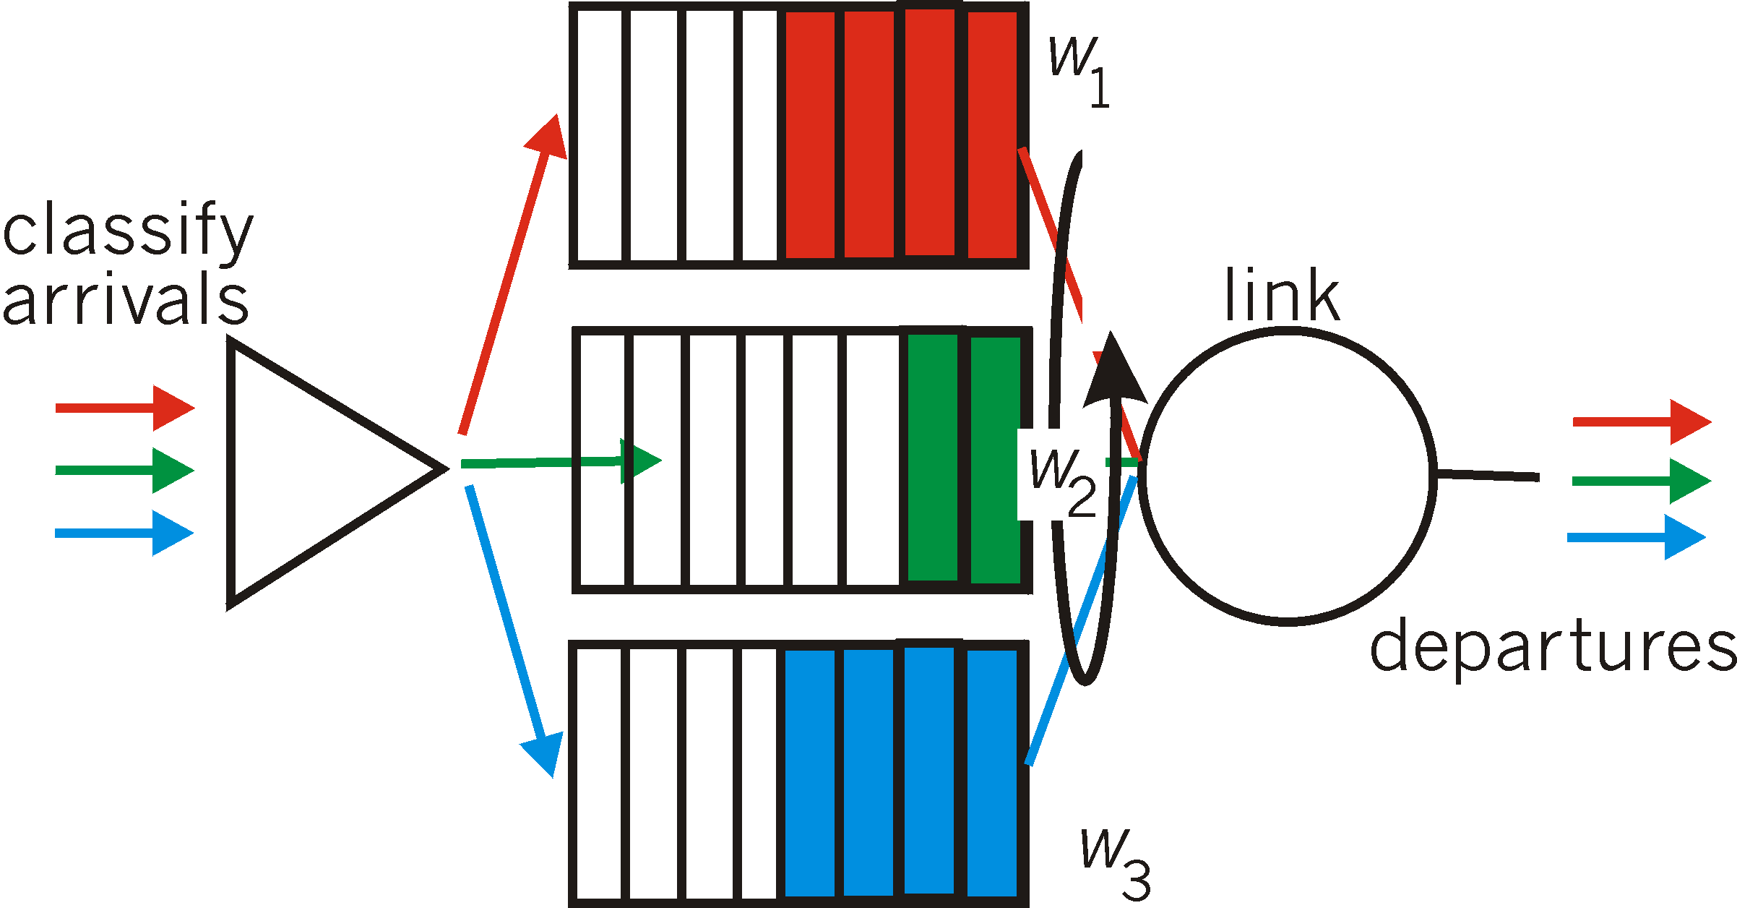
Scheduling policies: still more
Weighted Fair Queuing (WFQ):
generalized Round Robin
each class gets weighted amount of service in each cycle
real-world example?

Slide 62
Chapter 4: outline
4.1 Overview of Network layer
data plane
control plane
4.2 What’s inside a router
4.3 IP: Internet Protocol
datagram format
fragmentation
IPv4 addressing
network address translation
IPv6
4.4 Generalized Forward and SDN
match
action
OpenFlow examples of match-plus-action in action

Slide 63
The Internet network layer
host, router network layer functions:
transport layer: TCP, UDP
routing protocols
path selection
RIP, OSPF, BGP
IP protocol
addressing conventions
datagram format
packet handling conventions
network
layer
forwarding
table
ICMP protocol
error reporting
router “signaling”
link layer
physical layer

Slide 64
IP datagram format
IP protocol version
number
32 bits
total datagram
length (bytes)
header length
(bytes)
head.
len
type of
service
ver
length
for
fragmentation/
reassembly
“type” of data
flgs
fragment
offset
16-bit identifier
max number
remaining hops
(decremented at
each router)
time to
live
upper
layer
header
checksum
32 bit source IP address
upper layer protocol
to deliver payload to
32 bit destination IP address
options (if any)
e.g. timestamp,
record route
taken, specify
list of routers
to visit.
data
(variable length,
typically a TCP
or UDP segment)
how much overhead?
20 bytes of TCP
20 bytes of IP
= 40 bytes + app layer overhead

Slide 65
IP fragmentation, reassembly
network links have MTU (max.transfer size) - largest possible link-level frame
different link types, different MTUs
large IP datagram divided (“fragmented”) within net
one datagram becomes several datagrams
“reassembled” only at final destination
IP header bits used to identify, order related fragments
…
fragmentation:
in: one large datagram
out: 3 smaller datagrams
reassembly
…

Slide 66
IP fragmentation, reassembly
length
=4000
ID
=x
fragflag
=0
offset
=0
example:
4000 byte datagram
MTU = 1500 bytes
one large datagram becomes
several smaller datagrams
1480 bytes in data field
length
=1500
ID
=x
fragflag
=1
offset
=0
offset =
1480/8
length
=1500
ID
=x
fragflag
=1
offset
=185
length
=1040
ID
=x
fragflag
=0
offset
=370

Slide 67
IP addresses: how to get one?
Q: How does a host get IP address?
Static: hard-coded by system admin in a file
Windows: control-panel->network->configuration->tcp/ip->properties
UNIX: /etc/rc.config
Dynamic:
DHCP: Dynamic Host Configuration Protocol: dynamically get address from a server
“plug-and-play”

Slide 68
DHCP: Dynamic Host Configuration Protocol
goal: allow host to dynamically obtain its IP address from network server when it joins network
can renew its lease on address in use
allows reuse of addresses (only hold address while connected/“on”)
support for mobile users who want to join network (more shortly)
DHCP overview:
host broadcasts “DHCP discover” msg [optional]
DHCP server responds with “DHCP offer” msg [optional]
host requests IP address: “DHCP request” msg
DHCP server sends address: “DHCP ack” msg

Slide 69
DHCP Message Format
Request (1)/
Response (2)
Hardware Type
(Ethernet (1)
Hardware Len
(Ethernet (6)
0
8
16
24
31
OP
HTYPE
HLEN
HOPS
TRANSACTION ID
Match requests and replies
SECONDS
FLAGS
CLIENT IP ADDRESS
Client: 0.0.0.0 when unknown
YOUR IP ADDRESS
Server: IP address assigned to client
SERVER IP ADDRESS
ROUTER IP ADDRESS
Relay Agent: Router IP address
CLIENT HARDWARE ADDRESS
Client: MAC address
…
options

Slide 70
DHCP Message Format - Options
Options Structure
type
length
value
Option Type | Option Value
53 | Message Code (Discover, Offer, Request, Ack, …)
51 | IP address lease time
1 | Subnet Mask
3 | First-Hop Router(s)
6 | DNS Server(s)

Slide 71


DHCP client-server scenario (local LAN)
DHCP
server
223.1.1.0/24
223.1.1.1
223.1.2.1
223.1.1.2
arriving DHCP
client needs
address in this
network
223.1.1.4
223.1.2.9
223.1.3.27
223.1.2.2
223.1.1.3
223.1.2.0/24
223.1.3.1
223.1.3.2
223.1.3.0/24

Slide 72
DHCP client-server scenario (local LAN)
DHCP server: 223.1.2.5
DHCP discover
arriving
client
src : 0.0.0.0, 68
dest.: 255.255.255.255,67
yiaddr: 0.0.0.0
transaction ID: 654
Broadcast: is there a DHCP server out there?
DHCP offer
src: 223.1.2.5, 67
dest: 255.255.255.255, 68
yiaddrr: 223.1.2.4
transaction ID: 654
lifetime: 3600 secs
Broadcast: I’m a DHCP server! Here’s an IP address you can use
DHCP request
src: 0.0.0.0, 68
dest:: 255.255.255.255, 67
yiaddrr: 223.1.2.4
transaction ID: 655
lifetime: 3600 secs
Broadcast: OK. I’ll take that IP address!
DHCP ACK
src: 223.1.2.5, 67
dest: 255.255.255.255, 68
yiaddrr: 223.1.2.4
transaction ID: 655
lifetime: 3600 secs
Broadcast: OK. You’ve got that IP address!

Slide 73
DHCP: more than IP addresses
DHCP can return more than just allocated IP address on subnet:
address of first-hop router for client
name and IP address of DNS server
network mask (indicating network versus host portion of address)

Slide 74


DHCP: example
DHCP
DHCP
UDP
IP
Eth
Phy
connecting laptop needs its IP address, addr of first-hop router, addr of DNS server: use DHCP
DHCP
DHCP
DHCP
DHCP
DHCP request encapsulated in UDP, encapsulated in IP, encapsulated in Ethernet
DHCP
DHCP
UDP
IP
Eth
Phy
168.1.1.1
DHCP
DHCP
DHCP
Ethernet frame broadcast (dest: FFFFFFFFFFFF) on LAN, received at router running DHCP server
DHCP
router with DHCP
server built into
router
Ethernet demuxed to IP demuxed, UDP demuxed to DHCP
DHCP Server Not on Local LAN:
Relay Agent on Local Router ”relays” DHCP requests and responses between DHCP client and server

Slide 75
DHCP: example
DHCP
UDP
IP
Eth
Phy
DCP server formulates DHCP ACK containing client’s IP address, IP address of first-hop router for client, name & IP address of DNS server
DHCP
DHCP
DHCP
DHCP
encapsulation of DHCP server, frame forwarded to client, demuxing up to DHCP at client
DHCP
DHCP
UDP
IP
Eth
Phy
DHCP
DHCP
DHCP
router with DHCP
server built into
router
client now knows its IP address, name and IP address of DNS server, IP address of its first-hop router
DHCP

Slide 76
DHCP: Wireshark output (home LAN)
reply
Message type: Boot Reply (2)
Hardware type: Ethernet
Hardware address length: 6
Hops: 0
Transaction ID: 0x6b3a11b7
Seconds elapsed: 0
Bootp flags: 0x0000 (Unicast)
Client IP address: 192.168.1.101 (192.168.1.101)
Your (client) IP address: 0.0.0.0 (0.0.0.0)
Next server IP address: 192.168.1.1 (192.168.1.1)
Relay agent IP address: 0.0.0.0 (0.0.0.0)
Client MAC address: Wistron_23:68:8a (00:16:d3:23:68:8a)
Server host name not given
Boot file name not given
Magic cookie: (OK)
Option: (t=53,l=1) DHCP Message Type = DHCP ACK
Option: (t=54,l=4) Server Identifier = 192.168.1.1
Option: (t=1,l=4) Subnet Mask = 255.255.255.0
Option: (t=3,l=4) Router = 192.168.1.1
Option: (6) Domain Name Server
Length: 12; Value: 445747E2445749F244574092;
IP Address: 68.87.71.226;
IP Address: 68.87.73.242;
IP Address: 68.87.64.146
Option: (t=15,l=20) Domain Name = "hsd1.ma.comcast.net."
Message type: Boot Request (1)
Hardware type: Ethernet
Hardware address length: 6
Hops: 0
Transaction ID: 0x6b3a11b7
Seconds elapsed: 0
Bootp flags: 0x0000 (Unicast)
Client IP address: 0.0.0.0 (0.0.0.0)
Your (client) IP address: 0.0.0.0 (0.0.0.0)
Next server IP address: 0.0.0.0 (0.0.0.0)
Relay agent IP address: 0.0.0.0 (0.0.0.0)
Client MAC address: Wistron_23:68:8a (00:16:d3:23:68:8a)
Server host name not given
Boot file name not given
Magic cookie: (OK)
Option: (t=53,l=1) DHCP Message Type = DHCP Request
Option: (61) Client identifier
Length: 7; Value: 010016D323688A;
Hardware type: Ethernet
Client MAC address: Wistron_23:68:8a (00:16:d3:23:68:8a)
Option: (t=50,l=4) Requested IP Address = 192.168.1.101
Option: (t=12,l=5) Host Name = "nomad"
Option: (55) Parameter Request List
Length: 11; Value: 010F03062C2E2F1F21F92B
1 = Subnet Mask; 15 = Domain Name
3 = Router; 6 = Domain Name Server
44 = NetBIOS over TCP/IP Name Server
……
request

Slide 77
Network Layer – Control Plane
Section 5.6 Kurose & Ross 7th Ed

Slide 78
ICMP: internet control message protocol
used by hosts & routers to communicate network-level information
error reporting: unreachable host, network, port, protocol
echo request/reply (used by ping)
network-layer “above” IP:
ICMP msgs carried in IP datagrams (protocol 1)
ICMP message: type, code plus first 8 bytes of IP datagram causing error
Type Code description
0 0 echo reply (ping)
3 0 dest. network unreachable
3 1 dest host unreachable
3 2 dest protocol unreachable
3 3 dest port unreachable
3 6 dest network unknown
3 7 dest host unknown
4 0 source quench (congestion
control - not used)
8 0 echo request (ping)
9 0 route advertisement
10 0 router discovery
11 0 TTL expired
12 0 bad IP header

Slide 79
ICMP Messages
Echo Request/Reply Message Format (ping)
Echo Request (8)/
Echo Reply (0)
0
8
Reason Code
16
24
31
Type
Code
Checksum
Used in matching
Request & Reply
e.g. mimic “port:”
Identifier
Sequence #
Used in matching
Request & Reply
e.g. incremented on each new request
Optional Data (echoed in response)
Used in matching
Request & Reply
Destination Unreachable (Router return to host on error):
Destination
Unreachable (3)
0
8
Reason (0-12)
16
24
31
Type
Code
Checksum
Unused
IP Header + first 64 bytes of datagram
Packet that caused error

Slide 80
Traceroute and ICMP
source sends series of UDP segments to destination
first set has TTL =1
second set has TTL=2, etc.
unlikely port number
when datagram in nth set arrives to nth router:
router discards datagram and sends source ICMP message (type 11, code 0)
when ICMP message arrives, source records RTTs
stopping criteria:
UDP segment eventually arrives at destination host
destination returns ICMP “port unreachable” message (type 3, code 3)
source stops
3 probes
3 probes
3 probes

Slide 81
Traceroute Variations and Issues
Variations:
Uses UDP with increasing UDP port numbers
Start at high value to minimize possibility that real application using port
Increment on each request to match requests and replies
Original implementation by Van Jacobson
Uses ICMP Echo Request
Uses Identifier and Sequence Number to match requests and replies
Uses TCP SYN to well-known port
To get around firewalls
Issues:
Each probe may travel a different path
Requests and Responses may travel different paths
UDP messages with unknown port numbers and ICMP messages may be blocked

