Slide 1
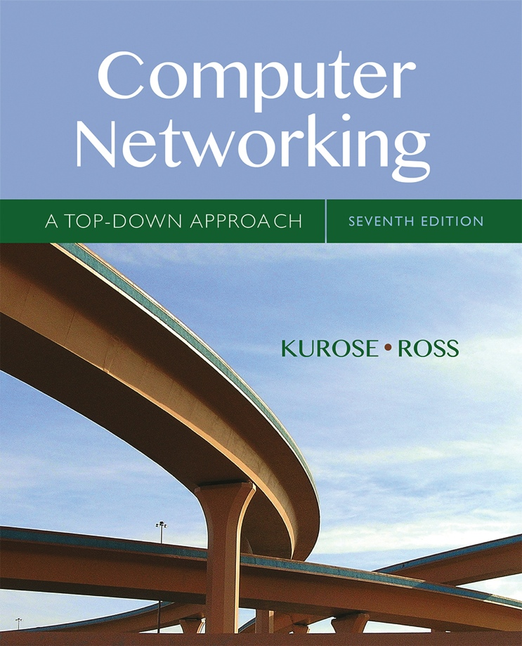

Chapter 5 Network Layer:
The Control Plane
A note on the use of these Powerpoint slides:
We’re making these slides freely available to all (faculty, students, readers). They’re in PowerPoint form so you see the animations; and can add, modify, and delete slides (including this one) and slide content to suit your needs. They obviously represent a lot of work on our part. In return for use, we only ask the following:
Computer Networking: A Top Down Approach
If you use these slides (e.g., in a class) that you mention their source (after all, we’d like people to use our book!)
If you post any slides on a www site, that you note that they are adapted from (or perhaps identical to) our slides, and note our copyright of this material.
Thanks and enjoy! JFK/KWR
All material copyright 1996-2016
J.F Kurose and K.W. Ross, All Rights Reserved
7th edition Jim Kurose, Keith Ross Pearson/Addison Wesley April 2016

Slide 2
Chapter 5: outline
5.1 introduction
5.2 routing protocols
link state
distance vector
5.3 intra-AS routing in the Internet: OSPF
5.4 routing among the ISPs: BGP
5.5 The SDN control plane
5.6 ICMP: The Internet Control Message Protocol
5.7 Network management and SNMP

Slide 3
Network-layer functions
Recall: two network-layer functions:
forwarding: move packets from router’s input to appropriate router output
data plane
routing: determine route taken by packets from source to destination
control plane
Two approaches to structuring network control plane:
per-router control (traditional)
logically centralized control (software defined networking)

Slide 4

Per-router control plane
Individual routing algorithm components in each and every router interact with each other in control plane to compute forwarding tables
Routing
Algorithm
control
plane
data
plane

Slide 5
Chapter 5: outline
5.1 introduction
5.2 routing protocols
link state
distance vector
5.3 intra-AS routing in the Internet: OSPF
5.4 routing among the ISPs: BGP
5.5 The SDN control plane
5.6 ICMP: The Internet Control Message Protocol
5.7 Network management and SNMP

Slide 6
Routing protocols
Routing protocol goal: determine “good” paths (equivalently, routes), from sending hosts to receiving host, through network of routers
path: sequence of routers packets will traverse in going from given initial source host to given final destination host
“good”: least “cost”, “fastest”, “least congested”
routing: a “top-10” networking challenge!

Slide 7
Graph abstraction of the network
5
v
3
w
2
5
u
2
1
z
3
1
2
x
y
1
graph: G = (N,E)
N = set of routers = { u, v, w, x, y, z }
E = set of links ={ (u,v), (u,x), (v,x), (v,w), (x,w), (x,y), (w,y), (w,z), (y,z) }

Slide 8
Graph abstraction: costs
5
c(x,x’) = cost of link (x,x’)
e.g., c(w,z) = 5
cost could always be 1, or
inversely related to bandwidth,
or inversely related to
congestion
v
3
w
2
5
u
2
1
z
3
1
2
x
y
1
cost of path (x₁, x₂, x₃,…, x_{p}) = c(x₁,x₂) + c(x₂,x₃) + … + c(x_{p-1},x_{p})
key question: what is the least-cost path between u and z ?
routing algorithm: algorithm that finds that least cost path

Slide 9
Routing algorithm classification
Q: global or decentralized information?
global:
all routers have complete topology, link cost info
“link state” algorithms
decentralized:
router knows physically-connected neighbors, link costs to neighbors
iterative process of computation, exchange of info with neighbors
“distance vector” algorithms

Slide 10
Chapter 5: outline
5.1 introduction
5.2 routing protocols
link state
distance vector
5.3 intra-AS routing in the Internet: OSPF
5.4 routing among the ISPs: BGP
5.5 The SDN control plane
5.6 ICMP: The Internet Control Message Protocol
5.7 Network management and SNMP

Slide 11
Basic Idea – High Level
Each router configured with own ID
Each router configured with cost of link to directly-connected neighbor
Each router uses 0 for distance to itself
Each router uses infinity for unknown costs
Each router sends its distance vector to neighbors when information changes (also when link comes up)
Each router saves distance vectors learned from other neighbors
Each router computes minimum distance to destination
Re-computes when link costs change or info learned changes

Slide 12
Distance vector algorithm
Bellman-Ford equation (dynamic programming)
let
d_{x}(y) := cost of least-cost path from x to y
then
d_{x}(y) = min {c(x,v) + d_{v}(y) }
v
cost from neighbor v to destination y
cost to neighbor v
min taken over all neighbors v of x

Slide 13
Bellman-Ford example
5
clearly, d_{v}(z) = 5, d_{x}(z) = 3, d_{w}(z) = 3
v
3
w
2
5
u
z
B-F equation says:
2
1
3
1
2
d_{u}(z) = min { c(u,v) + d_{v}(z),
c(u,x) + d_{x}(z),
c(u,w) + d_{w}(z) }
= min {2 + 5,
1 + 3,
5 + 3} = 4
x
y
1
node achieving minimum is next
hop in shortest path, used in forwarding table

Slide 14
Distance vector algorithm
node x:
knows cost to each neighbor v: c(x,v)
D_{x}(y) = estimate of least cost from x to y for all destination y in N
x maintains distance vector D_{x} = [D_{x}(y): y є N ]
Stores its neighbors’ distance vectors.
For each neighbor v, x stores D_{v} = [D_{v}(y): y є N ]

Slide 15
Distance vector algorithm
key idea:
from time-to-time, each node sends its own distance vector estimate to neighbors
when x receives new DV estimate from neighbor, it updates its own DV using B-F equation:
If changed, send D_{x}(y) to neighbors who in turn do the same
D_{x}(y) ← min_{v}{c(x,v) + D_{v}(y)} for each node y ∊ N
In this way, the estimate D_{x}(y) converge to the actual least cost d_{x}(y)

Slide 16
Distance vector algorithm
iterative, asynchronous: each local iteration caused by:
local link cost change
DV update message from neighbor
distributed:
each node notifies neighbors only when its DV changes
neighbors then notify their neighbors if necessary
each node:
wait for (change in local link cost or msg from neighbor)
recompute estimates
if DV to any dest has changed, notify neighbors

Slide 17
D_{x}(z) = min{c(x,y) + D_{y}(z), c(x,z) + D_{z}(z)}
= min{2+1 , 7+0} = 3
D_{x}(y) = min{c(x,y) + D_{y}(y), c(x,z) + D_{z}(y)} = min{2+0 , 7+1} = 2
node x
table
cost to
cost to
x y z
x y z
x
0 2 7
x
0
2
3
y
y
2 0 1
from
∞
∞
∞
from
z
∞
∞
∞
z
7 1 0
node y
table
cost to
x y z
y
2
1
x
∞
∞
z
∞
2 0 1
x
from
y
7
z
∞
∞
∞
node z
table
cost to
x y z
x
∞ ∞ ∞
from
y
∞
∞
∞
z
7
1
0
time

Slide 18
D_{x}(z) = min{c(x,y) + D_{y}(z), c(x,z) + D_{z}(z)}
= min{2+1 , 7+0} = 3
D_{x}(y) = min{c(x,y) + D_{y}(y), c(x,z) + D_{z}(y)} = min{2+0 , 7+1} = 2
node x
table
cost to
cost to
cost to
x y z
x y z
x y z
x
0 2 7
x
0
2
3
x
0 2 3
y
y
2 0 1
from
∞
∞
∞
from
y
2 0 1
z
z
from
∞
∞
∞
7 1 0
z
3 1 0
node y
table
cost to
cost to
cost to
x y z
x y z
x y z
y
2
1
x
∞
∞
x
0 2 7
∞
2 0 1
x
0 2 3
x
z
from
y
y
2 0 1
y
7
from
from
2 0 1
z
∞
∞
∞
z
7 1 0
z
3 1 0
node z
table
cost to
cost to
cost to
x y z
x y z
x y z
x
∞ ∞ ∞
x
0 2 7
x
0 2 3
y
y
2 0 1
from
y
∞
∞
from
2 0 1
from
∞
z
z
3 1 0
z
3 1 0
7
1
0
time
time

Slide 19
Distance vector: link cost changes
link cost changes:
node detects local link cost change
updates routing info, recalculates distance vector
if DV changes, notify neighbors
1
y
4
1
x
z
50
“good
news
travels
fast”
t₀ : y detects link-cost change, updates its DV, informs its neighbors.
t₁ : z receives update from y, updates its table, computes new least cost to x , sends its neighbors its DV.
t₂ : y receives z’s update, updates its distance table. y’s least costs do not change, so y does not send a message to z.
* Check out the online interactive exercises for more examples: http://gaia.cs.umass.edu/kurose_ross/interactive/

Slide 20
Distance vector: link cost changes
link cost changes:
node detects local link cost change
bad news travels slow - “count to infinity” problem!
44 iterations before algorithm stabilizes: see text
60
y
4
1
x
z
50
poisoned reverse:
If Z routes through Y to get to X :
Z tells Y its (Z’s) distance to X is infinite (so Y won’t route to X via Z)
will this completely solve count to infinity problem?

Slide 21
Chapter 5: outline
5.1 introduction
5.2 routing protocols
link state
distance vector
5.3 intra-AS routing in the Internet: OSPF
5.4 routing among the ISPs: BGP
5.5 The SDN control plane
5.6 ICMP: The Internet Control Message Protocol
5.7 Network management and SNMP

Slide 22
A link-state routing algorithm
Dijkstra’s algorithm
net topology, link costs known to all nodes
accomplished via “link state broadcast”
all nodes have same info
computes least cost paths from one node (‘source”) to all other nodes
gives forwarding table for that node
iterative: after k iterations, know least cost path to k dest.’s
notation:
c(x,y): link cost from node x to y; = ∞ if not direct neighbors
D(v): current value of cost of path from source to dest. v
p(v): predecessor node along path from source to v
N': set of nodes whose least cost path definitively known

Slide 23
Dijsktra’s algorithm
1 Initialization:
2 N' = {u}
3 for all nodes v
4 if v adjacent to u
5 then D(v) = c(u,v)
6 else D(v) = ∞
7
8 Loop
9 find w not in N' such that D(w) is a minimum
10 add w to N'
11 update D(v) for all v adjacent to w and not in N' :
12 D(v) = min( D(v), D(w) + c(w,v) )
13 /* new cost to v is either old cost to v or known
14 shortest path cost to w plus cost from w to v */
15 until all nodes in N'

Slide 24
Dijkstra’s algorithm: example
D(v)
p(v)
D(w)
p(w)
D(x)
p(x)
D(y)
p(y)
D(z)
p(z)
Step
N'
0
u
7,u
3,u
5,u
∞
∞
1
uw
6,w
5,u
11,w
∞
2
uwx
6,w
11,w
14,x
3
uwxv
10,v
14,x
4
uwxvy
12,y
5
uwxvyz
x
9
notes:
construct shortest path tree by tracing predecessor nodes
ties can exist (can be broken arbitrarily)
5
7
4
8
u
3
w
y
z
2
3
7
4
v

Slide 25
Dijkstra’s algorithm: another example
Step
0
1
2
3
4
5
N'
u
ux
uxy
uxyv
uxyvw
uxyvwz
D(v),p(v)
2,u
2,u
2,u
D(w),p(w)
5,u
4,x
3,y
3,y
D(x),p(x)
1,u
D(y),p(y)
∞
2,x
D(z),p(z)
∞
∞
4,y
4,y
4,y
5
v
3
w
2
5
u
2
1
z
3
1
2
x
y
1
* Check out the online interactive exercises for more examples: http://gaia.cs.umass.edu/kurose_ross/interactive/

Slide 26
Dijkstra’s algorithm: example (2)
resulting shortest-path tree from u:
v
w
u
z
x
y
resulting forwarding table in u:
destination
link
v
(u,v)
x
(u,x)
y
(u,x)
w
(u,x)
z
(u,x)

Slide 27
Dijkstra’s algorithm, discussion
algorithm complexity: n nodes
each iteration: need to check all nodes, w, not in N
n(n+1)/2 comparisons: O(n²)
more efficient implementations possible: O(nlogn)
oscillations possible:
e.g., support link cost equals amount of carried traffic:
A
A
A
A
1
1+e
2+e
0
0
2+e
2+e
0
D
B
D
B
D
B
D
B
0
0
1+e
1
0
0
1+e
1
0
C
e
0
0
1
0
0
1
C
C
1+e
C
1
e
initially
given these costs,
find new routing….
resulting in new costs
given these costs,
find new routing….
resulting in new costs
given these costs,
find new routing….
resulting in new costs

Slide 28
Comparison of LS and DV algorithms
message complexity
LS: with n nodes, E links, O(nE) msgs sent
DV: exchange between neighbors only
convergence time varies
speed of convergence
LS: O(n²) algorithm requires O(nE) msgs
may have oscillations
DV: convergence time varies
may be routing loops
count-to-infinity problem
robustness: what happens if router malfunctions?
LS:
node can advertise incorrect link cost
each node computes only its own table
DV:
DV node can advertise incorrect path cost
each node’s table used by others
error propagate thru network

