Slide 1
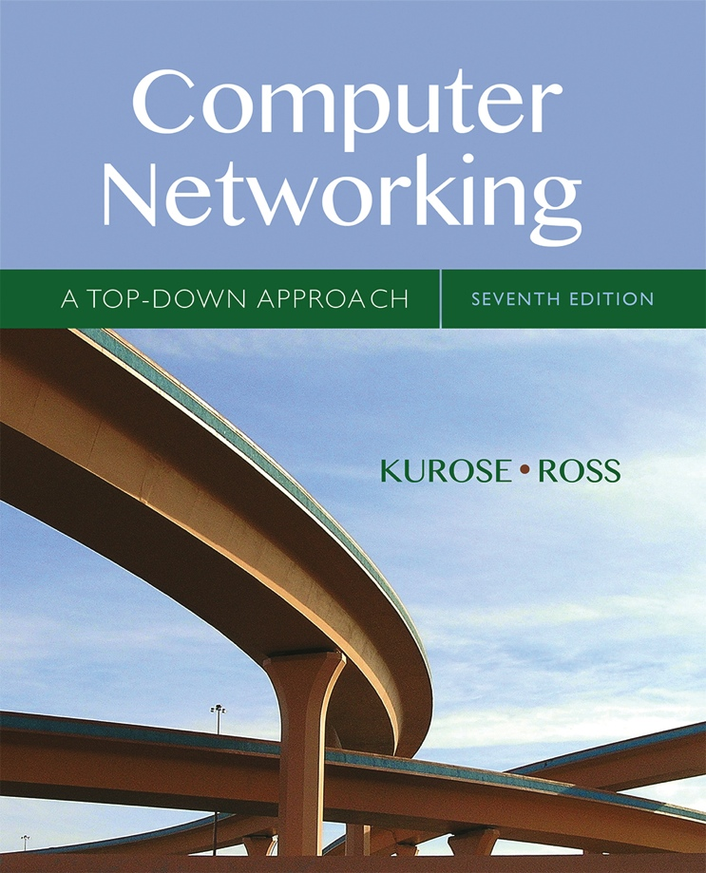

Chapter 5 Network Layer:
The Control Plane
These slides have been adapted from the Pearson slides. S. Thomson 03/2017.
A note on the use of these Powerpoint slides:
We’re making these slides freely available to all (faculty, students, readers). They’re in PowerPoint form so you see the animations; and can add, modify, and delete slides (including this one) and slide content to suit your needs. They obviously represent a lot of work on our part. In return for use, we only ask the following:
Computer Networking: A Top Down Approach
If you use these slides (e.g., in a class) that you mention their source (after all, we’d like people to use our book!)
If you post any slides on a www site, that you note that they are adapted from (or perhaps identical to) our slides, and note our copyright of this material.
Thanks and enjoy! JFK/KWR
All material copyright 1996-2016
J.F Kurose and K.W. Ross, All Rights Reserved
7th edition Jim Kurose, Keith Ross Pearson/Addison Wesley April 2016

Slide 2
Chapter 5: outline
5.1 introduction
5.2 routing protocols
link state
distance vector
5.3 intra-AS routing in the Internet: OSPF
5.4 routing among the ISPs: BGP
5.5 The SDN control plane
5.6 ICMP: The Internet Control Message Protocol
5.7 Network management and SNMP

Slide 3
Making routing scalable
our routing study thus far - idealized
all routers identical
network “flat”
… not true in practice
scale: with billions of destinations:
can’t store all destinations in routing tables!
routing table exchange would swamp links!
administrative autonomy
internet = network of networks
each network admin may want to control routing in its own network

Slide 4
Internet approach to scalable routing
3c
3a
3b
AS3
2c
other
networks
1c
2a
other
networks
1a
2b
1b
AS2
AS1
1d
aggregate routers into regions known as “autonomous systems” (AS) (a.k.a. “domains”)
Collection of routers under common administrative control e.g. ISP, large company
Collection of subnets (routing prefixes => route aggregation)
Present common routing policy to Internet
Identified by an AS number assigned: Internet Assigned Numbers Authority (IANA) -> Reginal Internet Registry (RIR)

Slide 5
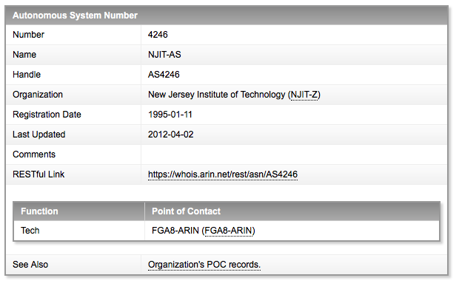
ARIN AS Assignment Example

Slide 6
Internet approach to scalable routing
aggregate routers into regions known as “autonomous systems” (AS) (a.k.a. “domains”)
intra-AS routing
routing among hosts, routers in same AS (“network”)
all routers in AS must run same intra-domain protocol
routers in different AS can run different intra-domain routing protocol
gateway router: at “edge” of its own AS, has link(s) to router(s) in other AS’es
inter-AS routing
routing among AS’es
gateways perform inter-domain routing (as well as intra-domain routing)

Slide 7
Types of Autonomous Systems
Stub AS
Carries traffic for which it is source or destination
Does not route traffic between AS’s
Multi-homed stub AS
Like a stub AS, but connected to multiple other ASes
Transit AS
Routes to and from other AS e.g. ISP

Slide 8
Intra-AS Routing
also known as interior gateway protocols (IGP)
most common intra-AS routing protocols:
RIP: Routing Information Protocol
OSPF: Open Shortest Path First (IS-IS protocol essentially same as OSPF)
IGRP: Interior Gateway Routing Protocol (Cisco proprietary, Informational RFC published in 2016)

Slide 9
OSPF (Open Shortest Path First)
IETF standard
uses link-state algorithm
link state packet dissemination
topology map at each node
route computation using Dijkstra’s algorithm
router floods OSPF link-state advertisements to all other routers in entire AS
carried in OSPF messages directly over IP (rather than TCP or UDP) Protocol number 89
link state: for each attached link
IS-IS routing protocol: nearly identical to OSPF

Slide 10
OSPF “advanced” features
security: all OSPF messages authenticated (to prevent malicious intrusion)
multiple same-cost paths allowed (only one path in RIP)
for each link, multiple cost metrics for different TOS (e.g., satellite link cost set low for best effort ToS; high for real-time ToS)
integrated uni- and multi-cast support:
Multicast OSPF (MOSPF) uses same topology data base as OSPF
hierarchical OSPF in large domains.

Slide 11
Hierarchical OSPF
boundary router
backbone router
backbone
area
border
routers
area 3
internal
routers
area 1
area 2

Slide 12
Hierarchical OSPF
two-level hierarchy: local area, backbone.
link-state advertisements only in area
each nodes has detailed area topology; only know direction (shortest path) to nets in other areas.
area border routers: “summarize” distances to nets in own area, advertise to other Area Border routers.
backbone routers: run OSPF routing limited to backbone.
boundary routers: connect to other AS’es.

Slide 13
Chapter 5: outline
5.1 introduction
5.2 routing protocols
link state
distance vector
5.3 intra-AS routing in the Internet: OSPF
5.4 routing among the ISPs: BGP
5.5 The SDN control plane
5.6 ICMP: The Internet Control Message Protocol
5.7 Network management and SNMP

Slide 14
Inter-AS tasks
suppose router in AS1 receives datagram destined outside of AS1:
router should forward packet to gateway router, but which one?
AS1 must:
learn which dests are reachable through AS2, which through AS3
propagate this reachability info to all routers in AS1
job of inter-AS routing!
3c
3a
3b
AS3
2c
other
networks
1c
2a
other
networks
1a
2b
1b
AS2
AS1
1d

Slide 15
Internet inter-AS routing: BGP
BGP (Border Gateway Protocol): the de facto inter-domain routing protocol
“glue that holds the Internet together”
BGP provides each AS a means to:
eBGP: obtain subnet reachability information from neighboring ASes
iBGP: propagate reachability information to all AS-internal routers.
determine “good” routes to other networks based on reachability information and policy

Slide 16
BGP Sessions
Pairs of routers exchange routing information via BP sessions over semi-permanent TCP connections
One connection between AS Gateway Routers (eBGP)
Internally distributed to routers within AS via a mesh of internal BGP sessions (iBGP)
2b
2a
2c
1b
3b
2d
1a
1c
3a
3c
AS 2
1d
3d
AS 1
eBGP connectivity
AS 3
iBGP connectivity

Slide 17
BGP Sessions
2b
∂
2a
2c
1b
3b
2d
∂
1a
1c
3a
3c
AS 2
1d
3d
AS 1
eBGP connectivity
AS 3
iBGP connectivity
1c
gateway routers run both eBGP and iBGP protocols

Slide 18
BGP Learns Aggregated Subnet Prefixes
200.23.64.0/24
.
.
Advertize
200.23.64.0/22” to AS1
.
200.23.65.0/24
AS3
3a
.
Route
Aggregation
.
.
Longest Prefix
Match
200.23.66.0/24
AS1
2a
AS2
“Advertize 200.23.67.0/24” to AS1
200.23.67.0/24

Slide 19
Internet inter-AS routing: BGP
BGP routers send route announcements
Destination address block/prefix/subnet
Path of AS numbers the packet will take
BGP Attributes
Key attributes
AS-PATH: Sequence of ASs through which advertisement passed
If a router sees a loop, reject
Next-Hop: Identifies the router IP address of the AS gateway router that sent the advertisement to this AS
Intra-AS routing knows how to get to the “next hop” IP address

Slide 20
BGP basics
BGP session: two BGP routers (“peers”) exchange BGP messages over semi-permanent TCP connection:
advertising paths to different destination network prefixes (BGP is a “path vector” protocol)
when AS3 gateway router 3a advertises path AS3,X to AS2 gateway router 2c:
AS3 promises to AS2 it will forward datagrams towards prefix X
AS 3
3b
AS 1
1b
3a
3c
1a
1c
AS 2
2b
3d
X
1d
2a
2c
BGP advertisement:
AS3, X
2d

Slide 21
BGP path advertisement
AS3
3b
AS1
1b
3a
3c
1a
1c
AS2
2b
3d
X
1d
AS3,X
AS2,AS3,X
2a
2c
2d
AS2 router 2c receives path advertisement AS3,X (via eBGP) from AS3 router 3a
Based on AS2 policy, AS2 router 2c accepts path AS3,X, propagates (via iBGP) to all AS2 routers
Based on AS2 policy, AS2 router 2a advertises (via eBGP) path AS2, AS3, X to AS1 router 1c

Slide 22
Path attributes and BGP routes
advertised prefix includes BGP attributes
prefix + attributes = “route”
two important attributes:
AS-PATH: list of ASes through which prefix advertisement has passed
NEXT-HOP: indicates specific internal-AS router to next-hop AS
Policy-based routing:
gateway receiving route advertisement uses import policy to accept/decline path (e.g., never route through AS Y).
AS policy also determines whether to advertise path to other other neighboring ASes

Slide 23
BGP path advertisement
AS3
3b
AS1
1b
AS3,X
3a
3c
1a
1c
AS2
2b
3d
X
1d
AS3,X
AS2,AS3,X
2a
2c
2d
gateway router may learn about multiple paths to destination:
AS1 gateway router 1c learns path AS2,AS3,X from 2a
AS1 gateway router 1c learns path AS3,X from 3a
Based on policy, AS1 gateway router 1c chooses path AS3,X, and advertises path within AS1 via iBGP

Slide 24
BGP: achieving policy via advertisements
legend:
provider
B
network
X
W
A
customer
C
network:
Y
Suppose an ISP only wants to route traffic to/from its customer networks (does not want to carry transit traffic between other ISPs)
A advertises path Aw to B and to C
B chooses not to advertise BAw to C:
B gets no “revenue” for routing CBAw, since none of C, A, w are B’s customers
C does not learn about CBAw path
C will route CAw (not using B) to get to w

Slide 25
BGP messages
BGP messages exchanged between peers over TCP connection
BGP messages:
OPEN: opens TCP connection to remote BGP peer and authenticates sending BGP peer
UPDATE: advertises new path (or withdraws old)
KEEPALIVE: keeps connection alive in absence of UPDATES; also ACKs OPEN request
NOTIFICATION: reports errors in previous msg; also used to close connection

Slide 26
Updating the Forwarding Table
3c
3a
2c
3b
AS3
2a
1c
2b
AS2
1a
1b
1d
AS1
forwarding table configured by both intra- and inter-AS routing algorithm
intra-AS routing determine entries for destinations within AS
inter-AS & intra-AS determine entries for external destinations
Intra-AS
Routing
algorithm
Inter-AS
Routing
algorithm
Forwarding
table

Slide 27
BGP, OSPF, forwarding table entries
Q: how does router set forwarding table entry to distant prefix?
AS3
3b
AS1
1b
AS3,X
1
AS3,X
3a
3c
1a
2
1c
local link interfaces
at 1a, 1d
AS2
2b
3d
X
2
1d
1
AS3,X
AS2,AS3,X
2a
2c
physical link
2d
dest
interface
recall: 1a, 1b, 1c learn about dest X via iBGP from 1c: “path to X goes through 1c”
…
…
…
…
X
1
1d: OSPF intra-domain routing: to get to 1c, forward over outgoing local interface 1

Slide 28
BGP, OSPF, forwarding table entries
Q: how does router set forwarding table entry to distant prefix?
AS3
3b
AS1
1b
1
3a
3c
1a
2
1c
AS2
2b
3d
X
1d
2a
2c
2d
dest
interface
recall: 1a, 1b, 1c learn about dest X via iBGP from 1c: “path to X goes through 1c”
…
…
…
…
X
2
1d: OSPF intra-domain routing: to get to 1c, forward over outgoing local interface 1
1a: OSPF intra-domain routing: to get to 1c, forward over outgoing local interface 2

Slide 29
BGP route selection
router may learn about more than one route to destination AS, selects route based on:
local preference value attribute: policy decision
shortest AS-PATH
closest NEXT-HOP router: hot potato routing
additional criteria

Slide 30
Hot Potato Routing
AS3
3b
AS1
1b
3a
3c
1a
1c
AS2
2b
3d
X
1d
112
152
AS3,X
AS1,AS3,X
2a
263
2c
201
OSPF link weights
2d
2d learns (via iBGP) it can route to X via 2a or 2c
hot potato routing: choose local gateway that has least intra-domain cost (e.g., 2d chooses 2a, even though more AS hops to X): don’t worry about inter-domain cost!

Slide 31
Why different Intra-, Inter-AS routing ?
policy:
inter-AS: admin wants control over how its traffic routed, who routes through its net.
intra-AS: single admin, so no policy decisions needed
scale:
hierarchical routing saves table size, reduced update traffic
performance:
intra-AS: can focus on performance
inter-AS: policy may dominate over performance

