Slide 1

Bangabandhu Sheikh Mujibur Rahman Science & Technology University,Gopalgonj-8100

Slide 2
A Project on
“Who wants to be a Millionaire (Game)”

Slide 3
Submitted by
Maniruzzaman Nayem
Student ID:20131101002
Department of Computer Science & Engineering

Slide 4
Supervised by
Saleh Ahmed
professor ,
Department of Computer Science & Engineering

Slide 5
About the game
Who wants to be a millionaire is an educational game. It is said to be educational because by playing this game anyone can enrich his/her general knowledge. On the other hand the game is more interesting than an user can thought because when a user give the correct answer he/she will get money(virtually) and the amount will increase level by level. The game is enjoyable because the user will get three life lines and the life lines will help him/her to give the correct answer.

Slide 6
The importance of this game
It is important to fresh our mind
it helps us to increase our general knowledge
It gives us pleasure

Slide 7
Header files
Stdio.h
Windows.h
String.h

Slide 8
Functions
play()
life_line()
fifty_fifty()
snd_ti()
persentage()
developer()
gm_info()

Slide 9
Files
congrats.txt
finalquestion.txt
gameinfo.txt

Slide 10
User Must input their choice in CAPITAL Letter
Otherwise the game will stopped

Slide 11
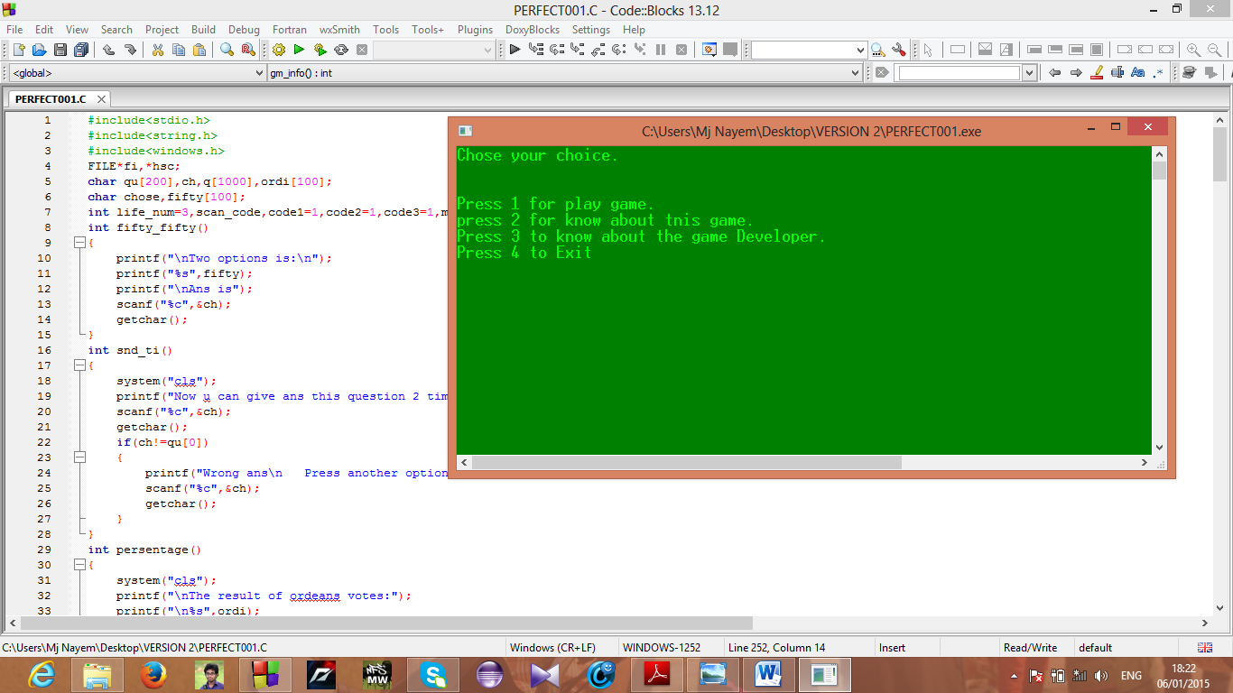
Lets play

Slide 12
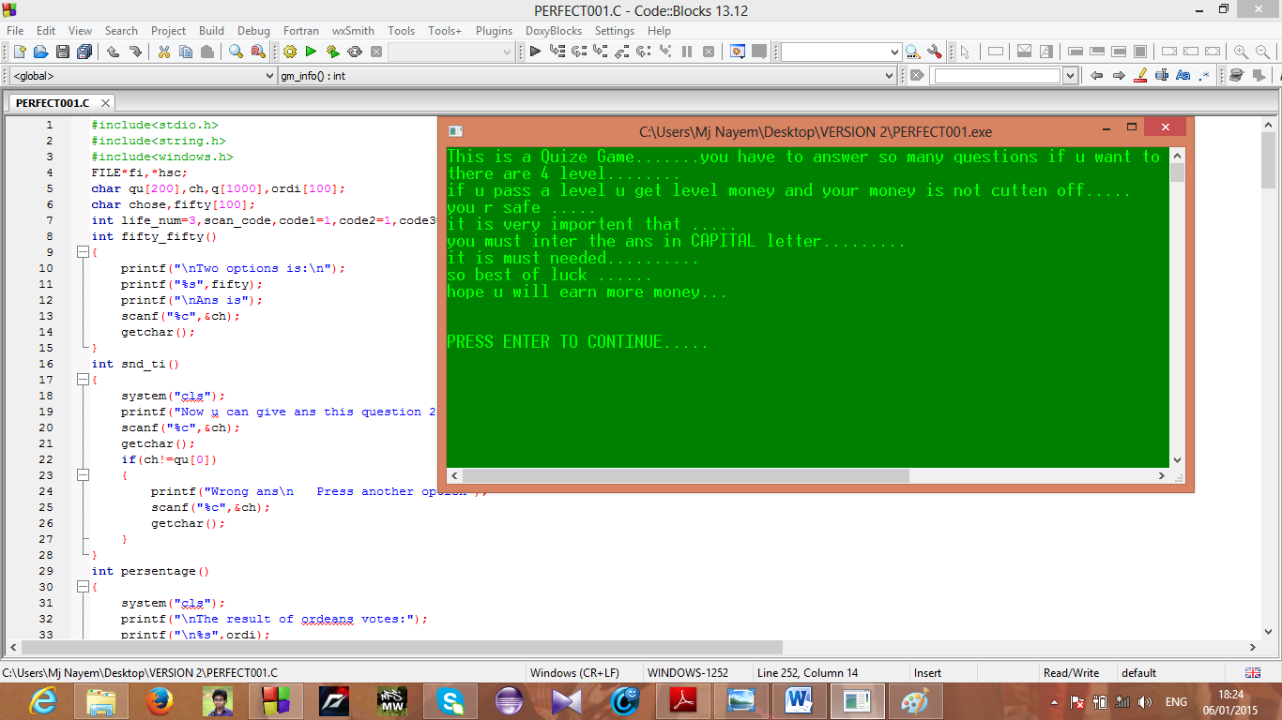
Press 1

Slide 13
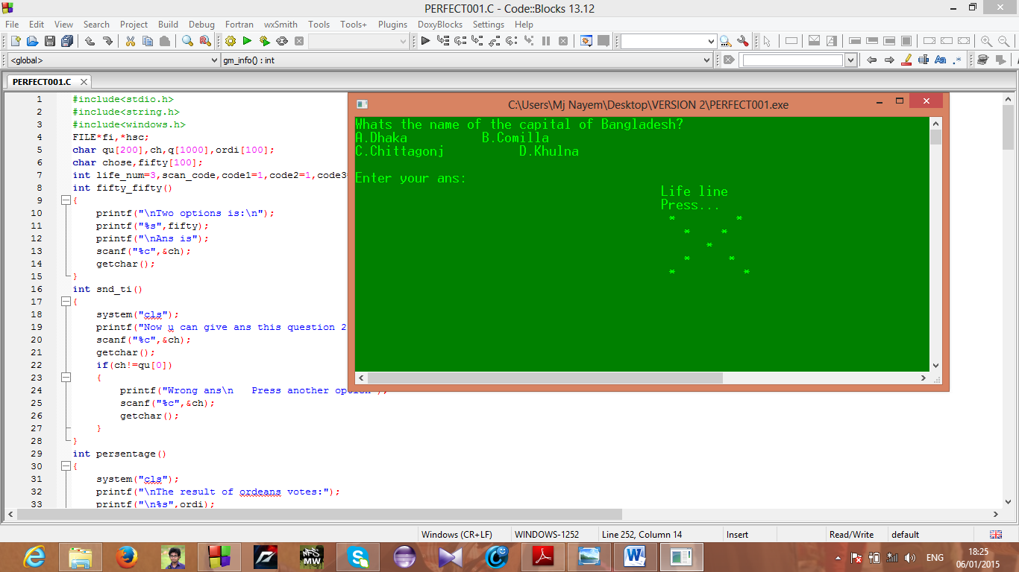
Press Enter

Slide 14
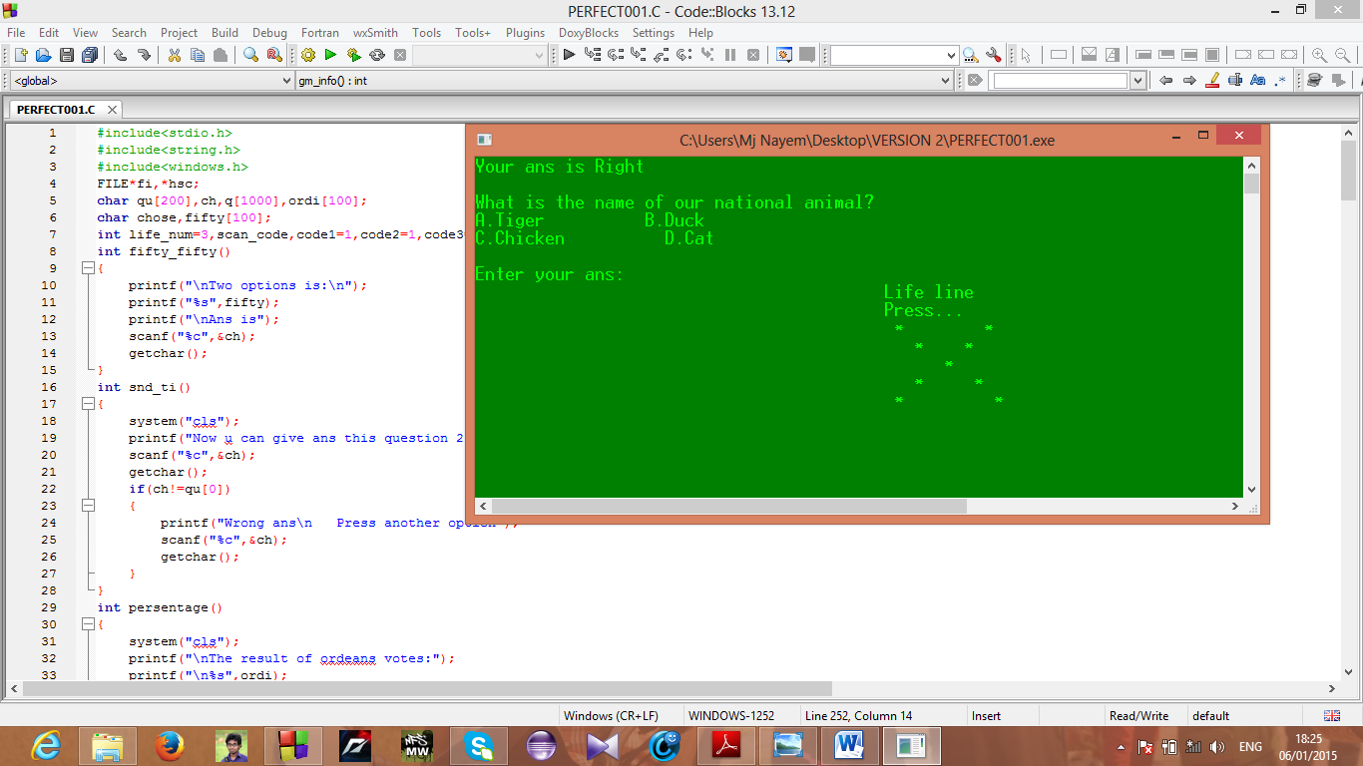
For right answer

Slide 15
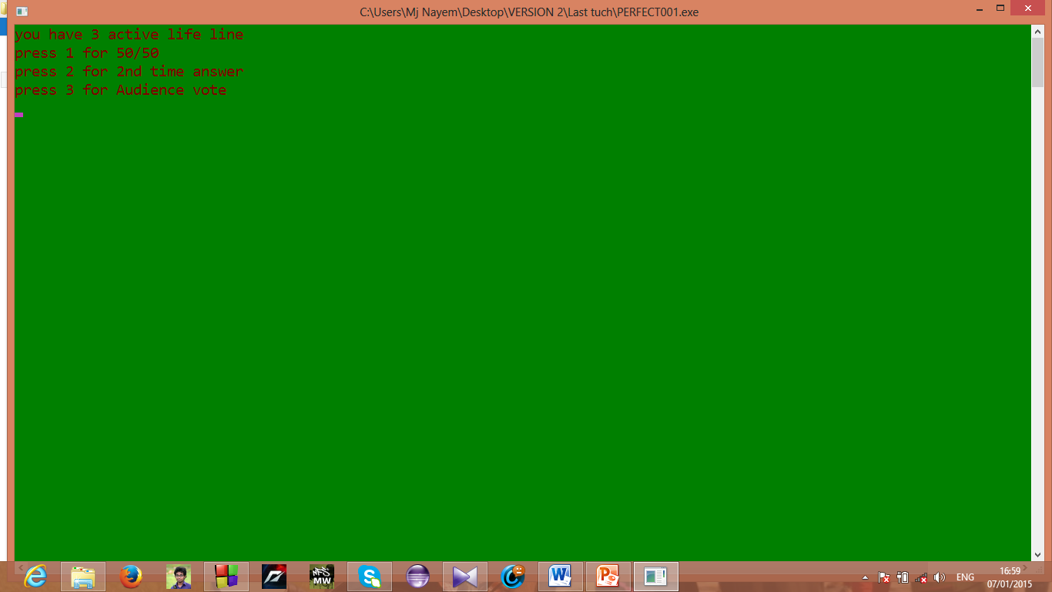
For life line

Slide 16

For Wrong ans

Slide 17
Future of this program
All sectors of people can easily play this game .
Specially the students can gain a huge knowledge by playing this game .so in future i develop it graphically .and new feature will come in this game .

Slide 18
Conclusion
I am really interested to doing this project .
In front of my view ,software project is a knowledge developing course on that particular language. It will be help me to develop a big application.

Slide 19
Thanks all
(^_^)

