Slide 1
BODYFAT ANALYSIS
Group 7:Hao Qin, Jiacheng Mao, Qiaoyu Wang, Yuhan Meng

Slide 2
CONTENT:
Data Display
Data Processing
Variable Selection
Model Building
Model Diagnostic
Discussion

Slide 3
DATA DISPLAY

Slide 4
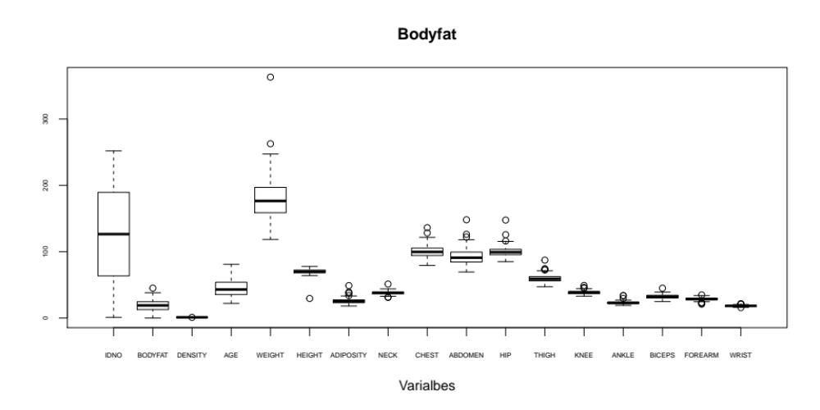
Data Display:

Slide 5
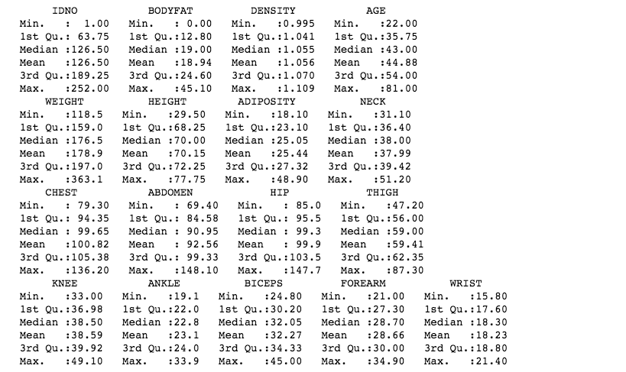
Data Display:

Slide 6
DATA PROCESSING

Slide 7
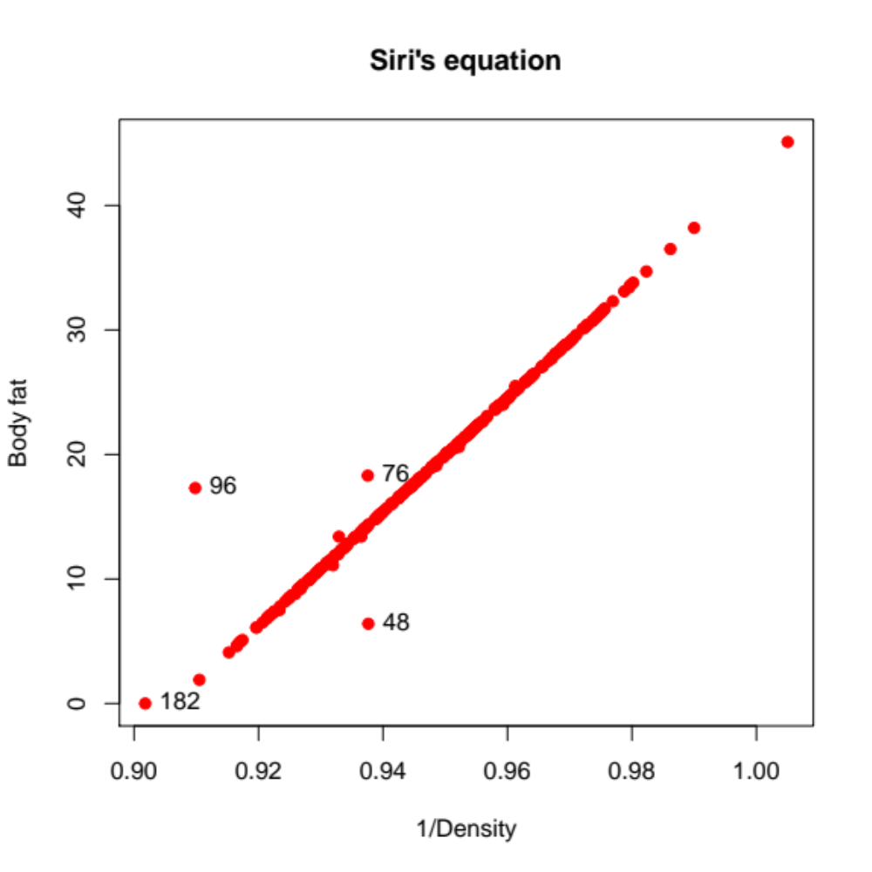
Data Processing:
1. use “Siri’s equation”
bodyfat = 495/Density - 450
IDNO | BODYFAT | CAL_BODYFAT
48 | 6.4 | 14.14
76 | 18.3 | 14.09
96 | 17.3 | 0.37
182 | 0 | -3.61

Slide 8
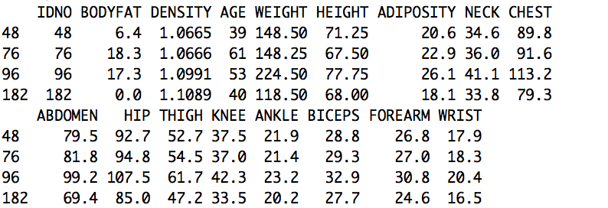
Data Processing:
1. use “Siri’s equation”

Slide 9
Data Processing:
1. use “Siri’s equation”
14.14

Slide 10
Data Processing:
1. use “Siri’s equation”

Slide 11


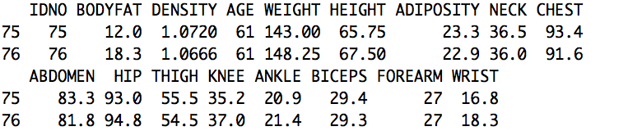
Data Processing:
1. use “Siri’s equation”

Slide 12
Data Processing:
1. use “Siri’s equation”
14.09

Slide 13
Data Processing:
1. use “Siri’s equation”

Slide 14
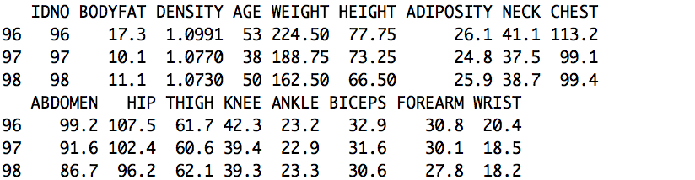
Data Processing:
1. use “Siri’s equation”
If use density →bodyfat : 495/1.0991- 450=0.3684833
If use bodyfat → density :495/(17.3+450) =1.059277

Slide 15
Data Processing:
1. use “Siri’s equation”
If use density →bodyfat : 495/1.0991- 450=0.3684833
If use bodyfat → density :495/(17.3+450) =1.059277

Slide 16
Data Processing:
1. use “Siri’s equation”
Negative!
Both density and bodyfat
are wrong! Delete 182!
If use density →bodyfat : 495/1.1089- 450=-3.611687

Slide 17
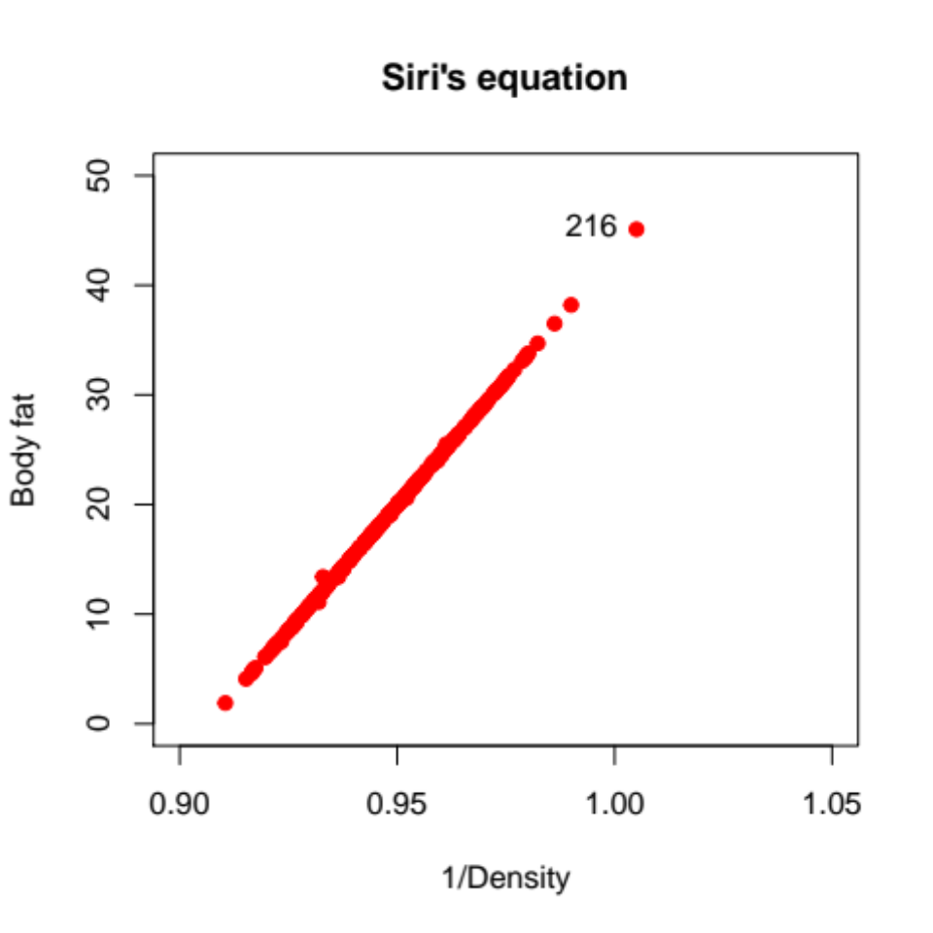
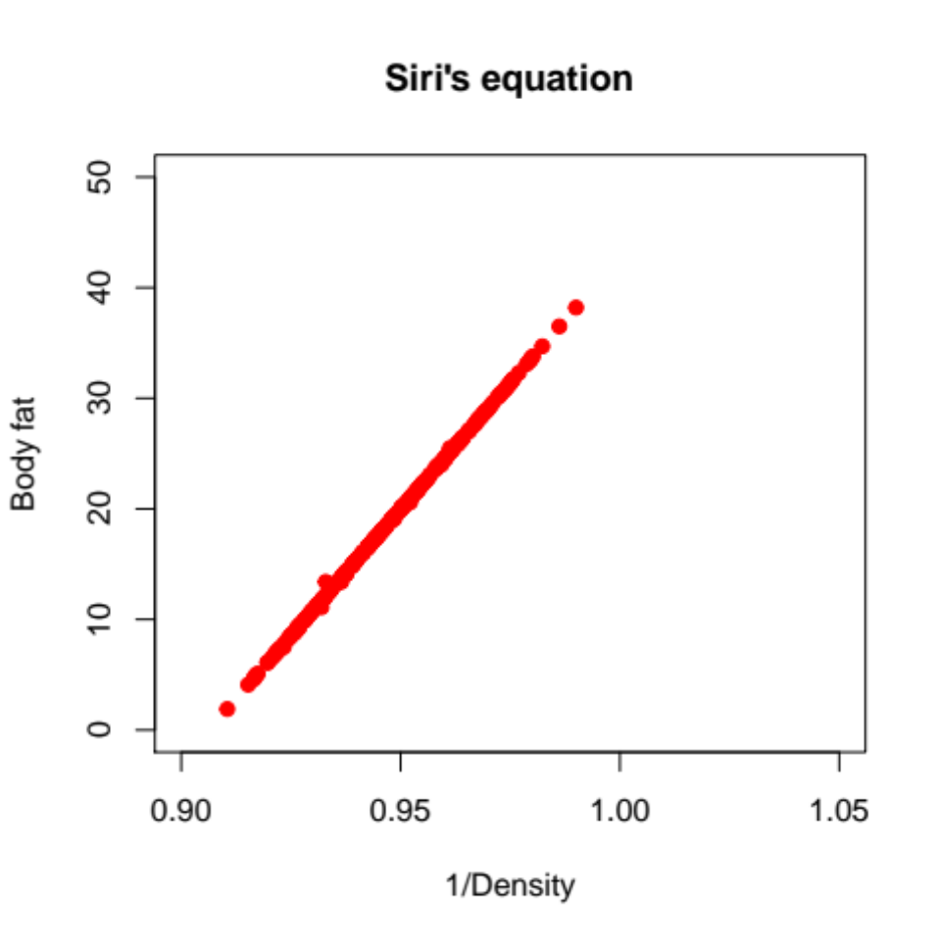
Data Processing:
1. use “Siri’s equation”
bodyfat = 495/Density - 450
After changing the values of 48,76,96,
and deleting the observation 182 :
Remember in the data display part
the 216 has a density<1, also delete.

Slide 18
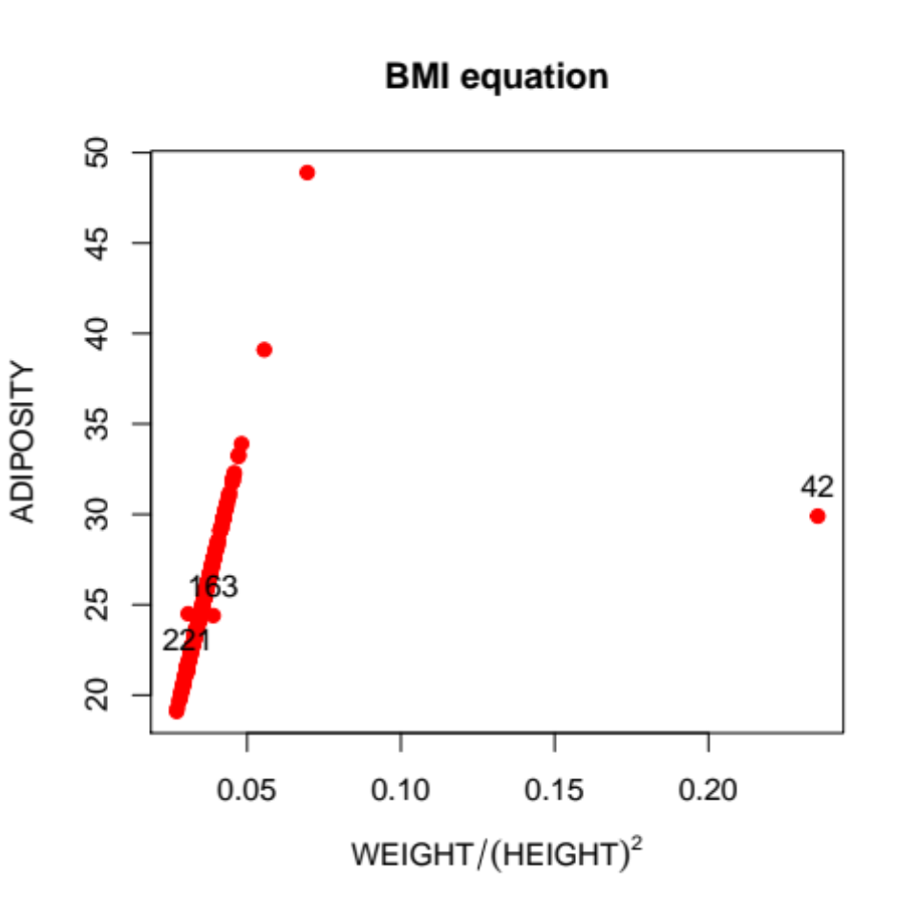
Data Processing:
2. use “BMI equation”
bmi=weight/(height)^2
IDNO | WEIGHT | HEIGHT | ADIPOSITY
42 | 205.00 | 29.50 | 29.9
163 | 184.25 | 68.75 | 24.4
221 | 153.25 | 70.50 | 24.5

Slide 19
Data Processing:
2. use “BMI equation”
bmi=weight/(height)^2
Construct a linear model between BMI and ADIPOSITY, without 42,163,221
IDNO | WEIGHT | HEIGHT | ADIPOSITY
42 | 205.00 | 29.50 | 29.9
163 | 184.25 | 68.75 | 24.4
221 | 153.25 | 70.50 | 24.5

Slide 20
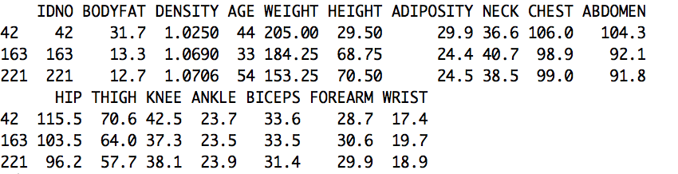
Data Processing:
2. use “BMI equation”
29.5 inches? Impossible!
Hence we use the model we fit to compute the BMI
first and then we can get the height: 69.46.

Slide 21
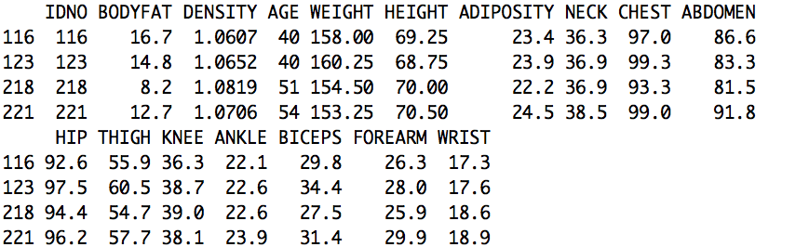
Data Processing:
2. use “BMI equation”
172.9469 lbs
Compare 218&221,similar weight and height but difference ADIPOSITY!
Other variables 221>218, especially the bodyfat !
Hence the ADIPOSITY is right. Also the mean of height is 70.15.

Slide 22
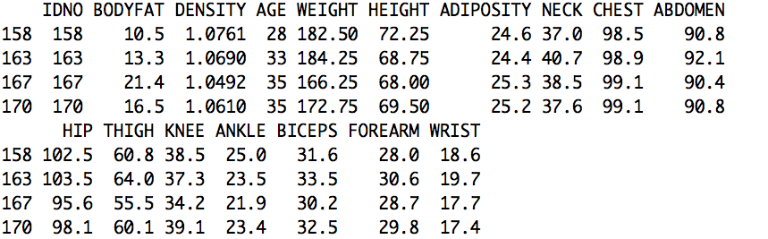
Data Processing:
2. use “BMI equation”
27.42749

Slide 23
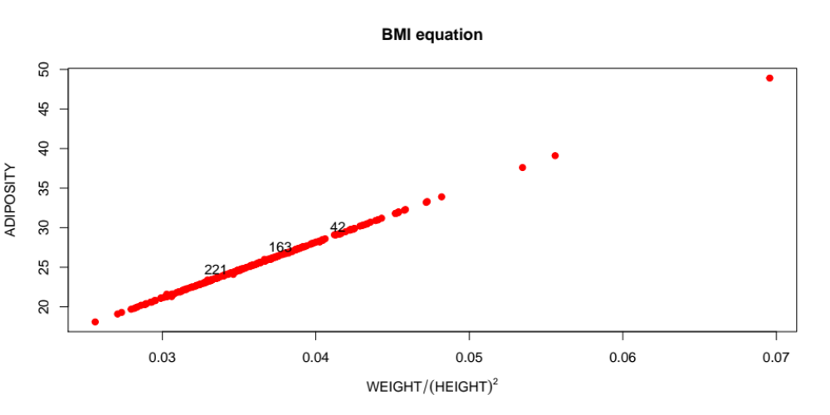
Data Processing:
2. use “BMI equation”
bmi=weight/(height)^2
Using these two euqations we only delete 182,216 and change some values.

Slide 24
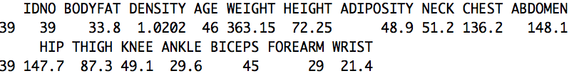
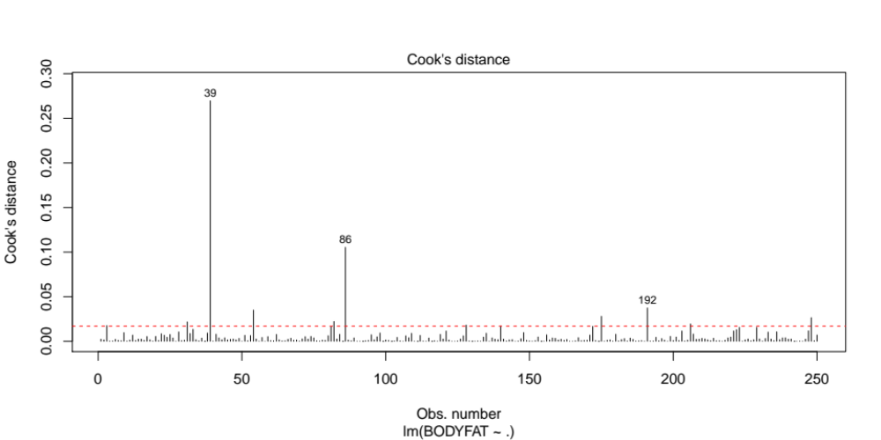
Data Processing:
3. Cook's distance

Slide 25
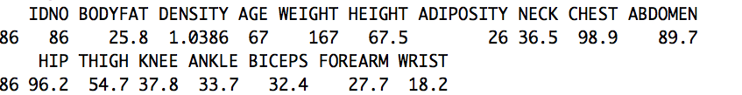
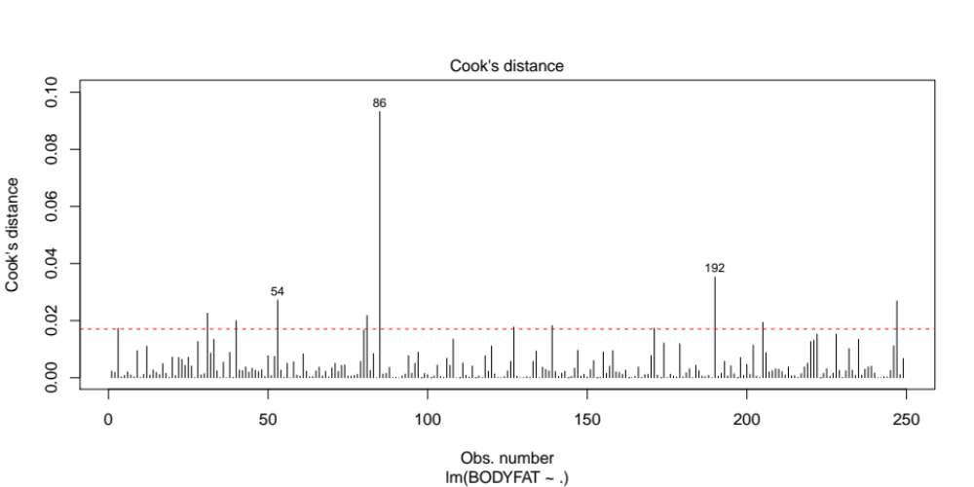
Data Processing:
3. Cook's distance
With values of the rest of the variables are on the average, the value of ankle is too high.

Slide 26
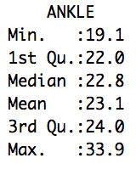
Data Processing:
3. Cook's distance
With values of the rest of the variables are on the average, the value of ankle is too high.

Slide 27
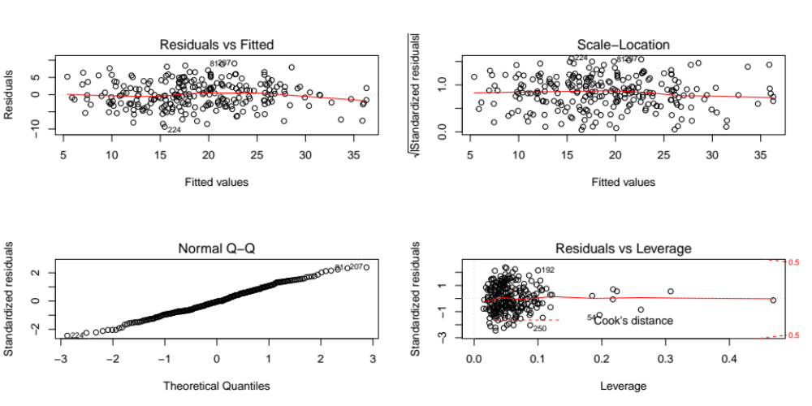
THE NOISE OBSERVATIONS :
39,86,182,216

Slide 28
MULTICOLLINEARITY CHECK

Slide 29
VARABLE SELECTION

Slide 30
MALLOW’S CP

Slide 31
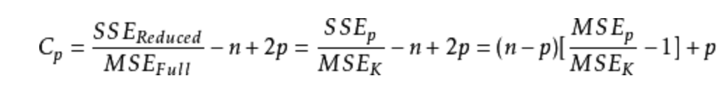
Definition:
Mallow’s Cp is used to evaluate the fit of a regression model with ordinary least square.
n means samples size ;
P means the number of regressors
Strengths: Our model is not that complex
Weakness: Our sample size is limited

Slide 32
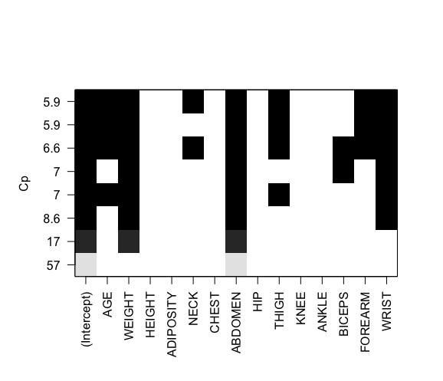
Scale Plot of Cp
ABDOMEN, WEIGHT, WRIST are relatively consistent factors.

Slide 33
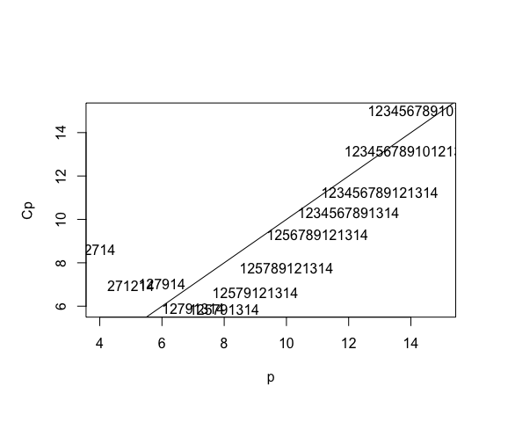
Cp plot
1: "AGE" 2: "WEIGHT" 3: "HEIGHT" 4: "ADIPOSITY" 5: "NECK" 6: "CHEST" 7: "ABDOMEN" 8:"HIP" 9:"THIGH" 10:"KNEE" 11:"ANKLE" 12:"BICEPS" 13: "FOREARM" 14"WRIST"

Slide 34
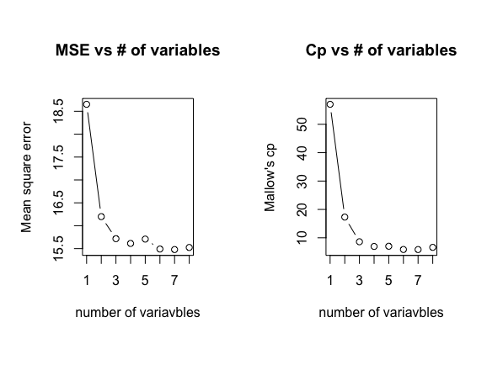
MSE after CV versus # of variables
Mallow’s Cp versus # of variables
From two plots above, we think 3 is the relatively good number of variables to estimate bodyfat since it’s the point after which mse and Cp has a small improvement.
The model after the criterion of mallow's cp is
BODYFAT ~ WEIGHT + ABDOMEN + WRIST.

Slide 35
ADJUSTED R SQUARE

Slide 36
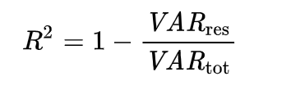
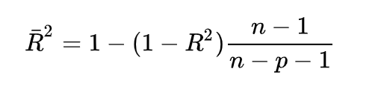
Definition:
It is a modification of R Square which punishes the complexity of the model.
n means samples size ;
p means the number of regressors

Slide 37
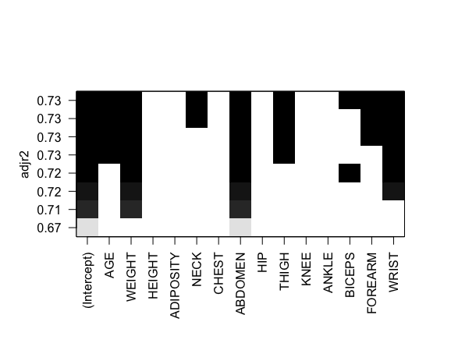
Scale Plot of Adjusted R Square
ABDOMEN, WEIGHT, WRIST are also consistent factors. Other factors appear differently in model compared with Mallow’s Cp.

Slide 38
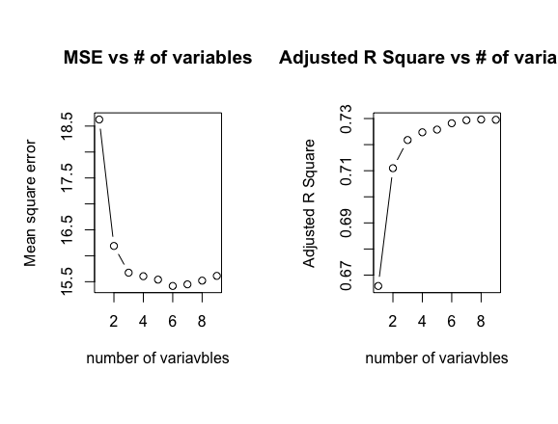
MSE after CV versus # of variables
Adjusted R Square versus # of variables
From plots above, it seems that 2 has met the requirement of enough accuracy of the model (Adjusted R Square exceeds 0.7 and improves slowly).
The model after the criterion of Adjusted R Square is
BODYFAT ~ WEIGHT + ABDOMEN.

Slide 39
CONTENT:
Dateset Display
Data Cleaning
Multicollinearity Check
Varable Selection
Model Building
Model Interpretation
Model Summary
Model Diagnostic
Discussion

