Slide 1
BODYFAT ANALYSIS
Group 7:Hao Qin, Jiacheng Mao, Qiaoyu Wang, Yuhan Meng

Slide 2
CONTENT:
Data Display
Data Processing
Variable Selection
Model Building
Model Diagnostic
Discussion

Slide 3
DATA DISPLAY

Slide 4
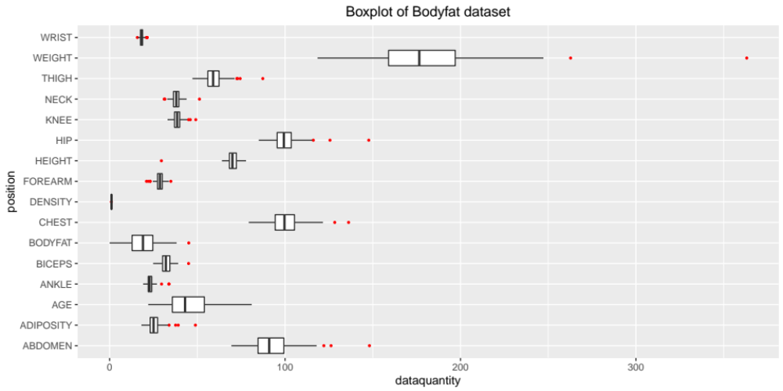
Data Display:

Slide 5
Data Display:

Slide 6
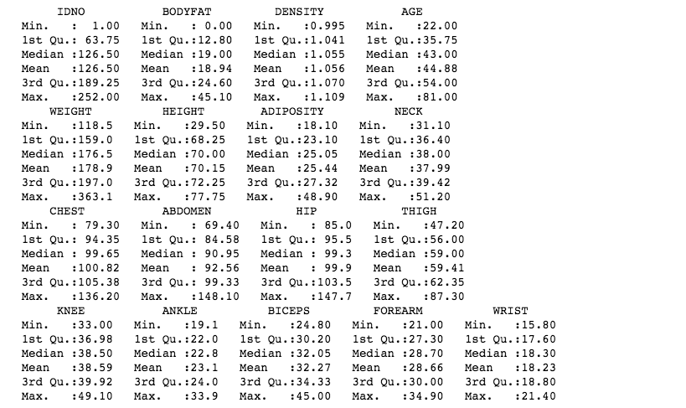
Data Display:

Slide 7
DATA PROCESSING

Slide 8
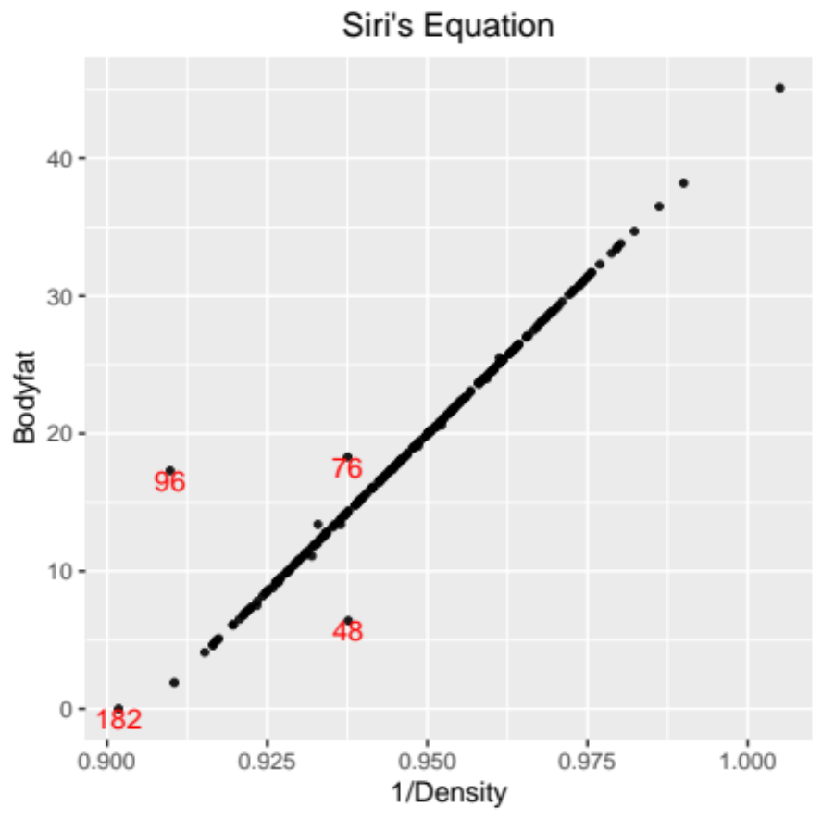
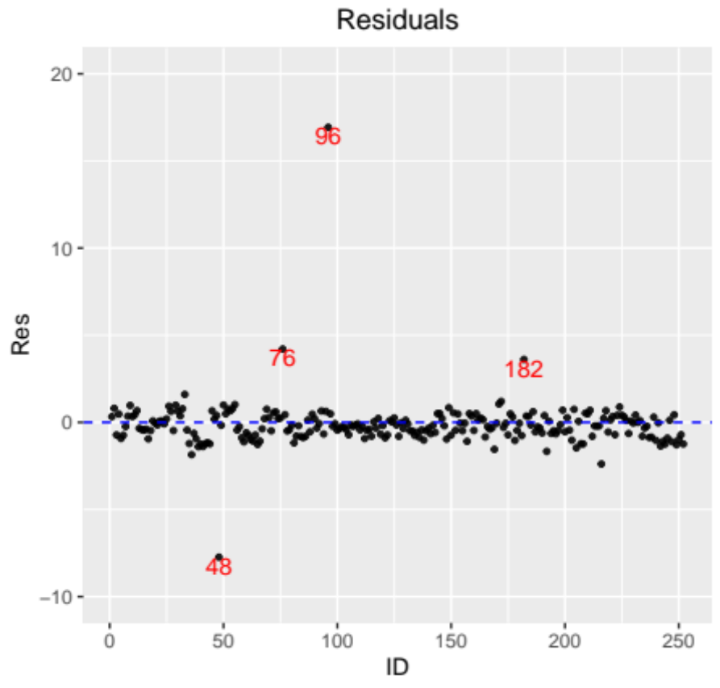
Data Processing:
1. use “Siri’s equation”
bodyfat = 495/Density - 450

Slide 9
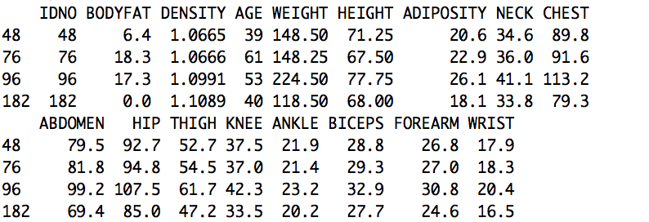
Data Processing:
1. use “Siri’s equation”

Slide 10
Data Processing:
1. use “Siri’s equation”
14.14

Slide 11
Data Processing:
1. use “Siri’s equation”

Slide 12


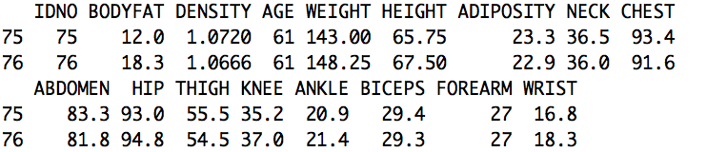
Data Processing:
1. use “Siri’s equation”

Slide 13
Data Processing:
1. use “Siri’s equation”
14.09

Slide 14
Data Processing:
1. use “Siri’s equation”

Slide 15
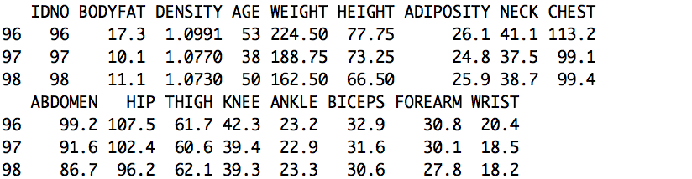
Data Processing:
1. use “Siri’s equation”
If use density →bodyfat : 495/1.0991- 450=0.3684833
If use bodyfat → density :495/(17.3+450) =1.059277

Slide 16
Data Processing:
1. use “Siri’s equation”
If use density →bodyfat : 495/1.0991- 450=0.3684833
If use bodyfat → density :495/(17.3+450) =1.059277

Slide 17
Data Processing:
1. use “Siri’s equation”
Negative!
Both density and bodyfat
are wrong! Delete 182!
If use density →bodyfat : 495/1.1089- 450=-3.611687

Slide 18
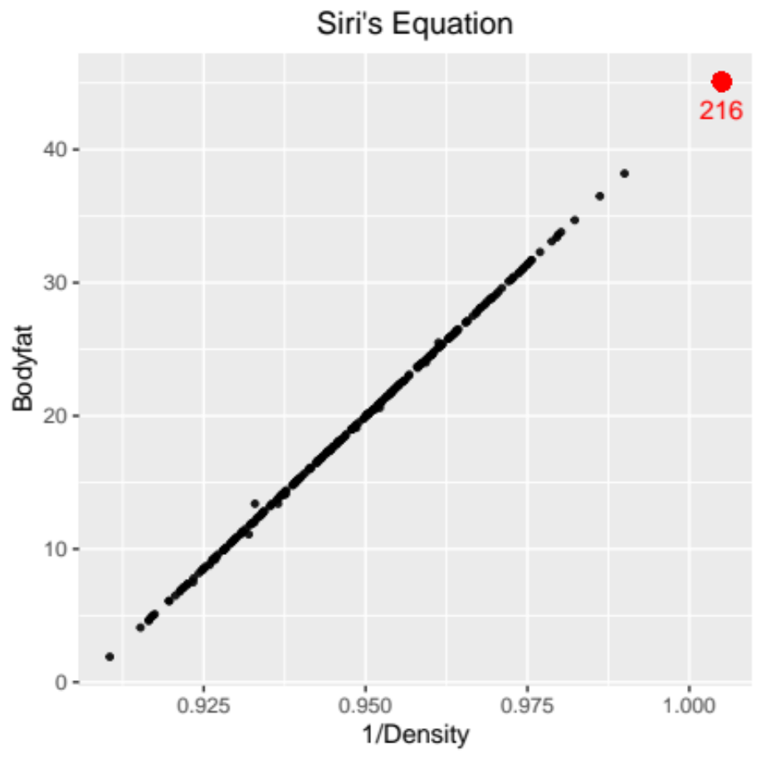
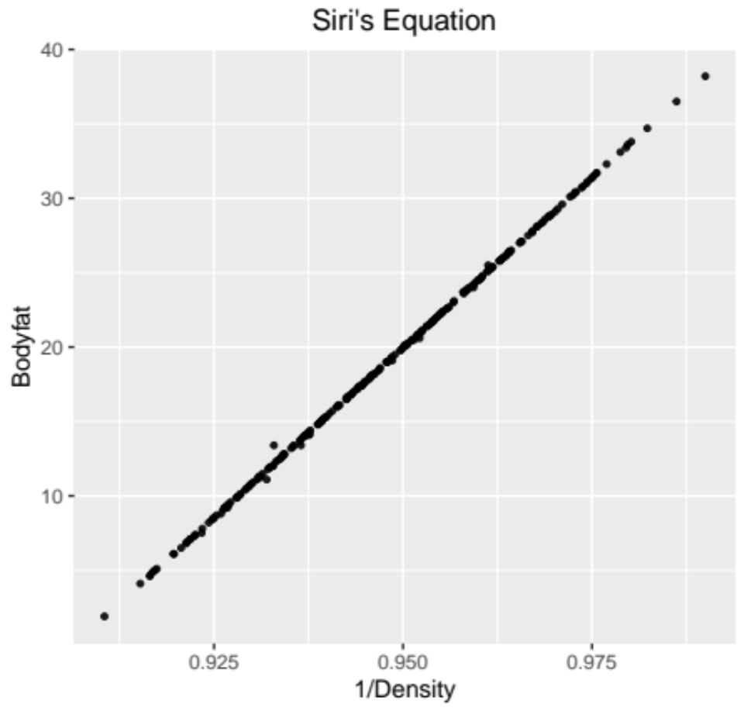
Data Processing:
1. use “Siri’s equation”
bodyfat = 495/Density - 450
After changing the values of 48,76,96,
and deleting the observation 182 :
Remember in the data display part
the 216 has a density<1, also delete.

Slide 19
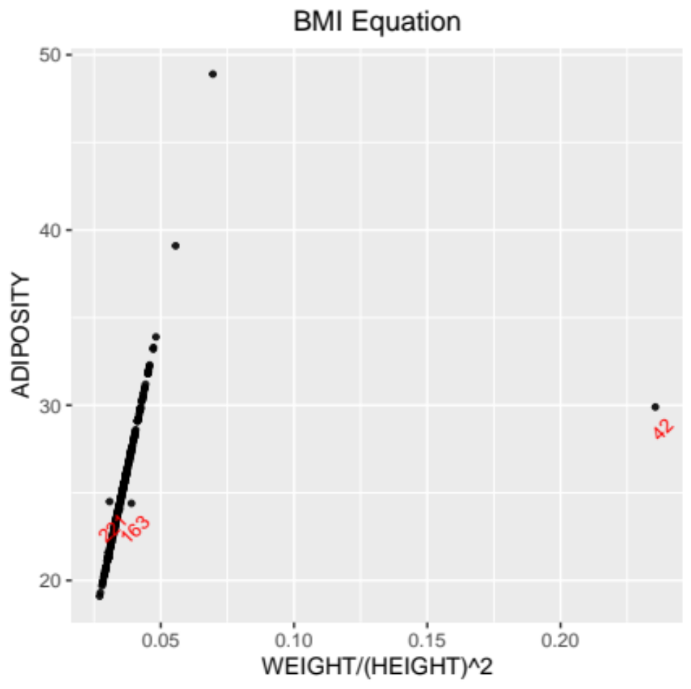
Data Processing:
2. use “BMI equation”
bmi=weight/(height)^2
Construct a linear model between BMI and ADIPOSITY, without 42,163,221
IDNO | WEIGHT | HEIGHT | ADIPOSITY
42 | 205.00 | 29.50 | 29.9
163 | 184.25 | 68.75 | 24.4
221 | 153.25 | 70.50 | 24.5

Slide 20
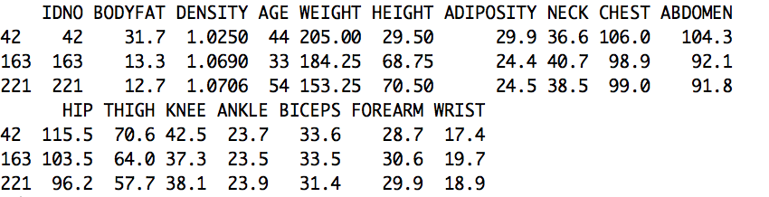
Data Processing:
2. use “BMI equation”
29.5 inches? Impossible!
Hence we use the model we fit to compute the BMI
first and then we can get the height: 69.46.

Slide 21
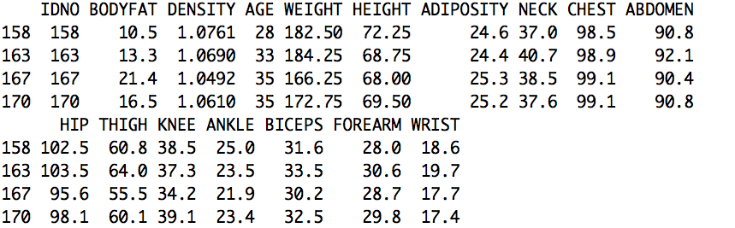
Data Processing:
2. use “BMI equation”
27.42749

Slide 22
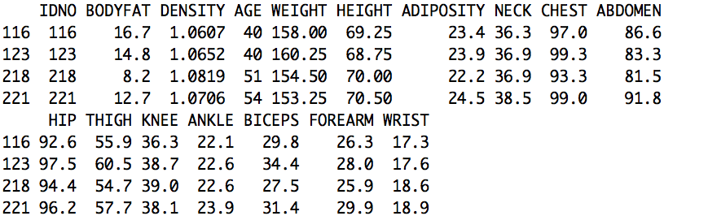
Data Processing:
2. use “BMI equation”
172.9469 lbs
Compare 218&221,similar weight and height but difference ADIPOSITY!
Other variables 221>218, especially the bodyfat !
Hence the ADIPOSITY is right. Also the mean of height is 70.15.

Slide 23
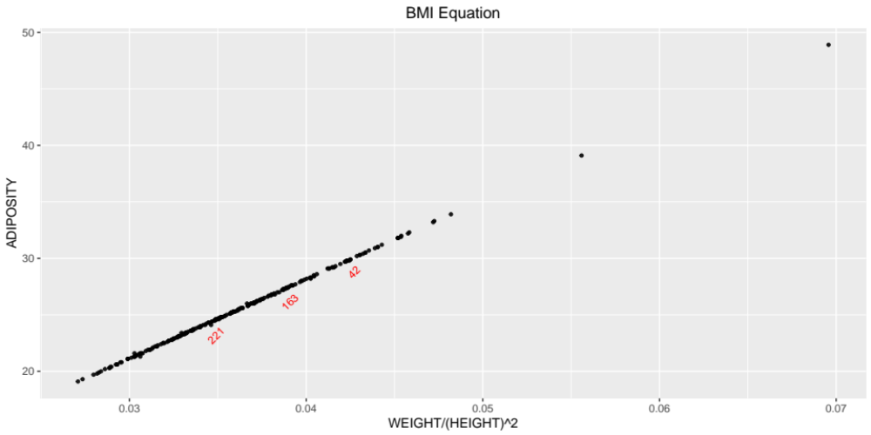
Data Processing:
2. use “BMI equation”
bmi=weight/(height)^2
Using these two euqations we only delete 182,216 and change some values.

Slide 24
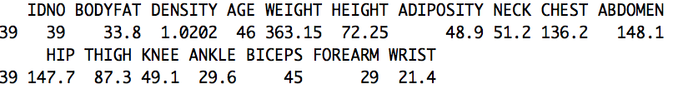
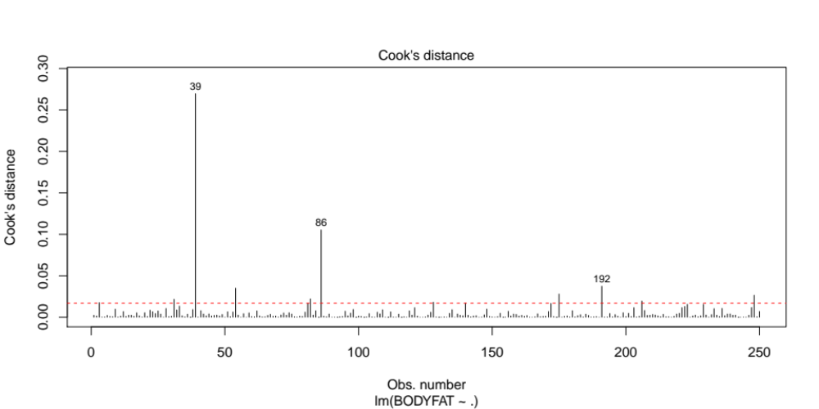
Data Processing:
3. Cook's distance

Slide 25
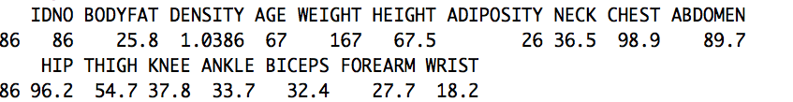
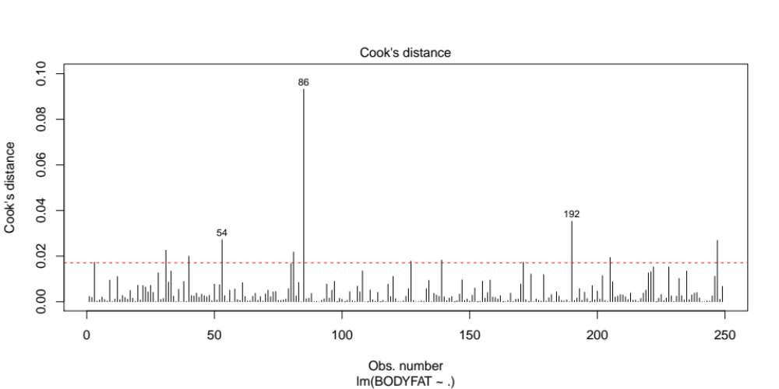
Data Processing:
3. Cook's distance
With values of the rest of the variables are on the average, the value of ankle is too high.

Slide 26
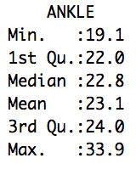
Data Processing:
3. Cook's distance
With values of the rest of the variables are on the average, the value of ankle is too high.

Slide 27
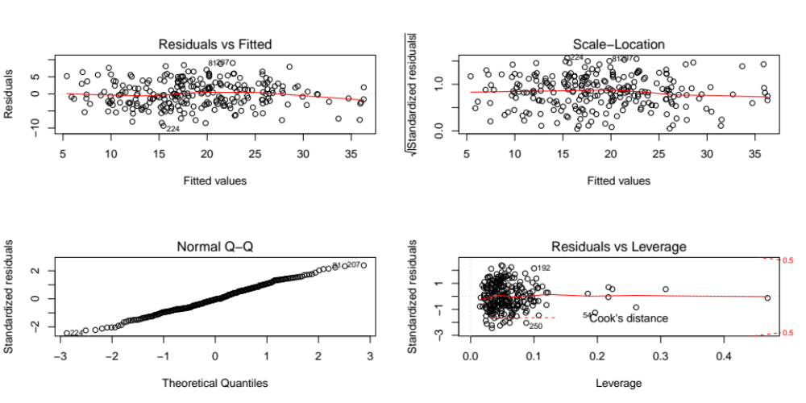
THE NOISE OBSERVATIONS :
39,86,182,216

Slide 28
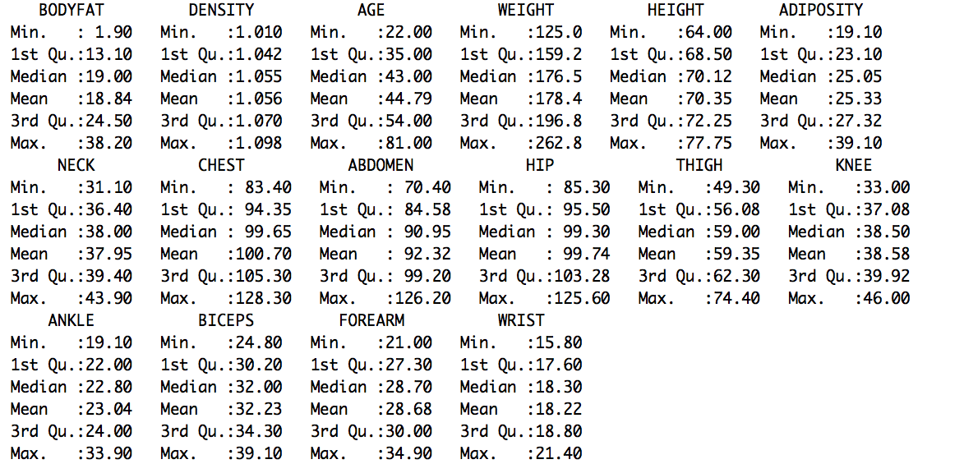
THE NOISE OBSERVATIONS :
39,86,182,216

Slide 29
MULTICOLLINEARITY CHECK

Slide 30
VARABLE SELECTION

Slide 31
CONTENT:
Dateset Display
Data Cleaning
Multicollinearity Check
Varable Selection
Model Building
Model Interpretation
Model Summary
Model Diagnostic
Discussion

