Slide 1


IESTI01 - TinyML
Machine Learning
Regression with DNN
Prof. Marcelo Rovai
May 12th, 2021

Slide 2
First Neural Network Putting it all together

Slide 3
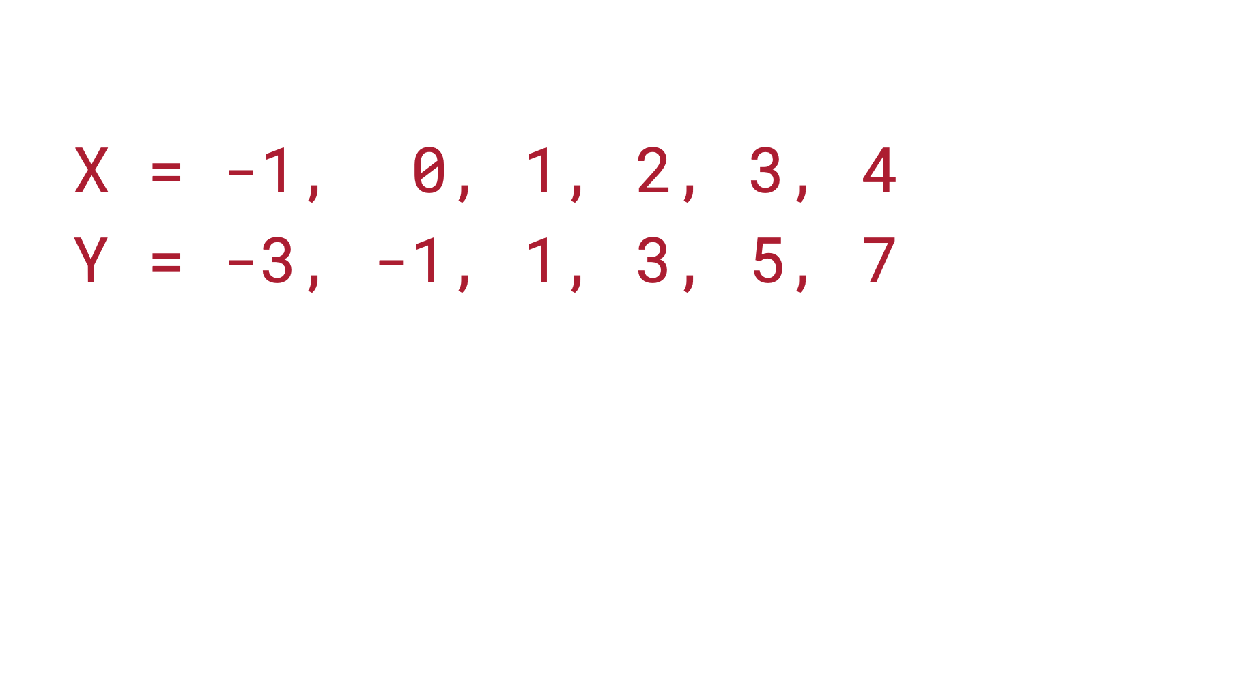

Slide 4
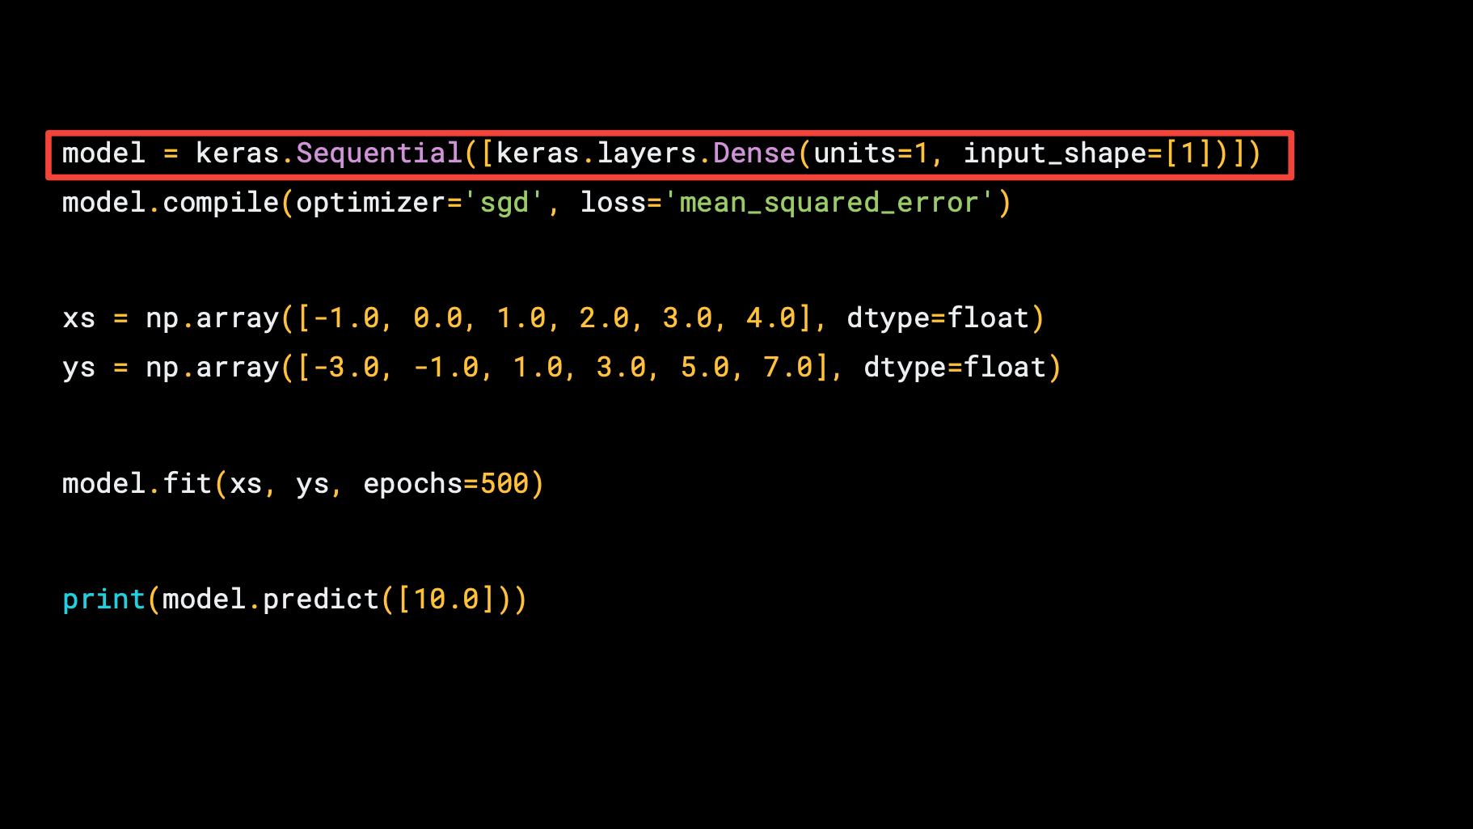

Slide 5
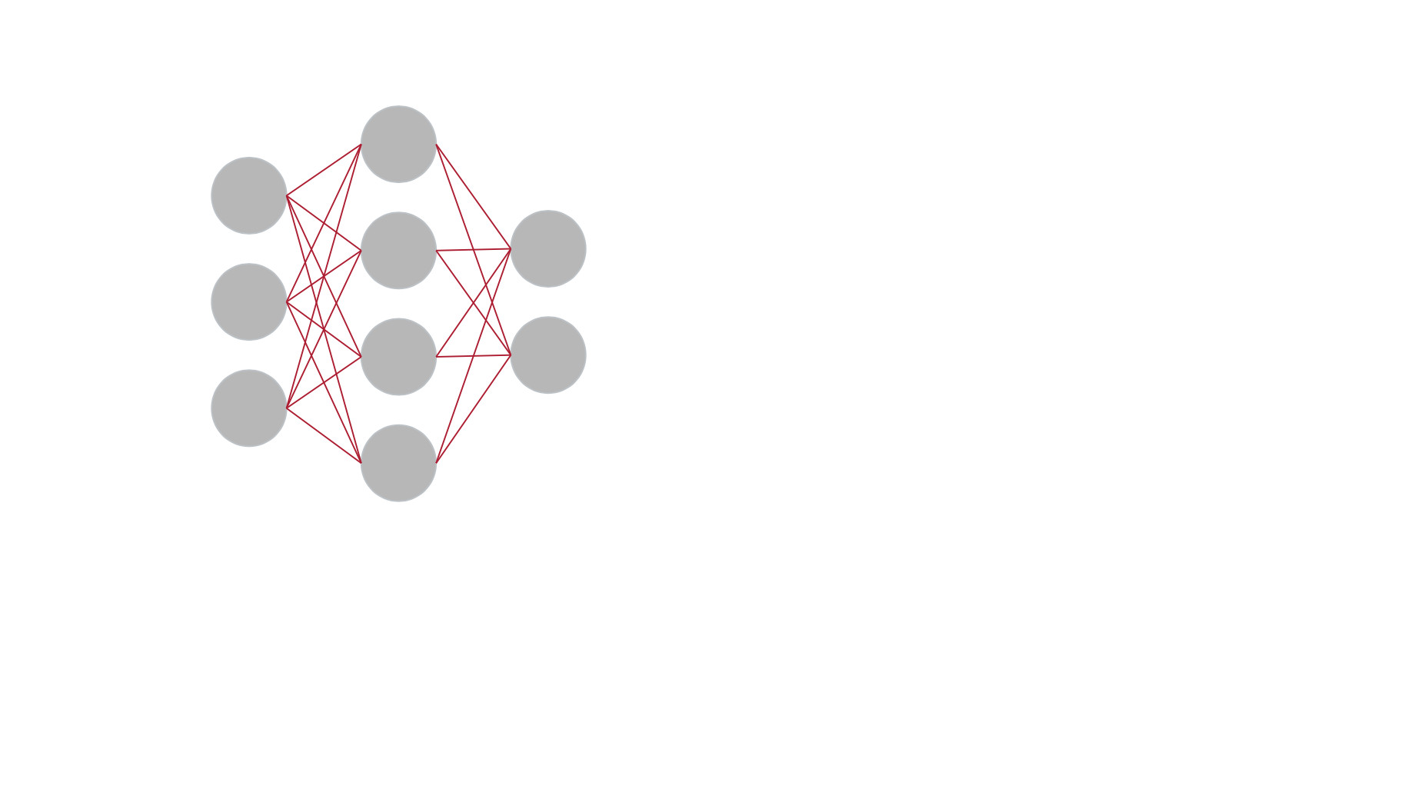
Neuron
Dense Neural Network

Slide 6
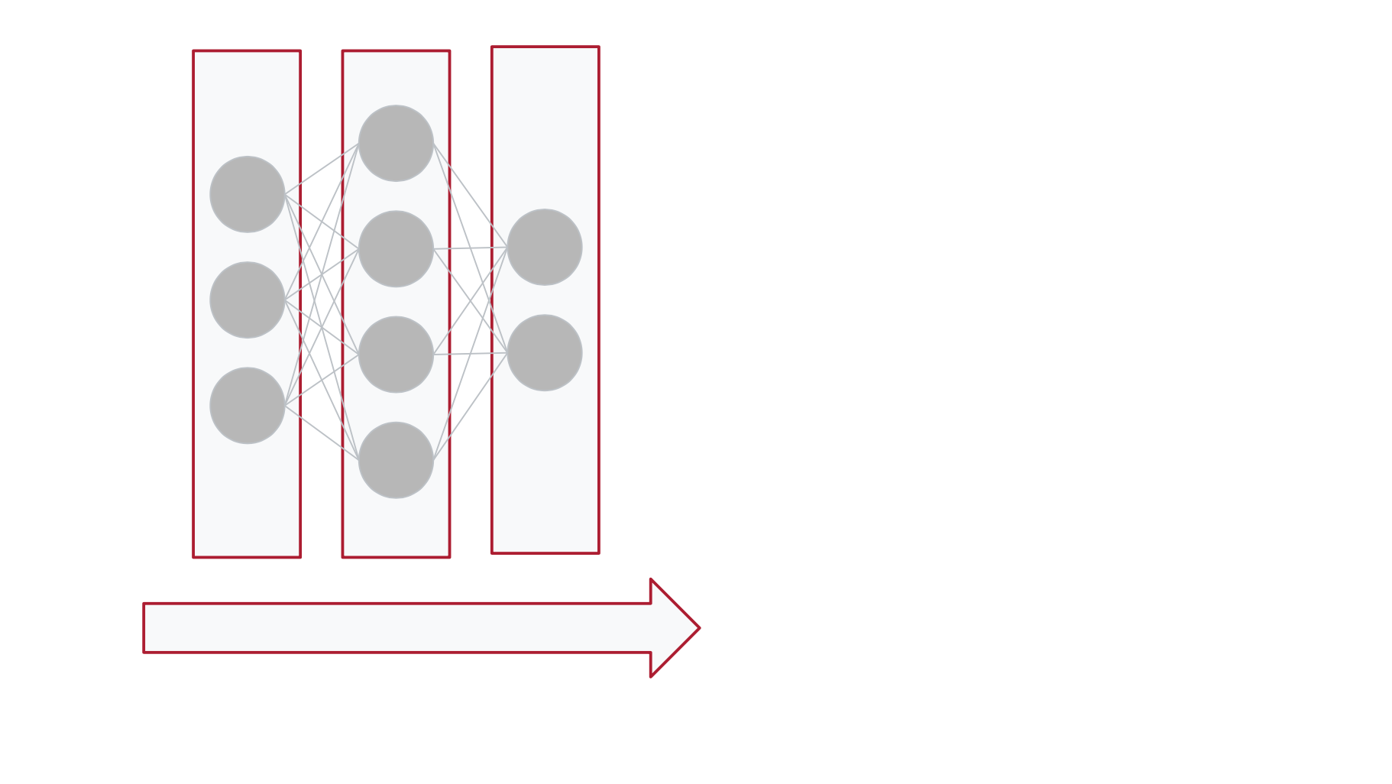
Layers
Input
Input
Hidden
Output

Slide 7
Sequencial

Slide 8
1 Layer

Slide 9
1 Neuron
1 Layer

Slide 10
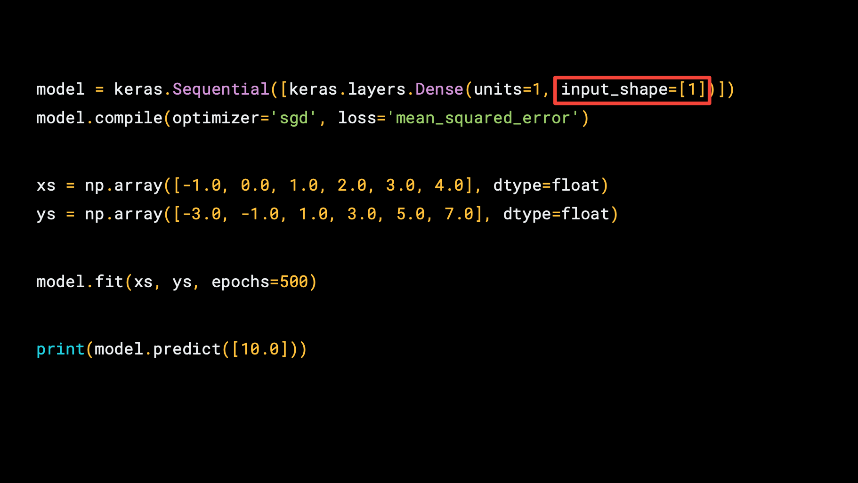
1 Neuron
1 Input

Slide 11
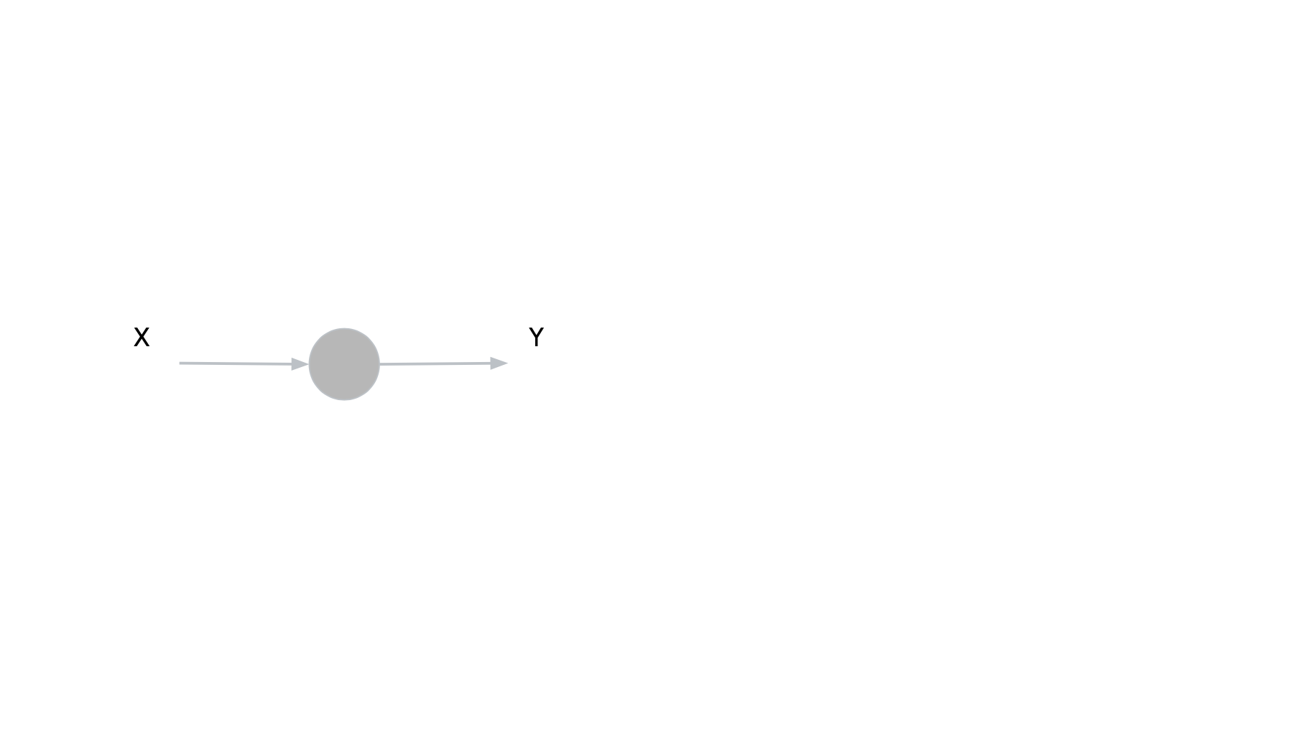
units=1, Input_shape=[1]

Slide 13
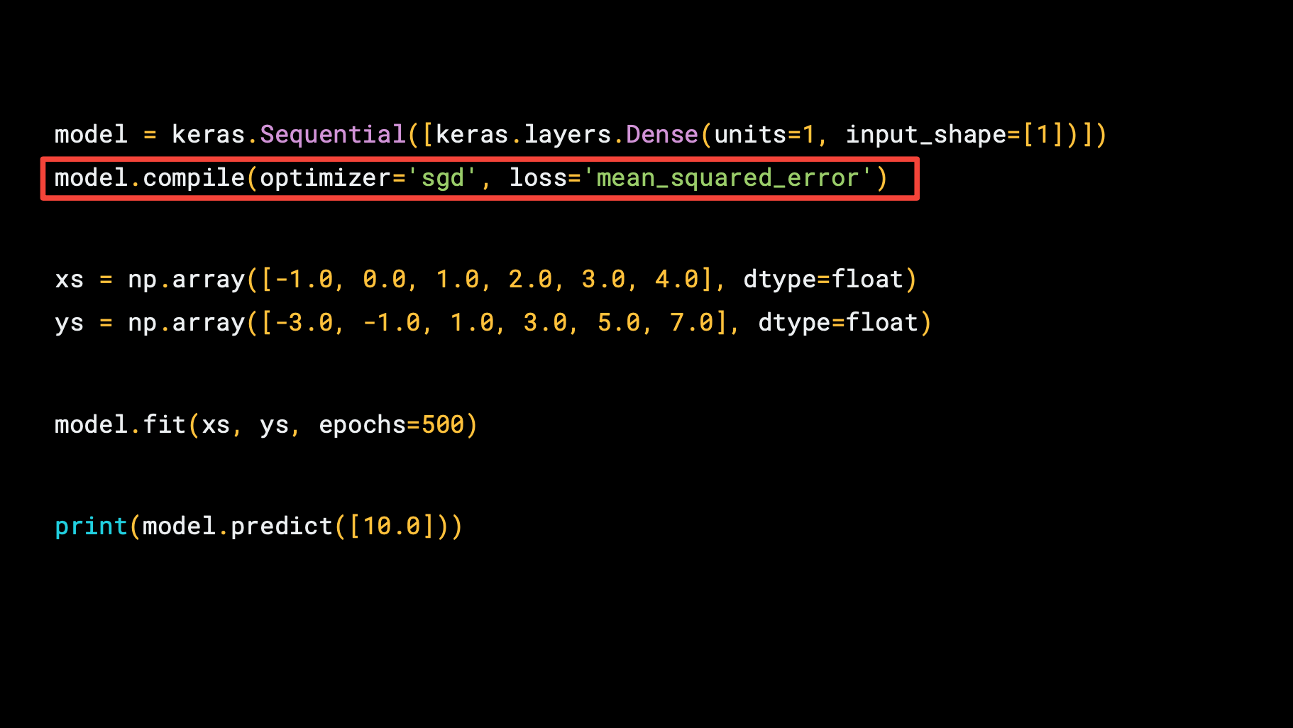

Slide 14
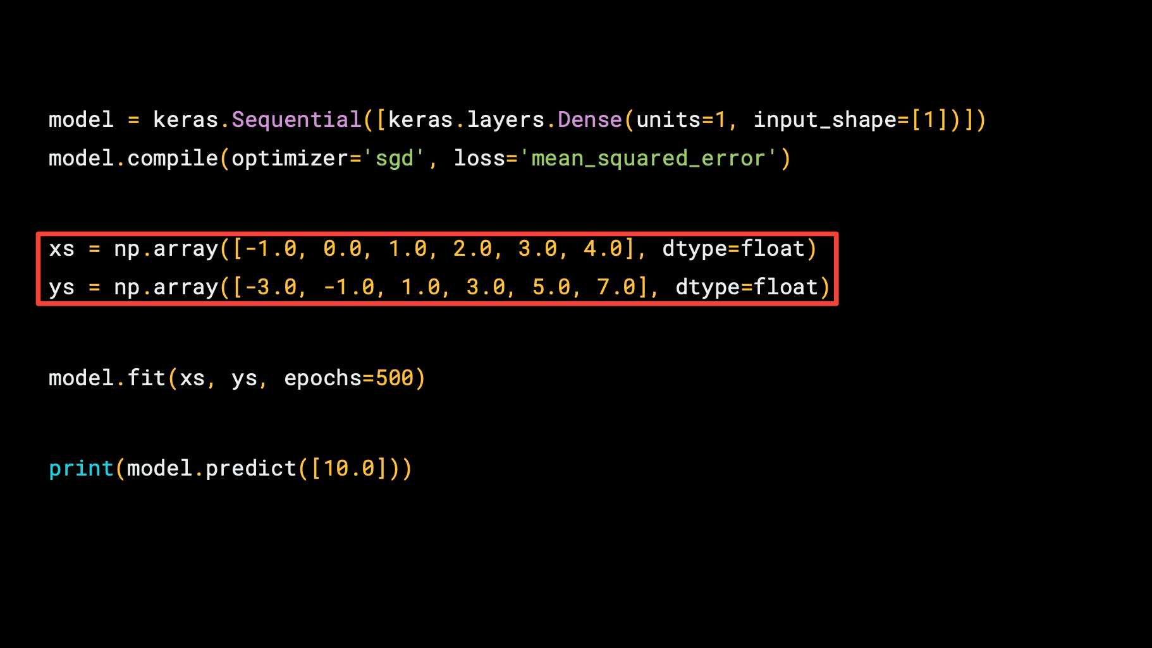

Slide 15
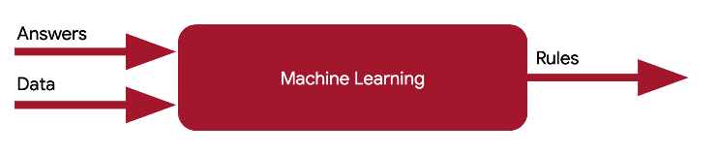
ys
model
xs

Slide 16
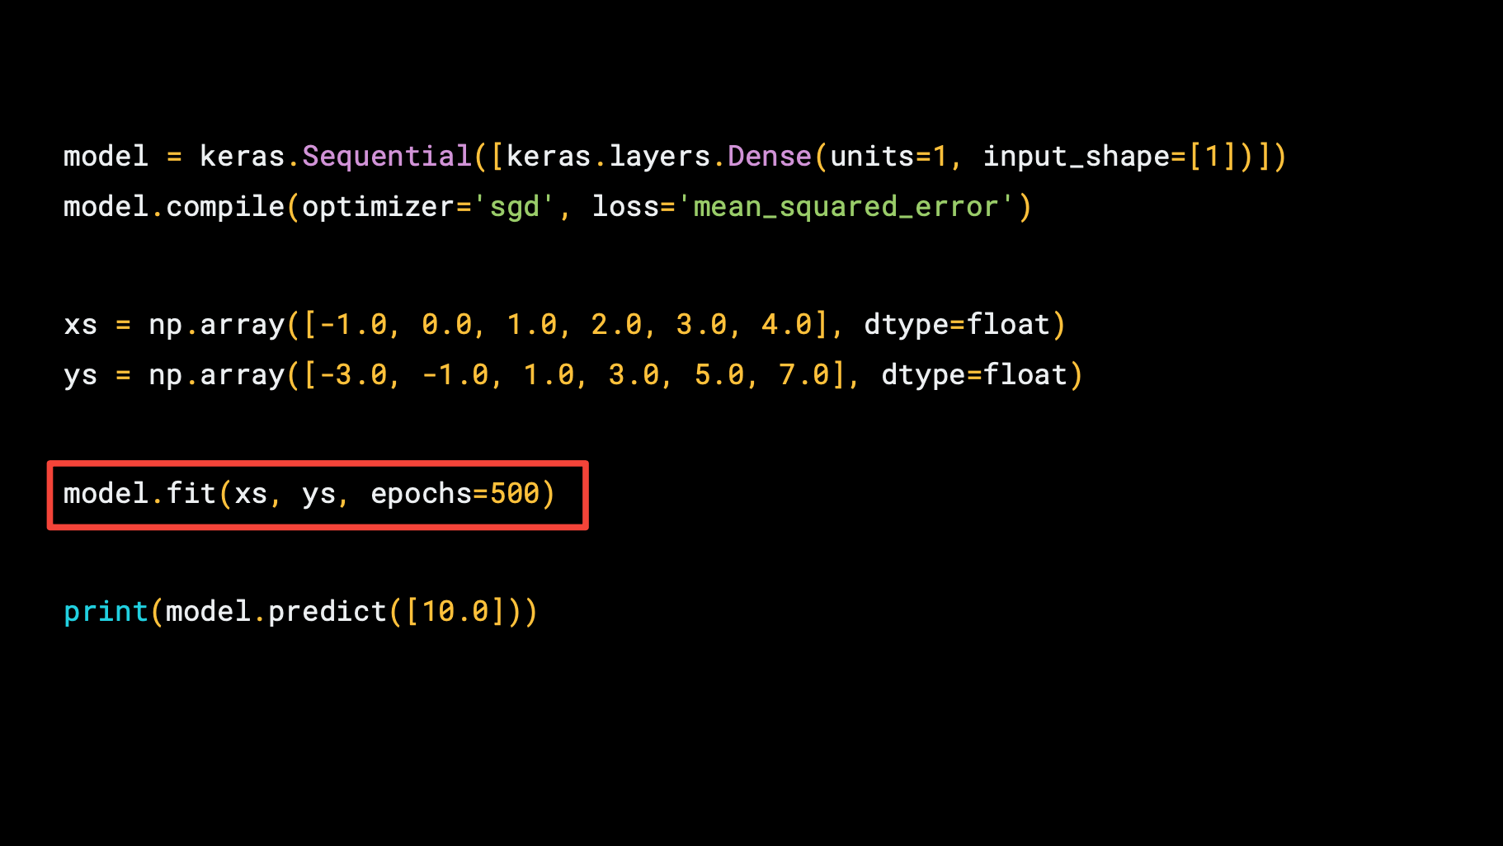

Slide 17

Training ➔ model.fit(xs, ys, epochs=500)
loss=‘mean_squared_error’
Optimizer=‘sgd’
(Epochs)

Slide 18
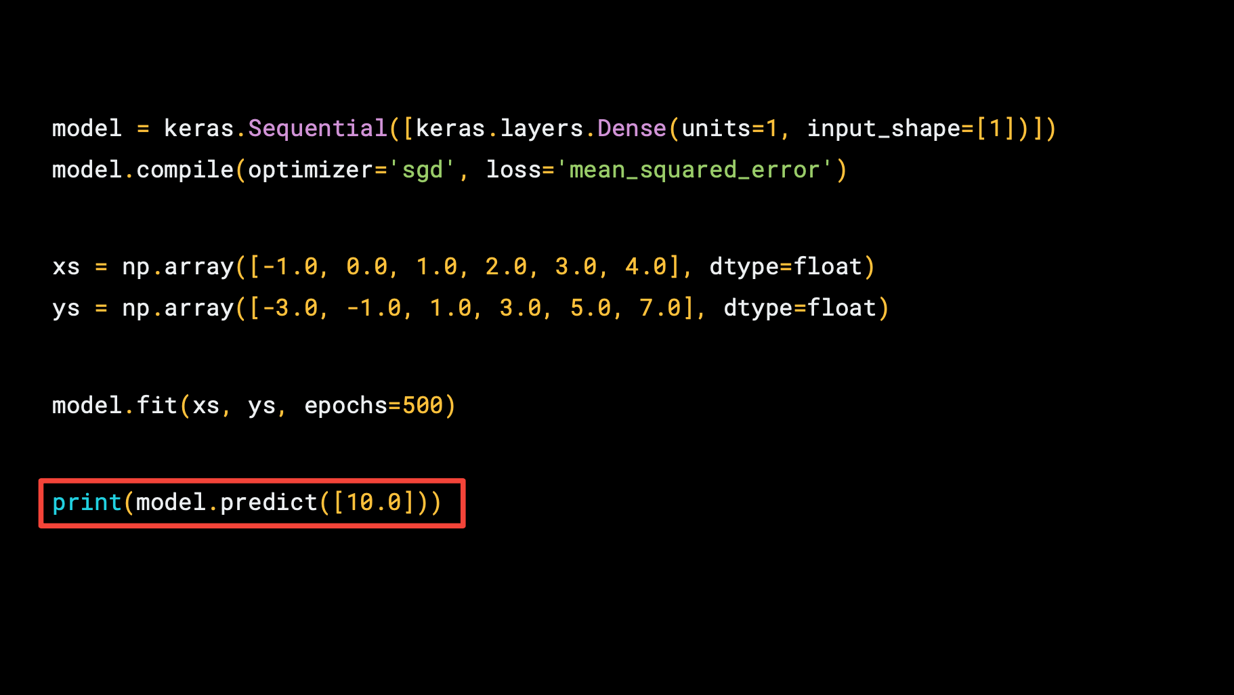

Slide 19
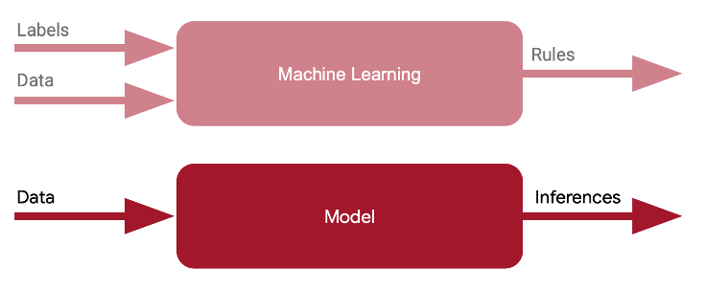
Inference ➔ model.predict([10.0])
10.0
?

Slide 20


First Neural Network with TF2 Code Time!

Slide 21
Reading Material

Slide 22
Main references
Harvard School of Engineering and Applied Sciences - CS249r: Tiny Machine Learning
Professional Certificate in Tiny Machine Learning (TinyML) – edX/Harvard
Introduction to Embedded Machine Learning (Coursera)
Text Book: "TinyML" by Pete Warden, Daniel Situnayake
I want to thank Laurence Moroney from Google, Harvard professor Vijay Janapa Reddi, Ph.D. student Brian Plancher and their staff for preparing the excellent material on TinyML that is the basis of this course at UNIFEI.
The IESTI01 course is part of the TinyML4D, an initiative to make TinyML education available to everyone globally.

Slide 23
Thanks
And stay safe!

