Slide 1
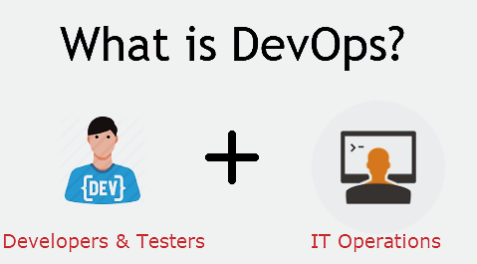
DevOps
4 Items of the slider
01. What is DevOps
02. Why DevOps is needed
03. Where it came from
04. CI/CD Pipeline

Slide 2
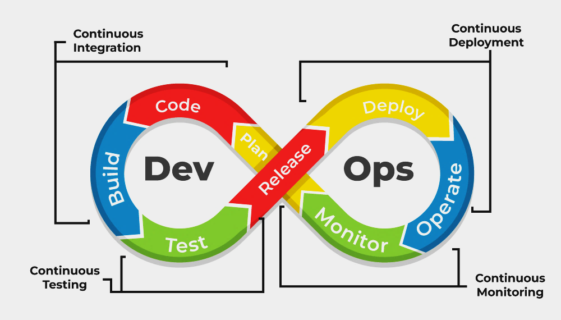
What is DevOps
DevOps is a collaborative approach to software development and IT operations that emphasizes automation, integration, and continuous delivery.
Dev can respond to bugs and deployment failures quickly. Ops anticipate how new functionality will effect production. Dev and Ops can work together to permanently remove root causes of bugs and failures.
It aims to break down traditional silos between development and operations teams, fostering a culture of shared responsibility and accountability throughout the software development life cycle.

Slide 3
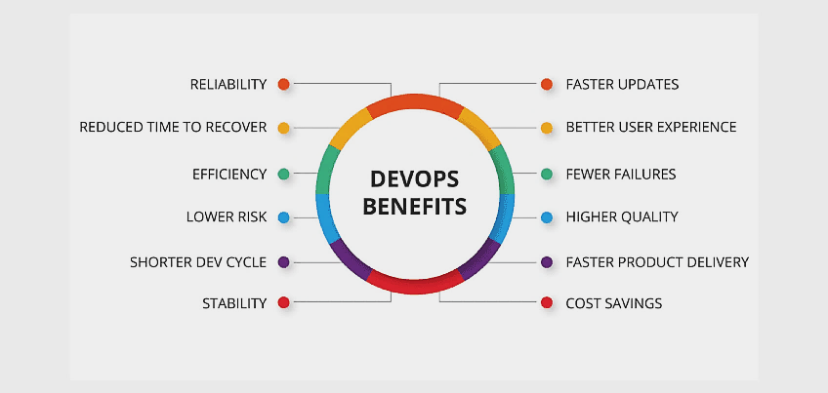
Why DevOps is needed
Before DevOps, the development and operation team worked in complete isolation.
Testing and Deployment were isolated activities done after design-build. Hence they consumed more time than actual build cycles.
Without using DevOps, team members spend a large amount of their time testing, deploying, and designing instead of building the project.
Manual code deployment leads to human errors in production.
DevOps allows Agile Development Teams to implement Continuous Integration and Continuous Delivery, which helps them launch products faster into the market.

Slide 4
Where it came from
Early 2000s: The Agile Manifesto is introduced, advocating for collaborative and iterative approaches to software development. Agile methodologies gain popularity, emphasizing flexibility, customer collaboration, and responding to change over rigid processes and tools.
2007: The term "DevOps" is coined by Patrick Debois , a Belgian IT consultant, during the "Agile System Administration" Birds of a Feather session at the Agile Conference in Toronto. Debois used the term to describe the need for collaboration between development and operations teams to improve software delivery processes.
2009: The first conference named DevOps Days was held in Ghent, Belgium. The conference was founded by Belgian consultant, project manager and agile practitioner Patrick Debois . The conference has now spread to other countries.
2012: A report called "State of DevOps" was first published by Alanna Brown at Puppet Labs.
As of 2014, the annual State of DevOps report was published by Nicole Forsgren, Gene Kim, Jez Humble and others. They stated that the adoption of DevOps was accelerating . Also in 2014, Lisa Crispin and Janet Gregory wrote the book More Agile Testing, containing a chapter on testing and DevOps.
2020s: DevOps continues to evolve, with organizations across industries adopting DevOps practices to accelerate software delivery, improve collaboration, and drive business agility in the digital age.

Slide 5
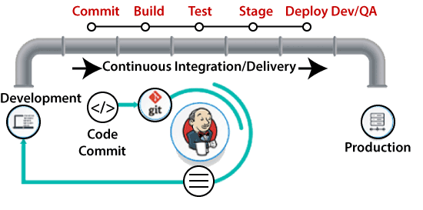
CI/CD Pipeline
Pipeline: A pipeline is an automated process that facilitates the continuous integration, delivery, and deployment of software. It consists of a series of steps, including building, testing, and deploying code changes, with the goal of delivering software quickly, reliably, and with high quality.
Continuous integration (CI): Focuses on the early stages of a software development pipeline where the code is built and undergoes initial testing. Multiple developers work on the same codebase simultaneously and make frequent commits to the code repository. Build frequency can be daily or even several times per day at some points in the project's lifecycle. These small, frequent builds enable easy and low-risk experimentation, as well as the ability to easily roll back or abandon undesirable outcomes.
Continuous delivery (CD): Picks up where CI leaves off. It focuses on the later stages of a pipeline, where a completed build is thoroughly tested, validated and delivered for deployment. Continuous delivery can -- but does not necessarily -- deploy a successfully tested and validated build.

Slide 6
Thank You
Presented By
Nitya Kaushik

