Slide 1
Introduction to PySpark and Kafka Integration for Streaming
Real-Time Data Processing Pipelines

Slide 2
History and Evolution of Streaming
1. Origins of Apache Spark (2009–2013): Spark was developed at UC Berkeley's AMPLab by Matei Zaharia to overcome the limitations of Hadoop's disk-based processing.
2. Emergence of Spark Streaming (2013): Spark Streaming was introduced to process real-time data streams using micro-batching. It allowed real-time analytics by integrating with data sources like Kafka.
3. Introduction of PySpark (2014): PySpark is the Python API for Apache Spark, designed to let Python developers harness the power of Spark's distributed computing. PySpark was less efficient than the native Scala and Java APIs due to communication overhead between Python and the JVM.

Slide 3
What is Apache Spark?
Apache Spark: Unified analytics engine for large-scale data processing. Provides “In-Memory Processing”, “Speed”, “Ease of Use”
Key Components:
- Spark Core: Engine for distributed computing.
- Spark SQL: Query structured data using SQL.
- Spark Streaming: Real-time stream processing.
- MLlib: Machine learning library.

Slide 4
Advantages of Apache Spark
In-Memory Processing: Spark stores intermediate data in memory (RAM), making data processing much faster than traditional disk-based processing frameworks like Hadoop MapReduce.
Speed: Spark is up to 100x faster than Hadoop for large-scale data processing due to its in-memory computing capabilities.
Ease of Use: Supports multiple programming languages, including Python (PySpark), Java, Scala, and R. It offers high-level APIs and libraries for SQL, streaming, machine learning, and graph processing.

Slide 5
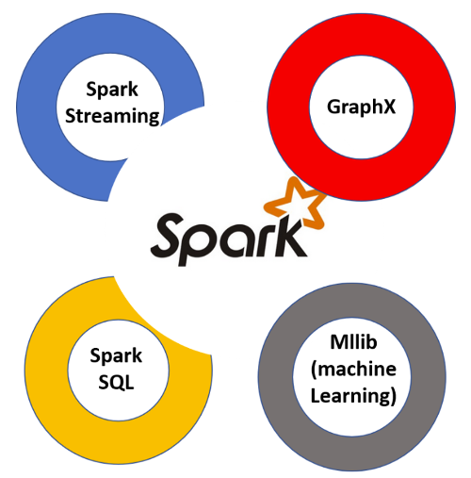
What is PySpark?
PySpark is the Python API for Apache Spark, allowing Python developers to harness Spark’s powerful distributed data processing capabilities.
1. Data Structures-
Resilient Distributed Datasets (RDDs): Immutable, distributed data collections.
DataFrames: Distributed collection of data organized into columns.
2. Features-
Python integration with data libraries like Pandas and NumPy.
In-memory cluster computing for faster processing.
Real-time data handling with Spark Streaming.
Fault tolerance and scalability across clusters.

Slide 6
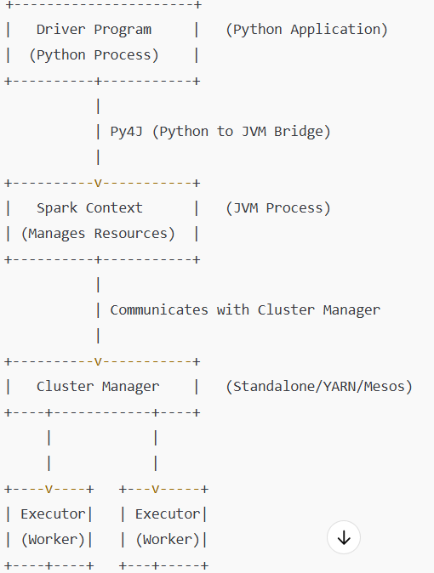
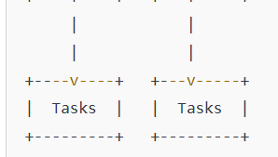
PySpark Architecture Diagram
Driver Program (Python script) defines RDD/DataFrame operations.
Py4J translates Python code to JVM bytecode.
Cluster Manager allocates resources and launches Executors.
Executors perform tasks and computations on data.
Results are collected and returned to the Driver.

Slide 7
Introduction to Apache Kafka
Apache Kafka is a distributed streaming platform designed for building real-time data pipelines and streaming applications. It is widely used for processing large volumes of data in real-time with high throughput and fault tolerance.
Data Flow
Producer → Sends data to a Topic.
Topic → Split into Partitions (distributed across Brokers).
Replication → Partitions replicated for fault tolerance.
Consumer Group → Reads data from partitions in parallel.
Offset → Tracks read progress in each partition.

Slide 8
Kafka Message Flow
Producers send messages to specific topics.
Messages are split and stored in multiple partitions for parallel processing.
Consumers subscribe to topics and read messages from assigned partitions.
Kafka guarantees message order within each partition but not across partitions.

Slide 9
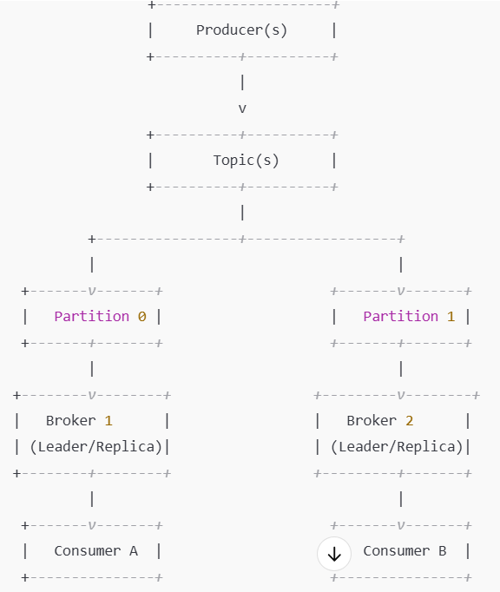
Kafka Architecture
Kafka Cluster: Comprises multiple brokers.
ZooKeeper: Coordinates Kafka brokers.
Producers → Brokers → Topics → Partitions → Consumers.

Slide 10
Basics of Streaming Data
-Streaming Data: Continuous real-time data flow.
-Sources: IoT devices, user activity logs, sensors, transactions.
Streaming vs Batch Processing: - Streaming: Low-latency, real-time analysis. - Batch: High-latency, bulk data processing.

Slide 11
Kafka + PySpark Integration
-Kafka for real-time data ingestion.
-PySpark for real-time data processing.
Flow: -Kafka Producer → Kafka Topic → PySpark Consumer → Data Processing → Storage/Visualization.

Slide 12
End-to-End Data Pipeline Flow
1. Data Source → Kafka Producer.
2. Kafka Topic → Kafka Broker.
3. PySpark Consumer → Data Processing.
4. Processed Data → Storage/Visualization (Database, Dashboard).

Slide 13
Advantages of Kafka-Spark Pipeline
1. High scalability for large datasets.
2. Real-time data processing.
3. Fault-tolerant with Kafka replication.
4. High throughput and reliability.

Slide 14
Real-World Use Cases
1.Fraud Detection in Banking: Detect suspicious transactions in real-time.
2. IoT Data Monitoring: Real-time insights from smart devices.
3. Clickstream Analysis: Track user behavior on websites.
4. Log Monitoring: Proactive system health monitoring.

Slide 15
Rule Engine Action
PySpark application involves real-time streaming, where Kafka serves as the data source for receiving packets related to different rule categories.
These packets are associated with various conditions or events like IMEI changes, SIM state changes, and device plan changes.
My Goal is to process the data of triggered rules based on specific conditions, transform the data using PySpark, and then take actions (such as sending emails or SMS) by calling external APIs.

Slide 16
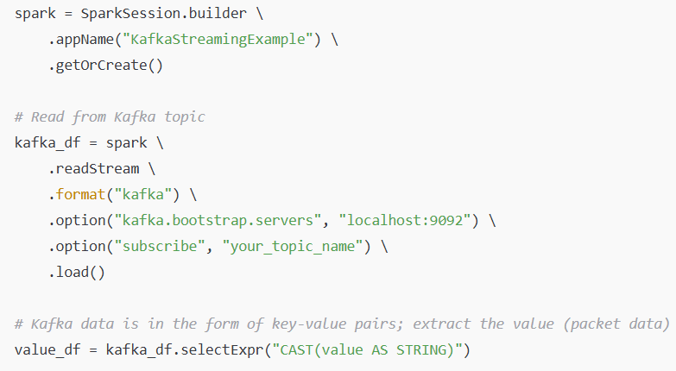
Rule Engine Action Flow - 1
1. Kafka as the Data Source
Kafka Topics: Ingesting data into the PySpark application from Kafka topics, where different packets (events) are published. Each packet might belong to different categories, such as IMEI changes, SIM state changes, device plan changes, etc.
Kafka Streaming: The data in Kafka is real-time, so using Structured Streaming in PySpark to continuously process the data.
2. Rule Categories and Transformation Logic:
In PySpark, I’ve applied SQL-like transformations to filter the packets based on their types (rules), parse and validate the data, and enrich the dataset with additional information (e.g., customer details).

Slide 17
Rule Engine Action Flow - 2
3. Rule Triggering and Event Processing
Triggering Rules: Based on the conditions you define, you will trigger specific actions for each rule. For example:
If the rule detects an IMEI change, it can trigger an action to notify the customer.
If a SIM state change occurs, it can trigger a customer alert.
4. Triggering Actions (Email/SMS) using External APIs
External APIs: Once the rule is triggered, you need to invoke external APIs to take actions such as sending emails or SMS. PySpark provides the capability to call external services via Python’s “request” modules

Slide 18
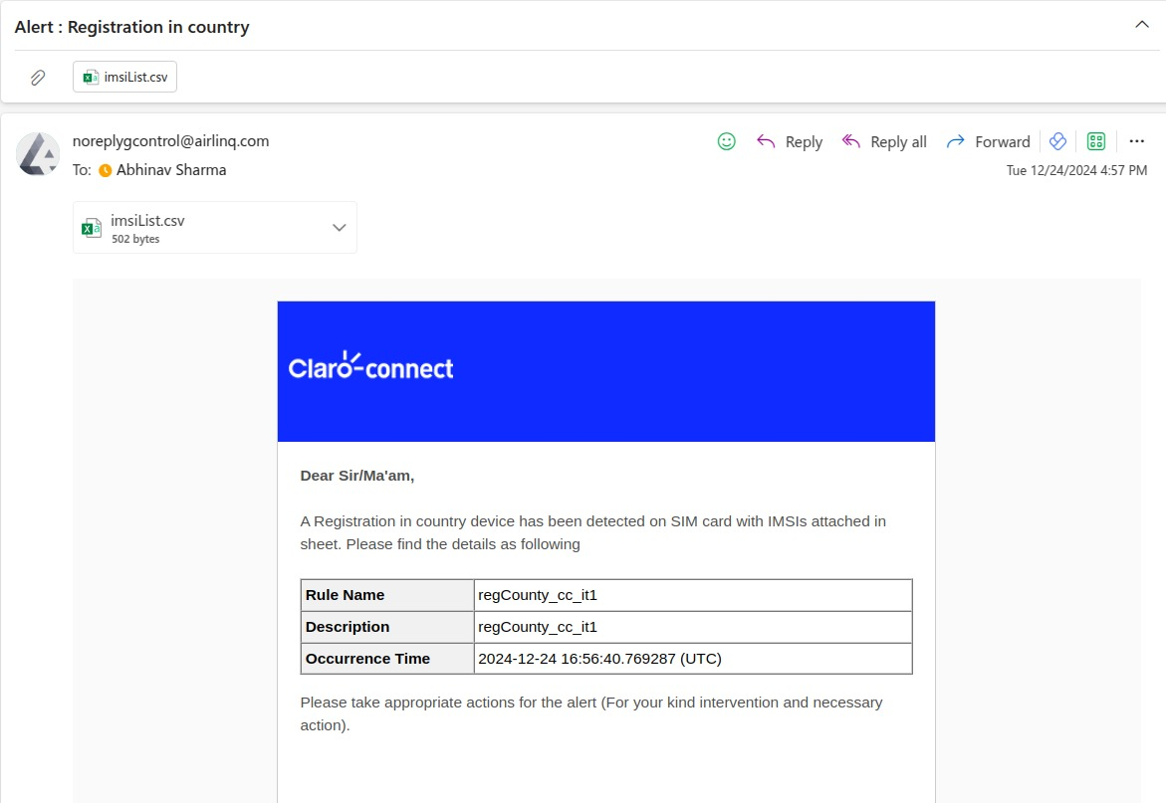
Action Example

Slide 19
OverView
Kafka is the real-time data source where packets are streamed.
The packets are categorized (IMEI change, SIM state change, device plan change) based on predefined rules.
Transformations are applied to the packets using PySpark DataFrames, and SQL queries can be used for more complex filtering.
Rules are triggered based on the incoming packets, identifying events like IMEI changes, SIM state changes, etc.
Actions (sending emails/SMS) are triggered by invoking external APIs when certain conditions are met.
Output: The processed data is written to an output sink, or appropriate alerts are sent.

Slide 20
Conclusion
- Kafka and PySpark provide a powerful, scalable solution for real-time data pipelines.
- Enabling businesses to gain real-time insights and make data-driven decisions.

Slide 21
Future Trends
- Serverless data processing with Spark.
- Integration with cloud-native services (AWS, Azure, GCP).
- AI and ML integration for predictive analytics.

Slide 22
Q&A
Thank You!
Any Questions?

