Slide 1

Fraudulent Detection using Machine Learning
Submitted by: Murtaza Kanchwala

Slide 2
CONTENTS
Introduction
Objective
Project Pipeline
Data Quality Assessment
Data Preparation
Data Analysis
Modelling Pipeline
Model Evaluation

Slide 3
INTRODUCTION
This project aim to use advance machine learning to detect the suspicious transaction using the historical data.
Traditional fraud detection methods struggle with evolving fraud tactics. They can’t keep up with new patterns, highlighting the need for more flexible solutions.
Machine Learning is the heart of this project. It’s a powerful tool for analysing large data to find anomalies and suspicious behaviour, making fraud detection more accurate and efficient.
This project benefits the Banks, Financial Institues,online stores and rental sites. It helps this institutes to combat fraud, build trust with the customer and ensures a secure payment system.

Slide 4
OBJECTIVE
To develop a fraud detection system to prevent fraudulent activities.
Objective is to efficiently analyse data through the application of machine learning techniques.
To enhance dataset analysis by exploring diverse sampling and scaling techniques.
To implement hybrid models as an extension to improve fraud detection accuracy.

Slide 5
PROJECT PIPELINE
Import and understand the given dataset
See if the data has any shortcomings like missing data or data imbalance, and fix them
Perform Data Analysis to get important insights form it
Develop predictive models using various machine learning algorithms
Evaluate the performance of the models using various metrics

Slide 6
DATA QUALITY ASSESSMENT
Null Values Check
Duplicate Record Check
Quality Checks
Class Imbalance Check
Outliers Check

Slide 7
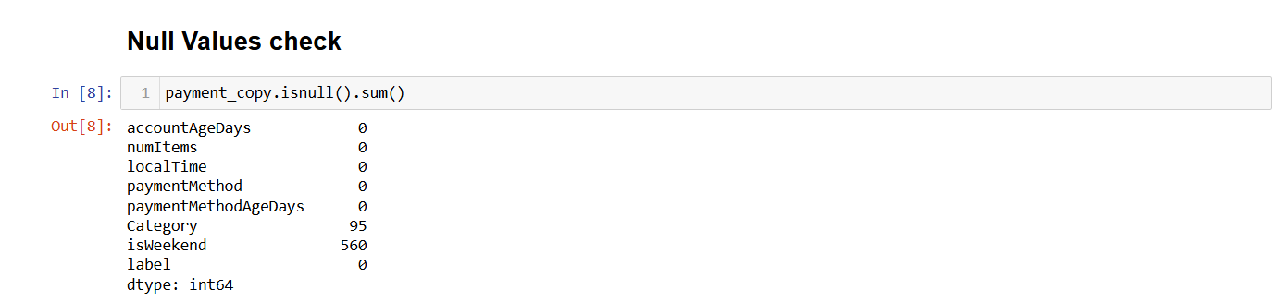
Null Values Check
There is a presence of Null values in the given dataset. The feature “isWeekend” has maximum null values count which 1.43% where as feature “Category” has 0.24% of null values.

Slide 8
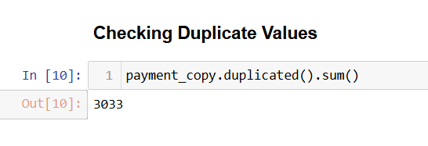
Data Duplicacy Check
The dataset contains duplicate records. This duplicate records needs to be removed before model building to avoid disperancy in the final outcome
There are 3033 duplicate records.

Slide 9
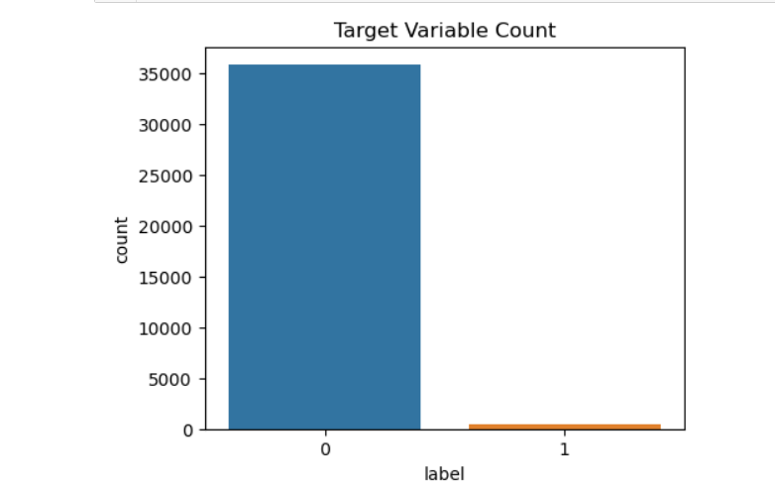
Target Class Imbalance Check
The dataset is heavily imbalanced. The values belonging to the minority class is only 1.09%. To deal with this class imbalance we have used SMOTE technique.
The class ‘0’ (zero) represents the instances of Safe Transactions & class ‘1’ (one) represents the instances of Fraudulent Transactions.
Graph shows the class imbalance

Slide 10
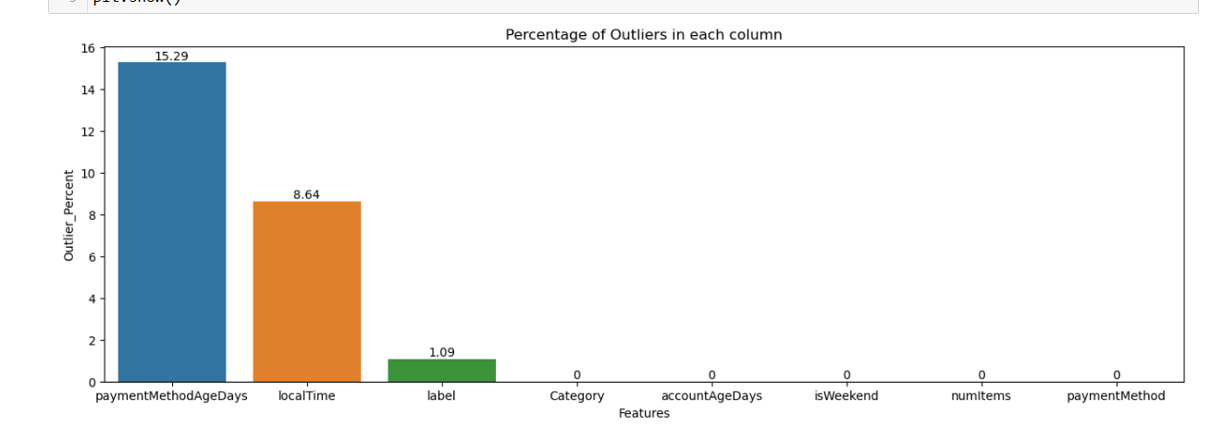
Outlier Check
When we apply outlier check on the dataset, we found few features in the data contains outliers. The graph below represents the Percentage of outliers in the dataset features.

Slide 11
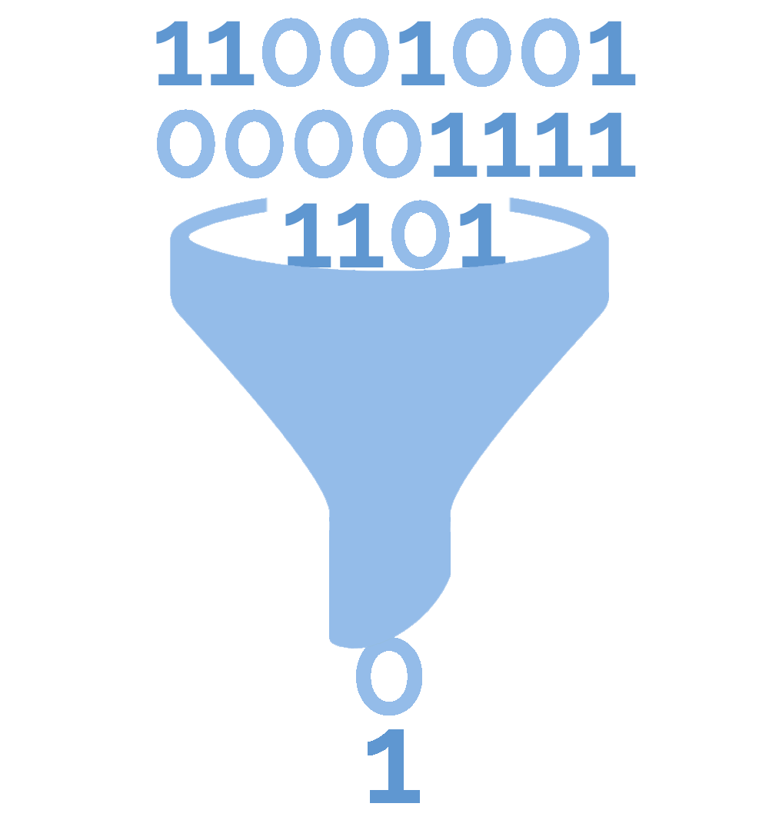
DATA PREPARATION
1) Handling the missing data
Mode imputation
Mean imputation
Median imputation
2) Dealing with the class imbalance
Oversampling
Undersampling
3) Dealing with the Duplicate records
4) Handling the outliers

Slide 12
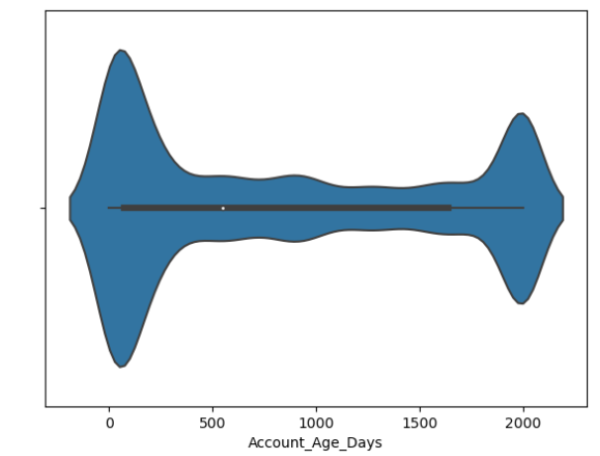
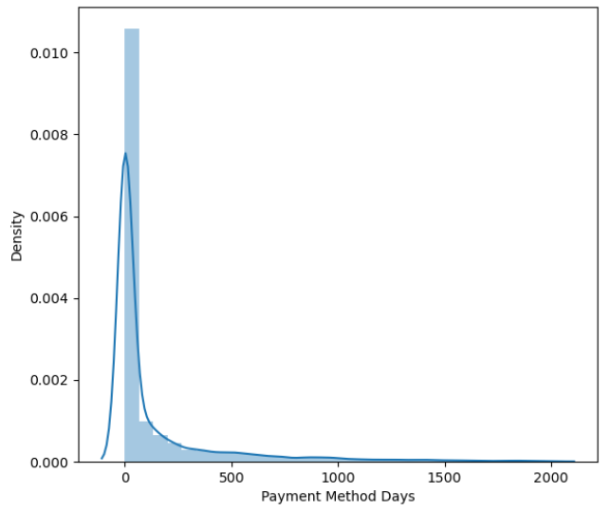
DATA ANALYSIS
Account Age Days:
This feature shows that how old the account is in terms of number of days. The median account age days is 603 days while minimum and maximum account age is 1 day and 2000 days respectively.
Payment Method Age Days:
This feature shows that how long ago the current payment method was linked to the account. The analysis shows that most of the users have linked the current payment method with their account very recently before the given transaction.

Slide 13
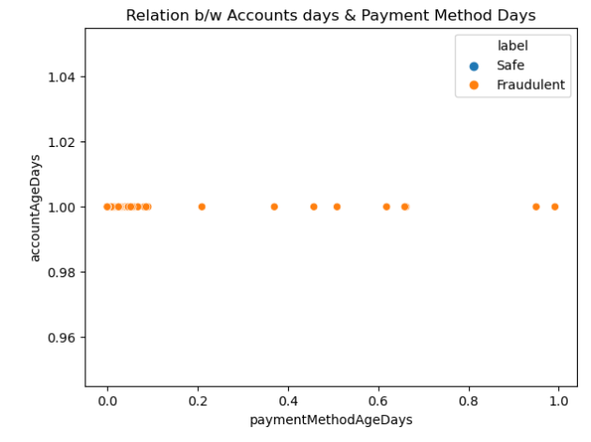
Relationship between Account Age Days and Payment Method Age Days:
We found all the transactions which were made using the accounts which have account age of 1 Day and payment method age of less than or equal to 1 Day are Fraud transactions.
When we apply the above such condition we got 396 records which satisfies the above condition.

Slide 14
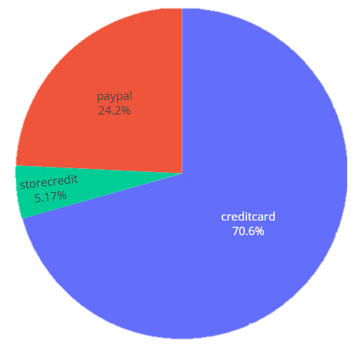
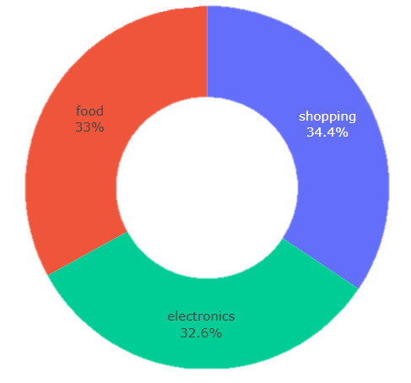
Payment Method:
This feature shows which payment method is used for the payment. In this dataset three types of payment methods are used. They are PayPal, Store-Credit and Credit-Card. The Credit-Card is most used payment method.
Category:
This feature shows which type of items the user has bought. In this dataset all the transactions that are made belongs to the three categories. They are Food, Electronic and Shopping. The most of the transactions are done in shopping category.

Slide 15
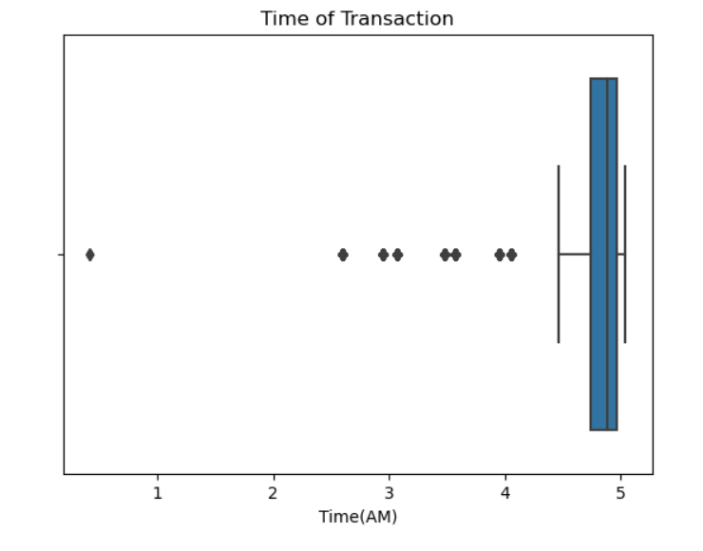
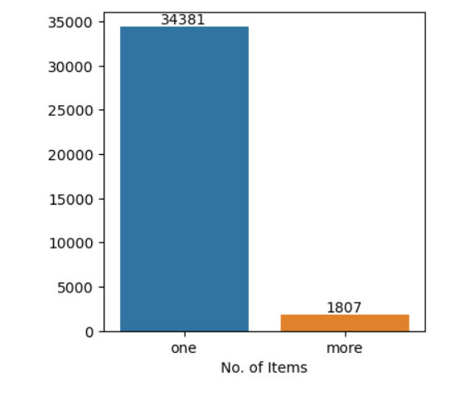
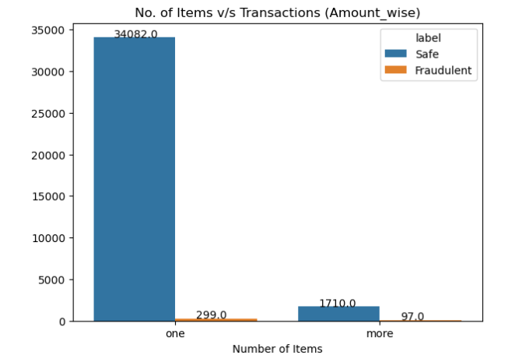
Time of the Transaction:
This feature shows the time of the day when the transaction is done. The analysis shows that the almost all the transactions are done between 4AM to 5AM. There are few exceptions also. The distribution of the time is shown by the boxplot.
Number of Items:

Slide 16
MODELLING PIPELINE
8 Features & 39221 Records
Dataset
Data Pre-Processing
Missing Values
Duplicate Removal
Outliers removal
Class Imbalance
Mode Imputation
SMOTE
Data Modelling
Decision Tree
KNN
Random Forest
Logistic Regression
XG-Boost
Stacking
Stacking
(DT +KNN)
Voting
(DT +KNN)
Evaluation

Slide 17

MODELS EVALUATION
While evaluating of all the models we get to know that all the models have training and test accuracy of around 99%. This accuracy score is due to lesser amount of minority class presence i.e due to the class imbalance. So for better judgement of the models we have used F1-Score as the evaluation parameter. The F1-score can be given as:

Slide 18
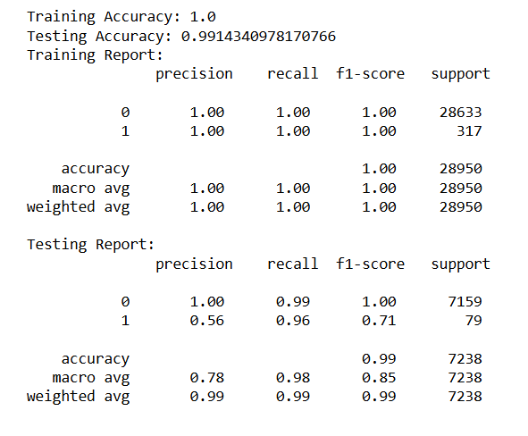
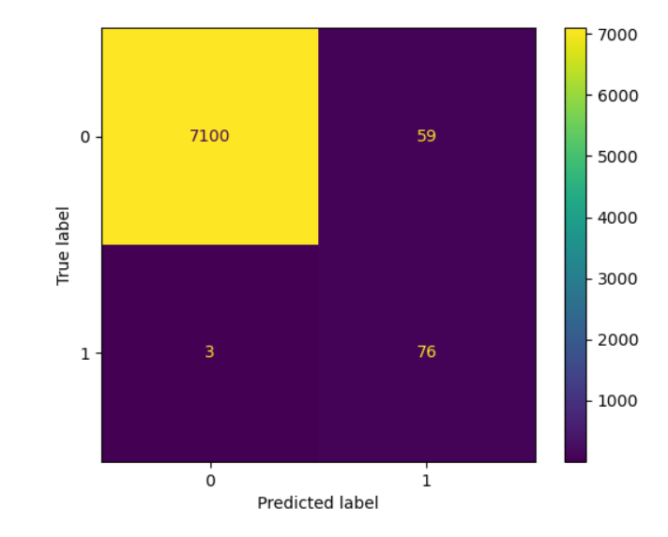
Results given by KNN Classifier

Slide 19
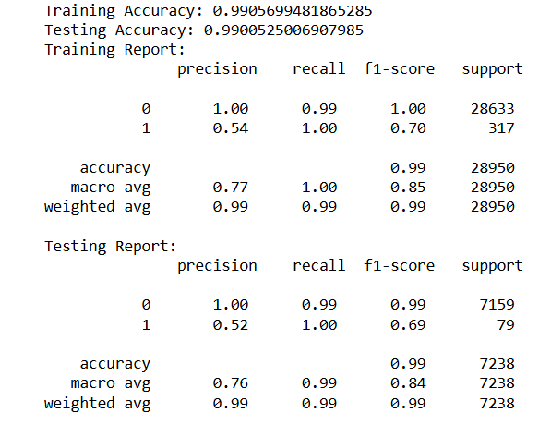
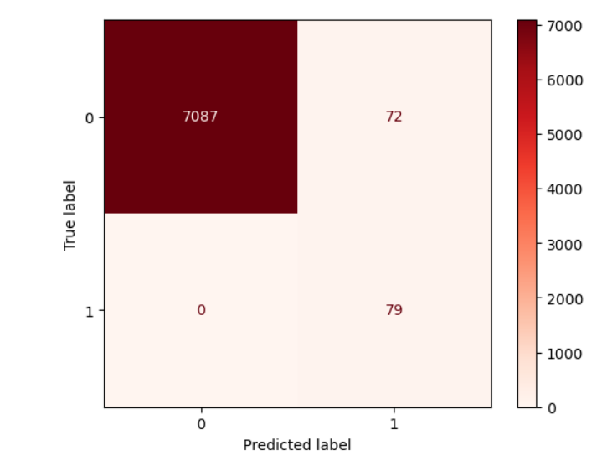
Results given by tuned Decision Tree Classifier

Slide 20
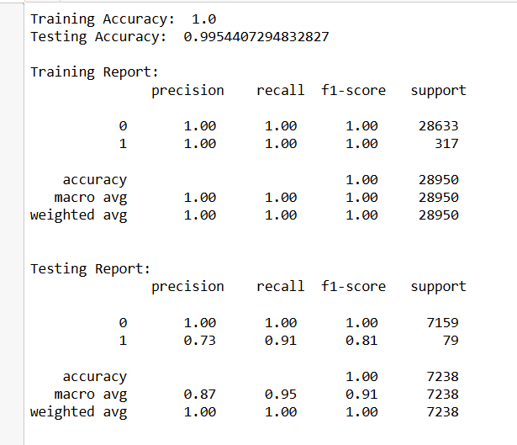
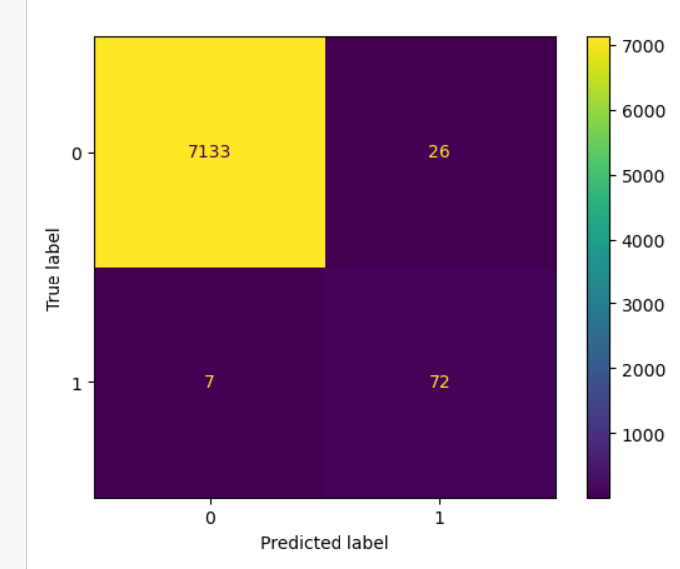
Results given by Stacking Classifier (DT+KNN)

Slide 21
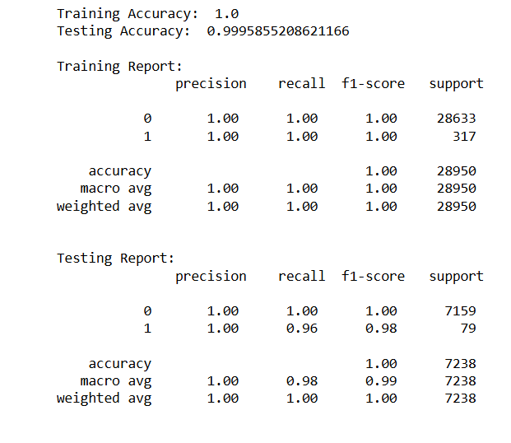
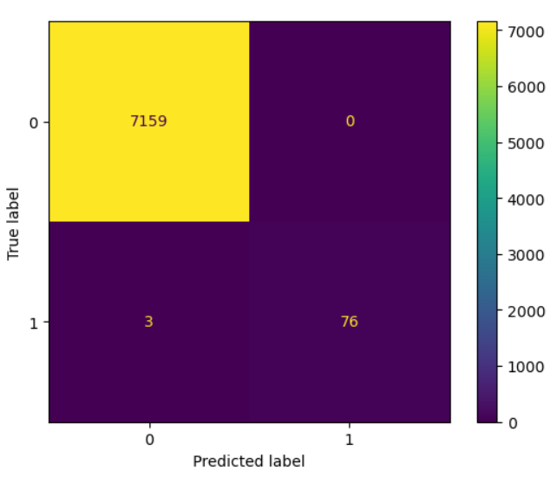
Results given by Voting Classifier (DT+KNN)

Slide 22
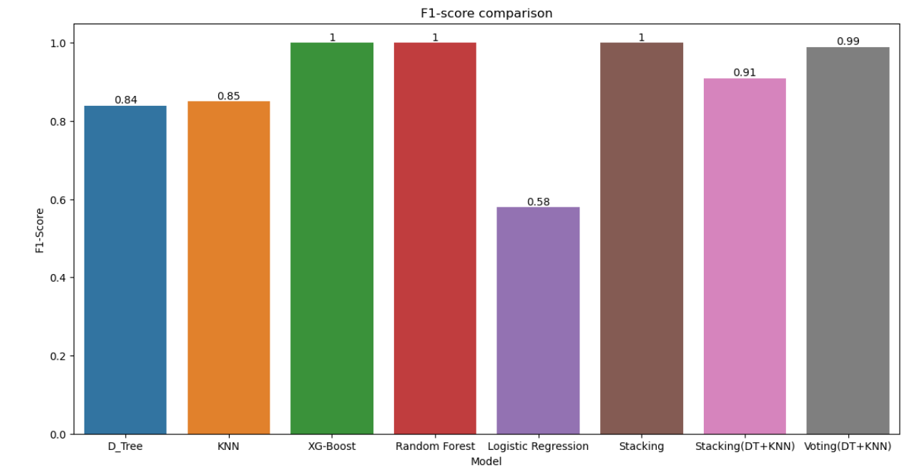
Models Comparison

