Slide 1
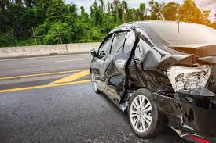
MODELING THE PRIMARY ACCIDENT CAUSE IN CHICAGO
A machine learning project by Amani Mkaya.

Slide 2
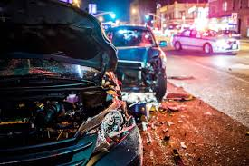
Overview
Car accidents are complex events influenced by multiple factors, including vehicle characteristics, occupant details, road conditions, and weather. Understanding the primary contributory cause of an accident can help authorities implement better safety measures, reduce accident rates, and save lives.
The objective of this project is to develop a predictive model that accurately identifies the primary contributory cause of a car accident.

Slide 3
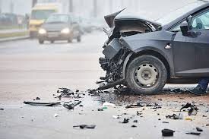
MAIN OBJECTIVE
Predict the primary contributory cause of a car accident, given information about the car, the people in the car, the road and weather conditions.

Slide 4
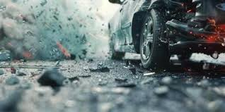
KEY BUSINESS QUESTIONS
What are the most common contributory causes of car accidents?
How do road and weather conditions impact the likelihood of different accident causes?
Do certain car models or vehicle types have a higher risk of specific accident causes?
Is blood alcohol content a major factor in accident occurence?
How do the above factors correlate with accident causes?
What machine learning techniques are most effective for accident cause prediction?

Slide 5
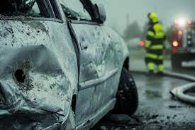
DATA SOURCE
The data was obtained from Chicago Data Portal
Data used are:
Traffic crashes- Crashes.
Traffic Crashes - Vehicles.
Traffic Crashes - People.

Slide 6
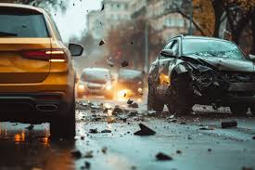
Analysis and modeling Steps
DATA EXPLORATION - Looking into the data to understand the structure before cleaning and analysis.
DATA PREPARATION - Involves cleaning, transforming, and organizing raw data into a usable format for analysis or model building.
EXPLORATORY DATA ANALYSIS - The process of analyzing and visualizing the dataset to understand its structure, patterns, and relationships.
MODELING - Develop a mathematical or computational representation of the underlying patterns within the data

Slide 7
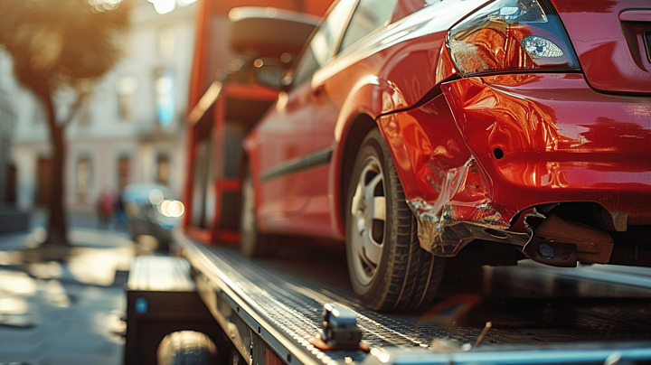
Observations and insights

Slide 8
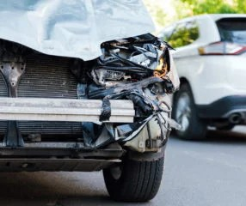
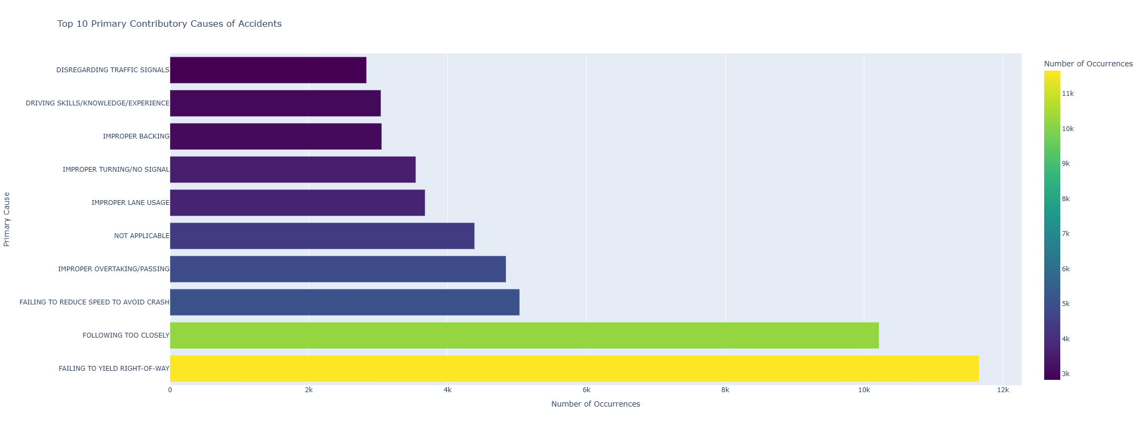
The top 10 primary accident contributors
Insight: Top 10 primary crash causes are:
1. Failing to yield right-of-way.
2. Following too closely.
3. Failing to reduce speed to avoid crash.
4. Improper overtaking.
5. Improper lane usage.
6. Improper turning.
7. Improper backing.
8. Driving skills.
9. Disregarding traffic signals

Slide 9
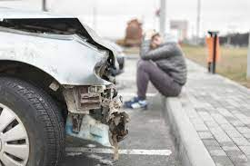
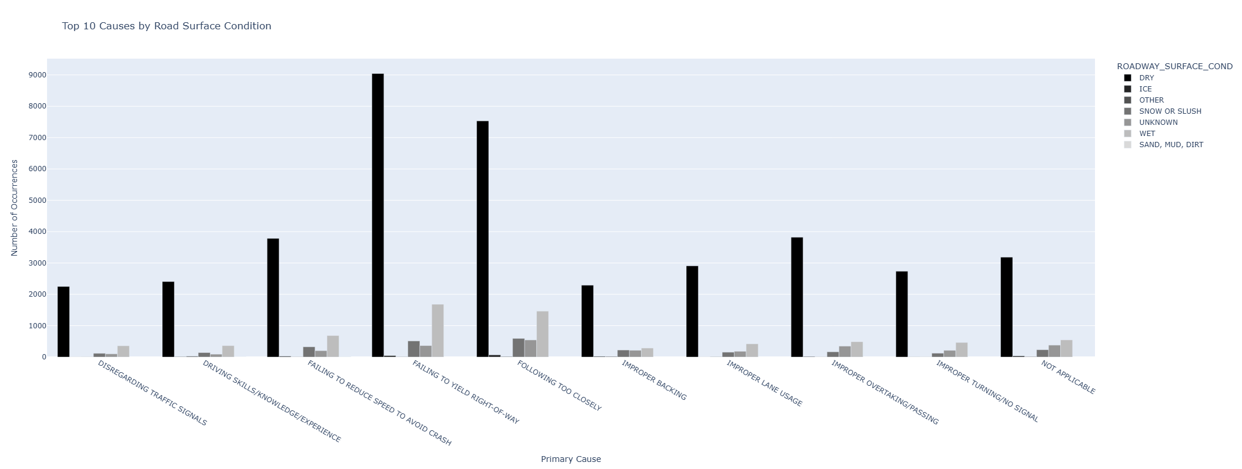
Top 10 causes against road surface condition.
INSIGHT: Most accidents occur on dry roads.

Slide 10
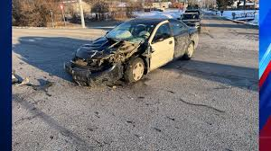
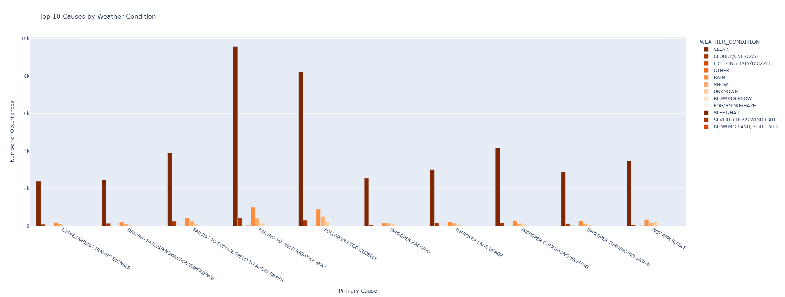
Top 10 causes against Weather conditions.
Insight: Most accidents occur in clear weather

Slide 11
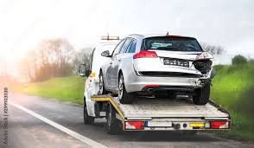
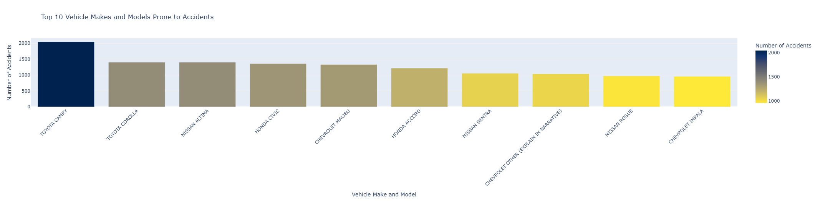
top 10 Vehicle make and model prone to accidents
Insight: The top 10 vehicles most prone to accidents are:
TOYOTA CAMRY with 87,396 accidents reported
HONDA CIVIC with 52,375 accidents reported
HONDA ACCORD with 47,035 accidents reported
CHEVROLET IMPALA with 37,739 accidents reported
NISSAN ROGUE with 36,619 accidents reported
FORD EXPLORER with 36,474 accidents reported
CHEVROLET EQUINOX with 34,638 accidents reported
HYUNDAI ELANTRA with 31,584 accidents reported
TOYOTA COROLLA with 30,719 accidents reported
NISSAN ALTIMA with 30,009 accidents reported

Slide 12
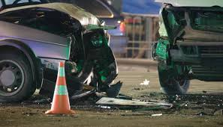
Best Models and metrics
1. XGBoost classifier.
Precision (XGBoost): 76.83%
Recall (XGBoost): 76.34%
F1-Score (XGBoost): 75.89%
AUC (XGBoost): 98.01%
XGBoost Accuracy: 76.34%
2. Decision tree classifier with Entropy impurity. (RandomizedSearchCV Hyperparameter tuning)
Precision (Entropy): 77.17%
Recall (Entropy): 77.19%
F1-Score (Entropy): 77.16%
AUC (Entropy): 84.02%
Base Decision Tree (Entropy) Accuracy: 77.19%

Slide 13
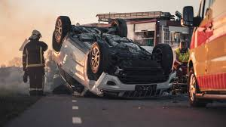
Model justification(XGBoost classifier)
High Accuracy and Balanced F1-Score The Accuracy of 76.34% indicates that the model correctly predicts the class in over three-quarters of instances. The F1-Score of 75.89% is also high and well-balanced, showing that the model: Effectively balances precision and recall. Maintains good performance across all classes, suggesting robust generalization.
Precision vs. Recall Analysis Precision (76.83%) and Recall (76.34%) are very close, indicating: The model accurately identifies true positives with minimal false positives. It generalizes well to unseen data, with a good balance between sensitivity and specificity. This reflects consistency in model predictions, with no significant bias towards either precision or recall.
Outstanding AUC Performance The AUC of 98.01% is exceptional, demonstrating: Excellent discriminatory power in distinguishing between classes. High sensitivity and specificity, meaning the model effectively ranks predictions. A high AUC combined with strong accuracy and F1-Score indicates the model: Is well-calibrated and confident in its predictions. Is reliable for decision-making, with low risk of misclassification.
Insights and Potential Strengths The consistency across all metrics suggests: The model effectively learns complex patterns without overfitting. It handles class imbalance well, maintaining high recall and precision. The model is robust and adaptable, likely due to the regularization techniques in XGBoost. The high AUC with balanced F1-Score implies that the decision thresholds are well-optimized.
Comparison with Other Models Compared to Decision Trees and Random Forests, this XGBoost model: Outperforms in accuracy, precision, recall, and F1-Score, showing better generalization. Excels in AUC (98.01%), proving better discriminatory power. Balances precision and recall better, reducing the risk of overfitting or underfitting.

Slide 14
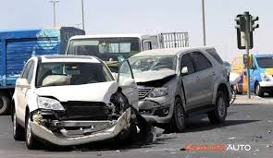
Conclusion
Conclusions Related to Business Questions:
1. The most common primary contributory causes identified were:
1. Failing to yield the right-of-way
2. Following too closely
3. Disregarding traffic signals
4. Improper overtaking/passing
2. How do road and weather conditions impact the likelihood of different accident causes?
We observe increased accidents occurence over claer weather and dry roads meaning people take advantage of good weather to drive carelessly.

Slide 15
Conclusion
3. Which car models are most prone to accidents.
We can see 60% of the top ten vehicles most prone to accidents are Japanese companies vehicles. These vehicles are also the budget friendly vehicles.
4. Best model for primary crash cause.
XGBoost and Decision Trees were the primary models tested for predicting the primary contributory cause of accidents. XGBoost outperformed Decision Trees in terms of accuracy, precision, recall, and AUC, indicating its superior ability to handle complex, non-linear relationships in the dataset.

Slide 16
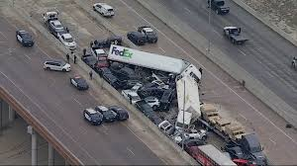
Recommendation
1. Implement targeted public awareness campaigns focusing on right-of-way rules and safe following distances.
Increase enforcement at high-risk intersections and areas prone to signal violations.
Enhance road design (e.g., better signage, dedicated turn lanes) to minimize overtaking risks.
When and where do most accidents occur, and how can resources be allocated effectively?
2. Implement targeted public awareness campaigns focusing on educating drivers about right-of-way rules, safe following distances, and the importance of obeying traffic signals.
Enhance law enforcement at high-risk intersections and areas prone to signal violations and improper overtaking.
Introduce driver training programs emphasizing defensive driving techniques to reduce tailgating and aggressive driving behaviors.

Slide 17
Recommendation
3. Launch awareness initiatives that emphasize the importance of safe driving practices even in clear weather and dry road conditions.
Deploy speed monitoring and enforcement systems in areas with high accident rates during good weather conditions to discourage reckless driving.
Introduce variable speed limits that adjust based on traffic density and time of day to manage speeding during optimal weather conditions.
4. Collaborate with automotive manufacturers to enhance safety features in budget-friendly vehicles, especially those prone to accidents.
Encourage the adoption of Advanced Driver Assistance Systems (ADAS) in popular Japanese models, such as automatic emergency braking and lane-keeping assistance.
Educate consumers on vehicle safety ratings and promote safer driving behaviors regardless of the vehicle's cost or brand.

Slide 18
Recommendation
5. Utilize the XGBoost model for real-time accident cause predictions due to its superior accuracy and ability to handle complex data relationships.
Integrate the model into traffic management systems to predict and mitigate high-risk scenarios in real-time.
Continuously update and retrain the model using new accident data to maintain its accuracy and relevance.
6. Increase road safety audits and implement infrastructure improvements at high-risk intersections and accident-prone areas.
Implement intelligent traffic signal controls in urban areas to optimize traffic flow and reduce collisions caused by traffic signal violations.
Enhance cross-industry collaboration between city planners, law enforcement, automotive manufacturers, and insurance companies to create holistic safety solutions.

Slide 19
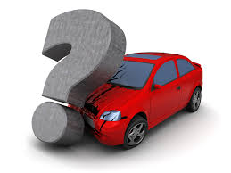
Q&A

Slide 20
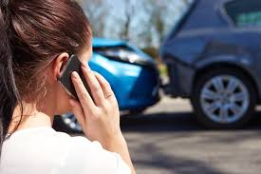
Contact info
Email: amanimkaya@students.moringaschool.com
LINKEDIN: www.linkedin.com/in/amani-mkaya

