Slide 2
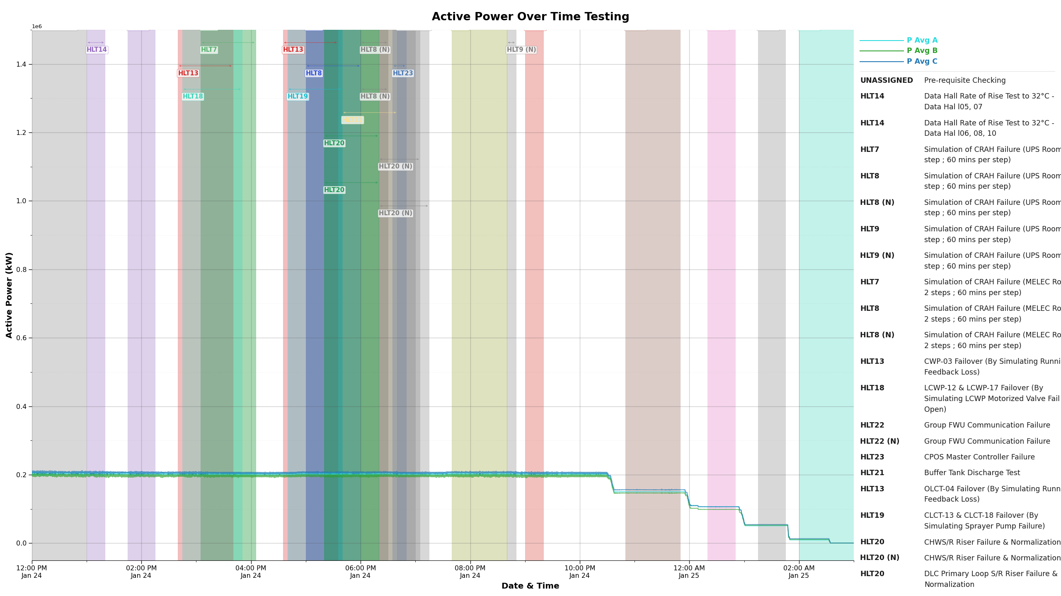
UPS-15-ISOTX-C1-IST-DAY4__0_config_composite_Active_Power

Slide 3
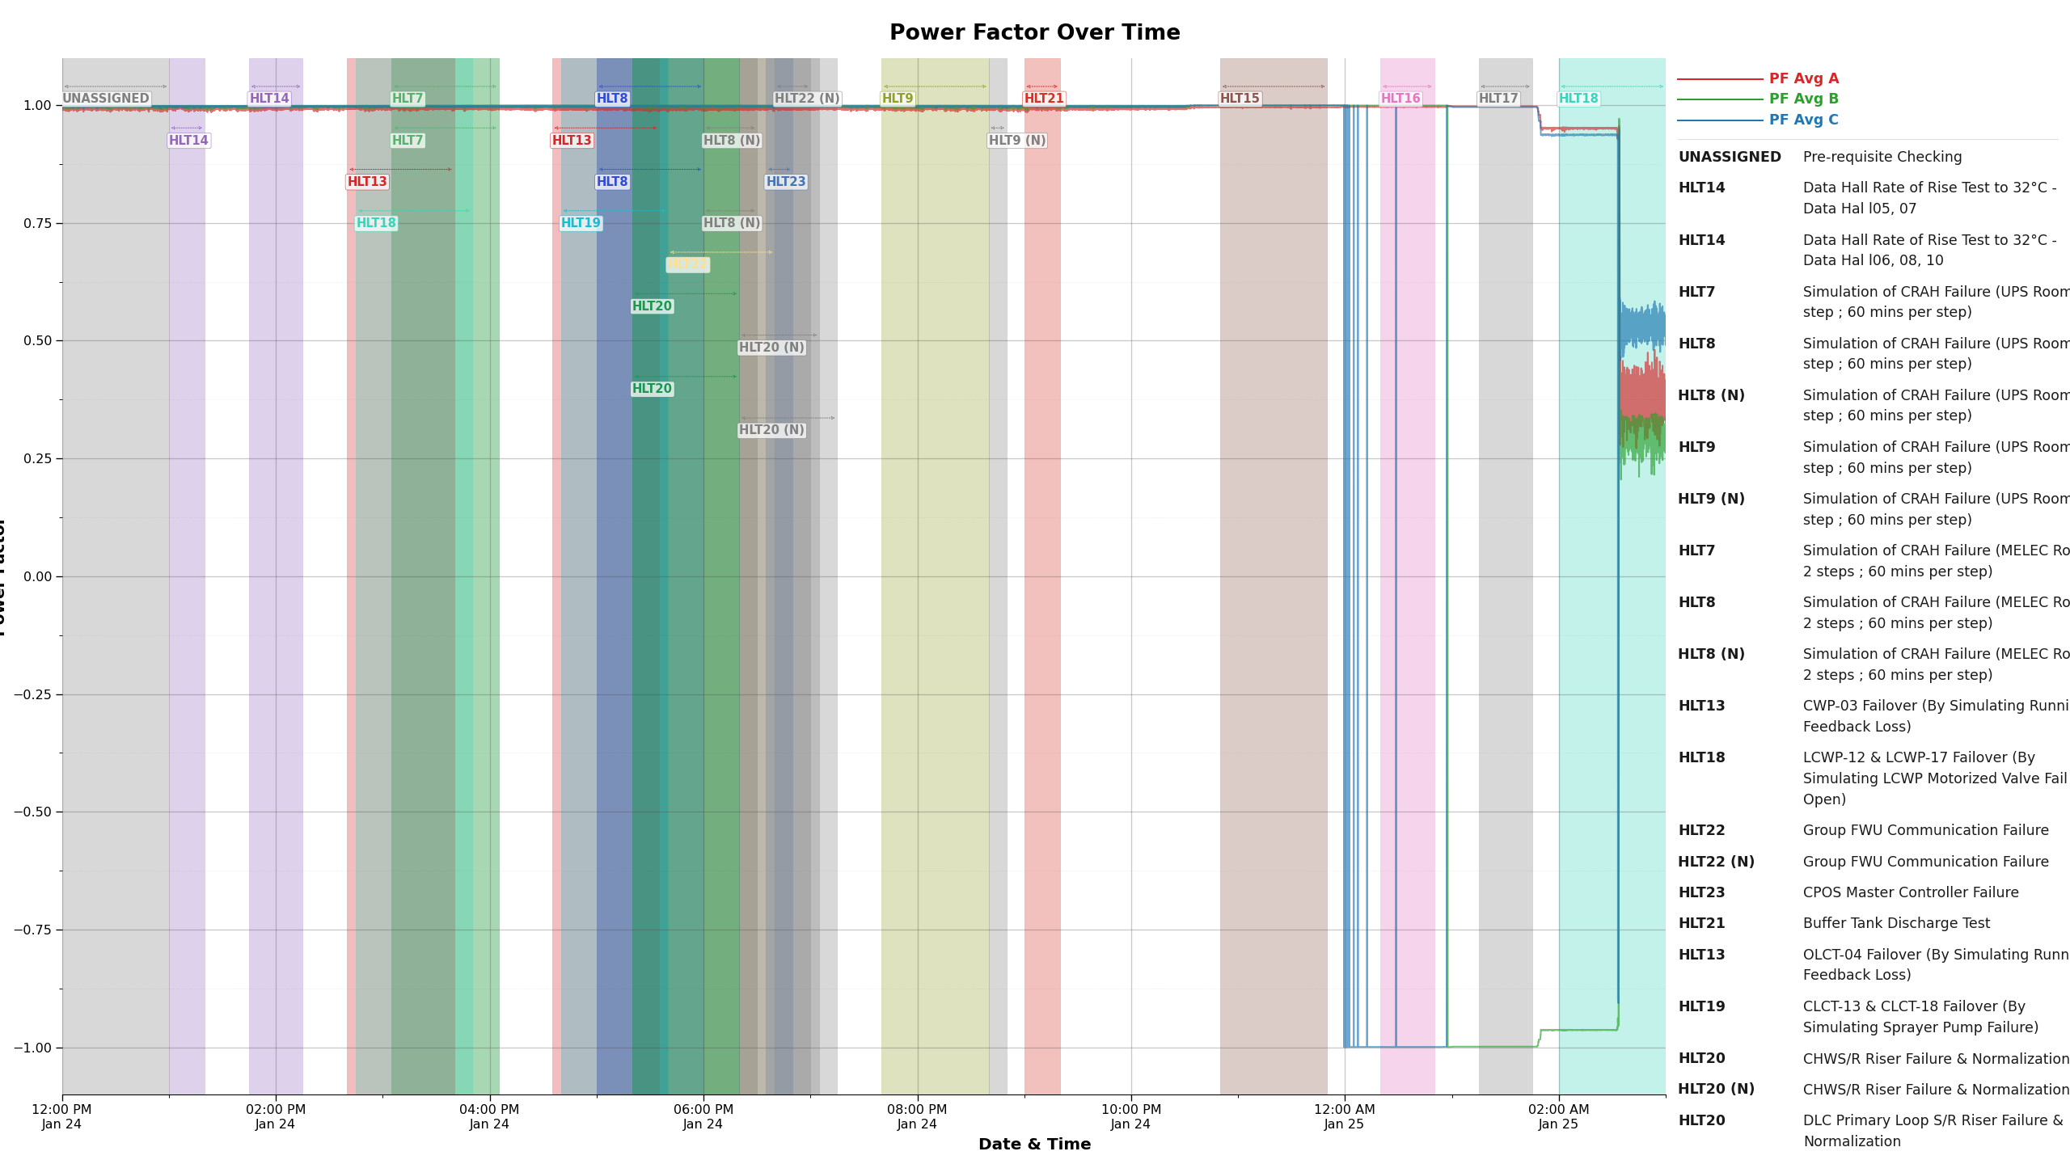
UPS-15-ISOTX-C1-IST-DAY4__1_config_composite_Power_Factor

Slide 4
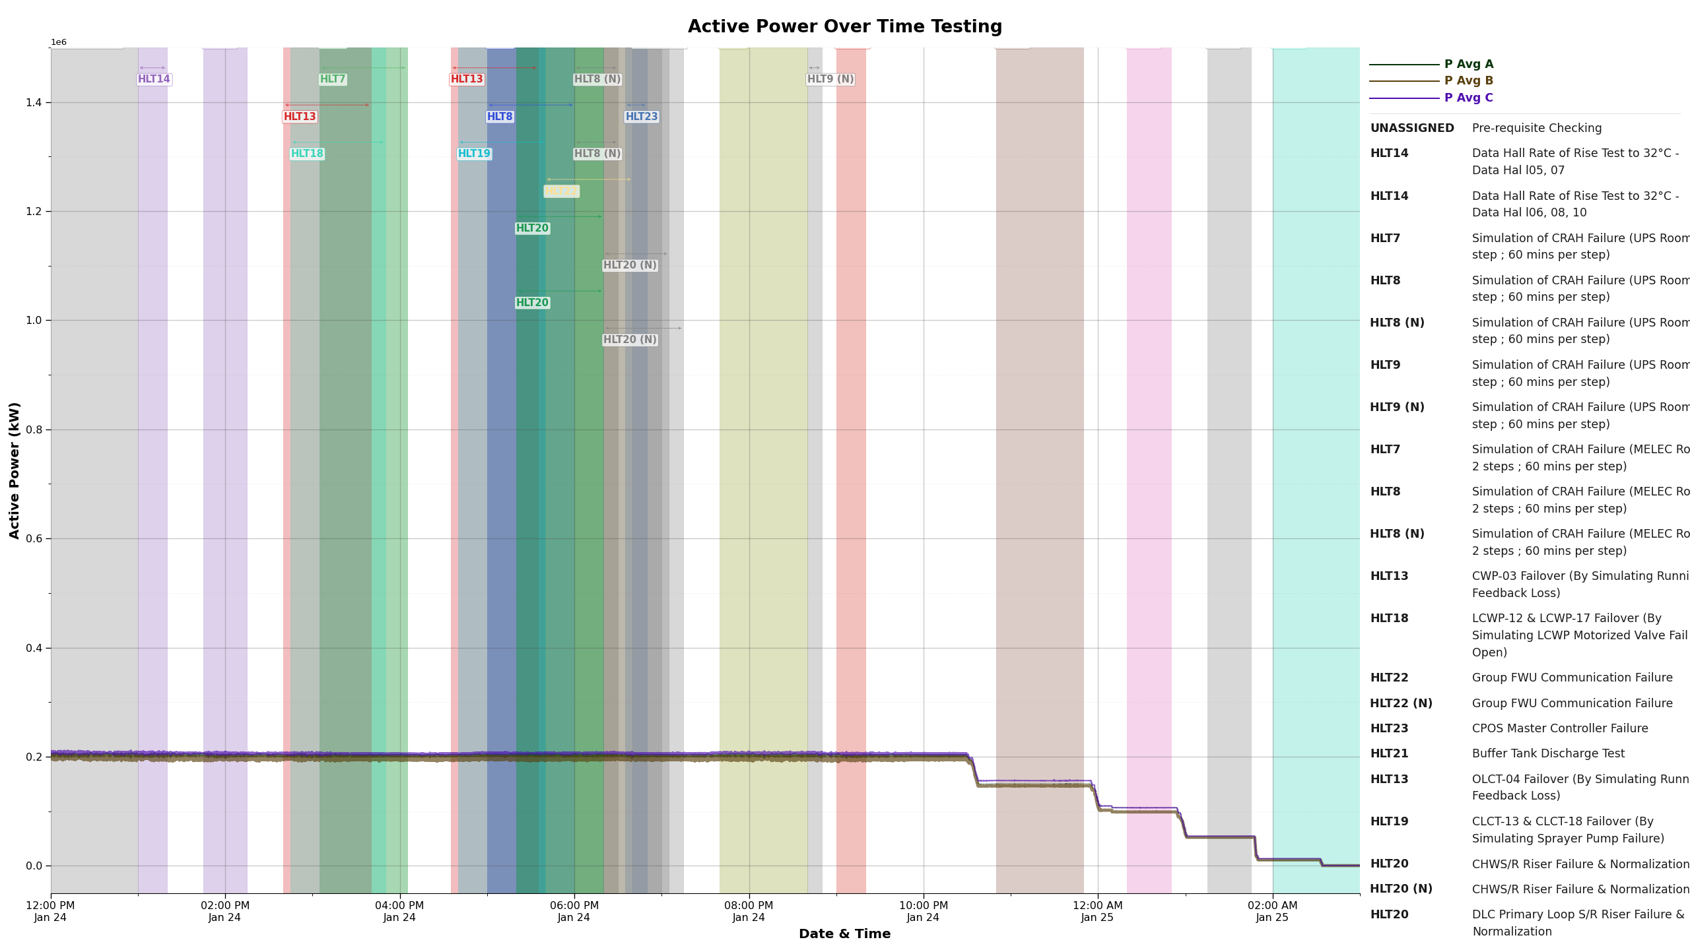
UPS-15-ISOTX-C1-IST-DAY4__0_config_composite_Active_Power_v_1

Slide 5
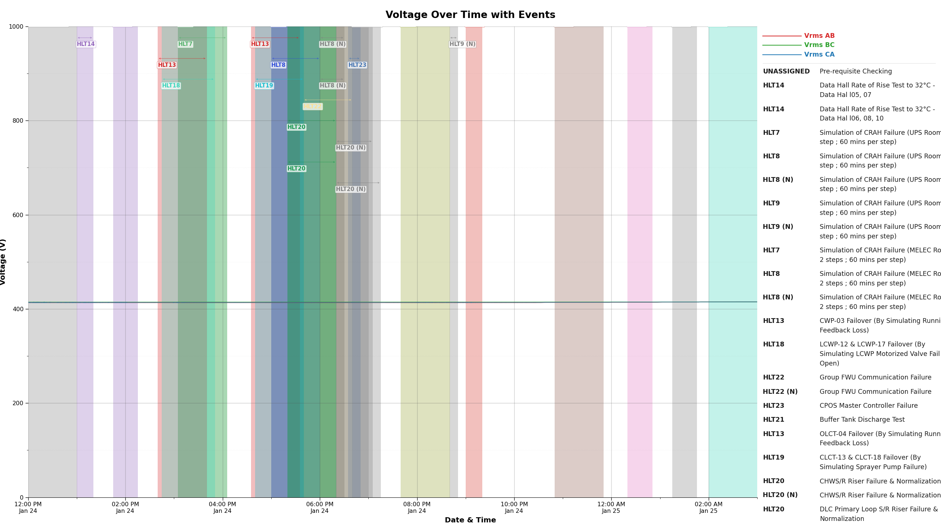
UPS-15-ISOTX-C1-IST-DAY4__2_config_composite_Voltage

Slide 6
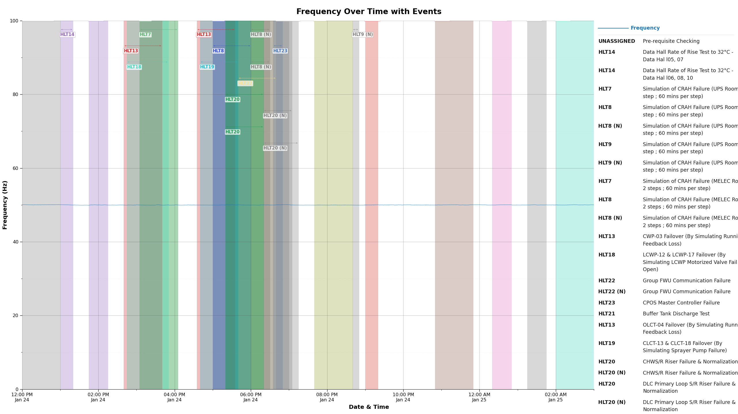
UPS-15-ISOTX-C1-IST-DAY4__5_config_composite_Frequency

Slide 7
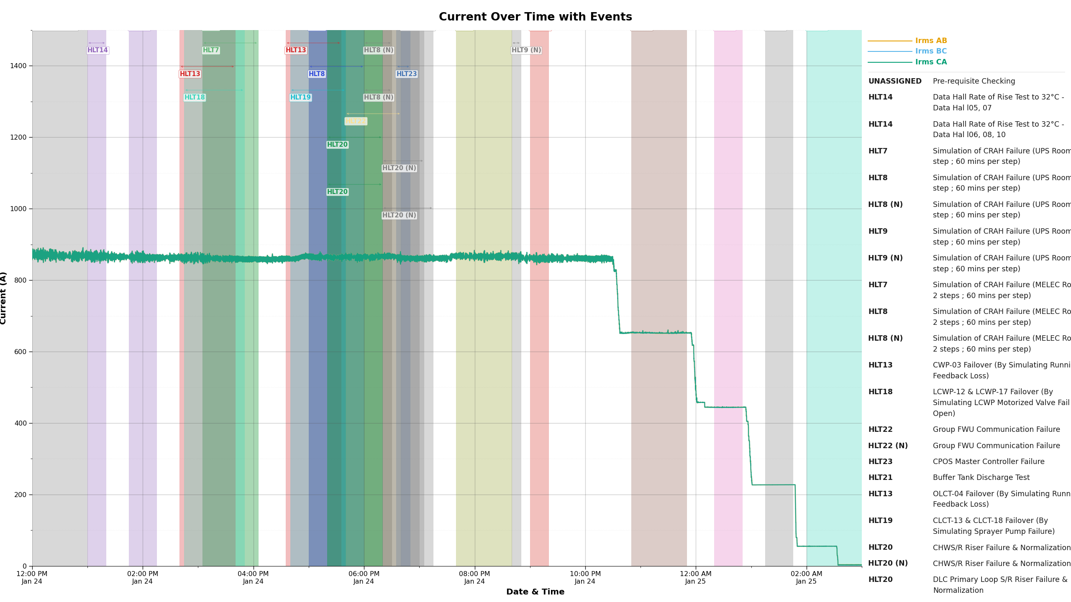
UPS-15-ISOTX-C1-IST-DAY4__3_config_composite_Current

Slide 8
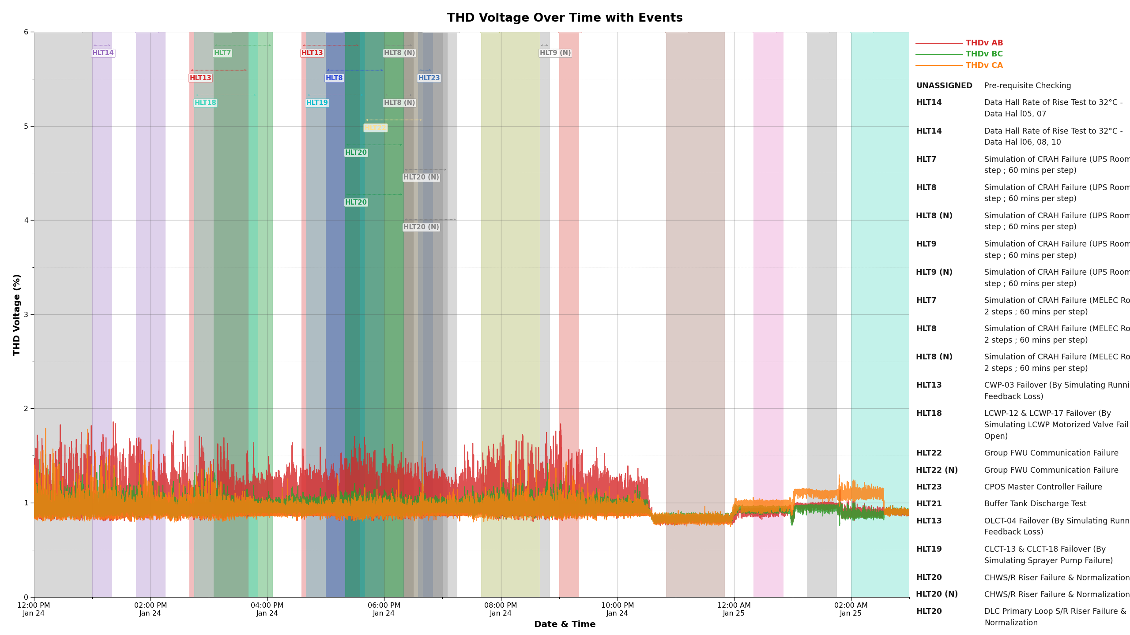
UPS-15-ISOTX-C1-IST-DAY4__6_config_composite_THD_Voltage

