Slide 1
Living Worlds
GPU-Accelerated Terrain Simulation
CS380 GPU Programming - Final Presentation
Mohammad Alkhalifah
December 2025

Slide 2
The Problem: Static Terrain is Boring
Traditional approaches:
  Offline generation or manual sculpting
Games need: Dynamic, evolving worlds
Our Goal:
Real-time terrain simulation using GPU cellular automata with interactive framerates.

Slide 3
What We Built: Living Worlds Engine
Architecture Components:
Component | Description
Geological Layer | Thermal erosion simulation
Ecological Layer | 9 biome types with spreading rules
Feedback Loop | Forests stabilize terrain
Renderer | 2.5D isometric with atmospheric fog

Slide 4
GPU Architecture: Vulkan Compute
Heightmap A ──► Erosion ──► Heightmap B
↑ │
└────── Ping-Pong Swap ─────┘
Biome A ──► Biome CA ──► Biome B
↑ │
└────── Ping-Pong Swap ───┘
Why Ping-Pong?
• Prevents race conditions in parallel updates
• Each frame: Read A → Write B → Swap

Slide 5
Cellular Automata Rules
// Thermal Erosion
if (h - neighbor_h > threshold) {
newHeight = height - erosionRate;
}
// Biome Spreading
if (grass && forestNeighbors >= 3) {
if (random() < 0.3) become(FOREST);
}
// Feedback
if (biome == FOREST) erosionRate *= 0.2;

Slide 6
Biome System: 9 Discrete Types
Biome | Behavior
🌊 Water | Height < 0.3 (forced)
🏖️ Sand | Coastal zones
🌲 Forest | Spreads, resists erosion
🏜️ Desert | Spreads in dry areas
❄️ Snow | Peaks (>0.85)

Slide 7
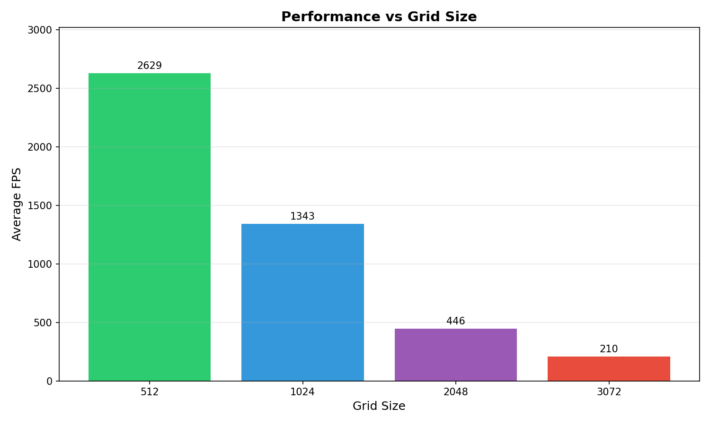
Benchmark: FPS vs Grid Size
Grid | FPS
512² | 3,062
1024² | 1,414
2048² | 505
3072² | 243

Slide 8
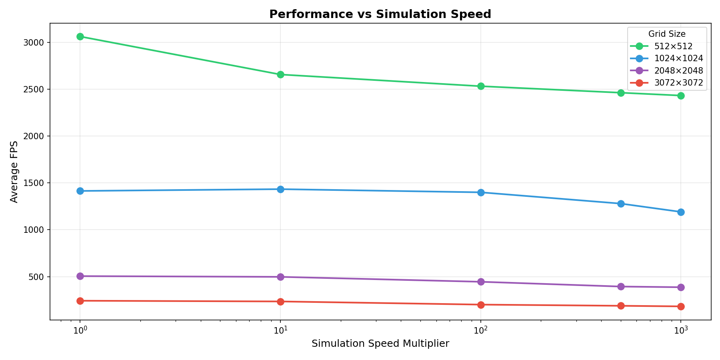
FPS vs Simulation Speed
Key Findings:
• Higher simulation speeds = More compute work
• Still interactive (>200 FPS) even at 3072x3072

Slide 9
Demo Video
[1-Minute Walkthrough Playback]
• Terrain Generation
• Camera Navigation
• Forest Spawning
• Erosion Dynamics

Slide 10
Future Work
Hydraulic erosion (water flow)
GPU tessellation for LOD
Infinite terrain streaming
Advanced lighting (Shadows, AO)

Slide 11
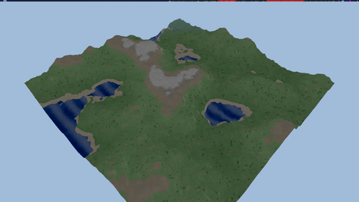
Thank You!
Questions?
github.com/mkhlf/livingworlds

