Slide 1
Handwritten digit recognition
Created by
M.Kishore
Reg.no:912321104015
Cse IIIyear
SACS MAVMM Engineering college, Madurai.

Slide 2
Project outline:
>Problem statement
>Proposed system /solution
>System development approach
>Algorithm and deployment
>Result
>Conclusion

Slide 3
Problem statement:
>This is a collection of thousands of handwritten pictures used to train classification models using Machine Learning techniques. As a part of this problem statement, we will train a multi layer perceptron using Tensorflow -v2 to recognize the handwritten digits
>The handwritten digit recognition is the capability of computer applications to recognize the human handwritten digits. It is a hard task for the machine because handwritten digits are not perfect and can be made with many different shapes and sizes. The handwritten digit recognition system is a way to tackle
>This problem which uses the image of a digit and recognizes the digit present in the image. Convolutional Neural Network model created using PyTorch library over the MNIST dataset to recognize handwritten digits

Slide 4
Proposed system/solutions:
>Handwritten digit recognition is a prevalent multiclass classification problem usually built into the software of mobile banking applications, as well as more traditional automated teller machines, to give users the ability to automatically deposit paper checks.
>Ensure the system is user-friendly, providing clear instructions and feedback to users.
>Monitor the performance of the deployed system in real-world scenarios and collect feedback
>Monitor the performance of the deployed system in real-world scenarios and collect feedback
>Split the dataset into training, validation, and testing sets.

Slide 5
System Development approach:
>Clearly define the problem you are trying to solve, including the scope of the project (e.g., recognizing handwritten digits from 0 to 9).
dentify the target audience and potential use cases for the system.
>Explore the dataset to understand its characteristics, such as the distribution of classes, image resolutions, and any preprocessing required.
>Preprocess the images to standardize them and make them suitable for training. This may include resizing, normalization, and augmentation to increase the diversity of the datas
>Visualize the model's performance using confusion matrices, ROC curves, and precision-recall curves.

Slide 6
Algorithm and Deployment:
>Design your CNN architecture consisting of convolutional layers, pooling layers, fully connected layers, and output layers.
>Input layer: Accepts grayscale images of handwritten digits as input.
>Convolutional layers: Apply filters to extract features from the input images.
>Pooling layers: Downsample the feature maps to reduce spatial dimensions.
>Fully connected layers: Flatten the feature maps and pass them through one or more fully connected layers.
>Output layer: Contains neurons corresponding to the possible classes (digits 0-9), with softmax activation to output class probabilities.
>Use popular deep learning frameworks such as TensorFlow, Keras,

Slide 7
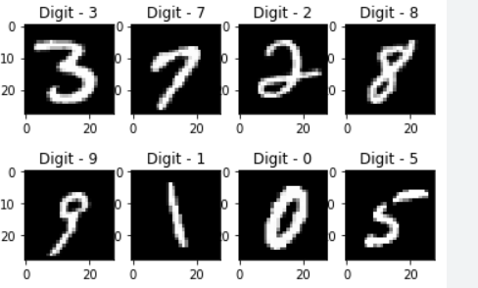
Result:
Handwritten digit recognition classification accuracy tested on the MNIST dataset while using training and testing sets is now higher than 99.5% and the most successful method is a convolutional neural network. Conclusions: Handwritten digit recognition is a problem with numerous real-life applications.

Slide 8
Reference:
https://www.google.com/search?sca_esv=6246709ce63302d6&rlz=1C1JJTC_enIN1045IN1045&sxsrf=ACQVn08vyHJS9ZSmImNaIQVShA1udntVbA:1711980672749&q=result+for+Handwritten+digit+r
https://images.app.goo.gl/JWZoQ6MWwTqTE6GC6

Slide 9
Conclusion:
Convolutional neural network (CNN, or ConvNet) can be used to predict Handwritten Digits reasonably. We have successfully developed Handwritten digit recognition with Python, Tensorflow, and Machine Learning libraries. Handwritten Digits have been recognized by more than

Slide 10


