Slide 1

FilmFókusz - Movie & Series Recommendation
End-of-Year Project Presentation
By: Miklós Merse Márton, Szitai Bence Márk & ChatGPT

Slide 2

Introduction
The goal of the project is to create a movie and Series recommendation website that helps users easily and quickly find content that matches their interests.
Users can easily choose which movie or TV show they want to watch based on their preferences.

Slide 3
Key Features
Login & Registration System
Search Bar & Navigation
Dropdown Menus for Genres
Profile Picture Update & Logout
Animated UI Elements

Slide 4
Frontend Technologies
Developed using React.js
Dynamic & Responsive UI
Interactive Animations
Smooth User Experience

Slide 5
Backend Technologies
Built with C#
MySQL Database for storing user data and ratings
Secure authentication system

Slide 6
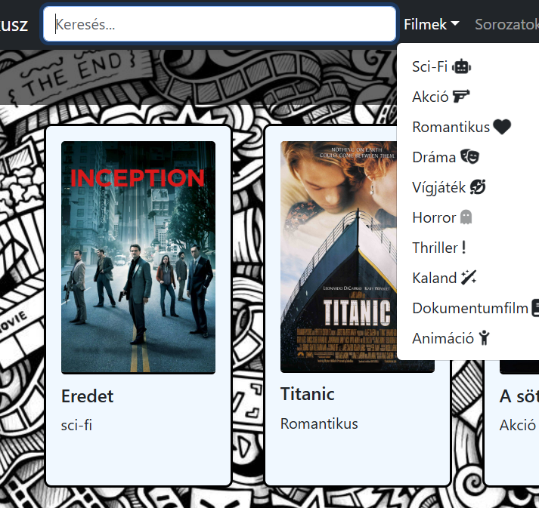
User Experience (UX)
Search Functionality
Genre Dropdown Menus
Smooth Page Navigation
Intuitive Design

Slide 7
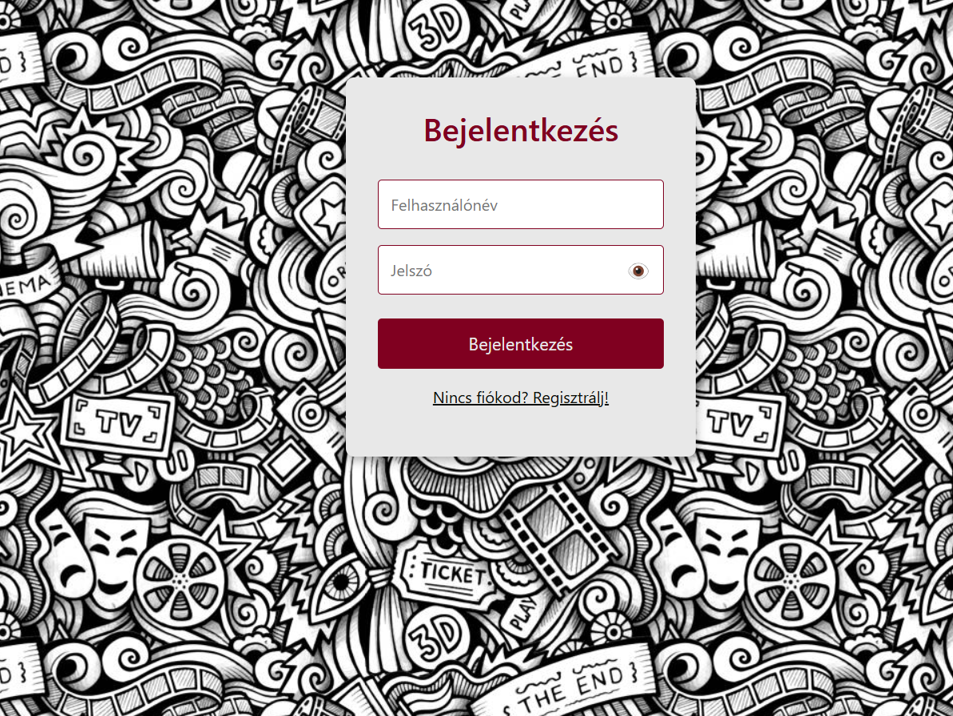

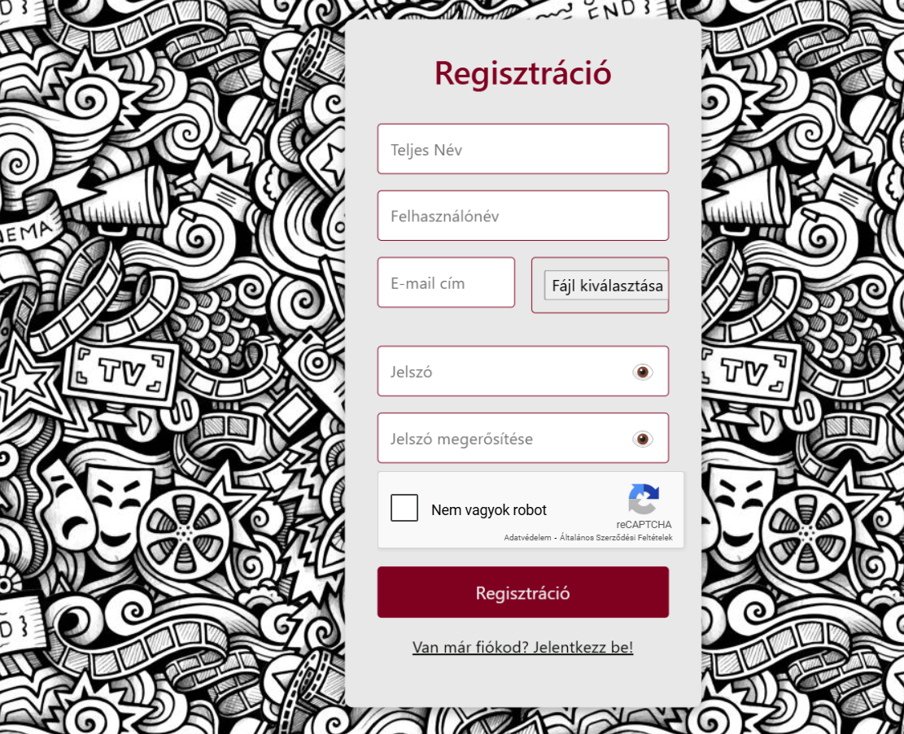
User Accounts
Users can register and log in
Profile picture customization
Logout functionality

Slide 8
Future Plans
Implement a user review system
Improve recommendation algorithms
Expand content categories

Slide 9
Project Links
GitHub: https://github.com/MklsMerse/Film-Sorozat-ajanlo
Trello: https://trello.com/w/filmsorozatajanlo
GitHub is used for version control and collaboration, allowing the team to manage and track code changes efficiently.
Trello is utilized for project management, helping the team organize tasks, set priorities, and track progress throughout the development process.

Slide 10
Team Members
Miklós Merse Márton
Szitai Bence Márk
ChatGPT (AI Assistant)

Slide 11

Thank You!
Any Questions?

