Slide 1
FilmFókusz – Movie and Series Recommendation Website
Created by: Bence Szitai, Merse Miklós
Date: 2025.03.26

Slide 2

Introduction – Project Objective
Why Did We Choose This Topic?
Movies and TV series have become an integral part of our daily lives, and there is a growing demand for clear, easy-to-use online databases. Our goal was to create a web application that helps users discover movies and series that interest them while providing a central hub for various information.
What Problem Does FilmFókusz Solve?
Detailed movie and series profiles, including trailers, descriptions, genres, cast, and directors.
A simple search function to quickly find desired content.
User rating and commenting features (planned future functionality).

Slide 3
Who Is the Target Audience?
FilmFókusz is designed for all movie lovers and series enthusiasts who want to explore a particular film or series.
Our key target audience includes:
Movie fans interested in the latest films.
Series watchers looking for new favorites.
Users who want to share their opinions and reviews with others.
Content is available for both older and younger audiences on our website.

Slide 4
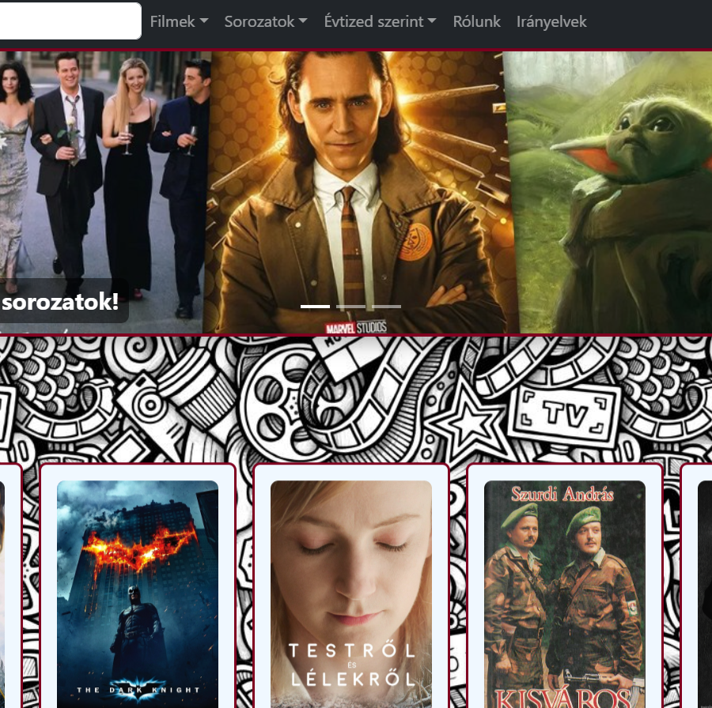
What Does the Website Offer?
FilmFókusz is a clear and user-friendly platform that allows:
Browsing movies and series
Viewing detailed information
Watching trailers
User ratings and commenting features (currently under development)

Slide 5
Features and Extras
Quiz – The user can choose whether they want to watch a movie or a series, then specify the genre and decade, and the website will recommend a random movie or series.
Movies and Series by Decade – The user can select a specific decade (1970–2020), and the website will only display content released during that period.
Movies and Series by Genre – Movies and series can be filtered by genre, such as action, comedy, horror, etc.
About Us – An informational page that introduces the purpose of FilmFókusz and the creators of the website.
Guidelines – Rules and guidelines for using the website, such as appropriate behavior, privacy, etc.
Profile Picture Change – Registered users can set a custom profile picture, which they can change at any time.
Log Out – The user can log out from the website.

Slide 6
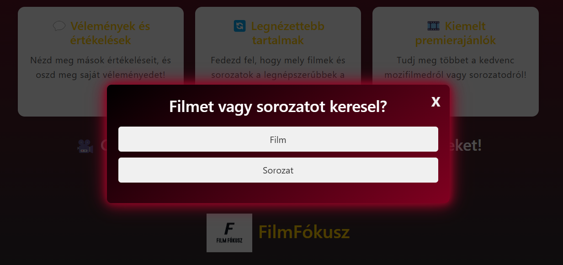
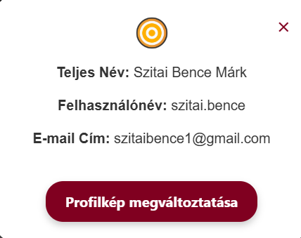
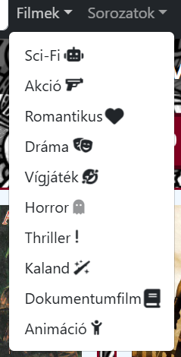
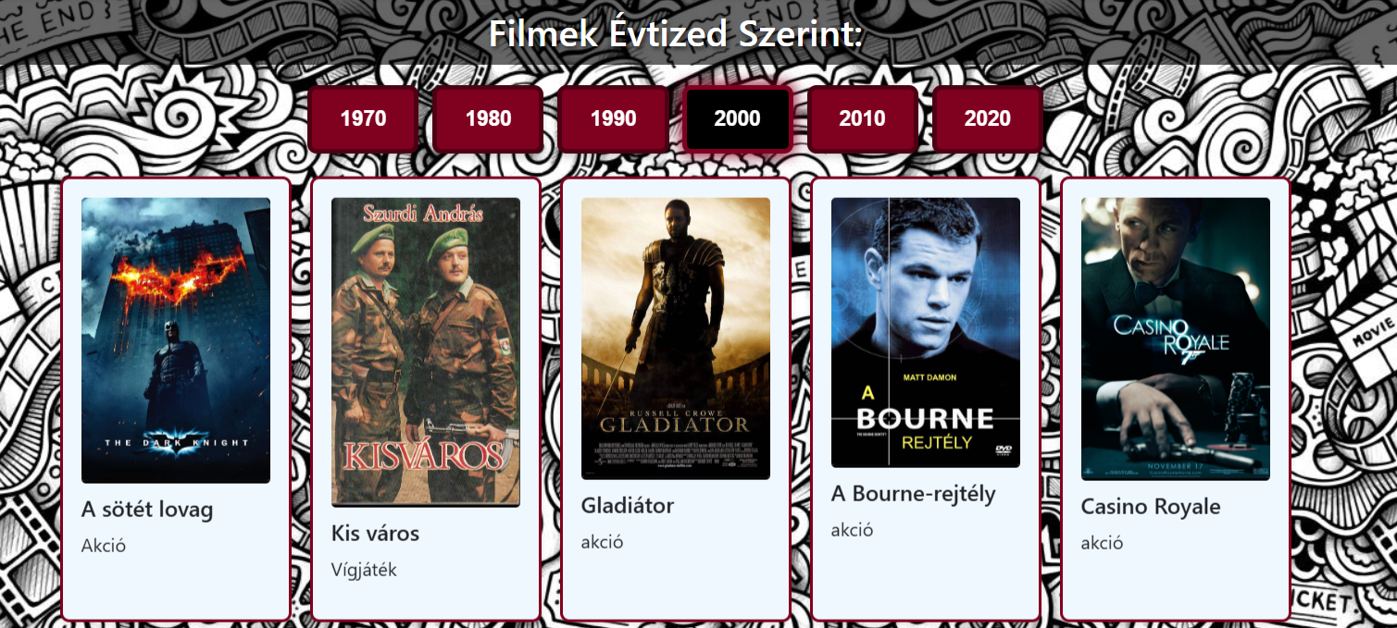
Genres, Profile Window, Movies/Series by Decade, Quiz

Slide 7
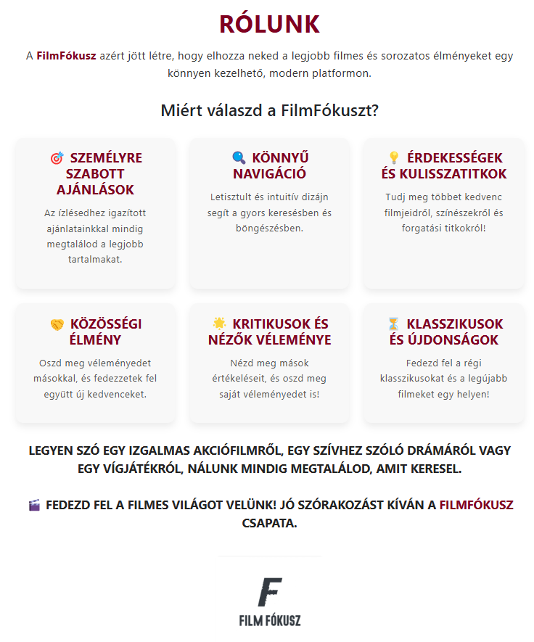
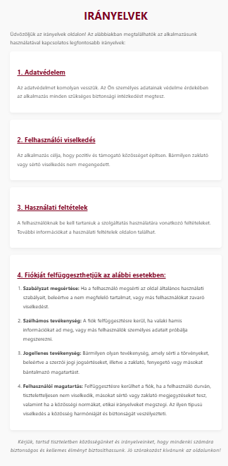
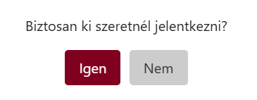

Guidelines, About Us, Log Out Features

Slide 8
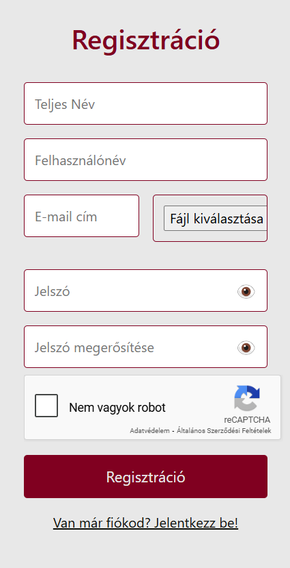
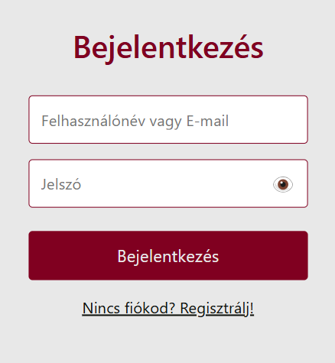
Login and Registration
Registration – New users must provide the following information:
Full name
Username
Email address
Password and password confirmation
Profile picture (optional)
Bot filter (CAPTCHA or other verification to filter out robots)
Login – After successful registration, users can log in with their username or email address and password.
Security – Passwords are stored encrypted in the database, and the bot filter helps prevent spam or automated registrations.

Slide 9




A technológiák kiválasztása
Why React for the Frontend?
Component-based architecture – Easily reusable UI elements.
Simple state management – Use of useEffect and useState hooks.
Why ASP.NET Core Web API for the Backend?
Fast and secure – Delivers excellent performance in the .NET environment.
RESTful API support – Easily scalable and extendable endpoints.
Why We Chose MySQL Database Management?
Reliable and highly scalable – Can handle large amounts of data.
Secure and scalable – Capable of managing growing user and data storage needs.
Why We Chose WPF?
Efficient desktop application development – WPF allows for the creation of modern and responsive desktop applications.
Customizable UI – WPF provides the ability to create a unique and modern administrative interface.
Why We Chose Visual Studio Code?
Extensions and support – Plenty of plugins and tools that assist in development (e.g., React, ASP.NET Core, MySQL management).
Convenient development environment – Allows for fast editing and testing of code while developing the React frontend.

Slide 10
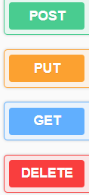
Backend (ASP.NET Core Web API)
The backend is the server-side part of the application, responsible for handling, storing, and transmitting data between the frontend and the database. We created the API endpoints using ASP.NET Core Web API, which enable the proper functioning of the application.
The Role of the Backend in the Application
Data Management: Storing and managing data for movies, series, and user information.
Authentication and Authorization: User login and access control management.
Database Connection: Communication between the application and the MySQL database.
Executing Business Logic: Validating, modifying, and processing data.

Slide 11
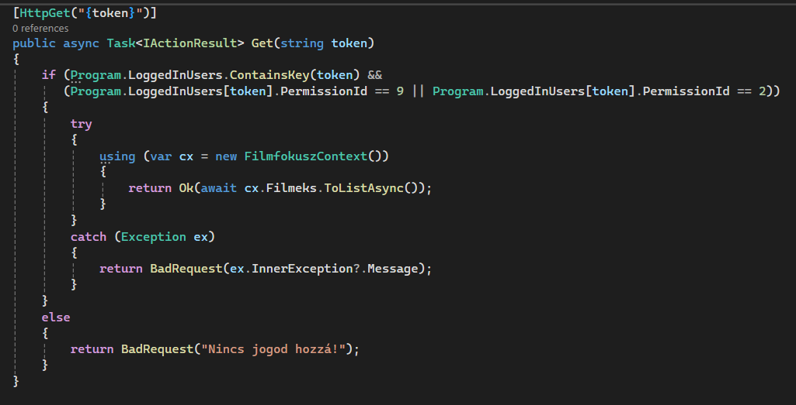
Example of an API endpoint
The following code snippet shows a GET endpoint that retrieves all movies from the database

Slide 12
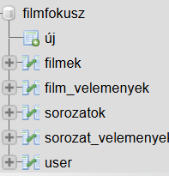
MySQL DataBase
MySQL is an open-source relational database management system that provides ideal data management for applications. In our project, we use MySQL to store and manage various data. We have created a central database named filmfokusz, which contains five tables:
movies: Stores movie data.
series: Stores series data.
movie_reviews: Contains reviews and ratings related to movies.
series_reviews: Contains reviews and ratings related to series.
user: Stores user data, including login credentials and profiles.
The database ensures secure data storage, fast access, and provides the ability for easy querying and modification.

Slide 13
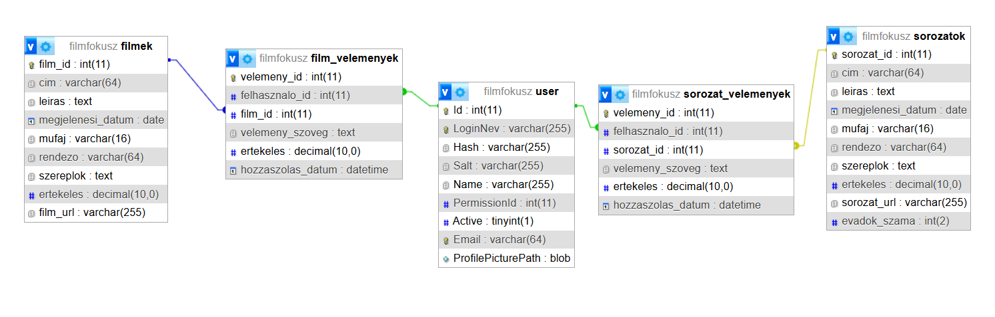
Database Connection

Slide 14


Frontend (React, JSX, CSS, API Connection)
The following technologies were used for frontend development:
React: A popular JavaScript library that enables the creation of dynamic, reusable user interfaces.
JSX: React's unique syntax that allows using HTML-like code within JavaScript. It simplifies component management and DOM manipulation.
CSS: Stylesheets responsible for the visual appearance of the web application. CSS allows customization of the user interface's design and layout.

Slide 15
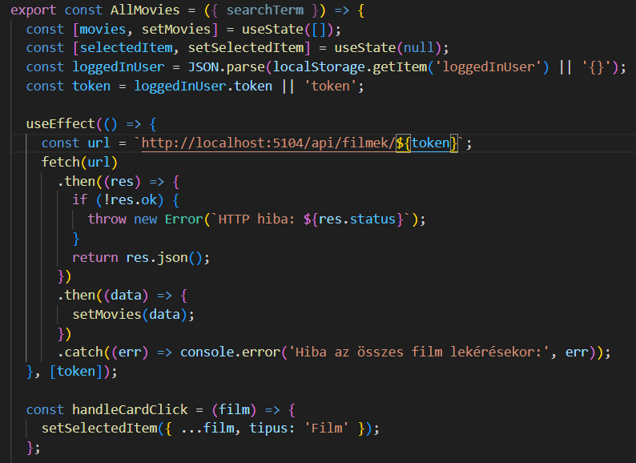
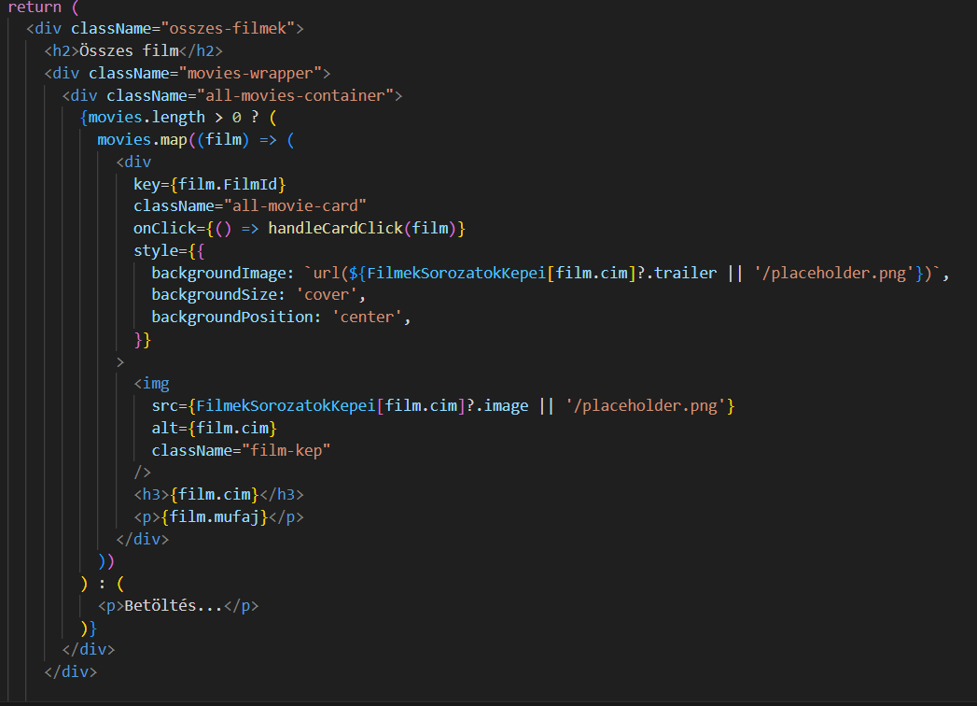
An example of an API call
The useEffect hook performs the API call when the component is first rendered.
Using the Fetch API, we retrieve data from the URL http://localhost:5104/api/filmek/${token}.
The received response is processed in JSON format and then stored in the movies state using the setMovies function, which contains the movies.
Once the data is loaded, it is displayed to the user.

Slide 16
WPF Application
The WPF (Windows Presentation Foundation) application aims to provide administrative functions for the application's system administrators. With the help of system administrators, administrators can manage movies, series, user data, and user reviews (under development) in the FilmFókusz database.
Technologies and Languages Used:
C#: The main programming language for the WPF application. Using C#, we handle database operations, application logic, and events.

Slide 17
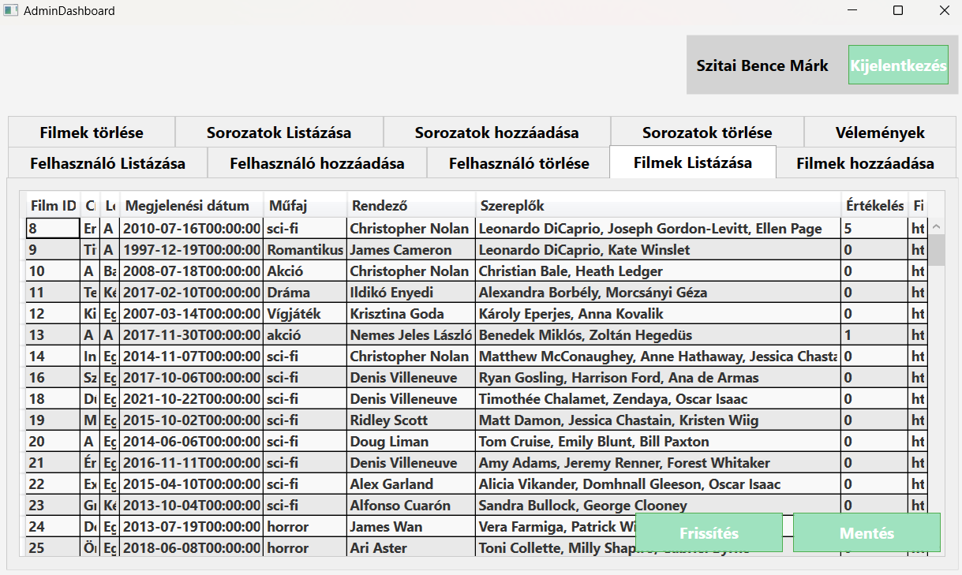
WPF AdminDashboard Home Page

Slide 18

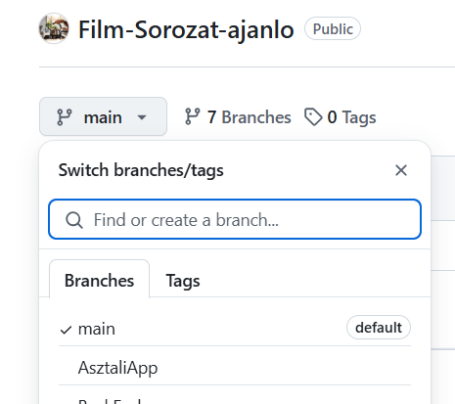
GitHub
GitHub was used for version control and supporting team collaboration. During the implementation of various features and tasks, different branches were created so that each team member could work in parallel without conflicts.
main branch: This contains the [Trello link], which connects tasks and to-dos between team members.
AsztaliApp branch: The development of the WPF application took place on this branch.
BackEnd branch: All work related to backend development was done here.
DataBase branch: Tasks related to the database were handled on this branch.
Documents branch: Tasks related to documentation were done here.
Frontend branch: The branch for frontend development, which includes the React-based application development.

Slide 19

Trello
Trello is an online project management tool that allowed the team to track the project's progress and manage tasks. Each team member could see which tasks were in progress, which were completed, and which were yet to be done.
On the Trello board, tasks were placed as cards, which could be moved to the appropriate columns based on their progress. The entire year-long project was completed in 3 sprints.

Slide 20
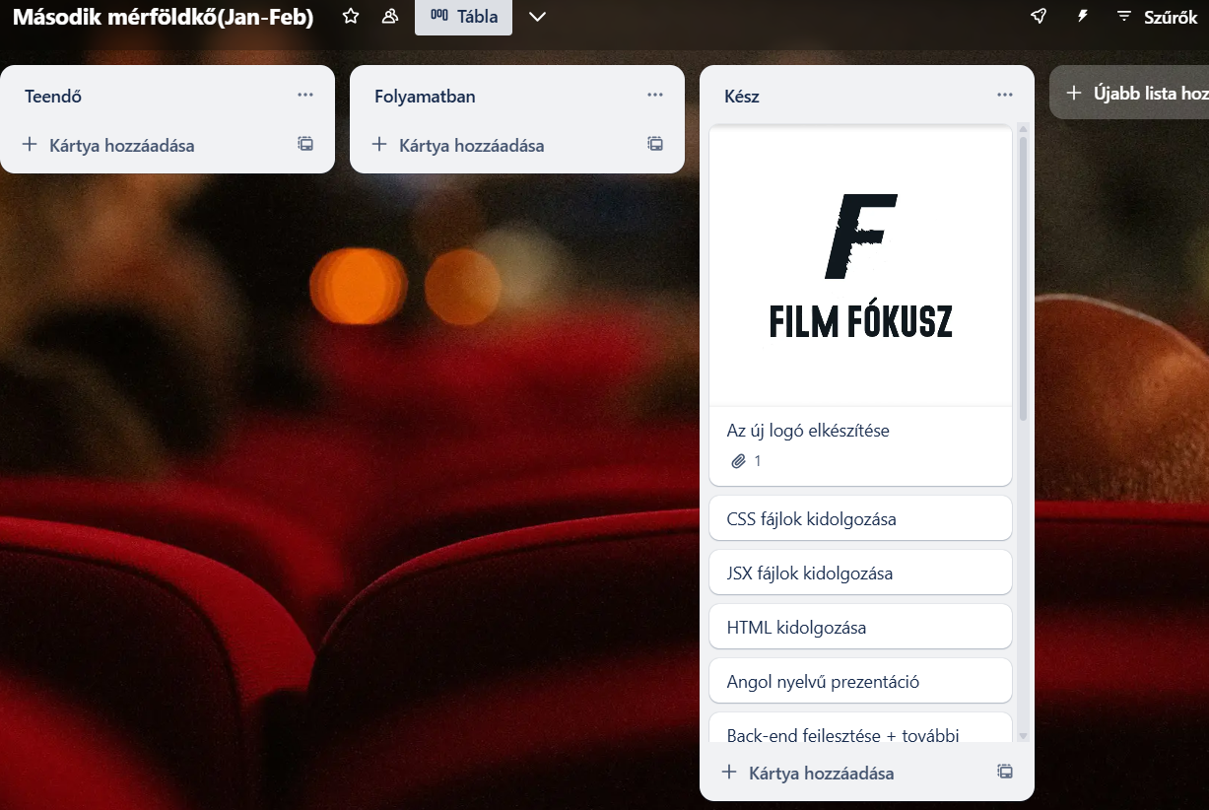
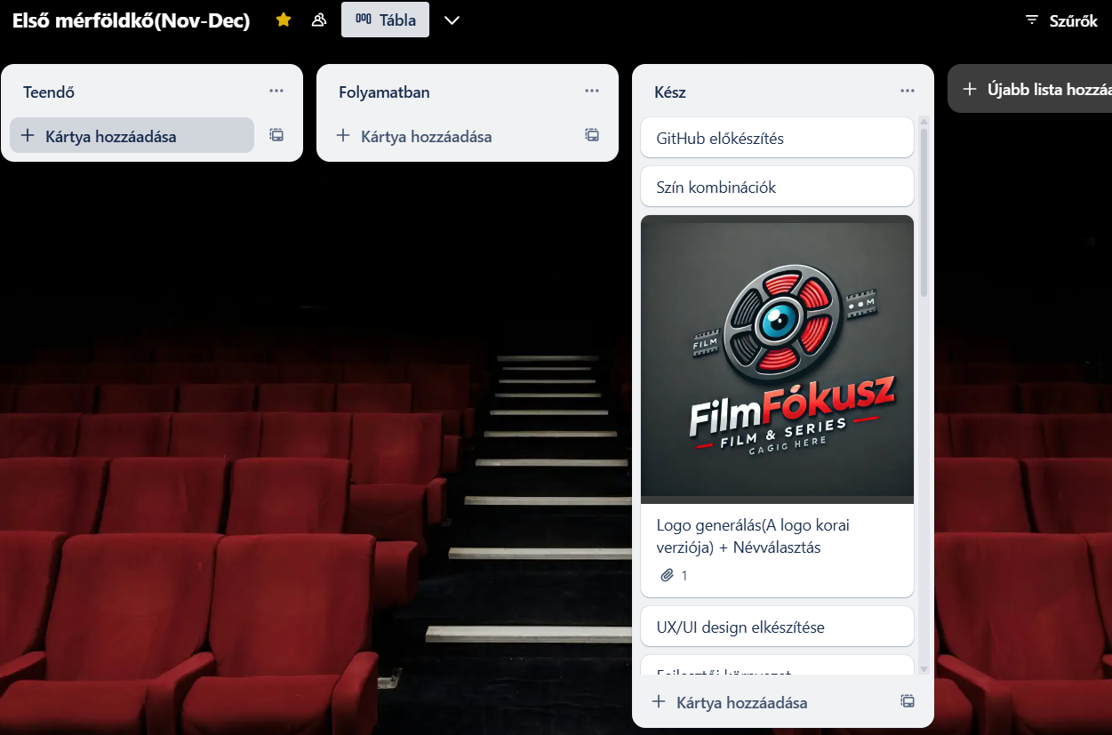
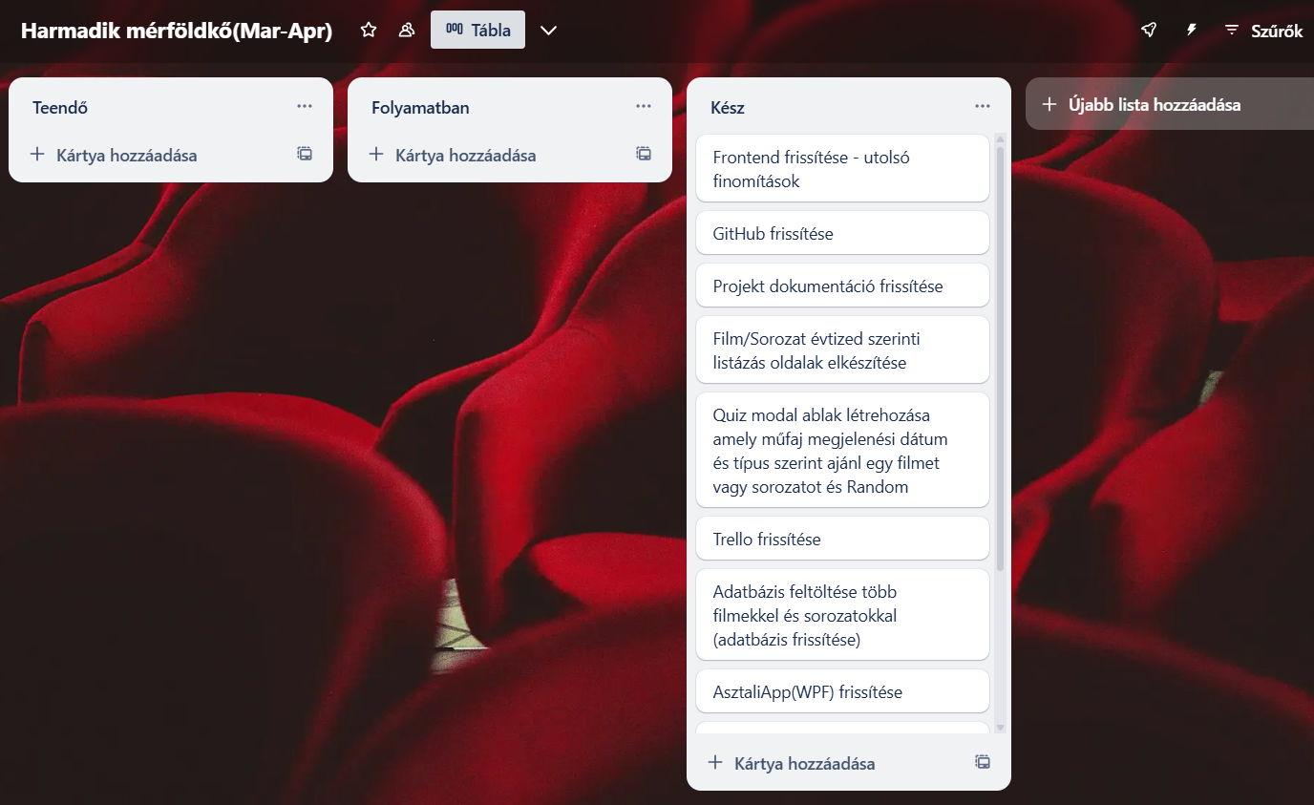
Workspace and Sprints

Slide 21
Future Developments and Plans
What features are planned for the future?
FilmFókusz will continue to evolve, and we plan to introduce several new features:
Rating System: Users will be able to rate movies and series, helping others in their decision-making.
Commenting Option: Users will be able to leave comments on individual movies and series, allowing interaction with others.

Slide 22
Summary
What FilmFókusz Can Do:
FilmFókusz is a dynamic application that allows users to search, rate, and review movies and series.
The application offers various filters for users to search, showcasing everything from classic shows to today's movies and series.
It also features a dedicated admin interface, enabling administrators to manage and modify data.

Slide 23
Thank you for your attention!

