Slide 1

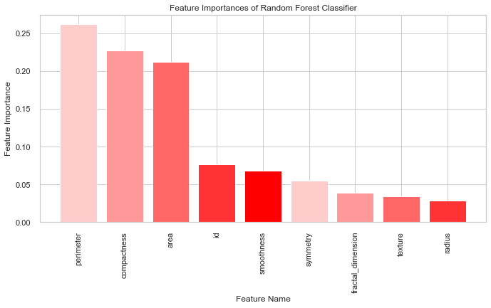
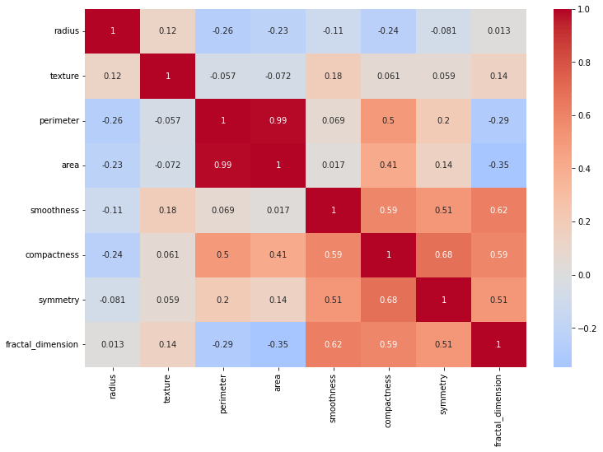
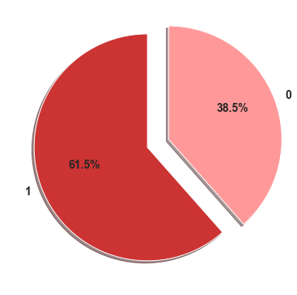
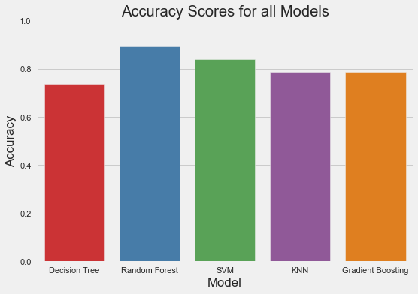
PROSTATE CANCER DETECTION
Advisor : Prof. Yue Gao
INTRODUCTION
DATA DESCRIPTION
IMPORTANT FEATURE PLOT
Model | Accuracy | Precision | Recall | F1
Logistic Regression | 0.789 | 0.923 | 0.800 | 0.857
Decision Tree | 0.737 | 0.917 | 0.733 | 0.815
Random Forest | 0.895 | 1.000 | 0.867 | 0.929
SVM | 0.842 | 1.000 | 0.800 | 0.889
KNN | 0.789 | 0.923 | 0.800 | 0.857
Gradient Boosting | 0.789 | 0.923 | 0.800 | 0.857
Early detection is essential for treating prostate cancer, the most prevalent male disease.
Current diagnostic procedures are prone to false positives and needless biopsies, causing patient worry.
This study uses clinical and imaging data to create a machine learning model to enhance prostate cancer detection and eliminate unnecessary biopsies.
This study aims to enhance prostate cancer diagnosis accuracy and patient outcomes.
Out of every 100 American men, 13% of them may get prostate cancer during their lifetime.
The data set has information about 100 patients' prostate gland tests.
Each biopsy has 9 numerical qualities, such as radius, texture, perimeter, area, smoothness, compactness, diagnosis_result, symmetry, and fractal dimension.
The diagnosis_result is the goal variable, where 1 means cancerous and 0 means not cancerous.
Dataset gives a full picture of the features of prostate cancer patients.
Based on the average values of the above features, the dataset is used to create a classification model that can identify the result of prostate cancer biopsies to help make a diagnosis.
OBJECTIVES
Early prostate cancer discovery improves treatment and survival.
Improve prostate cancer diagnosis to reduce biopsies and dangers.
Better prostate cancer screening to identify high-risk patients who may need closer monitoring or earlier action.
Understanding prostate cancer biology, risk factors, and outcomes to improve prevention and therapy.
HEAT-MAP
RESULTS
CONCLUSION
The random forest model obtained an accuracy of 89%
Identified perimeter, compactness, area, and smoothness as the most important prostate cancer detection features.
Based on test data, machine learning algorithms, particularly the random forest model, can detect prostate cancer.
All models performed well, but the random forest model had the highest accuracy and F1 score, suggesting clinical application.
This study shows machine learning algorithms can improve prostate cancer detection and treatment accuracy and efficiency.
These models should be evaluated on larger and more diverse datasets and integrated into clinical practice for early diagnosis and better patient outcomes.
MODEL COMPARISON
TARGET VARIABLE
The Random Forest model obtained the best accuracy of 0.895 and F1 score of 0.929.
The SVM model predicted malignant cancer with 1.0 precision.
The Decision Tree and KNN models performed worse than the others, with lower accuracy and F1 scores.
Logistic Regression, Gradient Boosting, and KNN models shared accuracy, precision, recall, and F1 scores.
FUTURE WORK
METHODOLGY
Improve prostate cancer diagnosis with powerful machine learning techniques and deep learning models.
Use additional imaging modalities or biomarkers to improve prostate cancer detection.
To validate and generalize the models, conduct a larger study with a more diverse patient group.
This study's dataset was small, which may restrict its generalizability.
The distribution of the target variable, diagnosis_result, is highly skewed towards the malignant class (1), with approximately 61.5% of cases classified as malignant and 38.5% as benign (0).
The dataset has a high number of malignant instances, making it difficult for the algorithm to reliably identify benign cases.
When evaluating the performance of the model and interpreting the results, it is necessary to account for this class imbalance.
Relevant characteristics were chosen using domain expertise and statistical analysis.
Random forest classification was selected as the primary model to predict prostate cancer.
Based on the preprocessed data, the selected model was trained and optimized for optimal performance.
Various metrics including accuracy, precision, recall, and F1-score were used to evaluate the model's performance.
The significance of the features was analyzed to determine the most pertinent features for prostate cancer detection.
REFERENCES
Siddiqui, M. A., Rais, R., & Ali, S. (2021). An ensemble of hybrid features for prostate cancer detection. Computer Methods and Programs in Biomedicine, 210, 106229. https://doi.org/10.1016/j.cmpb.2021.106229
Dhruv|Harsh|Mihir|Rushabh

