Slide 1

Telecom Company Customer Churn Prediction
By Group 5
Mihir Mahendra Koyande (MSBA)
Kartik Raj Gardas (MSBA)
Sayara Malla Thakuri (MSBA)

Slide 2


Introduction
Customer churn is one of the biggest fears of any industry.
From various studies in the past, we know that the cost of acquiring a new customer has been far greater than retaining one.
Churn or churn rate is defined as the percentage of customers who stop subscribing to a service or percentage of employees leave a job.
some of the major reasons are service dissatisfaction, costly subscription, and better alternatives.
this paper the problem of churning is addressed and data factors affecting the churn are analysed for their effect on the rate.

Slide 3
Business Analysis Problem
A crucial part of running a business is being able to understand the value of your customers. This is even more important in the digital age where it is easier than ever to get the attention of your customers. Churn rate is one of the most important metrics to your business because it will tell you how successful you’re marketing, and product strategies are.
aims to predict the customer churn in the telecom industry with the help of markers.
The aim of modelling is to focus on the prediction problems, so independent variables are taken from the data of the current period (i.e., current month) and dependent variables from the data of the lag period (i.e., next month)

Slide 4
Analysis and modelling approach
Data source - Teleco Data Set 7043 rows and 21 columns
We have performed analysis in two ways
EDA (Exploratory data analysis)
Visual Charts
For creating models, we have used logistic regression
For simulation purpose we used random forest model
To cross verify our model, we used hypothesis testing

Slide 5
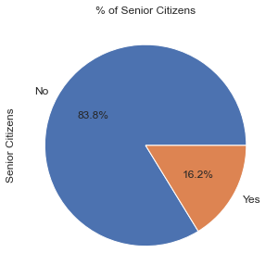
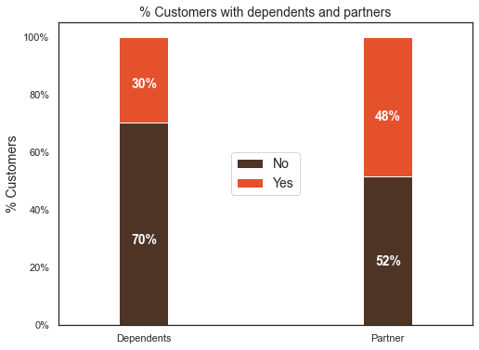
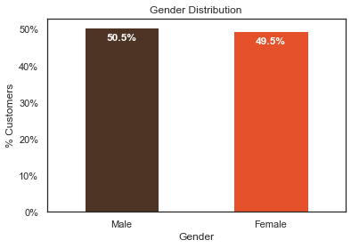
1. Percentage of senior citizens 2. Gender Distribution 3. percentage of customers with dependents and partners

Slide 6
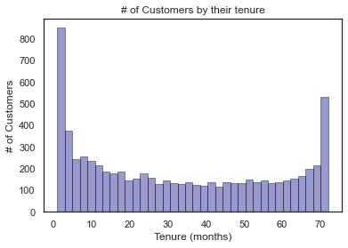
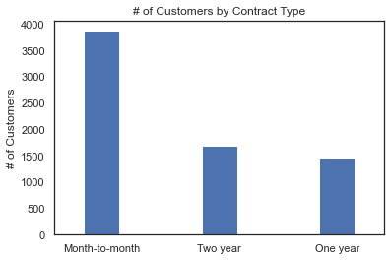
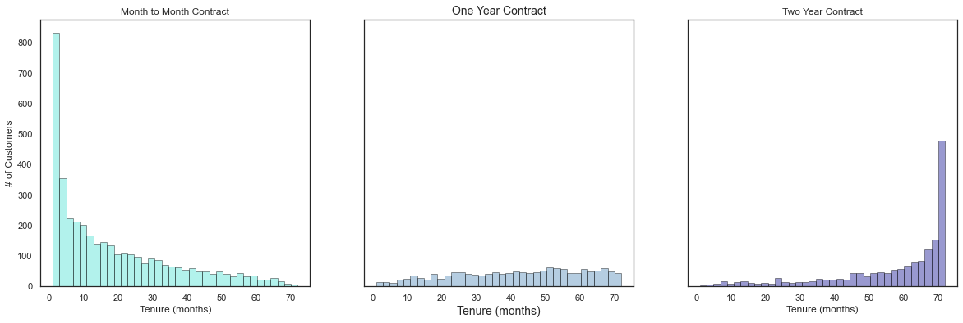
1. Customers by Contract type 2. Customers by tenure 3. tenure of customer based on contract type

Slide 7
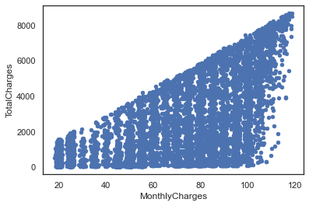
Relation Between Monthly and total Charges

Slide 8
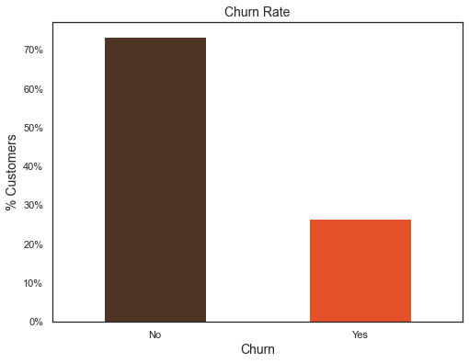
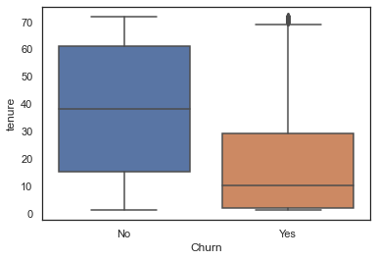
Predictor Variable churn with other important variables

Slide 9
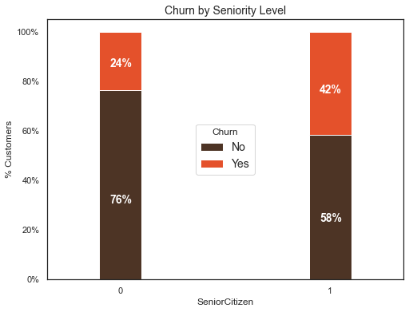
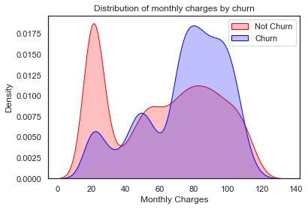
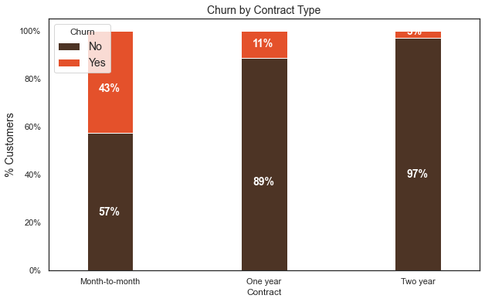
1. Churn by seniority level 2. churn on basic of monthly charges 3. churn by contract type

Slide 10
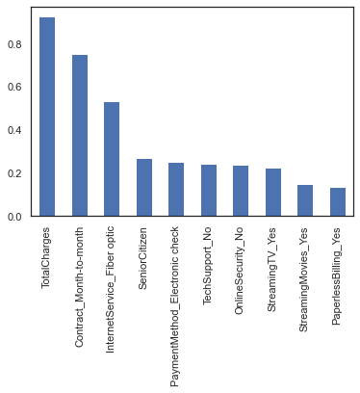
Modeling – Logistic Regression
It is important to scale the variables in logistic regression so that all of them are within a range of 0 to 1.
This helped us improve the accuracy from 79.7% to 82.7%.
Weights of all the variables

Slide 11
Observation on Logistic Regression
We can see that some variables have a negative relation to our predicted variable (Churn), while some have positive relation. Negative relation means that likeliness of churn decreases with that variable. Let us summarize some of the interesting features below:
As we saw in our EDA, having a 2-month contract reduces chances of churn. 2-month contract along with tenure have the most negative relation with Churn as predicted by logistic regressions
Having DSL internet service also reduces the probability of Churn
Lastly, total charges, monthly contracts, fiber optic internet services and seniority can lead to higher churn rates. This is interesting because although fiber optic services are faster, customers are likely to churn because of it.

Slide 12
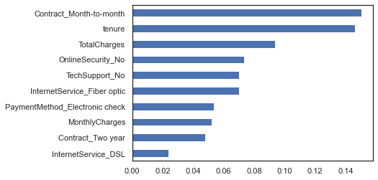
Modelling – Random Forest
Observation:
From random forest algorithm, monthly contract, tenure and total charges are the most important predictor variables to predict churn.
The results from random forest are very similar to that of the logistic regression and in line to what we had expected from our EDA
Accuracy of Random Forest: 80.88%
Important Variables according Random Forest

Slide 13
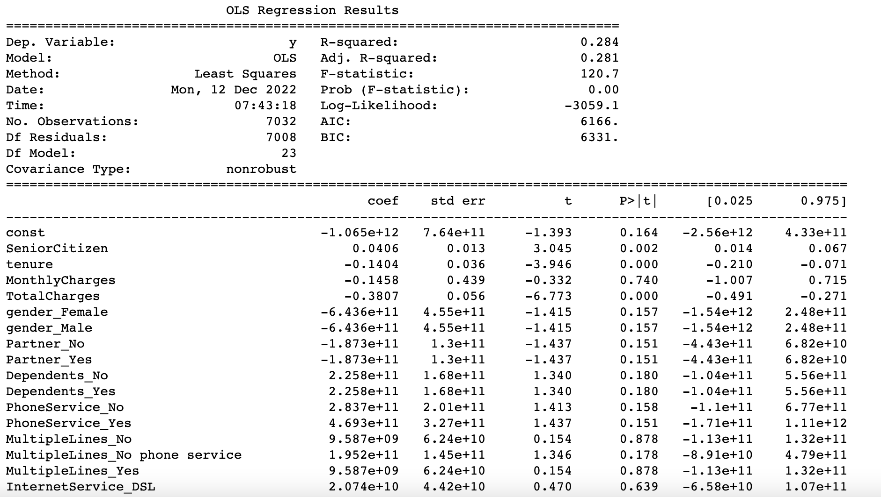
OLS Regression Results

Slide 14
Conclusion
We should pay more attention to customers who meet the criteria below
Contract: Month-to-month
Tenure: Short tenure
Internet service: Fiber optic
Payment method: Electronic check
Please, evaluate our service! Especially for internet service (fiber optic) and payment method (electronic check)
Can we give more benefit to a new customer? Because the new customer has a high probability to churn

Slide 15
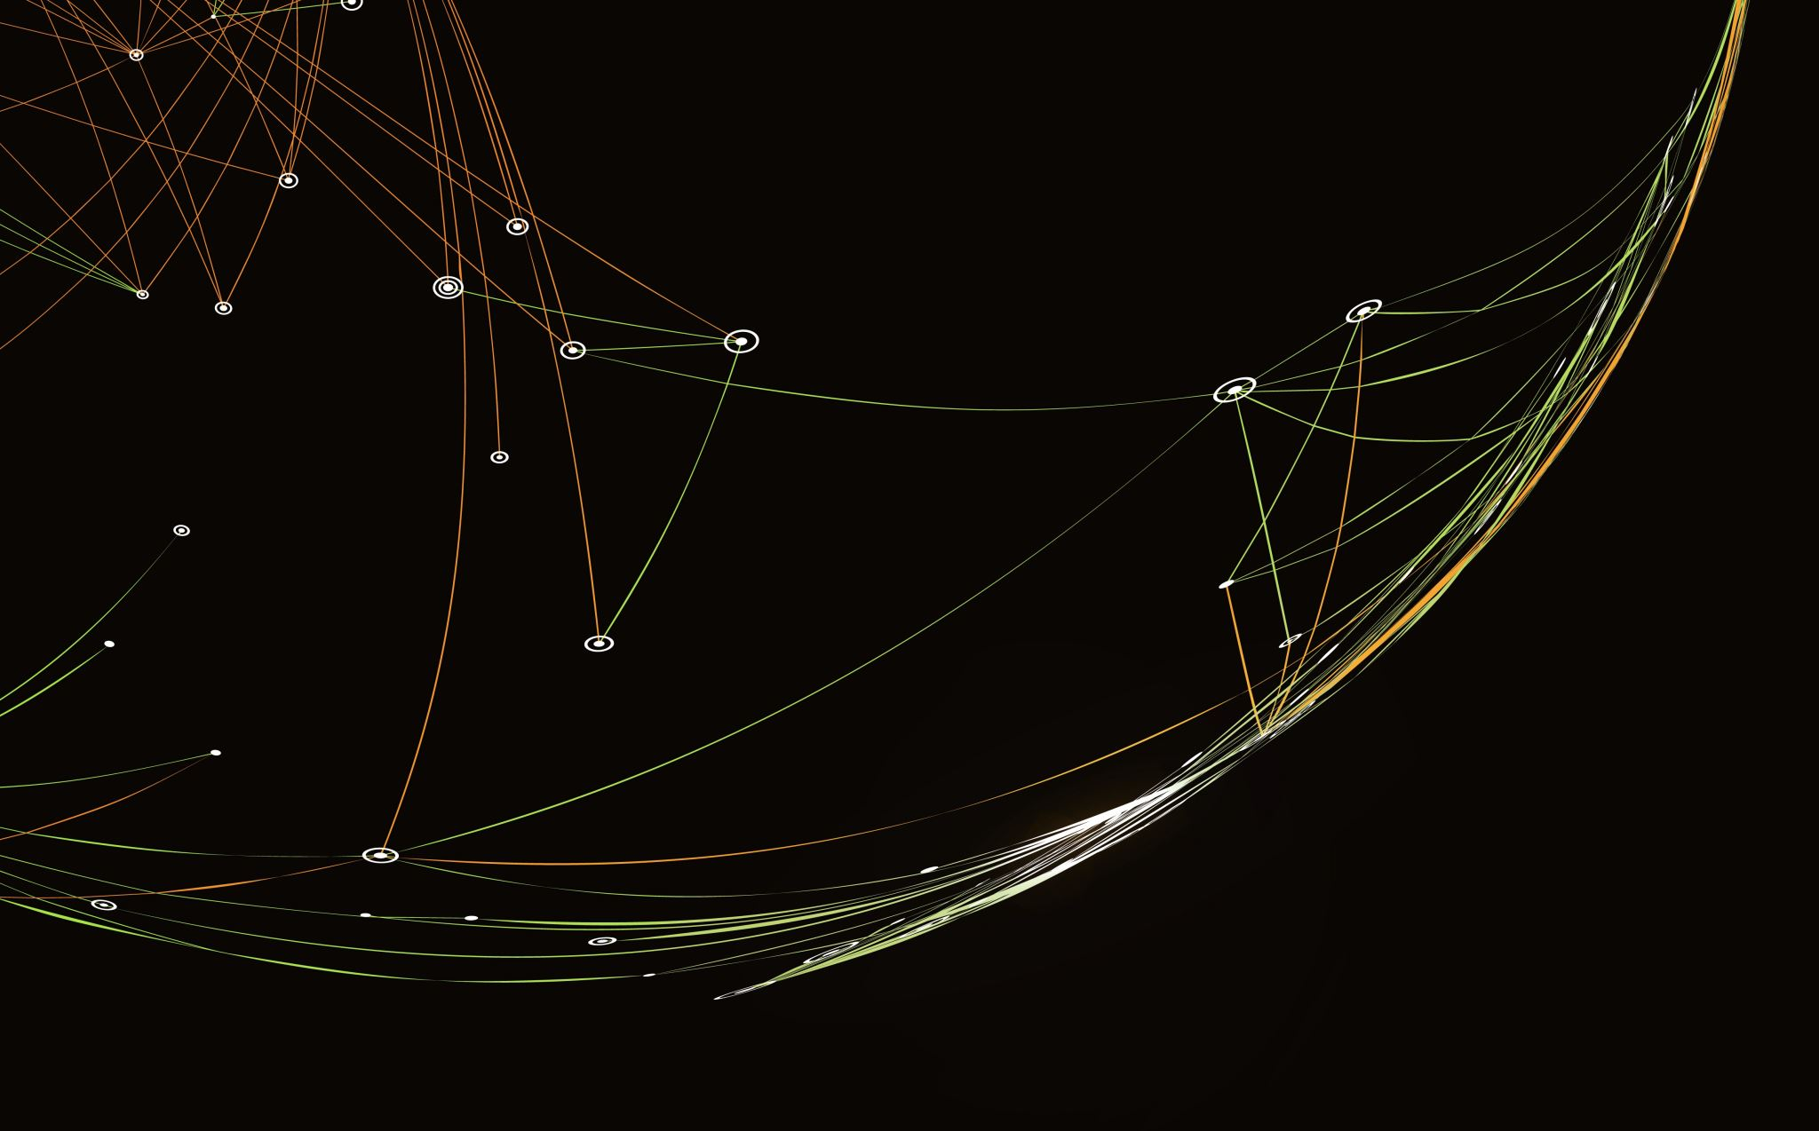
Thankyou

