Slide 1

MegaMetrix Mart

Slide 2
Table of content
Purpose of the Project
Current Marketing and Analysis Domain
Tools and Technology of Proposed system
System Design
Visualization using Tableau
Money-Centric View
Repetitive Customers Patterns
Recommendation
Favorites
Use Case
Conclusion

Slide 3
Purpose of the Project
Data analytics solution for business
Optimize business operations
Analyze the data of organization
Sales and marketing insights

Slide 4


Current Marketing and Analysis Domain
Current System
Customer relationship management (CRM) software
Email marketing platforms, and social media advertising platforms
Different tools and technology
Weaknesses of the Current System
Lack of integration among tools
Analysis capabilities
Limited insights

Slide 5

Tools and Technology of Proposed system
Excel
Python
Tableau
MySQL
Algorithm

Slide 6
System Design
Algorithms
Collaborative
Filtering
Apriori
K-mean

Slide 7


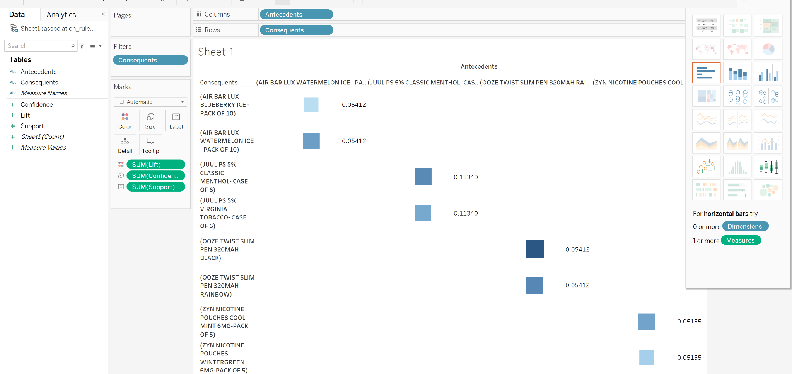
Visualization using Tableau

Slide 8
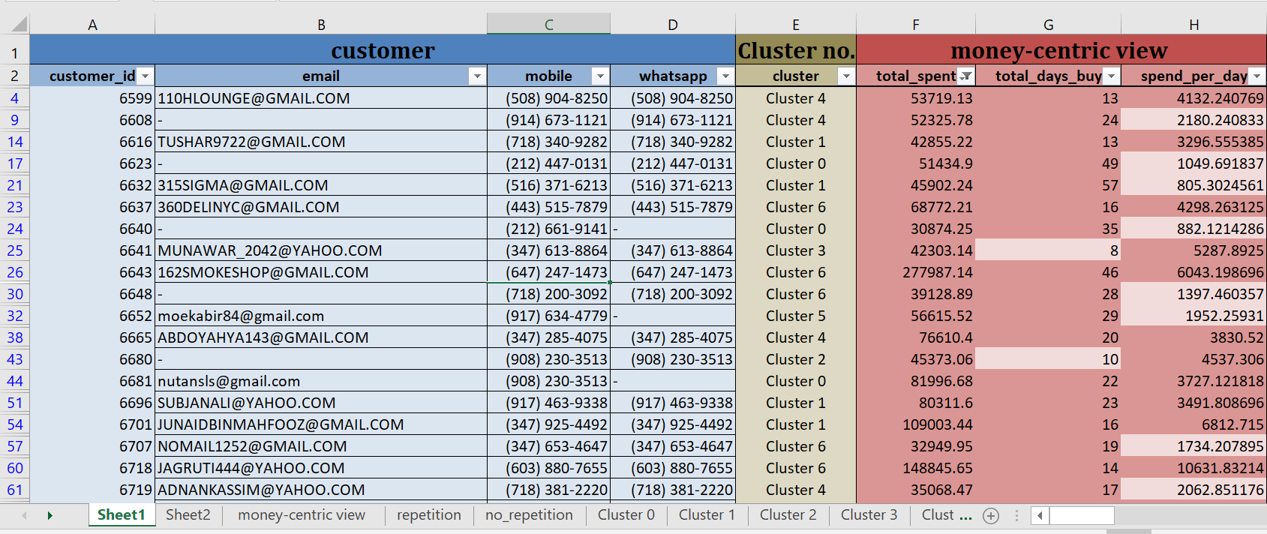
Money-Centric View
Identifying High-Value Customers
Targeting High-Value Customers with Personalized Campaigns

Slide 9
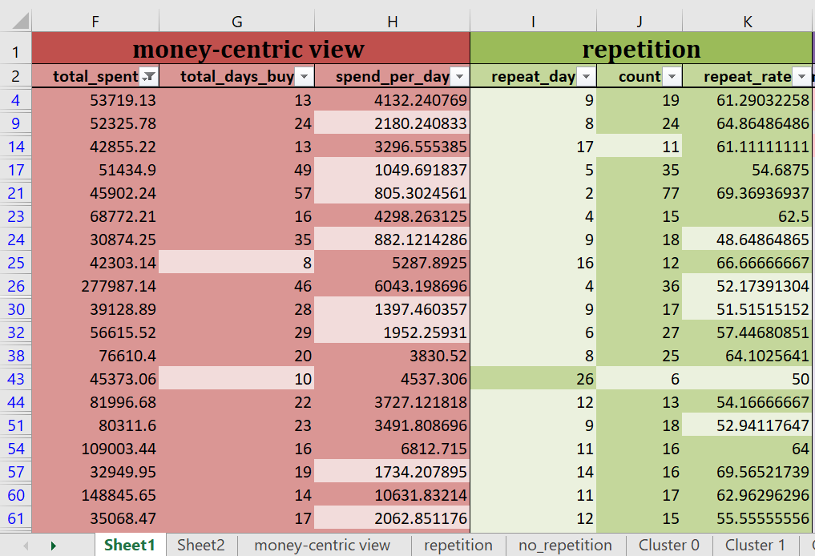
Repetitive Customers Patterns
Identifying Customers with High Repeat Purchases
Targeting Repetitive Customers with Relevant Promotions

Slide 10
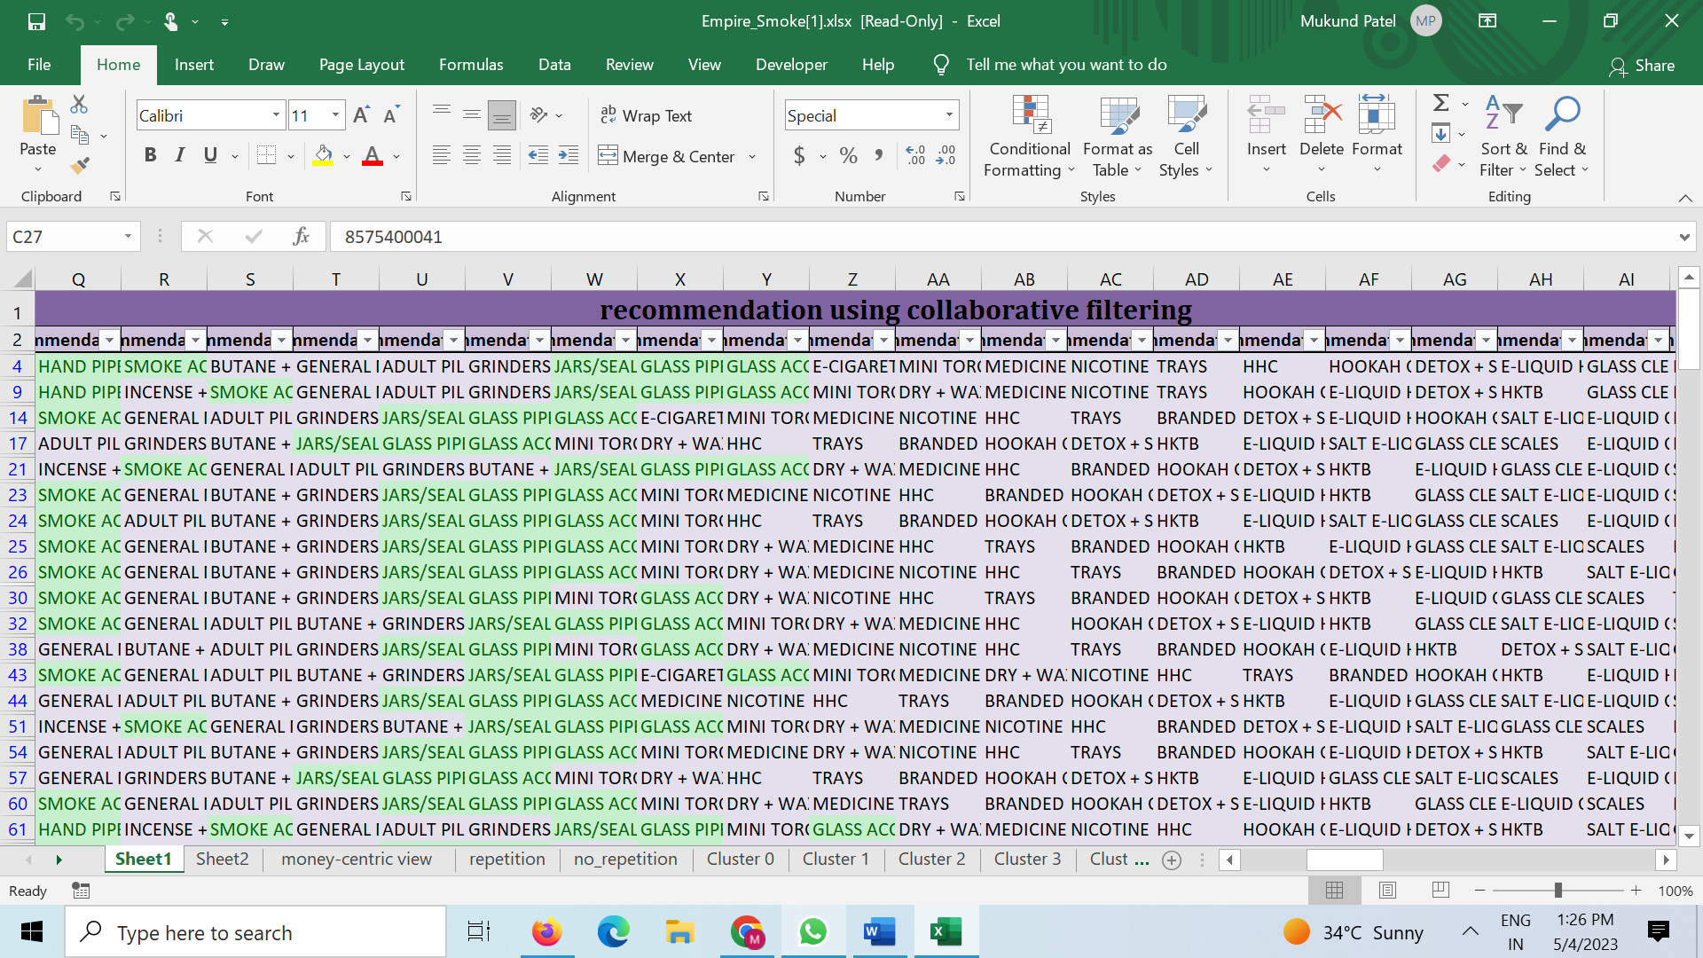
Recommendation
Generating Product Recommendations for Customers
Creating Bundles of Frequently Recommended Products

Slide 11
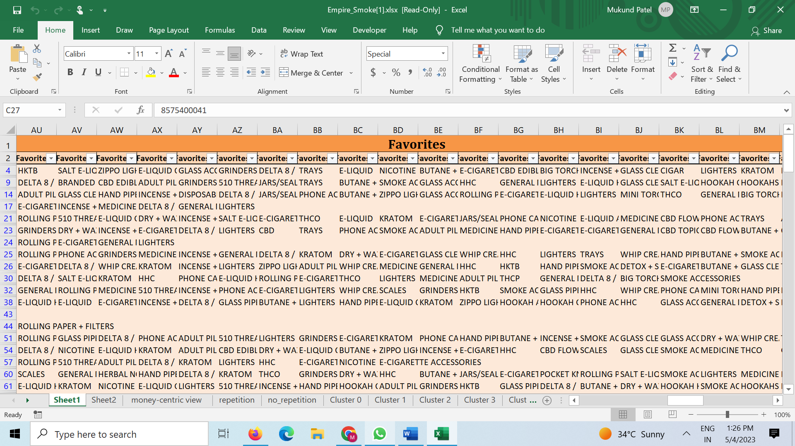
Favorite
Analyzing Customer Favorites for Product Insights

Slide 12
Use Case
The Advanced Analytics Mastersheet
Targeted Email and SMS Campaigns
Targeting High Repeat Rate and High Spend Customers
Analyzing Cluster Characteristics for Targeted Promotions

Slide 13
Conclusion
Flaws
Future scope

Slide 14
References
W3school: https://www.w3schools.com/ MySQL/DEFAULT.asp
Code With Harry: https://www.youtube.com/@CodeWithHarry
AWS: https://aws.amazon.com/
Developer Mozilla: https://developer.mozilla.org/en-US/
Shashank Kalanithi: https://www.youtube.com/@ShashankData

Slide 15
Thank You

