Slide 1


Assessing the Feasibility of Machine Learning to Predict Chronic Pain in Adolescence
Max Kramer

Slide 2
Introduction
Chronic Pain is surprisingly common in adolescence
5% of adolescents experience life-changing chronic pain
Evidence suggests that changes in functioning precede changes in pain
GOAL: Design a Machine Learning model to see if it can be useful in predicting pain trajectories
Being able to do so will help teens better understand the relationship between their behavior and long term outcomes

Slide 3
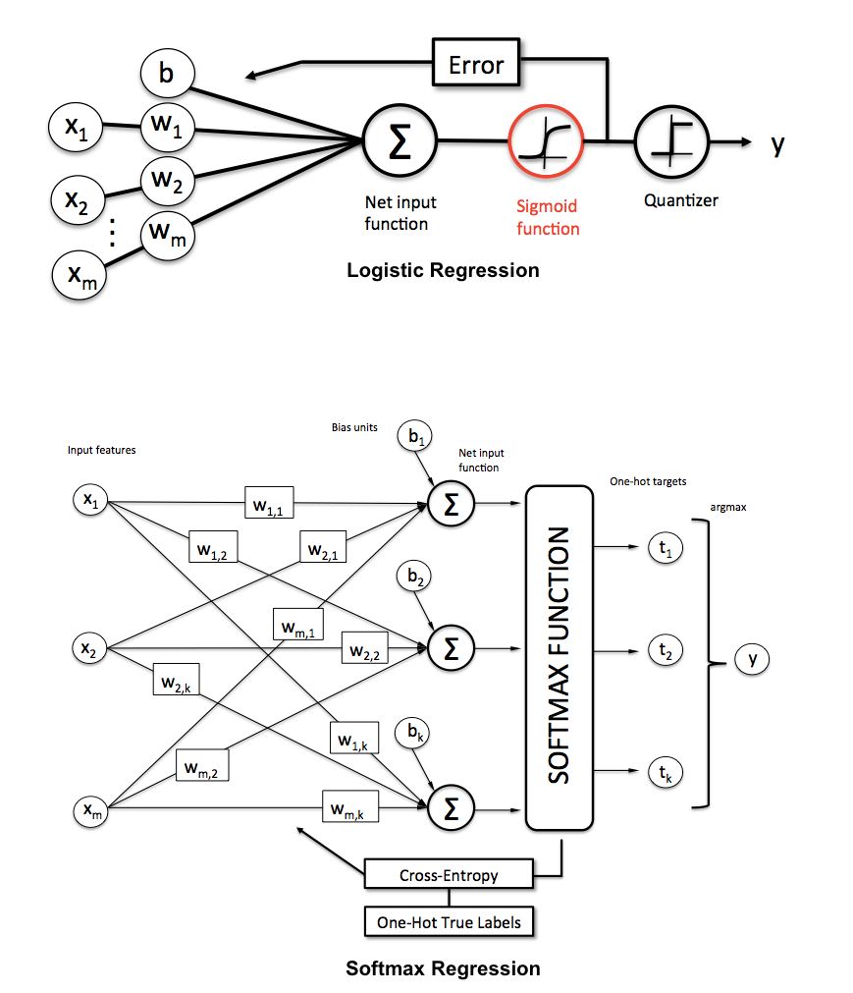
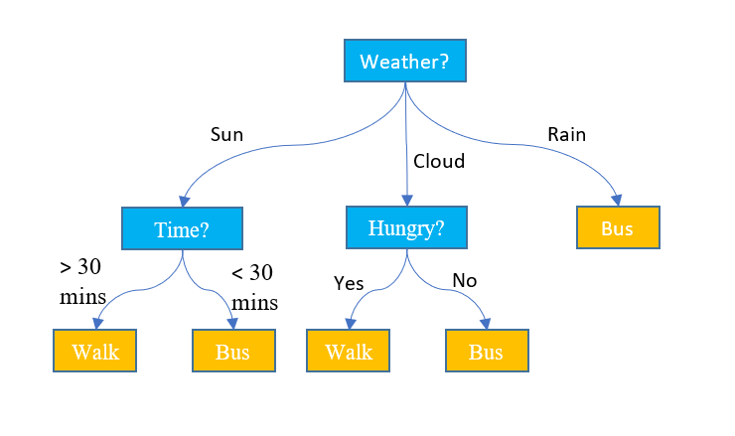
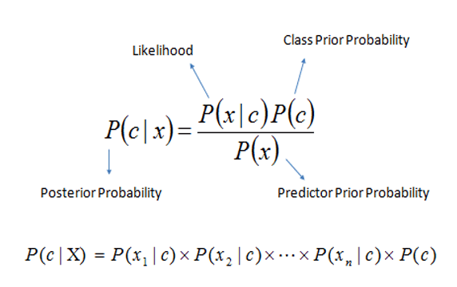
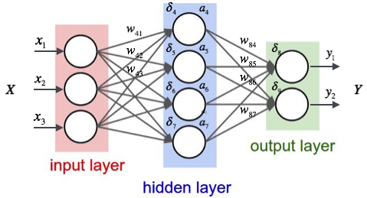
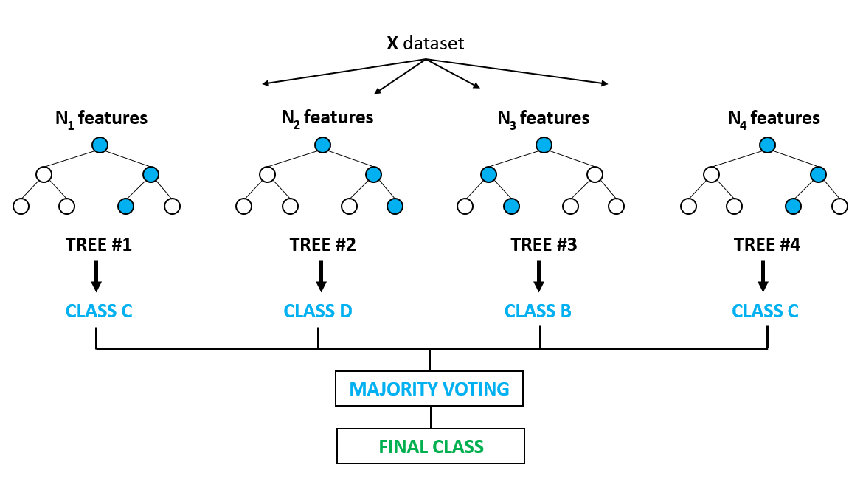
Machine Learning Models
Multiple architectures, multiple methods
Logistic Regression - Baseline
Naive Bayes
Neural Network
Decision Tree
Random Forest
Examine relationship of past and future
k = number of past days
N = prediction date
Notes:
Logistic Regression serves as a baseline due to its ease of interpretability and similarity to non ML statistical modeling
NOTE: The longitudinal nature of the dataset violates the assumptions of Logistic Regression
Naive Bayes uses Bayesian Estimation to determine the most likely label attached to a set of attributes
A neural network serves as an extension of the logistic regression, capable of learning complex nonlinear decision boundaries (logistic regression is the simplest case of a neural network)
Decision Trees employ rule based learning and can attach importance to individual attributes
Random Forests take the power of decision trees and augment them by an ensemble method - using several trees to generate a distribution and then selecting the mode as the prediction
IMAGE CREDITS:
https://www.google.com/url?sa=i&url=https%3A%2F%2Fwww.techleer.com%2Farticles%2F200-naive-bayes-machine-learning-algorithm-for-classification-problems%2F&psig=AOvVaw2K0mpEbszvWZT0OwlcLFj3&ust=1588272403917000&source=images&cd=vfe&ved=0CAMQjB1qFwoTCLi3wIKmjukCFQAAAAAdAAAAABAJ
https://www.google.com/url?sa=i&url=https%3A%2F%2Fsebastianraschka.com%2Ffaq%2Fdocs%2Fsoftmax_regression.html&psig=AOvVaw0HmWxZ6RyZdPhe_ZoAIclc&ust=1588272388255000&source=images&cd=vfe&ved=0CAMQjB1qFwoTCPipxJemjukCFQAAAAAdAAAAABAD
https://www.google.com/url?sa=i&url=https%3A%2F%2Fmedium.com%2F%40curiousily%2Ftensorflow-for-hackers-part-iv-neural-network-from-scratch-1a4f504dfa8&psig=AOvVaw3xWnZIb6WAwL9yn37mH8Jh&ust=1588272490681000&source=images&cd=vfe&ved=0CAMQjB1qFwoTCNDmlaamjukCFQAAAAAdAAAAABAO
https://www.google.com/url?sa=i&url=https%3A%2F%2Fwww.displayr.com%2Fwhat-is-a-decision-tree%2F&psig=AOvVaw1a2NrICj53tdp6GuKXgydP&ust=1588272528293000&source=images&cd=vfe&ved=0CAMQjB1qFwoTCJCpsrimjukCFQAAAAAdAAAAABAc
https://www.google.com/url?sa=i&url=https%3A%2F%2Fmedium.com%2F%40ar.ingenious%2Fapplying-random-forest-classification-machine-learning-algorithm-from-scratch-with-real-24ff198a1c57&psig=AOvVaw1-Lo4SrA8xC8r0nBhw4J4A&ust=1588272564508000&source=images&cd=vfe&ved=0CAMQjB1qFwoTCLj81MemjukCFQAAAAAdAAAAABAK

Slide 4
Experimental Setup
Dataset creation
Gathered 28 days of diary data from 10 college students with life changing chronic pain
Qualtrics survey examining chronic pain related functioning
Developing Synthetic Dataset
Large sample size with statistical characteristics of seed data
Longitudinal Data
High intraclass correlation in pain ratings over time (0.789)
Recency effect - pain ratings become less correlated over time
Notes:
CPRF: Sleep, Mood, Diet/Exercise, Mindfulness
ICC demonstrates that 80% of variance in pain is due to who you’re talking to

Slide 5
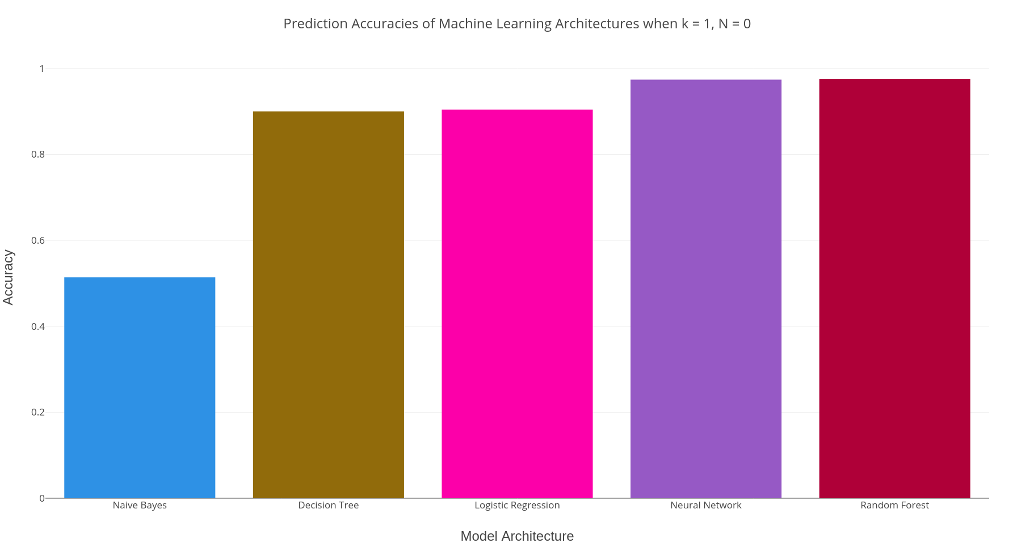
Results - Predicting Pain From Diary Data
Baseline Logistic Regression (90.4%)
Suggests functioning data is predictive of concurrent pain
Some models perform better
Neural Network
Random Forest
Some models perform worse
Naive Bayes
Decision Tree
Bar graph of prediction accuracies of models given k = 1, N = 0.

Slide 6
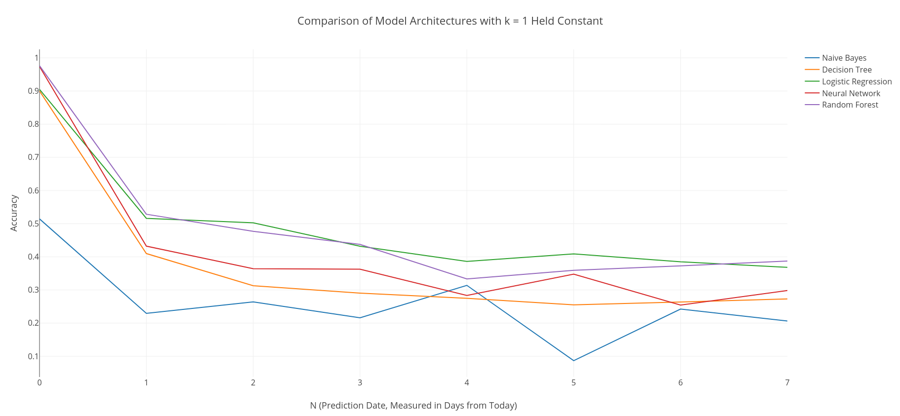
Results - Predictive Power of Today’s Data
Consistent pattern
Accuracy declines sharply from N = 0 to N = 1
Today is more predictive of today than future days
Consistent with inter item correlation matrix (Recency Effect)
Some models still perform better than chance
Random Forest
Robustness to irrelevant attributes
Line graph of prediction accuracies of models given k = 1, N increasing.

Slide 7
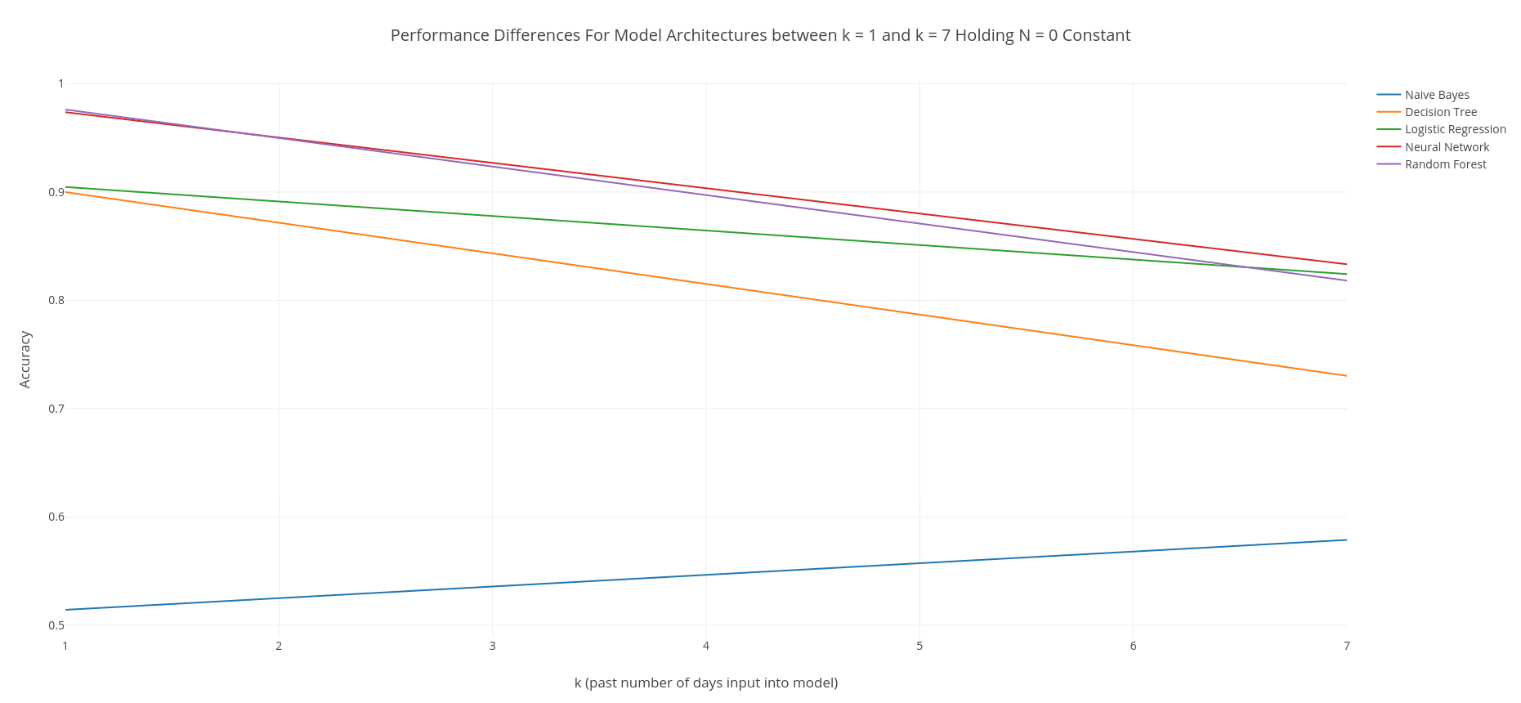
Results - Augmenting Predictions with Past Data
Not possible with simple models
Increasing k at constant N reduced accuracy on all models
Aggregation of irrelevant attributes
Addressable with changes
Feature selection
Class imbalance correction
Majority Undersampling
SMOTE (Imputation)
Line graph of Differences between models at k = 1 and k = 7 (N = 0 constant).

Slide 8
Conclusion
Machine Learning seems promising for predicting the relationship between short term behavior and long term outcomes
Limitations
Majority of variance in pain is between-persons, rather than within
Classification penalty
Future Directions
Examine longer term trends
Develop typologies - unsupervised learning
Notes:
Classification penalizes any answer that is not exactly the label attached to the test example. To a classifier, predicting 3 when the pain is 4 is just as bad as predicting 1.

