Slide 1
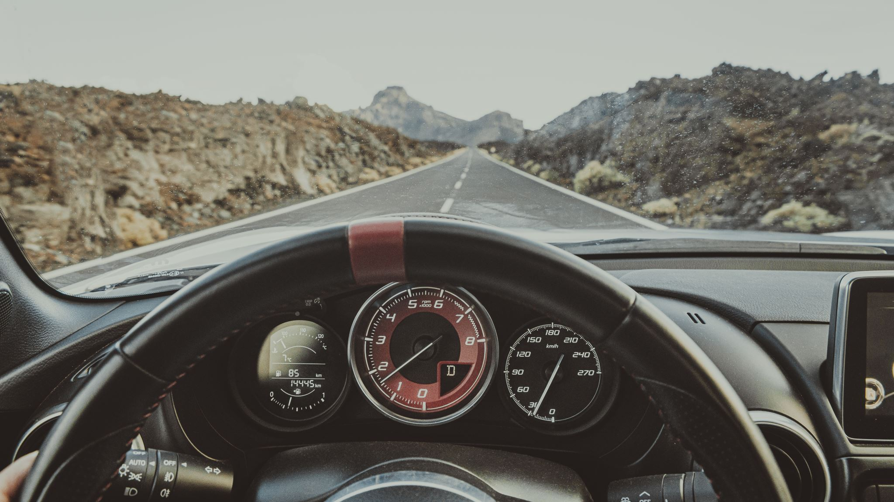
Automatic speed control in self-driving vehicles using Deep learning
By
Mukesh Sekar
Nipul Avduth

Slide 2
PROBLEM STATMENT
Challenges in autonomous driving systems, particularly in speed control .
Current systems face difficulties handling the unpredictable nature of real-world driving scenarios.
Conventional methods may lack the flexibility needed for effective navigation in complex road conditions.

Slide 3
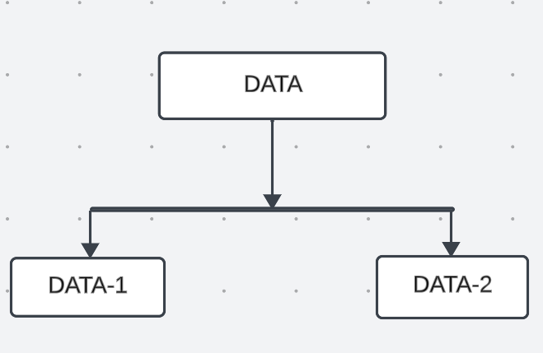
DATA COLLECTION

Slide 4
DATA-1
DATA-1 is used for Object Detection
We Obtained it from public GitHub repository
We also added new Data manually in Data-1

Slide 5
DATA-2
DATA-2 is used for classification.
It Consists of 8 Classes with different speed board signs.
We got this dataset from Kaggle.
It consists of total 1300 images.

Slide 6
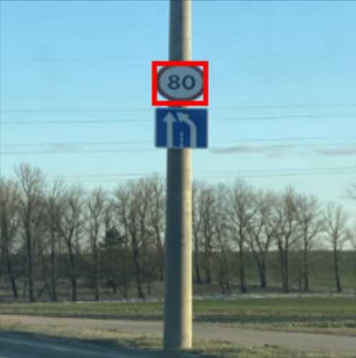
SAMPLE DATASET-OBJECT DETECTION

Slide 7
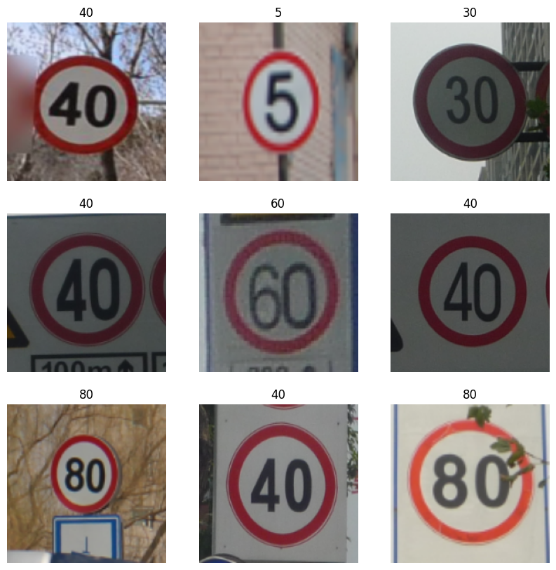
SAMPLE DATASET-CLASSIFICATION

Slide 8
DATA AUGMENTATION
So, our dataset had a limited number of images, and some were blurry.
When initially evaluated, the accuracy ranged between 40-50%.
After implementing data augmentation and incorporating new data, the accuracy improved.

Slide 9
Models Used
ResNet SSD
Mobilenet SSD
Darknet
Most Efficient
Darknet

Slide 10
DARKNET
It is an Open-Source neural network framework written in C and CUDA.
Using Darknet framework we can implement YOLO models.
Darknet includes scripts and commands for training YOLO models, streamlining the training process.
So, we decided to use Darknet Framework.

Slide 11
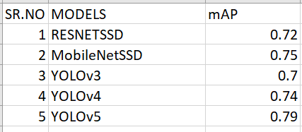
YOLOv5
We chose YOLOv5 because it is a pre-trained model that excels in real-time object detection with high accuracy.
We tried YOLO3, YOLO4, YOLO5 and the mAP achieved was 0.7, 0.74, 0.79 respectively.

Slide 12
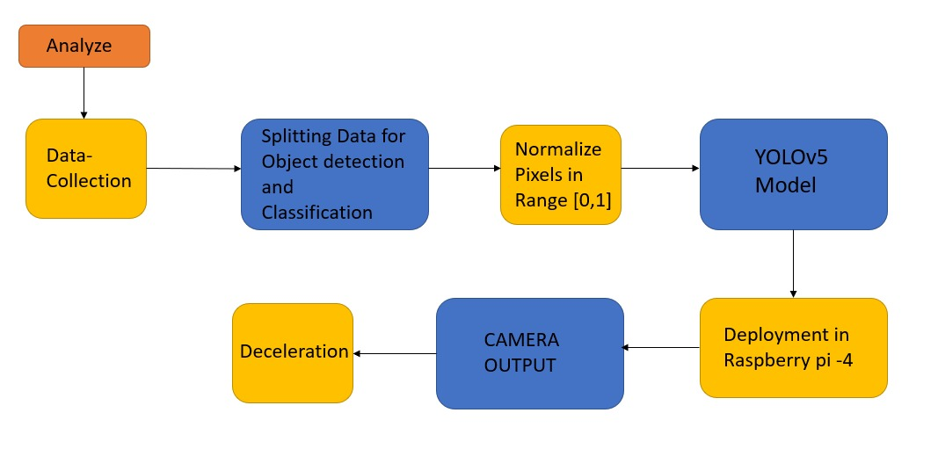

Slide 13
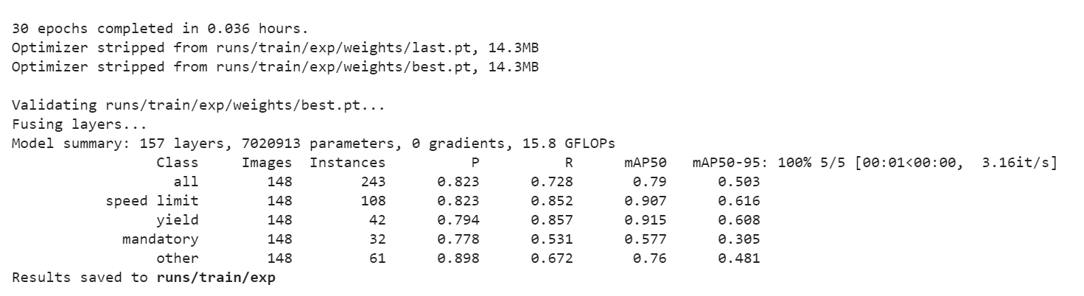
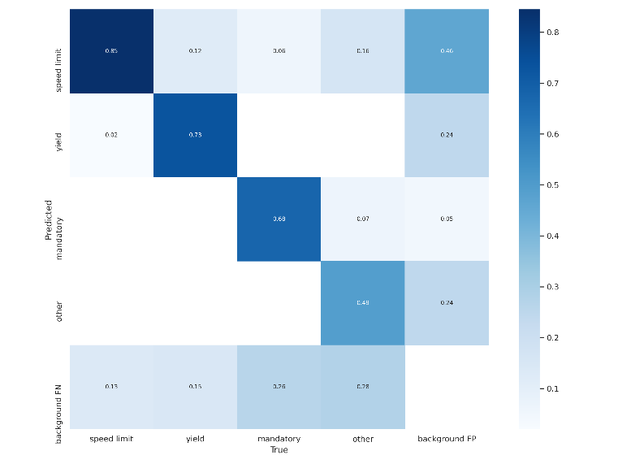
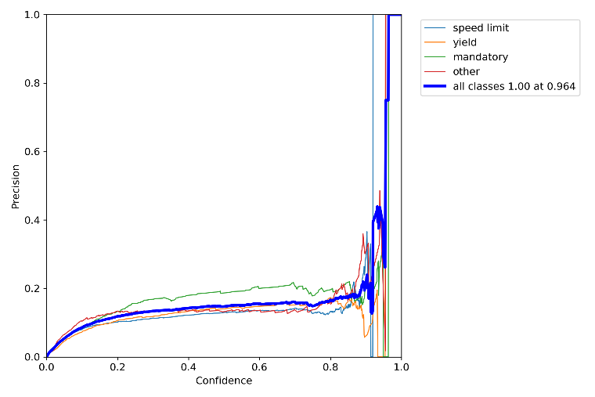
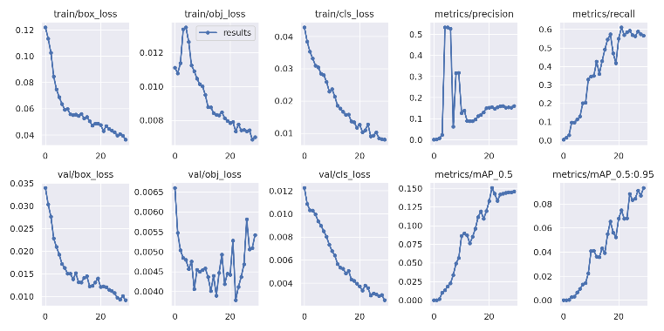

Slide 14
LIMITATIONS
According to our model we think it has two main drawbacks.
The model might face challenges in detecting speed signs during low-light or nighttime conditions.
Adverse weather conditions, such as snow, will impact the model's accuracy in detection of speed signs.

Slide 15
Future Scopes
Enhanced Nighttime Object Detection:
Future developments aim to improve the model's capability to detect objects during nighttime conditions.
Addressing current challenges in recognizing and accurately identifying objects in low-light scenarios.
Extended Operational Modes:
The model's operational modes are planned to be extended beyond cruise control.
Efforts to enable seamless functionality during manual driving for increased versatility.
Versatility Across Driving Scenarios:
The objective is to make the model applicable across various driving scenarios, adapting to different operational contexts.
Enhancing the model's adaptability for diverse driving conditions.
Expansion of Functional Capabilities:
Future developments aim to expand the functional capabilities of the model beyond its current scope.
Introducing enhancements to ensure broader applicability and usefulness.
Implementation of Additional Safety Measures:
Emphasis on implementing extra safety measures to enhance overall system reliability.
Ongoing efforts to bolster the model's safety features for increased effectiveness.
Commitment to Research and Development:
Continuous research and development efforts are in place to advance the model's capabilities.
A commitment to staying at the forefront of object detection and driving safety technologies

