Slide 1
Thermal Phase Shifters Optical Linear Multipliers
Kevin Mienta & Mukesh Sekar

Slide 2
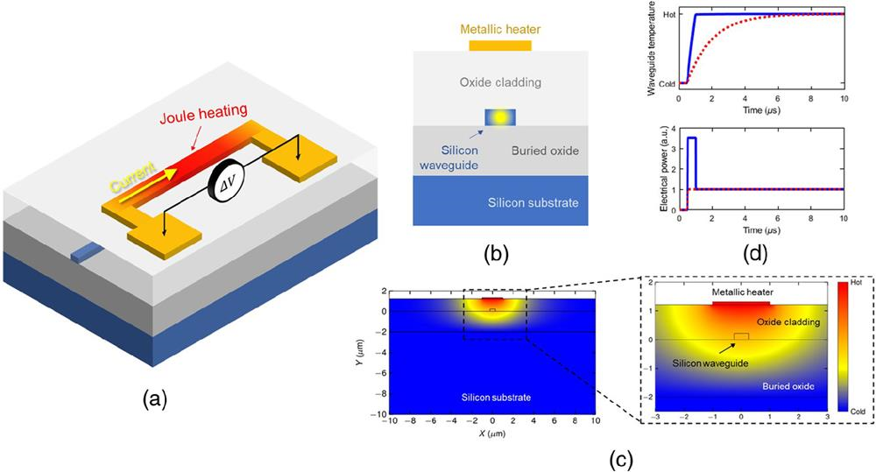
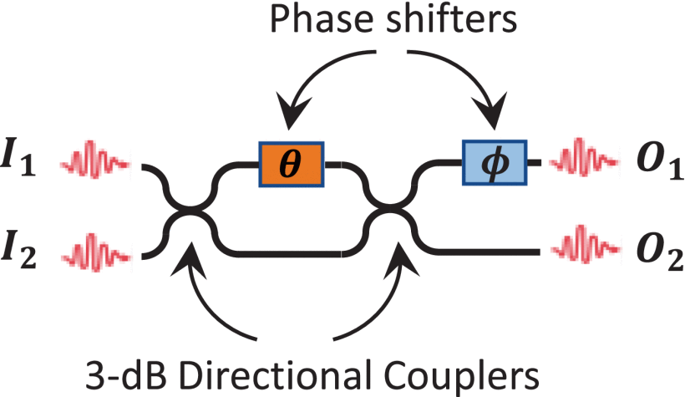
Introduction
What is an MZI?
How can we modify the outputs of this MZI?
[2]
[6]

Slide 3
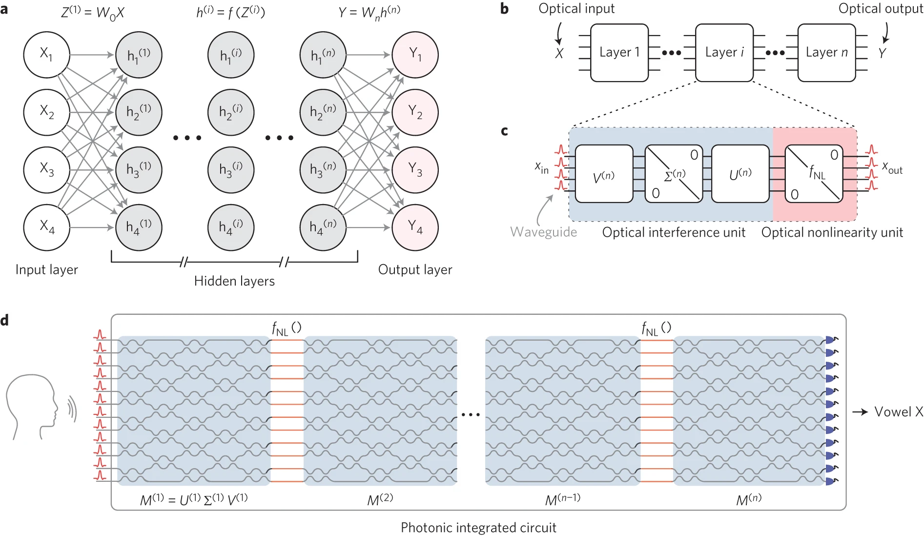
Motivation
Optical Neural Networks (ONN)
MZI mesh networks (multipliers) utilizing active phase shifters are crucial in making ONN a reality.
The energy efficiency of such networks is extremely important
The MZI with active phase shifters is a foundational building block for these networks
Thus, the energy efficiency of the MZI phase shifter is of extreme importance to any overall structure (ONN) that uses them
a, General artificial neural network architecture composed of an input layer, a number of hidden layers and an output layer. b, Decomposition of the general neural network into individual layers. c, Optical interference and nonlinearity units that compose each layer of the artificial neural network. d, Proposal for an all-optical, fully integrated neural network.
[3]

Slide 4
Methodology
INTERCONNECT
Showcase MZI operation
HEAT Simulations
Different materials
Different heater wire locations
FDTD Simulations
Optical loss for the different combinations simulated in HEAT

Slide 5
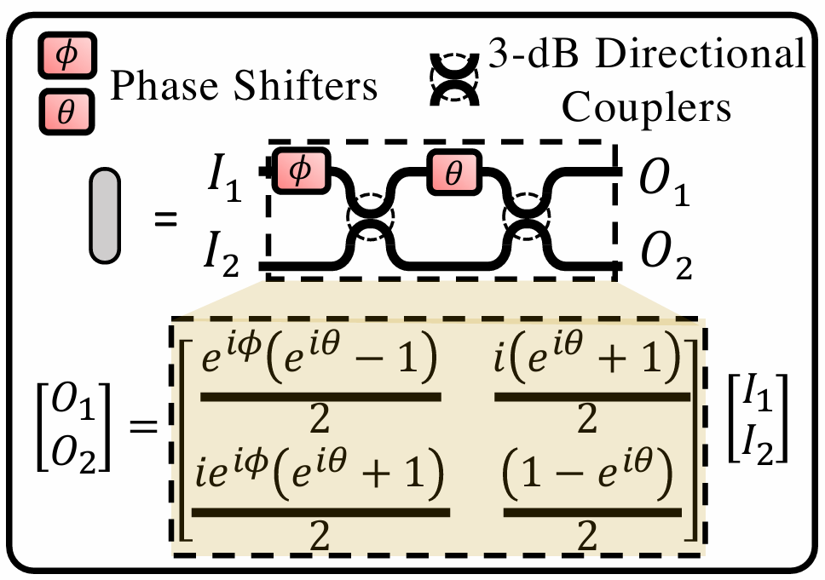
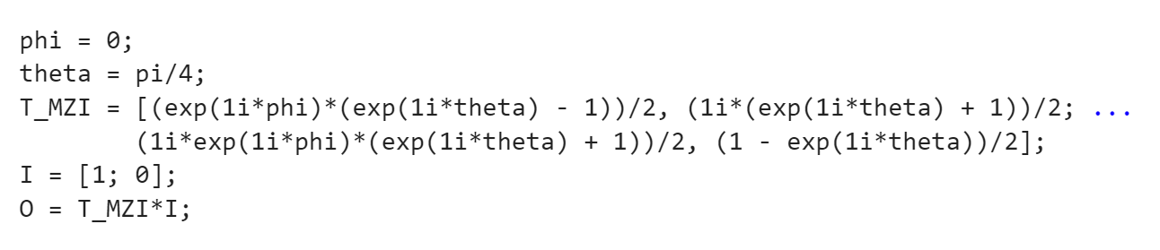
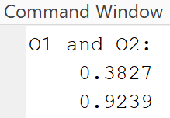
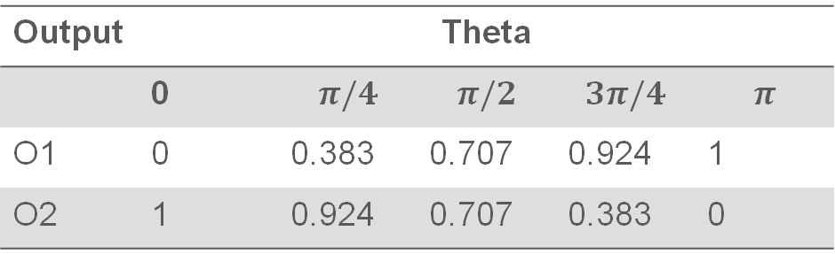
Optical Multiplication – MATLAB Compact Model
Replicated the MZI transfer matrix in MATLAB
Calculated O1 and O2 for various theta values
Absolute values shown in table below
Input 1 is 1mW and Input 2 is off
Transmission [uW]
Output | Theta
 | 0 | $$π/4$$ | $$π/2$$ | $$3π/4$$ | $$π$$
O1 | 0 | 0.383 | 0.707 | 0.924 | 1
O2 | 1 | 0.924 | 0.707 | 0.383 | 0
MZI Transfer Matrix [4]
MZI MATLAB Implementation

Slide 6
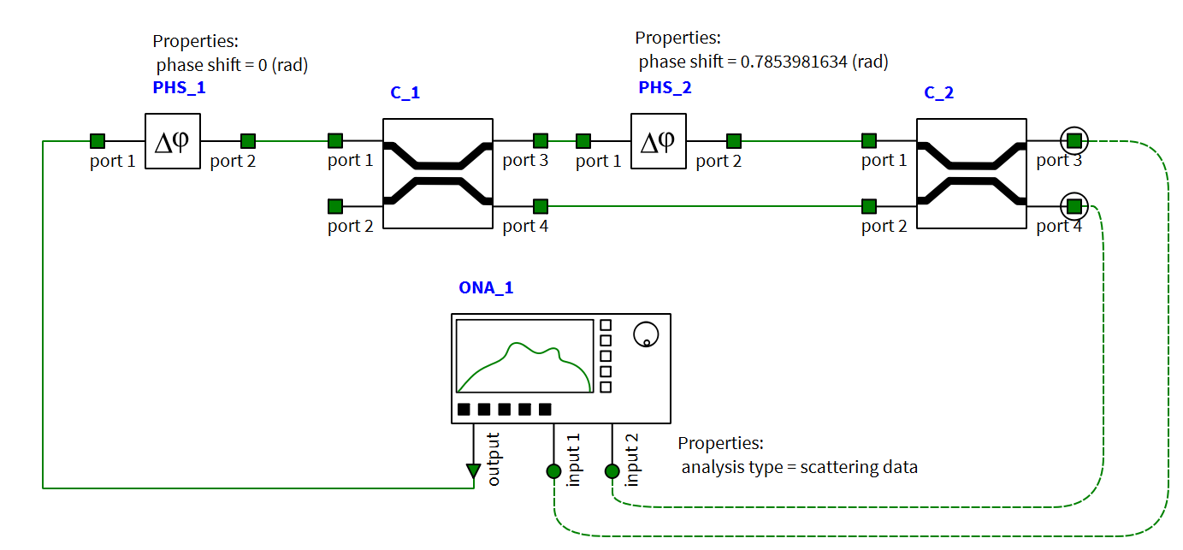



Optical Multiplication – INTERCONNECT Simulation
Exact same values can be replicated in INTERCONNECT
Transmission [uW]
Output | Theta
 | 0 | $$π/4$$ | $$π/2$$ | $$3π/4$$ | $$π$$
O1 | 0 | 0.383 | 0.707 | 0.924 | 1
O2 | 1 | 0.924 | 0.707 | 0.383 | 0

Slide 7
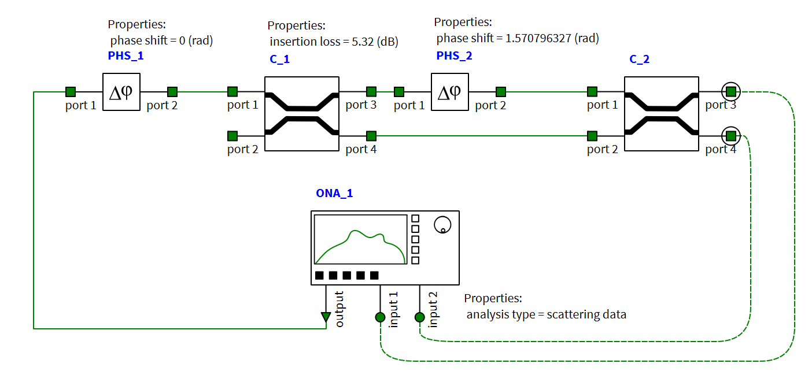
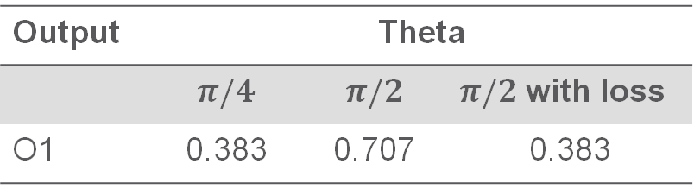
Optical Multiplication – Phase Shifter Impacts
Optical loss can impact optical multiplication
Two outputs can be the same for different inputs
One input without loss
One with loss
Transmission [uW]
Output | Theta
 | $$π/4$$ | $$π/2$$ | $π/2$ with loss
O1 | 0.383 | 0.707 | 0.383

Slide 8


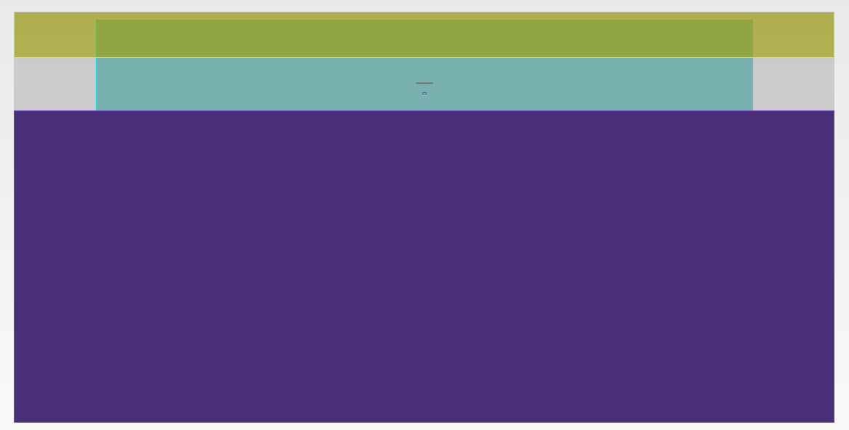
Phase Shifter Efficiency – Simulation Setup
Replicating real device environment
Simulation contains:
Air
Cladding
Silicon base
Silicon waveguide
Wire heater (various materials)
Wire (Heater)
Wire Distance
Waveguide
Notes:
A metal wire (e.g., Aluminum, Copper, or Silver) is placed near an optical waveguide to act as a heat source.
The metal wire is connected to a power supply for controlled heating.
Heating changes the waveguide's temperature, affecting its refractive index due to temperature dependency.
The change in refractive index modifies the effective index, enabling phase tuning of the transmitted light.

Slide 9

Phase Shifter Efficiency – Metrics
The main metric rate a phase shifter design:
Power needed to obtain 2 pi phase shift (mW/FSR) [1]
The equation for phase change is:
$Δφ=\frac{{2π(n}_{eff}−n_{eff0})L}{λ}$

Slide 10
Phase Shifter Efficiency – 200nm Wire Distance
Tuning Efficiency
[mW/FSR]
Aluminum | Copper | Gold | Silver
36.6025 | 36.677 | 36.663 | 36.681

Slide 11
Phase Shifter Efficiency – 500nm Wire Distance
Tuning Efficiency
[mW/FSR]
Aluminum | Copper | Gold | Silver
40.564 | 40.5834 | 40.587 | 40.570

Slide 12
Phase Shifter Efficiency – 1um Wire Distance
Tuning Efficiency
[mW/FSR]
Aluminum | Copper | Gold | Silver
46.285 | 46.315 | 46.311 | 46.3165

Slide 13
Phase Shifter Efficiency – Summarized Results
Aluminum was the overall best performing wire material for all wire distances
Wire Distance | Materials Tuning Efficiency [mW/FSR]
 | Aluminum | Copper | Gold | Silver
200 [nm] | 36.6025 | 36.677 | 36.663 | 36.681
500 [nm] | 40.564 | 40.5834 | 40.587 | 40.570
1 [um] | 46.285 | 46.315 | 46.311 | 46.3165

Slide 14
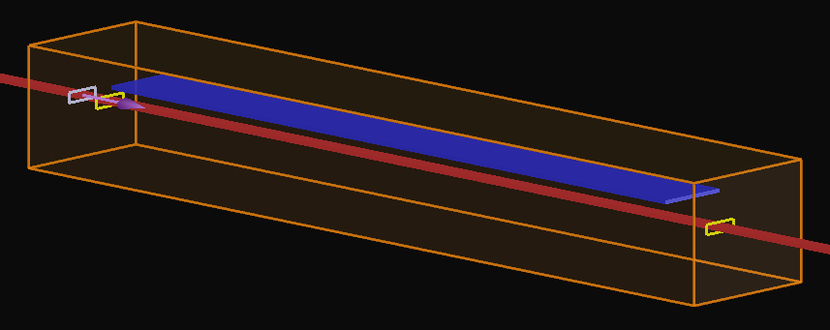
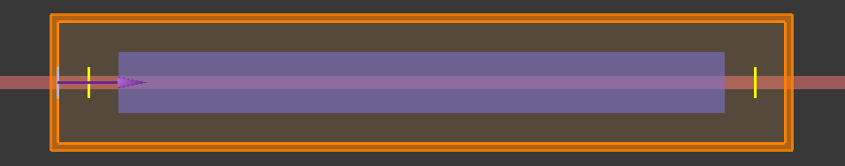
Optical Loss – Simulation Setup
Optical loss = input transmission – output transmission
Optical loss only due to presence of wire
No sidewall scattering
Input Transmission Monitor
Output Transmission Monitor
Wire

Slide 15
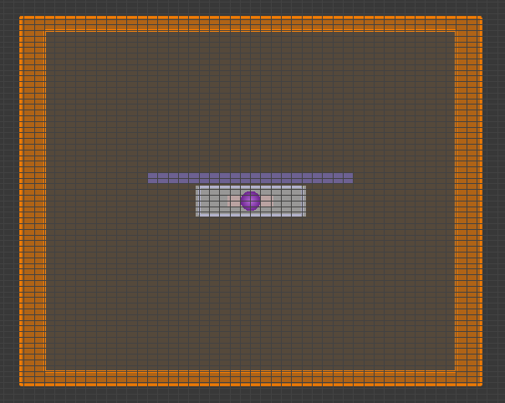
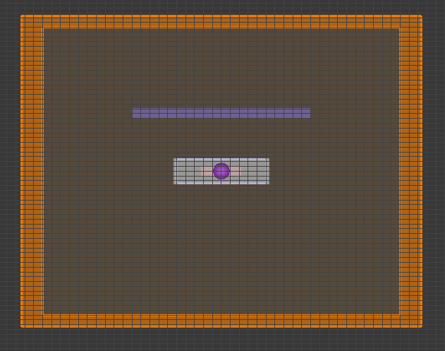
Optical Loss – Simulation Setup
Close up of FDTD simulation
200nm wire distance
1um wire distance

Slide 16
Optical Loss – 200nm Wire Distance
Across all wavelengths, the lowest optical loss materials were:
Silver
Aluminum
Gold
Copper
Material choice is significantly important at low wire distances from the input waveguide

Slide 17
Optical Loss – 500nm Wire Distance
Almost no optical loss at 500nm
Negative values are due to simulation granularity
Material choice mostly insignificant

Slide 18
Optical Loss – 1um Wire Distance
Almost no optical loss at 1um
Negative values are due to simulation granularity
Material choice mostly insignificant

Slide 19
Optical Loss – Results Discussion
Optical loss was only observed when the wire distance was reduced to 200nm
Silver had lowest optical loss
Copper has the most optical loss
High mesh-order FDTD simulations could be utilized to accurately analyze optical loss at 500nm wire distance
Increasing the wire length is expected to amplify optical loss due to extended propagation losses
At 1µm wire distance, no optical loss was detected, aligning well with theoretical expectations and simulation results

Slide 20
Roles and Contribution
Mukesh
Mainly worked on creating a thermally tunable waveguide and measuring its performance for different metal heaters (e.g., Aluminum, Copper, Silver, Gold). The impact of heat on the phase difference in a Mach-Zehnder Interferometer (MZI) was observed, along with how the phase shift influenced optical loss. These measurements provided insights into the relationship between heating, phase modulation, and loss in the MZI.
Kevin
Mainly worked on creating an FDTD simulation to measure the optical loss, allowing the analysis of how different metals influence phase shifts and identifying which metal provides optimal performance. Also developed a MATLAB code to compare matrix multiplication results with realistic interconnect values.
Additionally, both of us collaborated to examine the phase difference in INTERCONNECT and evaluate how the introduction of loss impacts the performance and results of an MZI.

Slide 21
Conclusion
Why We Chose This Project
Advancing Silicon Photonics
Results Achieved
Material Comparison
Industry Impact
Enhanced Energy Efficiency
Energy Optimization
Practical Applications
Cost-Effective Solutions
Research Relevance
Phase Shift Insights
Loss Analysis
Matrix Multiplication Insights
Improved Device Performance
Scalability
Support for AI Hardware
Future Innovations

Slide 22

Questions?

Slide 23
Speakers
Kevin Mienta
Mukesh Sekar

Slide 24
References
[1] Chrostowski L, Hochberg M. Silicon Photonics Design: From Devices to Systems. Cambridge University Press; 2015.
[2] F. Shokraneh, M. S. Nezami and O. Liboiron-Ladouceur, "Theoretical and Experimental Analysis of a 4 × 4 Reconfigurable MZI-Based Linear Optical Processor," in Journal of Lightwave Technology, vol. 38, no. 6, pp. 1258-1267, 15 March15, 2020, doi: 10.1109/JLT.2020.2966949
[3] Shen, Y., Harris, N., Skirlo, S. et al. Deep learning with coherent nanophotonic circuits. Nature Photon 11, 441–446 (2017). https://doi.org/10.1038/nphoton.2017.93
[4] A. Mirza, A. Shafiee, S. Banerjee, K. Chakrabarty, S. Pasricha and M. Nikdast, "Characterization and Optimization of Coherent MZI-Based Nanophotonic Neural Networks Under Fabrication Non-Uniformity," in IEEE Transactions on Nanotechnology, vol. 21, pp. 763-771, 2022, doi: 10.1109/TNANO.2022.3223915.
[5] “Thermally tuned waveguide (FDE),” Ansys Optics, 2024. https://optics.ansys.com/hc/en-us/articles/360042833673-Thermally-tuned-waveguide-FDE
[6] "Silicon thermo-optic phase shifters: a review of configurations and optimization strategies "Advanced Photonics Nexus Vol. 3, Issue 4, 044001 (2024) .https://www.researching.cn/articles/OJ65d959b1e95c60cc

