Slide 1



You2.0 – Beyond Tracking, Into Becoming.
Jaypee University of Information Technology
Department of Computer Science and Engineering and Information Technology
Major Project - I (18B19CI791) | AY 2025-26
Mid-Term Evaluation | Sept 29 – Oct 03, 2025.
Group No.:
Team Member (s)
Aashi Gupta (221030140)
Ishleen Kaur (22130249)
Lakshay Malik (221030022)
Supervisor
Mr. Kuntal Sarkar
Assistant Professor (Contractual)
CS/IT Department

Slide 2
Outline
Introduction
Problem Statement
Objectives
Literature Review
Project Design
Tools, Technologies and Languages
Dataset
Implementation (if any)
Results (if any)
Key Learnings
Work Plan till End-Term Evaluation
Project Plan
Work Contribution and Attendance
Supervisor Interactions
References

Slide 3
Introduction
Challenges in Modern Lifestyle
Poor eating habits, prolonged sitting, irregular sleep, and high stress
Rising lifestyle disorders: Obesity, Diabetes, Hypertension
Limitations of Current Fitness Apps/Devices
Focus mainly on steps or heart rate
Provide generic advice
Often costly and less engaging
Our Solution: You2.0 – AI-Powered Lifestyle & Wellness Tracker
Goes beyond tracking → focuses on transformation
Uses human logging + sensor-based tracking for holistic activity data
Employs machine learning to detect risks & provide personalized, real-time recommendations
Key Features
Proactive health insights
Gamified habit tracking
Intelligent reminders to sustain lifestyle changes

Slide 4
Problem Statement
People frequently find it difficult to lead balanced lives in today's fast-paced world because of erratic sleep patterns, unhealthy eating patterns, extended periods of inactivity, and poor eating habits. These elements play a significant role in the development of lifestyle-related conditions like diabetes, obesity, hypertension, and chronic stress, which are now among the most urgent worldwide health issues. The World Health Organization reports that non-communicable diseases brought on by unhealthy lifestyle choices are responsible for a sizable percentage of annual premature deaths, and this number is still rising. Despite increased awareness, the majority of people do not regularly monitor or assess their daily routines. Even seemingly simple tasks like keeping track of water intake, keeping an eye on the quality of sleep, or cutting back on inactivity are frequently disregarded, which can have long-term health effects that could be avoided with prompt intervention.

Slide 5
Objectives
To create a system that records lifestyle data (diet, sleep, physical activity, hydration, and mood) using manual or sensor-based inputs.
To develop and implement machine learning models that assess data and forecast potential health hazards (for example, obesity, stress, and diabetes).
To encourage healthy habits, offer individualized, real-time suggestions and gamified habit tracking.
To incorporate customized alerts and reminders that encourage people to make better choices all day long.
To provide an intuitive mobile interface that makes tracking, data entry, and visualization fun and easy.
To give consumers weekly or monthly reports with trend analysis and data-driven insights so they can recognize long-term trends in their lifestyle.

Slide 6
Literature Review
S. No. | Author & Paper Title [Citation] | Journal/ Conference (Year) | Tools/ Techniques/ Dataset | Key Findings/ Results | Limitations/ Gaps Identified
1. | Chiam et al. – Co-Pilot for Health Personalized Algorithmic AI Nudging to Improve Health Outcomes[1] | arXiv Preprint (2024) | Wearables + AI nudging system; large-scale intervention (84,764 participants) | Increased daily steps by ~6.17% and MVPA by ~7.61% with AI nudges vs control | Limited to physical activity outcomes; does not cover diet, stress, or holistic wellness
2. | JMIR Cardio – AI-Based, Autonomous, Digital Health Intervention Using Precise Lifestyle Guidance on Blood Pressure in Adults With Hypertension[2] | JMIR Cardio (2024) | BP monitor + wearable tracker + questionnaires + personalized ML models | Improved blood pressure control using AI-driven personalized guidance | .Non-randomized single-arm trial; results may lack generalizability
3. | Stolfi et al. – Use of Non-Invasive Parameters and Machine Learning Algorithms for Predicting Future Risk of Type 2 Diabetes[3] | BMC Bioinformatics (2020) | ML models using non-invasive lifestyle & clinical data | Successfully predicted diabetes risk using ML | Dataset limited in diversity; model may not generalize
4. | Patra et al. – Personal Goals, User Engagement, and Meal Adherence within a Personalised AI-Based Mobile Application for Nutrition and Physical Activity[4] | MDPI Life (2024) | AI-based nutrition & activity mobile app; engagement tracking | Personalized goal-setting improved user engagement and meal adherence | Study limited to short-term engagement; scalability not tested

Slide 7
Literature Review (cont…)
S. No. | Author & Paper Title [Citation] | Journal/ Conference (Year) | Tools/ Techniques/ Dataset | Key Findings/ Results | Limitations/ Gaps Identified
5. | Meta-analysis-The Effectiveness of Gamification in Changing Health-Related Behaviors: Systematic Review & Meta-analysis [5] | Systematic Review (2024) | Review & meta-analysis of gamification studie | Gamification increases engagement and improves outcomes like step counts | Many studies lacked long-term evaluation; focus mostly on physical activity
6. | JMIR mHealth – Applying AI in the Context of the Association Between Device-Based Assessment of Physical Activity and Mental Health: Systematic Review [6] | JMIR mHealth (2025) | Review of device-measured activity + AI models | AI can link physical activity patterns with mental health insights | Few longitudinal studies; lack of standardized datasets
7. | Straczkiewicz et al. - A systematic review of smartphone-based human activity recognition methods for health research [7] | npj Digital Medicine (2021) | Systematic review of 108 studies; Accelerometer, gyroscope, magnetometer sensors; Machine learning classifiers | Smartphones are well-suited for HAR research in health sciences. | Limited generalizability due to small sample sizes, homogeneous populations (primarily young adults), lack of diverse participants and activities.
8. | Kundu et al. - Smartphone based human activity recognition irrespective of usage behavior using deep learning technique [8] | Int. j. inf. tecnol. (2025) | CNN-based HAR framework; 2-D frequency domain images; Real-life data from 4 devices. | Proposed ensemble CNN model achieved 94% accuracy even when training and test devices were different. | Limited to 4 basic activities (sitting, standing, walking, jogging); small dataset with only 8 users.

Slide 8
Literature Review (cont…)
S. No. | Author & Paper Title [Citation] | Journal/ Conference (Year) | Tools/ Techniques/ Dataset | Key Findings/ Results | Limitations/ Gaps Identified
9. | Wang et al. - The Impact of Gamification-Induced Users' Feelings on the Continued Use of mHealth Apps: A Structural Equation Model With the Self-Determination Theory Approach [9] | J Med Internet Res (2021) | Structural Equation Model; Self-Determination Theory; Survey of 307 mHealth app users; PLS-SEM analysis | Gamification boosts intrinsic motivation through autonomy, competence, and relatedness, which in turn enhances satisfaction and continuance intention. | Limitations: small sample (307/2988), focus on Chinese users, limited gamification elements, and no long-term analysis.
10. | Hwang et al. - Research Trends on Mobile Mental Health Application for General Population: A Scoping Review [10] | Int. J. Environ. Res. Public Health (2021) | Scoping review of 14 studies; Scottish Intercollegiate Guidelines Network (SIGN) checklist | Mobile mental health apps reduced stress, depression, and anxiety, with mindful meditation apps most used (35.7%). | Only 14 studies, mostly therapy-based apps, with no long-term effect analysis.
11. | Almuqrin et al. - Smartphone apps for mental health: systematic review of the literature and five recommendations for clinical translation [11] | BMJ Open (2025) | Systematic review of 31 studies; RCTs only; Risk-of-bias assessment using RoB 2 tool | Smartphone apps were effective and acceptable for mental health treatment, self-monitoring, and multipurpose interventions. | Homogeneous sample of mainly middle-aged women, bias in 15 of 31 studies, and underrepresented groups.
12. | Gemesi et al. - Efficacy of an app-based multimodal lifestyle intervention on body weight in persons with obesity: results from a randomized controlled trial [12] | International Journal of Obesity (2024) | RCT with 168 participants; Oviva Direkt app; 12-week intervention with 12-week follow-up; BMI 30.0-40.0 kg/m² | ADHOC group lost 3.2±3.2 kg, maintained weight at 24 weeks, with app usage time linked to greater weight loss. | Single-center study in Munich, 12-week intervention, declining app usage, limited to moderate obesity (BMI 30–40).

Slide 9
Literature Review (cont…)
S. No. | Author & Paper Title [Citation] | Journal/ Conference (Year) | Tools/ Techniques/ Dataset | Key Findings/ Results | Limitations/ Gaps Identified
13. | Birhanu et al. - A mobile health application use among diabetes mellitus patients: a systematic review and meta-analysis [13] | Frontiers in Endocrinology (2024) | Meta-analysis of 13 studies; Random-effects model; Joanna Briggs Institute critical appraisal tool | Pooled prevalence of mHealth app use for diabetes self-management was 35%. Future interest in using apps was 57%. Significant heterogeneity observed (I²=97.7%). | Significant heterogeneity among studies; limited to developed countries only; cross-sectional design prevents causal conclusions; geographic disparities in app usage patterns.
14. | Hend S. Saad et al.- Employing of machine learning and wearable devices in healthcare system: tasks and challenges [14] | Neural Computing and Applications (2024) | No primary dataset; refers to reviewed datasets like MIT-BIH for arrhythmia | ML is crucial for remote patient monitoring, but faces significant challenges | Data reliability, security, high power consumption, and optimal model selection.
15. | Jon N. Bondevik et al.- A systematic review on food recommender systems [15] | Expert Systems with Applications (2024) | Identifies common datasets: Allrecipes, Food, and Yummly | Most FRS use Content-based filtering with ML; few are truly personalized. | Small datasets, regional data imbalance, and lack of robust real-world evaluation.
16. | Hafsa Habehh et al.- Machine Learning in Healthcare [16] | Current Genomics (2021) | ML algorithms (supervised, unsupervised, reinforcement) and their application in healthcare | Not a primary study; no dataset used. | ML has made substantial strides in predicting and identifying health emergencies and disease states

Slide 10
Literature Review (cont…)
S. No. | Author & Paper Title [Citation] | Journal/ Conference (Year) | Tools/ Techniques/ Dataset | Key Findings/ Results | Limitations/ Gaps Identified
17. | Logacjov A. et al.- A Machine Learning Model for Predicting Sleep and Wakefulness Based on Accelerometry, Skin Temperature and Contextual Information[17] | Nature and Science of Sleep (2024) | SVM, accelerometer + skin temp, 29 adults | Improved specificity (0.72) with high sensitivity (0.95). | Small dataset (29 participants), limited generalizability.
18. | Qi An et al.- A Comprehensive Review on Machine Learning in Healthcare Industry: Classification, Restrictions, Opportunities and Challenges [18] | Sensors( 2023) | discusses classification, anomaly detection, clustering | ML improves diagnosis, treatment, and data-driven healthcare insights; supervised methods excel in prediction tasks, unsupervised useful for clustering | Requires large labeled datasets, risk of bias, ethical/data privacy issues, limited interpretability of unsupervised models
19. | Tagne Poupi Theodore et al.- Applications of Artificial Intelligence, Machine Learning, and Deep Learning in Nutrition: A Systematic Review [19] | Nutrients (2024) | PRISMA + SLR, 2019–24 papers | AI aids dietary assessment, personalization, disease prediction. | No standard datasets, limited clinical trials.
20. | Raciel Yera et al.- A Systematic Review on Food Recommender Systems for Diabetic Patients [20] | IJERPH (2023) | PRISMA, RS methods, literature survey | Identified gaps in diabetic-focused recommender systems. | Few diabetes-specific RS, scarce real-world validation.

Slide 11
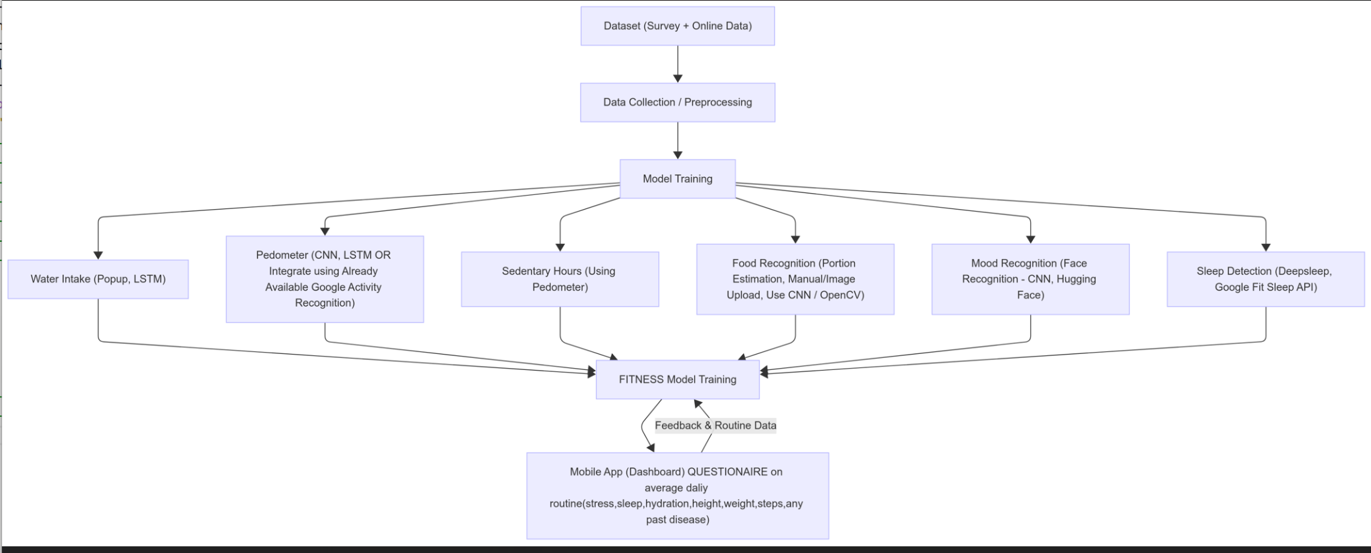
Project Design
System Architecture

Slide 12
Project Design (cont…)
1. Dataset & Preprocessing
• Sources: Survey data and online health datasets
• Techniques: Data cleaning, normalization, and feature extraction for consistent, high-quality inputs
2. Model Training Modules
• Water Intake: LSTM (time-series) with popup reminders
• Pedometer Data: CNN / LSTM or Google Activity Recognition API
• Sedentary Hours: Derived from pedometer data with threshold-based classification
• Food Recognition: CNN + OpenCV for portion estimation (with optional manual correction)
• Mood Recognition: CNN (facial recognition) + Hugging Face transformer-based models
• Sleep Detection: Deep Sleep framework /Google Fit Sleep API
3. Integrated Fitness Model Training
• Module Integration: Combines all trained modules into a unified fitness model
• Learning Approach: Ensemble learning (stacked/weighted models) for robust lifestyle prediction and health insights
4. Mobile App Dashboard
• Daily Questionnaire: Collects user inputs (stress, sleep, hydration, weight, steps, medical history)
• Feedback Loop: Personalized alerts and adaptive recommendations (e.g., “Low hydration,” “Excessive sitting,” “Poor . sleep quality”)

Slide 13
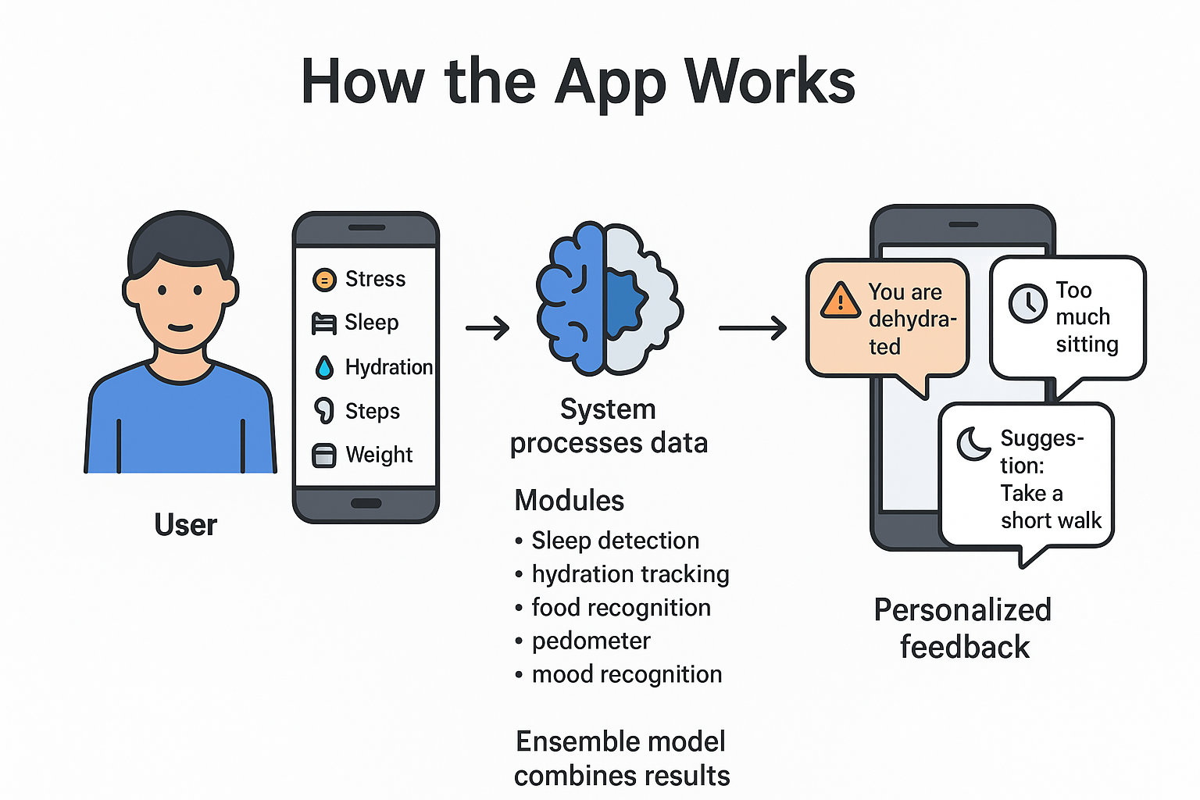
Project Design (cont…)

Slide 14
Tools, Technologies and Languages
1. Programming Languages:
JavaScript / TypeScript
Python
SQL
2. Technologies:
React Native 0.76 - mobile app development
Node.js 20 LTS + Express.js 4.21 - backend APIs
MongoDB Atlas 7.0 + Mongoose 8.6 - NoSQL database
JWT Authentication (jsonwebtoken 9.0.2) - secure login
Firebase Cloud Messaging v12.0 / OneSignal 5.0 - push notifications
TensorFlow 2.16 / Keras 3.4 - LSTM, CNN, DeepSleep framework
scikit-learn 1.5 - baseline ML models, ensemble learning
Hugging Face Transformers 4.44 - mood detection (text/emotion)
OpenCV 4.10 - food recognition & portion estimation
ONNX Runtime 1.20 / TensorFlow Lite 2.16 - model deployment on mobile
Google Fit API - step count & sleep tracking (alternative to sensors)
GitHub - version control

Slide 15
Tools, Technologies and Languages (cont…)
3. Tools
pandas 2.2, numpy 1.26 → dataset preprocessing & feature extraction
Matplotlib 3.9 / Seaborn 0.13 → visualizations
Draw.io → architecture diagrams
Google Docs / MS Word 2025 → documentation & reports

Slide 16
Dataset
Data Sources:
Primary: Google Form “Daily Wellness Check-In” — self-reported lifestyle, nutrition, sleep, mood, and activity data.
Secondary: Food image datasets for portion detection: Food-101 (101 categories) and IndianFood16 (16 Indian cuisines).
Key Features:
Demographics: Age, Gender, Occupation, Weight, Height
Sleep & Mood: Sleep hours & quality, Fatigue, Emotional state, Stress
Diet & Nutrition: Water intake, Meal quality, Number of meals, Food images/labels
Physical Activity: Activity level, Steps, Exercise frequency, Sedentary hours
Medical History: Diabetes, Obesity, Hypertension, Heart Disease, etc.
Purpose: Train AI/ML models for personalized wellness tracking, diet & portion detection, and health insights.

Slide 17
Implementation
Dataset Creation
Designed and circulated a Google Form to collect real user lifestyle details (sleep, activity, diet, hydration, mood, etc.).
Combined user responses with publicly available health datasets to improve accuracy and generalization.
Data Processing
Performed data cleaning (removing duplicates, handling missing values, correcting inconsistencies).
Conducted preprocessing (normalization, encoding categorical variables).
Prepared a refined dataset ready for machine learning model training.

Slide 18
Experimental Results (if any)
None

Slide 19
Key Learnings
Dataset Building
Gained experience in creating a dataset from scratch by combining primary data (Google Form responses) with secondary data (online sources).
Data Handling Skills
Learned techniques for data cleaning, preprocessing, and integration to prepare reliable datasets.
Machine Learning Workflow
Understood the importance of structured pipelines: data collection - cleaning - preprocessing - model training.
Practical Challenges
Faced issues like missing/inconsistent entries, data imbalance, and merging formatS.

Slide 20
Work Plan till End-Term Evaluation
Aug–Sept 2025 - Literature Review & Research
Sept–Oct 2025 - Requirement Analysis & Dataset Preparation
Oct–Dec 2025 - System Design & Implement ML Models
Dec 2025–Feb 2026 - Implementation (App, Backend)
Feb–Mar 2026 - Testing & Validation
Apr–May 2026 - Documentation & Final Report

Slide 21
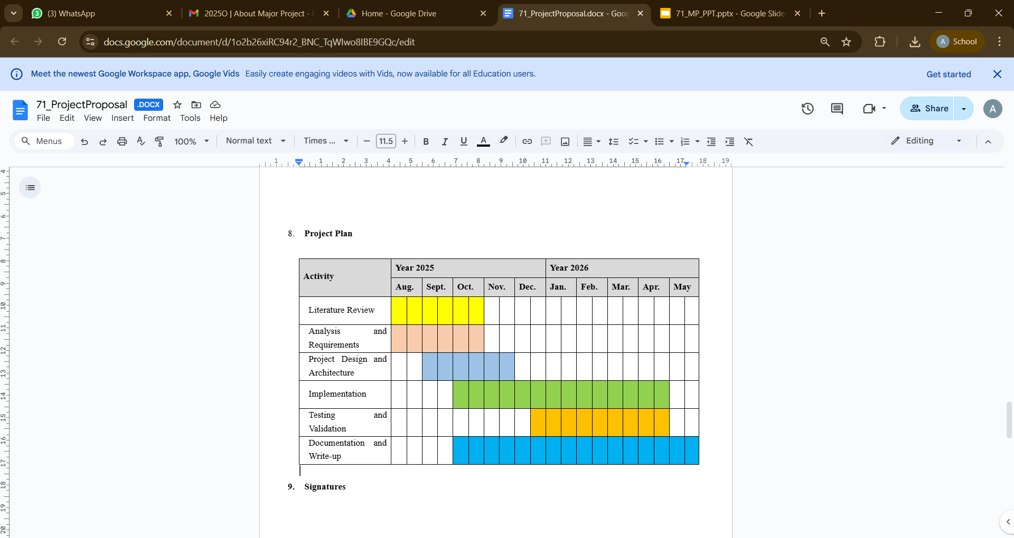
Project Plan

Slide 22
Work Contribution and Attendance
GitHub Repository URL: https://github.com/Mlakshay01/YOU2.O-MAJOR-PROJECT
Team Member | Roll No. | Work Done (provide complete details) | Work Contribution (%) | Lines of Code (if any) | Lab Attendance (%)
1. | 221030140 | Circulated the google form for dataset to the faculty and family members. Done data cleaning and made dataset ready for project use Did Research work and literature survey for the project | 33.3% |  | 100%
2. | 221030249 | Circulated the google form for dataset to family members. Done data cleaning and made dataset ready for project use Did Research work and literature survey for the project | 33.3% |  | 100%
3. | 221030022 | Circulated the google form for dataset to the college students. Done data cleaning and made dataset ready for project use Did Research work and literature survey for the project. | 33.3% |  | 100%

Slide 23
Supervisor Interactions (as mentioned in weekly log)
No. of Meetings with Supervisor:
Week No. | Duration | Remarks (as mentioned in the weekly log) | Incorporated (Yes/No)
1. | 21/8/2025 to 24/8/2025 | Topic discussion
2. | 25/8/2025 to 28/8/2025 | Come up with research paper Research about the topic what and how it is to be done what technology and tools are already available | Yes
3. | 15/9/2025 to 17/9/2025 | Start a survey on dataset Keep in mind all the parameters | Yes
4. | 18/9/2025 to 20/9/2025 | Look for online dataset Merge them for better accuracy | Yes
5. | 22/9/2025 to 24/9/2025 | Do data preprocessing and cleaning Dataset is good | Yes
6. | 25/9/2025 to 27/9/2025 | Make changes in ppt and report as told | Yes

Slide 24
References
[1] J. Chiam, M. Zhang, and L. Wee, “Co-Pilot for Health: Personalized Algorithmic AI Nudging to Improve Health . preprint arXiv:2401.10816, 2024. [Online].Available: https://arxiv.org/abs/2401.10816
[2] R. Zahedani, et al., “AI-Based, Autonomous, Digital Health Intervention Using Precise Lifestyle Guidance on Blood Pressure in Adults With Hypertension,” JMIR Cardio, vol. 8, no. 1, p. e51916, 2024. [Online]. Available: https://cardio.jmir.org/2024/1/e51916
[3] P. Stolfi, G. Manco, and L. Tagliaferri, “Use of Non-Invasive Parameters and Machine Learning Algorithms for Predicting Future Risk of Type 2 Diabetes,” BMC Bioinformatics, vol. 21, no. 1, pp. 1–14, 2020. [Online]. Available: https://doi.org/10.1186/s12859-020-3415-9
[4] K. G. Deterding and N. Johnson, “The Effectiveness of Gamification in Changing Health-Related Behaviors: Systematic Review & Meta-analysis,” BMC Public Health, vol. 24, no. 3, pp. 451–467, 2024.
[5] A. Subramanian and H. Rahmani, “Applying AI in the Context of the Association Between Device-Based Assessment of Physical Activity and Mental Health: Systematic Review,” JMIR mHealth and uHealth, vol. 13, no. 1, p. e59660, 2025. [Online]. Available: https://mhealth.jmir.org/2025/1/e59660
[6] R. Zahedani, A. Wadhawan, and E. Fernandez, “Digital Health Application Integrating Wearable Data and Continuous Glucose Monitoring to Deliver Lifestyle Recommendations,” npj Digital Medicine, vol. 6, no. 4, pp. 1–12, 2023. [Online]. Available: https://doi.org/10.1038/s41746-023-00735-8
[7] Straczkiewicz et al., “A Systematic Review of Smartphone-Based Human Activity Recognition Methods for Health Research,” 2020. Review: Summarizes activity recognition techniques using smartphones. Highlights accuracy and reliability challenges across varied user behaviors and devices.

Slide 25
References (cont…)
[8] Kundu et al., “Smartphone-Based Human Activity Recognition Irrespective of Usage Behavior Using Deep Learning Technique,” 2021. Review: Proposes robust deep learning methods to recognize activity regardless of phone placement, improving real-world applicability.
[9] Wang et al., “The Impact of Gamification-Induced Users’ Feelings on the Continued Use of mHealth Apps: A Structural Equation Model With the Self-Determination Theory Approach,” 2020. Review: Shows gamification enhances motivation and retention in health apps, emphasizing user psychology for sustained engagement.
[10] Hwang et al., “Research Trends on Mobile Mental Health Application for General Population: A Scoping Review,” 2022. Review: Identifies trends in mental health apps; notes gaps in personalization and integration with healthcare systems.
[11] Almuqrin et al., “Smartphone Apps for Mental Health: Systematic Review of the Literature and Five Recommendations for Clinical Translation,” 2021. Review: Highlights clinical translation challenges and emphasizes evidence-based app design for real-world efficacy.
[12] Gemesi et al., “Efficacy of an App-Based Multimodal Lifestyle Intervention on Body Weight in Persons with Obesity: Results from a Randomized Controlled Trial,” 2021. Review: Validates app-based interventions for weight loss; underlines the importance of personalized recommendations.
[13] Birhanu et al., “A Mobile Health Application Use Among Diabetes Mellitus Patients: A Systematic Review and Meta-Analysis,” 2022. Review: Demonstrates the effectiveness of mobile apps in improving glucose control and adherence in diabetic patients.

Slide 26
References (cont…)
[14] H. S. Saad, J. F. W. Zaki, and M. M. Abdelsalam, “Employing of machine learning and wearable devices in healthcare system: tasks and challenges,” Neural Computing and Applications, vol. 36, pp. 17829–17849, Aug. 2024. Available: 10.1007/s00521-024-10197-z
[15]M. N. Islam, S. M. A. Shima, A. S. M. J. Uddin, and J.-M. Kim, “Deep learning based wearable real-time heart attack detection system,” Scientific Reports, vol. 11, no. 1, p. 17714, Sept. 2021. Availablei: 10.1038/s41598-021-96938-3
[16]H. Habehh and S. Gohel, “Machine learning in healthcare,” Current Genomics, vol. 22, no. 4, pp. 291–300, 2021. Available: 10.2174/1389202922666210705124359
[17] A. Logacjov, E. S. Skarpsno, A. Kongsvold, K. Bach, and P. J. Mork, “A Machine Learning Model for Predicting Sleep and Wakefulness Based on Accelerometry, Skin Temperature and Contextual Information,” Nature and Science of Sleep, vol. 16, pp. 699–710, 2024. [Online]. Available: https://doi.org/10.2147/NSS.S452799
[18] Q. An, S. Rahman, J. Zhou, and J. J. Kang, “A Comprehensive Review on Machine Learning in Healthcare Industry: Classification, Restrictions, Opportunities and Challenges,” Sensors, vol. 23, p. 4178, 2023. [Online]. Available: https://doi.org/10.3390/s23094178
[19] T. P. T. Armand, K. A. Nfor, J.-I. Kim, and H.-C. Kim, “Applications of Artificial Intelligence, Machine Learning, and Deep Learning in Nutrition: A Systematic Review,” Nutrients, vol. 16, no. 7, p. 1073, 2024. [Online]. Available: https://doi.org/10.3390/nu16071073
[20] R. Yera, A. A. Alzahrani, L. Martínez, and R. M. Rodríguez, “A Systematic Review on Food Recommender Systems for Diabetic Patients,” International Journal of Environmental Research and Public Health, vol. 20, no. 5, p. 4248, 2023. [Online]. Available: https://doi.org/10.3390/ijerph20054248

Slide 27

Thanks.

