Slide 1


Intelligence, Analysis, and Decision-Making
Chris Tatarka, Ph.D.

Slide 2
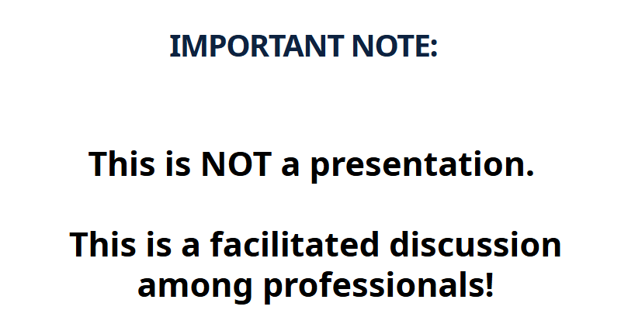

Slide 3
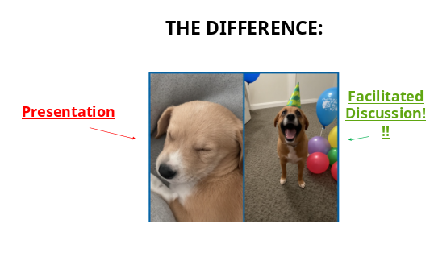

Slide 4

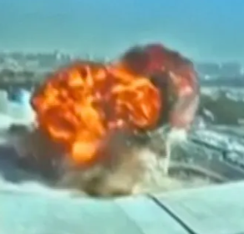

Uncertainty in Decision Making

Slide 5
Two Questions:
Which type of weapon(s) were used in the attack on the airport and did they come from Iran?
Will Iran attack other military or civilian targets in the next 72 hours?

Slide 6
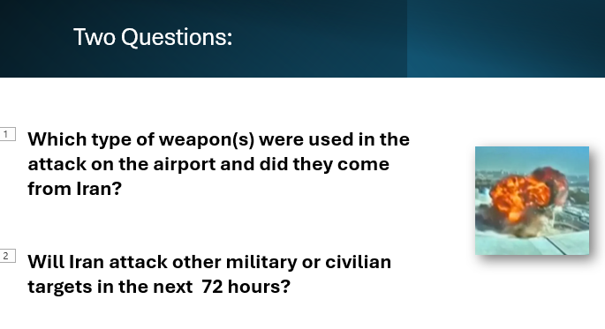
Which is “easier” to Answer & Why?

Slide 7


How About a Question a Bit Closer to Home?
Will car thefts increase, decrease or remain the same for June-Dec 2026
in the Twin Cities Metro???

Slide 8
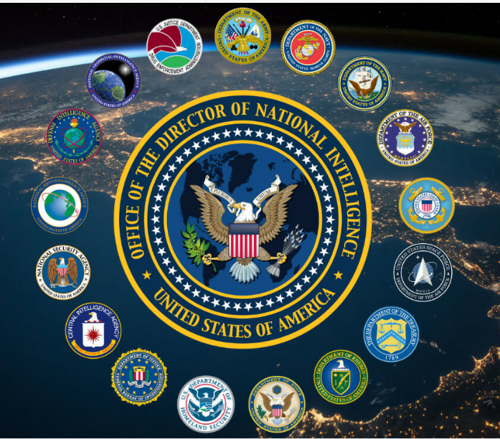
The United States Intelligence Community

Slide 9
The United States Intelligence Community
-The U.S. Intelligence Community is a network of 18 organizations that collect, analyze, and share intelligence to support national security.
- Employs >100,000+ people and operates with an annual budget of >$100 billion.

Slide 10
What is “Intelligence”?
Richelson (paraphrased):
Intelligence is information that is collected, processed and narrowed to meet the needs of policy or decision makers
Note: “Intelligence” is different from “information” which is different from “data”
Notes:
Chapter 1 defines intelligence in multiple ways: process, product, organization. Stress that it has no single definition. Discuss the cycle, main INTs, and key tensions (policy vs intelligence, secrecy vs transparency). Engage students by asking how they’d define intelligence in one sentence.

Slide 11
What is “Intelligence”?
Richelson (paraphrased):
Intelligence is information that is collected, processed and narrowed to meet the needs of policy or decision makers
Note: “Intelligence” is different from “information” which is different from “data”
You may be thinking:
WHAT THE ___ DOES THAT MEAN OR MATTER?
Notes:
Chapter 1 defines intelligence in multiple ways: process, product, organization. Stress that it has no single definition. Discuss the cycle, main INTs, and key tensions (policy vs intelligence, secrecy vs transparency). Engage students by asking how they’d define intelligence in one sentence.

Slide 12
What is “Intelligence”?
Data Raw, unprocessed facts with no meaning on their own.
Information Data that has been given context so it becomes meaningful.
Intelligence Information that has been analyzed to understand significance or implications for decision-making.
Notes:
Chapter 1 defines intelligence in multiple ways: process, product, organization. Stress that it has no single definition. Discuss the cycle, main INTs, and key tensions (policy vs intelligence, secrecy vs transparency). Engage students by asking how they’d define intelligence in one sentence.

Slide 13
What is “Intelligence”? (HYPOTEHTICAL EXAMPLES)
Data Raw, unprocessed facts with no meaning on their own. Example: The Intel Community identifies an (overseas) active phone in Iran with number 98 21 1234 567## contacting numbers in Singapore and Malaysia
Information Data that has been given context so it becomes meaningful. Example:
98 21 1234 567## is previously associated with a person named John Doe a known Iranian armed drone procurement agent
Previous reporting suggestions weapons procurement networks exist in Singapore and Malayasia
Intelligence Information analyzed to understand significance or implications for decision-making.
SO………….?????????????????????????????????????????????
Notes:
Chapter 1 defines intelligence in multiple ways: process, product, organization. Stress that it has no single definition. Discuss the cycle, main INTs, and key tensions (policy vs intelligence, secrecy vs transparency). Engage students by asking how they’d define intelligence in one sentence.

Slide 14
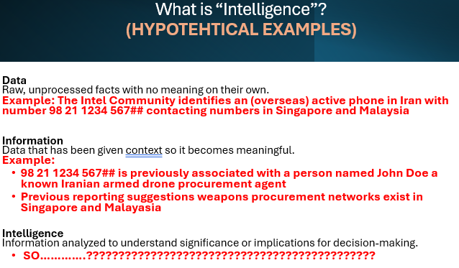
What is “Intelligence”? (HYPOTEHTICAL EXAMPLES)
Is Iran trying to obtain more armed drones from Singapore or Malaysian arms dealers?
“It is likely that Iran is trying to obtain armed drone materials from Singapore and/or Malysia.. This is made with medium confidence”
(HYPOTEHTICAL EXAMPLE ONLY)
Notes:
Chapter 1 defines intelligence in multiple ways: process, product, organization. Stress that it has no single definition. Discuss the cycle, main INTs, and key tensions (policy vs intelligence, secrecy vs transparency). Engage students by asking how they’d define intelligence in one sentence.

Slide 15
What is “Intelligence”? (HYPOTEHTICAL EXAMPLES)
Given that information, is Iran trying to obtain more armed drones from Singapore or Malaysian arms dealers?
This is the type of question intelligence professionals
try to answer…all the time!
Notes:
Chapter 1 defines intelligence in multiple ways: process, product, organization. Stress that it has no single definition. Discuss the cycle, main INTs, and key tensions (policy vs intelligence, secrecy vs transparency). Engage students by asking how they’d define intelligence in one sentence.

Slide 16

Analytic Process
Collect Information – Gather data from various sources.
Organize the Information – Sort, categorize data.
Evaluate the Sources – Assess credibility of information.
Look for Patterns and Relationships
Make Judgments – Develop analytical conclusions based on the available evidence.
Communicate Findings – Present conclusions, confidence levels, supporting evidence, and remaining uncertainties to decision-makers.
Notes:
Chapter 1 defines intelligence in multiple ways: process, product, organization. Stress that it has no single definition. Discuss the cycle, main INTs, and key tensions (policy vs intelligence, secrecy vs transparency). Engage students by asking how they’d define intelligence in one sentence.

Slide 17
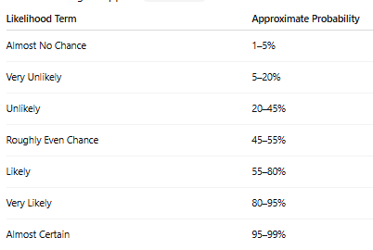
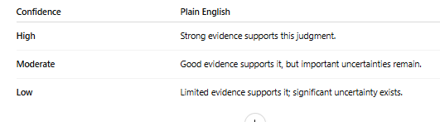
Analytic Judgments Typically Include Likelihood and Confidence Level
“It is (insert likelihood) that X will occur.” AND
“This judgment is made with insert confidence level”
Notes:
Chapter 1 defines intelligence in multiple ways: process, product, organization. Stress that it has no single definition. Discuss the cycle, main INTs, and key tensions (policy vs intelligence, secrecy vs transparency). Engage students by asking how they’d define intelligence in one sentence.

Slide 18
Random Thoughts on “Technical” Data/Info on Analysis
Traditionally: intelligence analysis does not rely solely on statistical analysis (e.g. regression models)
However, those are used to inform probability and confidence levels
Data Science, computer science, cyber security and AI are expanding in the profession.
Some agencies more aggressive than others (from what I can tell as an outsider)
BUT ethics, legalities, and values clearly make their use a significant concern.
E.g. Do you want your government collecting and gathering “big data” on you?
AI trust and reliability a major concern
Notes:
Chapter 1 defines intelligence in multiple ways: process, product, organization. Stress that it has no single definition. Discuss the cycle, main INTs, and key tensions (policy vs intelligence, secrecy vs transparency). Engage students by asking how they’d define intelligence in one sentence.

Slide 19
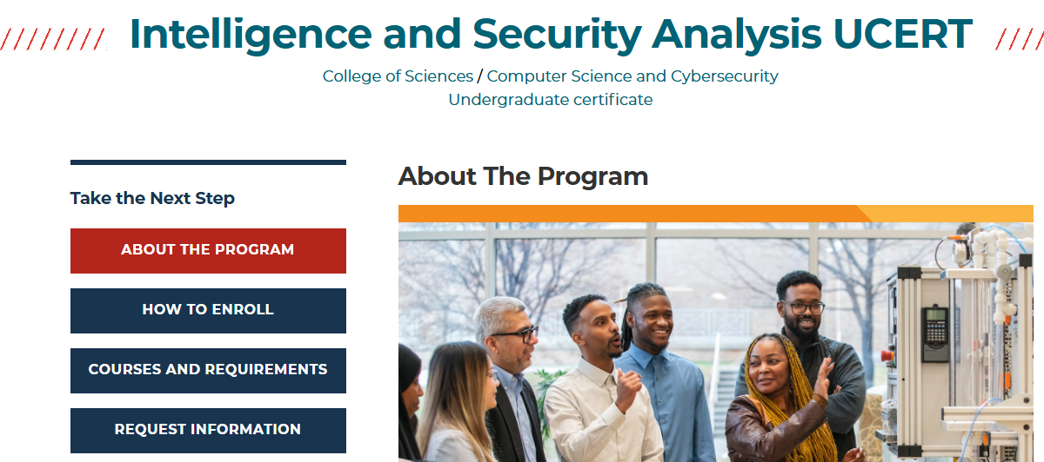
Want to Know More?
Google:
Careers in Intelligence: IC Jobs.gov
More about the Intelligence Community: IC.GOV
METRO STATE INTELLIGENCE CERTIFICATE
Consider enrolling in CJS 366 THE US INTELLIGENCE COMMUNITY this Fall!!
Wednesday Evenings from 6-9:20 PM ON CAMPUS! (NO ONLINE VERSION)
Notes:
Chapter 1 defines intelligence in multiple ways: process, product, organization. Stress that it has no single definition. Discuss the cycle, main INTs, and key tensions (policy vs intelligence, secrecy vs transparency). Engage students by asking how they’d define intelligence in one sentence.

Slide 20
IF YOU HAVE ANY QUESTIONS:
christopher.tatarka@metrostate.edu
I am the only “Tatarka” in the directory at Metro State ☺

