Slide 1
Abstracts Clustering of the New York Times
Daniel Waybright
&
Matthew Letter

Slide 2
Data Acquisition
Anatomy of a Request
$URL = $baseURL . $source . $section . $format . "?" . $offset . $key;
$raw = @file_get_contents( $URL );
$response = unserialize( $raw );
Reattempt if encounter errors
if( $response["status"] == "OK" ) { … }
Store all raw files!!!
Notes:
Our initial step was to download “raw” file from the NYT, where each grab pulled down 20 documents.
$source and $section were set to “all”, to just grab everything
IF you don’t base64_encode sphp files, transferring can corrupt…

Slide 3
Preprocessing The Abstracts
Combine all raw files into a single PHP array where the URL is the “unique” key, thereby eliminating duplicates.
We then mapped each URL to a unique numerical ID
subsequently outputting a file containing the abstract with the ID as filename.
Downloaded a combined 41,116 unique documents.

Slide 4
Notes:
42 Sections total.
Notice that (blank) is just under 1000 of the documents.

Slide 5
Calculating TF-IDF with MapReduce First Run
Converted a directory of documents into a single <key,value> file
Key: ( word, docID )
Value: # this word in this document
Word Stemming and Stop Word:
Word stemming was done with a java implementation Porter stemmer.
Removed stop words using the Wikipedia stop word list.
Took about 50 minutes on Galles

Slide 6
Calculating TF-IDF with MapReduce Second Run
Input < (word, docID), #timesWordInDoc >
Which is the output of the first run
Run2 Goal:
capture the number of words in each document.
capture the max number of words in a document.
Mapper sends out < docID, (word, #wordInDoc) >
Reducer uses a HashMap* to collect the documents words
Output < (word, docID), (#wordInDoc, #totalWordsInDoc) >
Notes:
* This is ok, because the documents have very few words in them

Slide 7
Calculating TF-IDF with MapReduce Third Run
Input < (word, docID), (#wordInDoc, #wordsInDoc) > along with the max document word count.
Goal:
Calculate Term Frequency (TF) and Inverse Document Frequency (IDF).
Output < (word, docID), (#wordInDoc, #numDocsWithTerm, TF, IDF, TF-IDF) >
Used the max document wordcount obtained in the 2nd run to normalize.

Slide 8
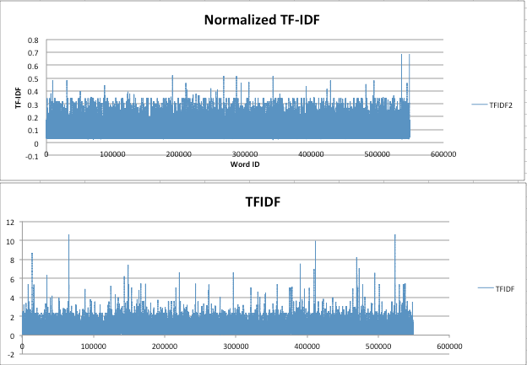
Normalizing TF-IDF with Respect to Document Length
A comparison of before and after(TFIDF2 = normalized)
Take notice of the Y axes(TF-IDF values)

Slide 9
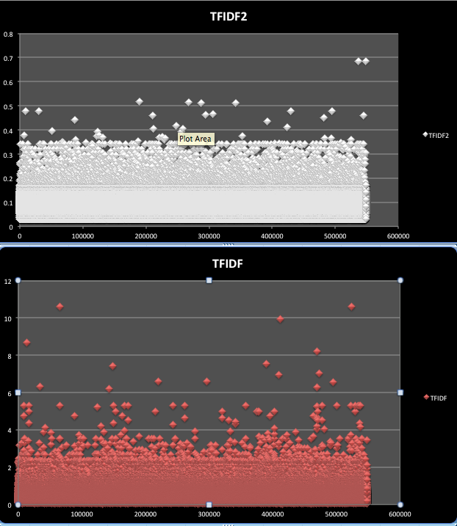
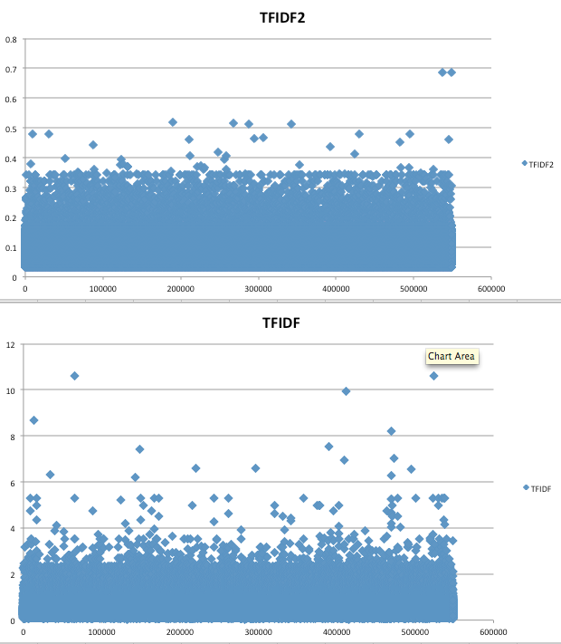
More Representations of The Data

Slide 10
Clustering Mahout
We used Mahout’s version of K-Means because it was available and it processes using map reduce
Pros:
General Purpose, the swiss army knife of clusterer’s
Running mapreduce version on Mahout is fast
Cons:
Umm… k anyone?
Documentation? We don’t need no stinking documentation!!!
Result:
Text file of centroids, followed by the centroids clustered documents

Slide 11
Clustering MatLab
We tried MatLab’s version of K-Means because we have free access and wanted to compare and contrast
Pros:
Lots of documentation/tutorials
Enormous inventory of methods
Cons:
Umm… HUGE amount of data for little ol’ macBook
Result:
Calculated the Euclidean distances for The 30000x41000 vector matrix. Ended up with a 1x900billion point vector of doubles……kmeans in MatLab died.
Notes:
Can talk about race to cluster mahout vs matlab

Slide 12
Selecting the ‘best’ Number of Clusters
Ran Fuzzy partitioning on MatLab, but the process was taking upwards of 20hours.
Instead went with New York Times abstract by section which was 42 section, we expanded to 50 clusters based on the subsections.

Slide 13
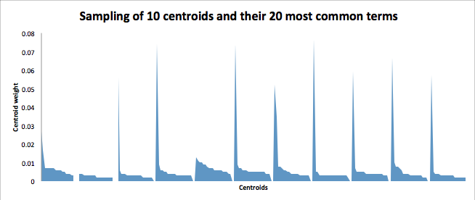
20 Most Discriminative Terms per Cluster
The clusters tended to key a few terms.

Slide 14
What We Gleaned From Top 20 Terms
Good example of a banking cluster had these terms:
bank central invest financi european settlement mortgag rate billion wall street west america ar million firm new loan ha deutsch
From these words we can see that this cluster focuses on banking.
Other cluster topics include:
Horse racing
Marriage/dating
Crossword puzzles

Slide 15
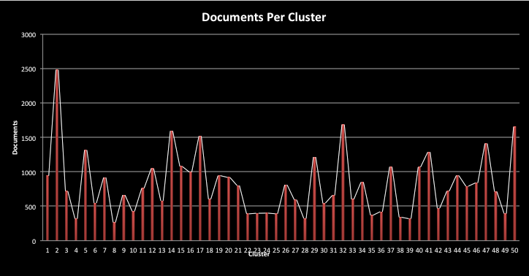
Documents per Cluster
Largest cluster had ~2500 documents

Slide 16
Visualization of Clusters and Term Frequencies
With Orange, “Data Mining - Fruitful and Fun”, we plotted centroids picked by our clusterer using the linear projections visualization
Runs very slowly on desktop, so unable to perform much analysis
The black outer ring is all of the terms, and the dots are where the clusters are

Slide 17
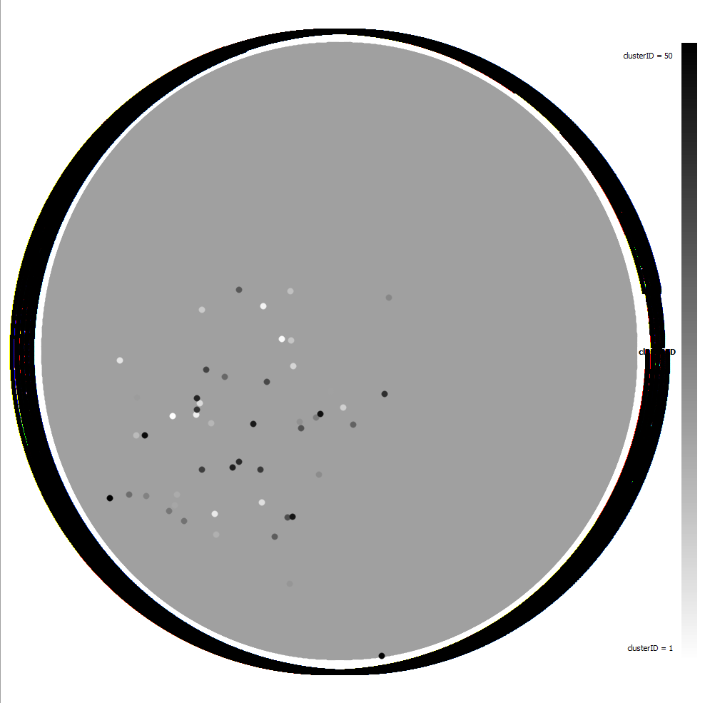

Slide 18
A Better Visualization
The X axis represents overlap between clusters the top 20 terms of cluster centroids
The size of the circles represents the amount of documents clustered around the centroids.
The Y access spreads them out for a better visual
End goal:
Have clusters sharing top terms to be touching

Slide 19
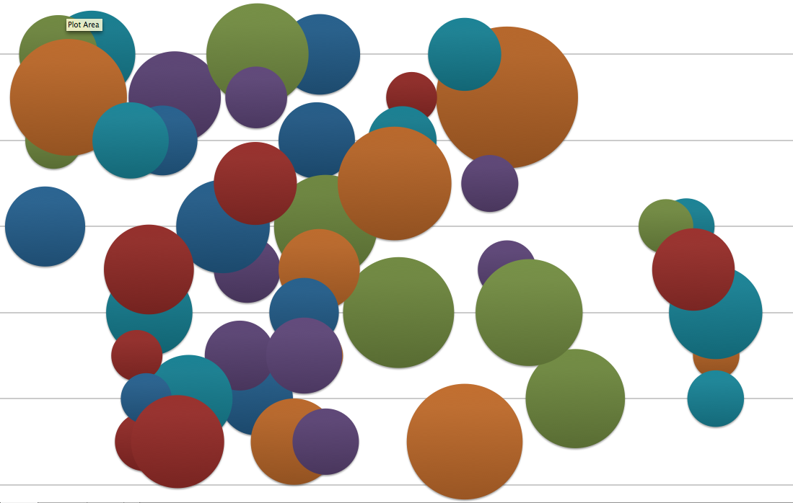
Cluster Size With Clusters Being closer Together by top 20 Words

Slide 20
Citations
Common English Word." Common English Word. N.p., n.d. Web. 20 Oct. 2014. <http://www.textfixer.com/resources/common-english-words.txt>.
PorterStemmer." PorterStemmer. N.p., n.d. Web. <http%3A%2F%2Ftartarus.org%2Fmartin%2FPorterStemmer%2Findex-old.html>.
My Blog by Philippe Adjiman." My Blog by Philippe Adjiman. N.p., n.d. Web. 20 Oct. 2014. <http://www.philippeadjiman.com/blog/2010/12/30/how-to-easily-build-and-observe-tf-idf-weight-vectors-with-lucene-and-mahout/>.

