Slide 1
Abstracts Clustering of the New York Times
Daniel Waybright
&
Matthew Letter

Slide 2
Data Acquisition
Anatomy of a Request
$URL = $baseURL . $source . $section . $format . "?" . $offset . $key;
$raw = @file_get_contents( $URL );
$response = unserialize( $raw );
Reattempt if encounter errors
if( $response["status"] == "OK" ) { … }
Store all raw files!!!
Notes:
Our initial step was to download “raw” file from the NYT, where each grab pulled down 20 documents.
$source and $section were set to “all”, to just grab everything
IF you don’t base64_encode sphp files, transferring can corrupt…

Slide 3
Preprocessing The Abstracts
Combine all raw files into a single PHP array where the URL is the “unique” key, thereby eliminating duplicates.
We then mapped each URL to a unique numerical ID, and output a file containing the abstract and has the ID as filename.
Downloaded a combined 41,116 unique documents.

Slide 4
Notes:
42 Sections total.
Notice that (blank) is just under 1000 of the documents.

Slide 5
Calculating TF-IDF with MapReduce First Run
Convert a directory of documents into a single <key,value> file
Key: ( word, docID )
Value: # this word in this document
Word Stemming and Stop Word:
removal via and Implementation of portStemmer.
Took about 50 minutes on Galles

Slide 6
Calculating TF-IDF with MapReduce Second Run
Input < (word, docID), #timesWordInDoc >
This run we want to capture the number of words in each document. Also, capture the max words in a document.
Mapper sends out < docID, (word, #wordInDoc) >
Reducer uses a HashMap* to collect the documents words
Output < (word, docID), (#wordInDoc, #totalWordsInDoc) >
Notes:
* This is ok, because the documents have very few words in them

Slide 7
Calculating TF-IDF with MapReduce Third Run
Input < (word, docID), (#wordInDoc, #wordsInDoc) > along with the max document word count.
Calculate Term Frequency (TF) and Inverse Document Frequency (IDF). We used the max document wordcount obtained in the first run to normalize.
Output < (word, docID), (#wordInDoc, #numDocsWithTerm, TF, IDF, TF-IDF) >

Slide 8
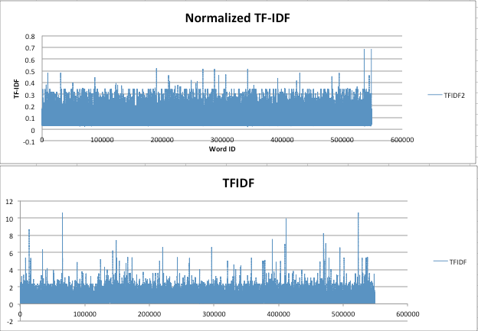
Normalizing TF-IDF with Respect to Document Length
A comparison of before and after(TFIDF2 = normalized)
Take notice of the Y axes(TF-IDF values)

Slide 9
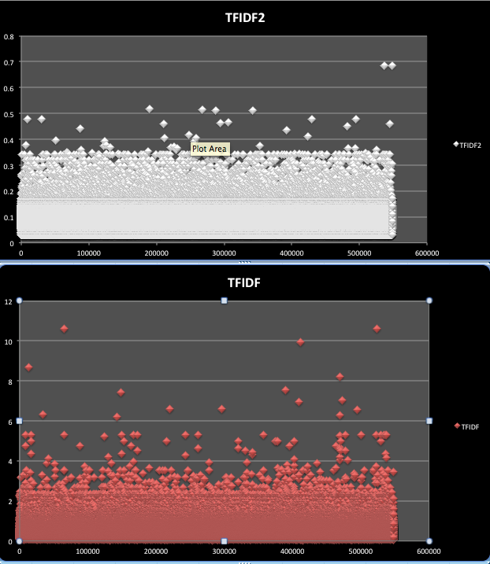
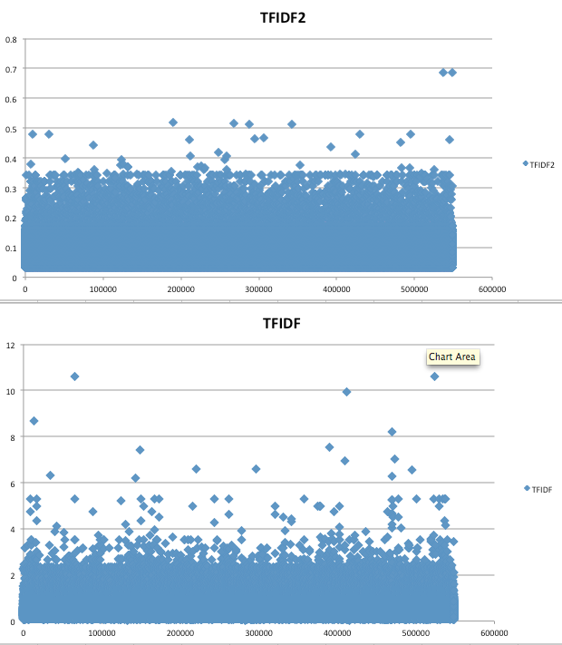
More Representations of The Data

Slide 10
Clustering
We used Mahout’s version of K-Means
Pros:
General Purpose, the swiss army knife of clusterer’s
Running mapreduce version on Mahout is fast
Cons:
Umm… k anyone?
Documentation? We don’t need no stinking documentation!!!

Slide 11
Clustering
We tried MatLabs’s version of K-Means
Pros:
Lots of documentation/tutorials
Enormous inventory of methods
Cons:
Umm… HUGE amount of data for little ol’ macBook
Result:
Calculated the Euclidean distances for The 30000x41000 vector matrix. Ended up with a 1x900billion point vector of doubles……kmeans in MatLab died.

Slide 12
Selecting the ‘best’ Number of Clusters
Ran Fuzzy partitioning on MatLab, but the process was taking upwards of 20hours.
Instead went with New York Times abstract by section which was 42 section, we expanded to 50 clusters based on the subsections.

Slide 13
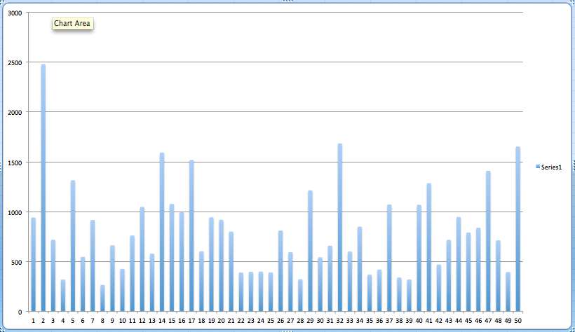
Documents per Cluster
Largest cluster had ~2500 documents

Slide 14
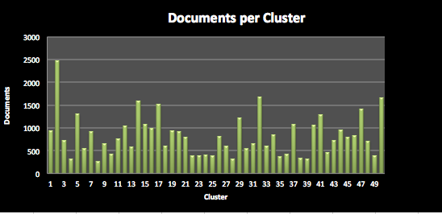
A Little Easier on The eyes

Slide 15
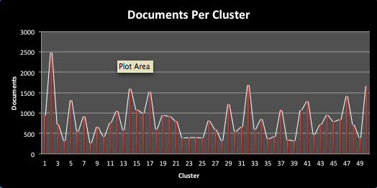
Let’s Make The Data Easier To Understand

Slide 16
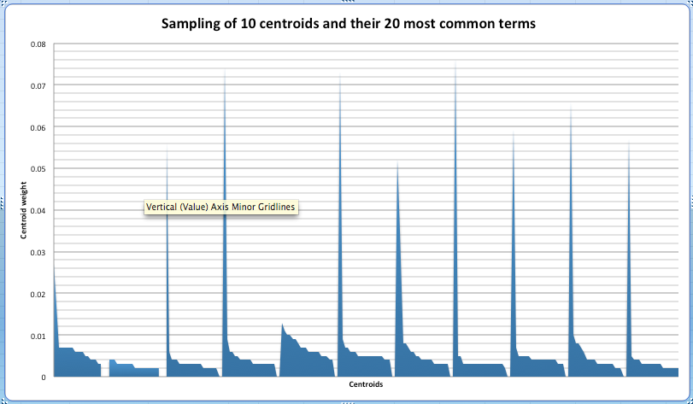
20 Most Discriminative Terms per Cluster
The clusters tended to key a few terms.

Slide 17
What We Gleaned From Top 20 Terms
One of the clusters had the stemmed words:
bank central invest financi european settlement mortgag rate billion wall street west america ar million firm new loan ha deutsch
From these words we can see that this cluster focuses on banking.

Slide 18
Visualization of Clusters and Term Frequencies
With Orange, “Data Mining - Fruitful and Fun”, we plotted centroids picked by our clusterer using the linear projections visualization
Runs very slowly on desktop, so unable to perform much analysis
The black outer ring is all of the terms, and the dots are where the clusters are

Slide 19
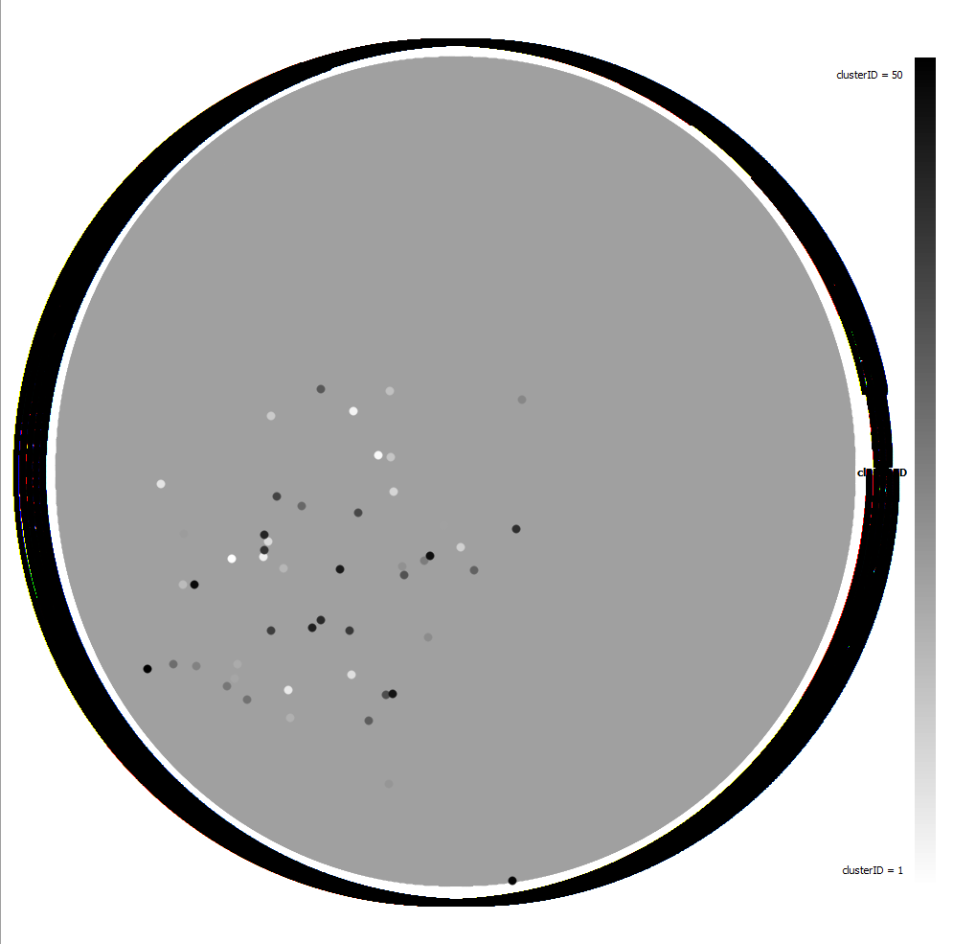

Slide 20
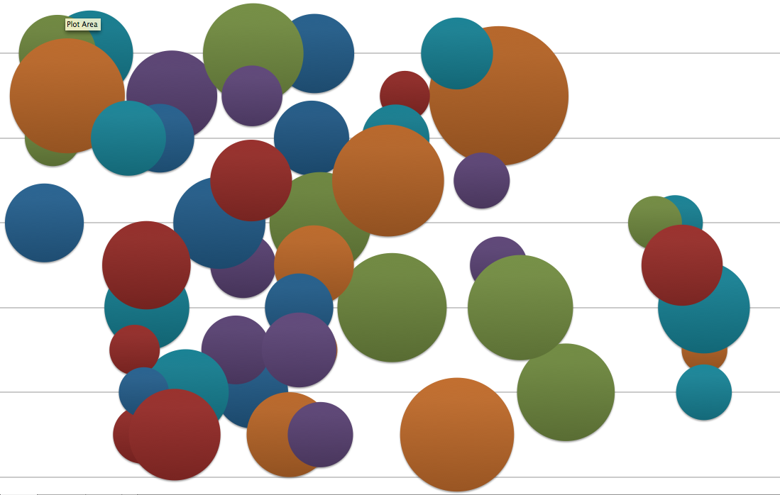
Cluster Size With Clusters Being closer Together by top 20 Words

