Slide 1

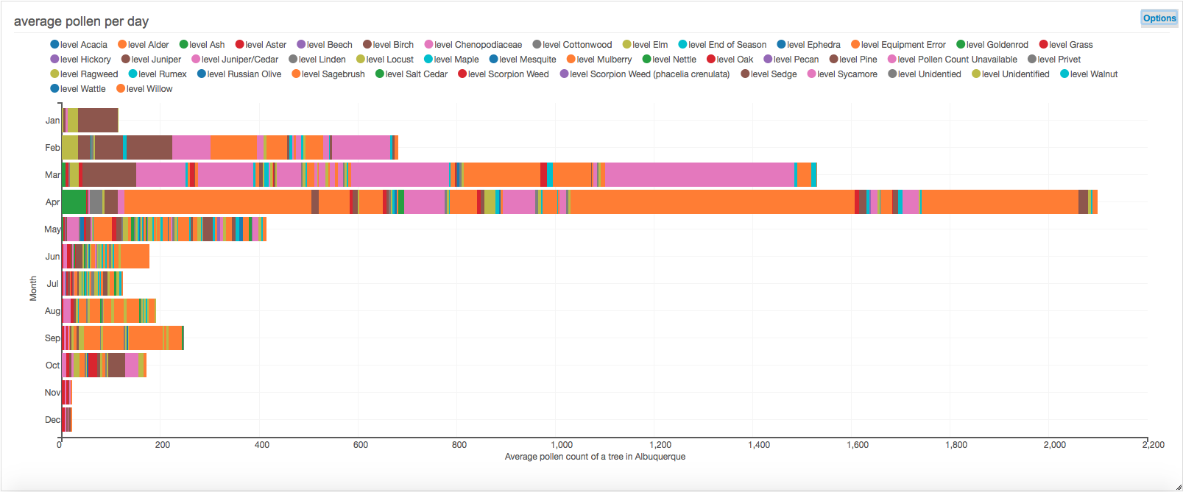
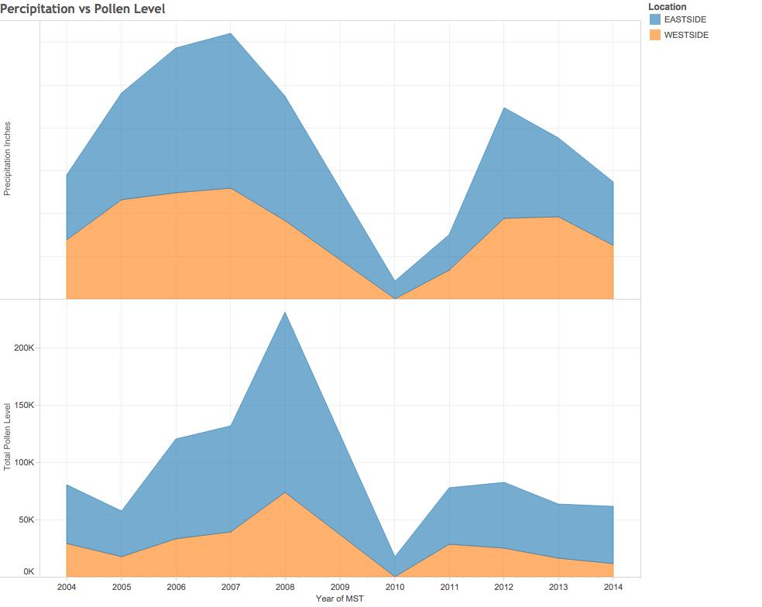
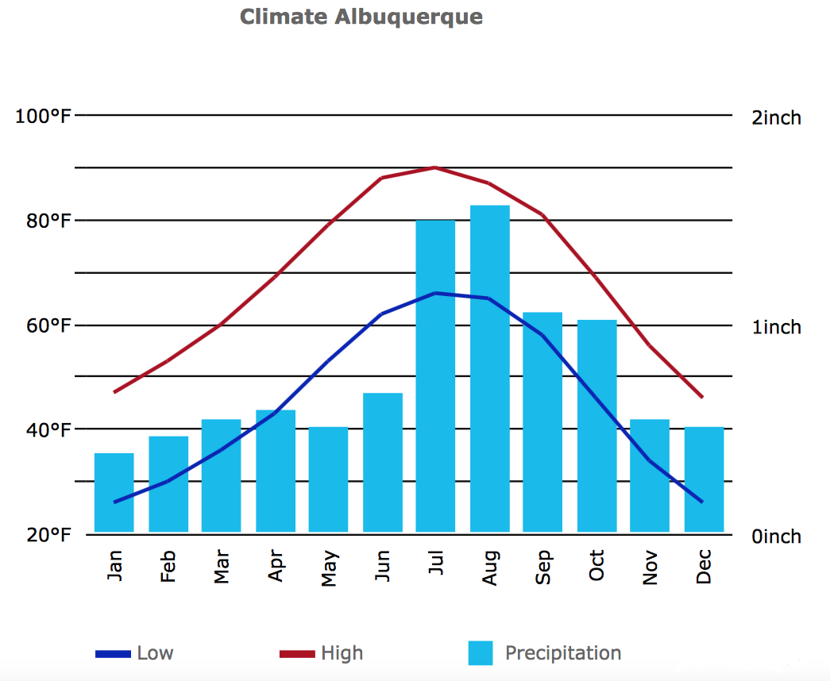
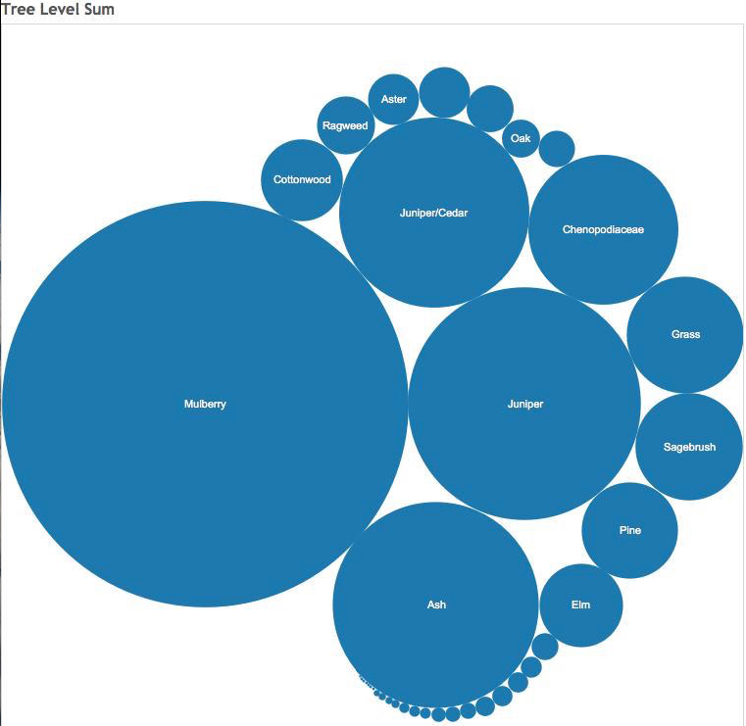
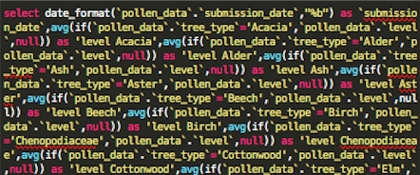

Purchasing Allergy Medication
Matthew Letter
Department of Computer Science, University of New Mexico
The Problem
People spend billions of dollars a year trying to control their allergies. Unfortunately, a large amount of allergy medication is thrown away each year. This waste is partially because people buy their allergy medications at the wrong time during the year, leading to the medicine expiration before use. The goal of this study is to give people in the Albuquerque area a way of determining when to buy their allergy medication so as to not let them go to waste.
A Background on Antihistamines
When your body is exposed to allergens, such as tree pollen, it releases histamines. Histamines attach to the cells in your body causing the cells to swell and leak fluid. This can cause itching, sneezing, runny nose, and watery eyes. Antihistamines medications prevent histamines from attaching to your cells and causing symptoms. Only antihistamine allergy medications were addressed in this research study.
Method and Design
Results
The Albuquerque data warehouse publishes a data set of pollen records. A SAX parser took the XML pollen data and cleaned it for insertion into the MySQL database. A second parser was used for parsing a CSV data file obtained from Wunderground that contained all the weather data for the Albuquerque area over the past 100 years. The Java language was chosen to implement these Parsers for its extensive libraries.
Ubiq was used for initial discovery and insight on the MySQL database, yielding Figure 1. The goal being to obtain a representation of the average pollen counts for each month. The weather data set was independently examined as well (see Figure 3).
The weather data and pollen data sets were inner joined and virtualized on the “date” attribute, yielding a large combined data set. Once the data is in this form, correlation between the two sets were examined by comparing the data on the joined timeline attribute.
Average Pollen Count per Month
Precipitation and Total Pollen Level vs. Year
Figure 1: Month of the year vs. average pollen count per tree. Each column is made up of its respective tree pollen quantities, shown by the different color make up of each column. April is the month with the highest average pollen count. November and December are the months with the lowest average pollen count.
Albuquerque Weather Data
Tree Pollen Levels by Tree Type
Figure 3: Temperature (left y-axis), precipitation (right y-axis) vs. month averages for the Albuquerque. Notice how the pollen levels in Figure 1 do not correlate well with the precipitation levels in this graph.
Figure 2: Precipitation (top) and total pollen levels (bottom) for the eastside (blue) and westside (orange) of Albuquerque vs. year.
Figure 4: Highest pollen producing trees in Albuquerque, the larger the circle the higher the amount of pollen.
Data Sets and Preprocessing
Conclusions
Pollen data readings were taken at two different locations in Albuquerque, the Eastside and Westside referring to their respective portions of the Albuquerque area.
Mulberry makes up 40% of all pollen produced in the Albuquerque area. If a person has a mulberry allergy, it is recommended that if a person buys double the amount of allergy medication in January or live on the west side of Albuquerque because this portion of town has much lower pollen levels.
Pollen levels are directly correlated with drought years.
Drought Years, wait to buy allergy medication due to the drastic reduction in pollen levels.
Non-drought years, allergy medication should be purchased in January. January is shown to be the month where the pollen levels begin to rise. Antihistamines have a shelf life of 12 months and therefore will not expire before the end of the years allergy season.
Pollen Data Set
10 years of pollen data from 2004-2014,
~100,000 data points
Each data point included data on pollen level, location, and date of data collected
Figure 5: A portion of the SQL statement used to produce Figure 1.
Weather Data Set
100 years of weather data trimmed down to data between years 2004-2012
Weather data consisted of 24 attributes including precipitation, temperature, barometric pressure, and date
Project for CS 591-001 Big Data

