Slide 1

Nifty 100 Stocks
By: Marwan Lloyd, Max Schleck, Skylar Shafer, Rachel Studer, James Wan

Slide 2
Dataset
Nifty 100, a set of stocks in India, including the Nifty 50
Time of data collection ranges from 2015 to 2021
60 Columns, minute by minute data
For analysis, we used the standard stock information columns and constructed several day values from those

Slide 3
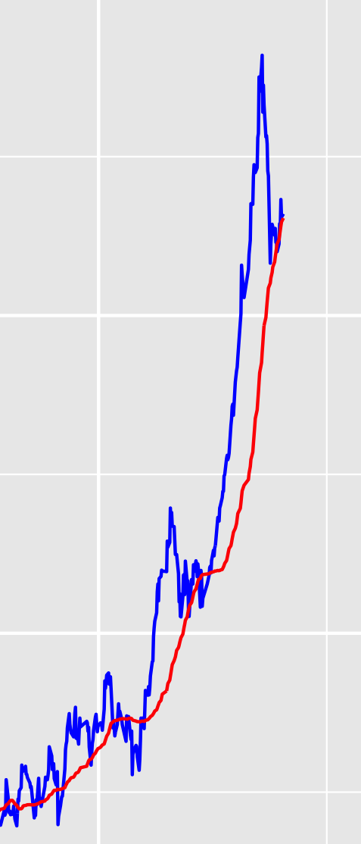
Data Handling
Reduced to day-by-day data
Day Open, and Day Close
50 Day Moving Average
List of duration periods in which the stock price was above 50-day MA for more than 2 days in a row

Slide 4
Parallel Processing
100 jobs
Ran for 24 min each
3.31 MB of Memory
1.14 GB of Disk space

Slide 5
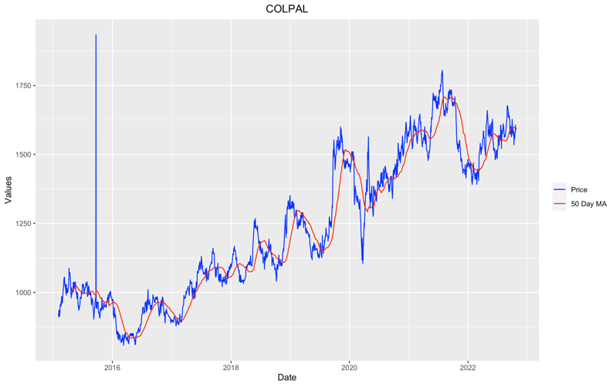
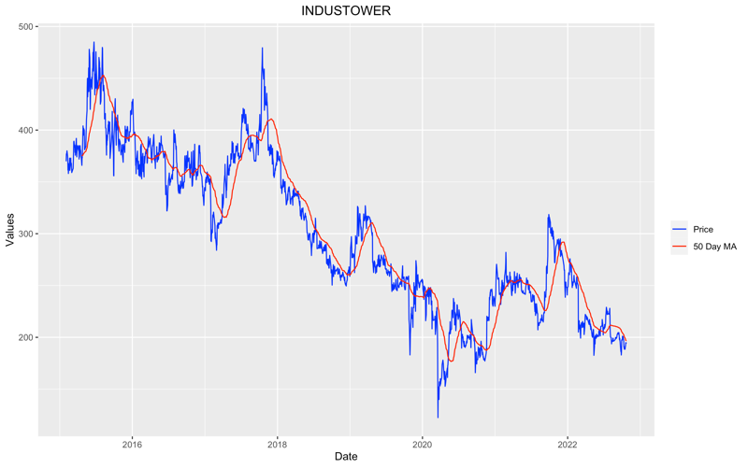
Analysis
All Medians = 5
Largest Mean = 4.55
7 of the stocks were shown to be stationary by the Augmented-Dickey Fuller Test (p < 0.05)
Trends appear to exist, as seen to the right comparison of MA and raw stock prices

Slide 6
Conclusion
From our analysis, we conclude that the movement of stock prices is not random.
The stocks that were ”mathematically stationary” did not pass the human eye test.
The industry standard 50-day MA is accurate even down to the minute level.

