Slide 1

Nifty 100 Stocks
By: Marwan Lloyd, Max Schleck, Skylar Shafer, Rachel Studer, James Wan

Slide 2
Dataset
- Nifty 100, a set of Stocks in India
- Time of data collection ranges from 2015 to 2021
- 60 Columns, minute by minute data

Slide 3
Data Handling
- Reduced to day-by-day data
- Day Open, and Day Close
- 50 Day Moving Average
- List of duration periods in which the stock price was above 50-day MA for more than 2 days in a row

Slide 4
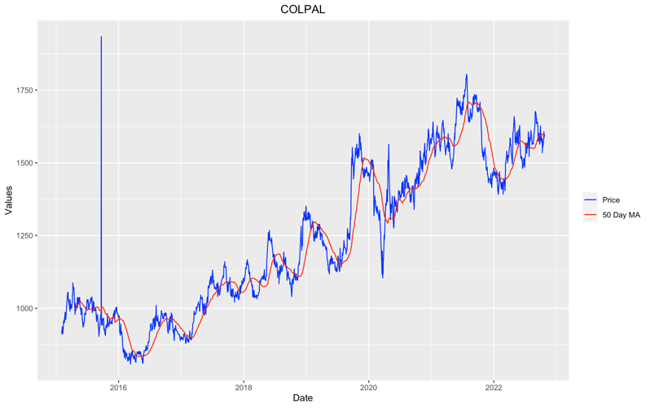
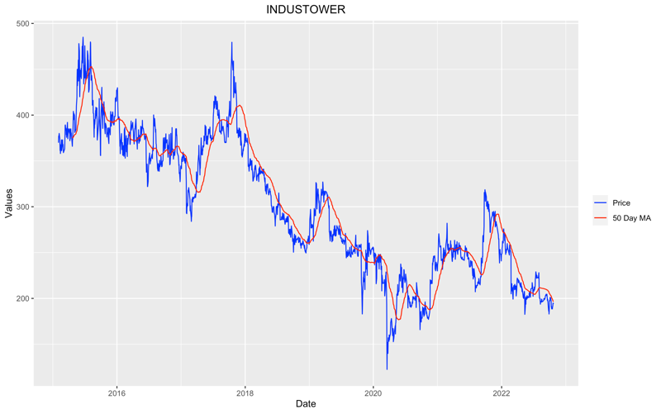
Analysis
- 7 of the stocks were shown to be stationary by the Augmented-Dickey Fuller Test
- Median duration of continuous movement above the 50-day MA was 5 for all stocks
- Trends appear to exist, as seen to the right comparison of MA and raw stock prices

Slide 5
Conclusion
- From our analysis, we conclude that the movement of stock prices is not random.

