Slide 1
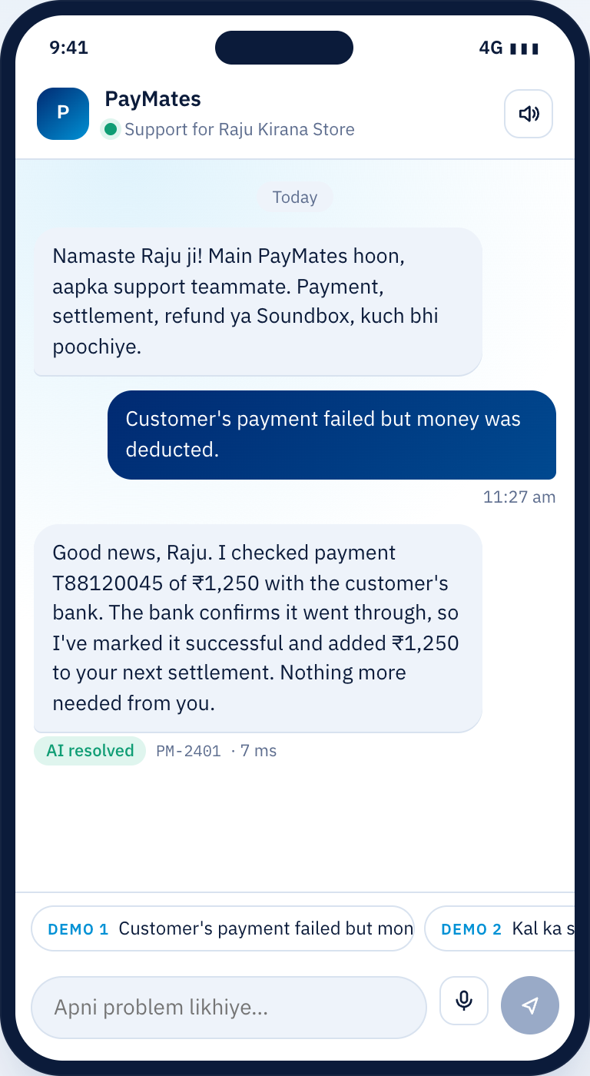
PayMates
PAYTM BUILD FOR INDIA · TRACK 3
The AI support teammate that fixes merchants’ problems, not just answers them
English · हिन्दी · Hinglish
6 model providers
Model Council
Notes:
Meet Raju, a kirana owner in Lucknow. It is 9 PM, his shop is full, and money is stuck. PayMates is the teammate he messages: it understands him in Hinglish, checks his records, takes the fix through guarded tools, and only brings in a human when it matters.

Slide 2



At 9 PM, a stuck payment is a stuck business
Small merchants run on thin margins and tight cash flow. When money is stuck, they need it fixed now, not a ticket number and a callback.
Failed payment, money deducted
The customer was debited, the merchant sees FAILED. Someone has to ask the bank.
~18 min
Settlement didn’t arrive
Yesterday’s payout is on hold. The merchant can’t restock until it lands.
typical manual handling time per support ticket (our assumed baseline, labelled as an assumption in the app)
Refund bounced
The customer is angry and the merchant is stuck in the middle, with no update.
Notes:
Three problems make up most merchant support pain: failed payments where money was deducted, delayed settlements, and bounced refunds. Today each one means a queue and a callback. The 18-minute figure is an assumption we use as a baseline and we label it as one.

Slide 3
It doesn’t answer questions. It recovers money
DEMO 1 · ENGLISH
DEMO 2 · HINGLISH
DEMO 3 · ENGLISH
DEMO 4 · हिन्दी
₹1,250
₹18,640
₹7,800
₹3,400
credited back
payout re-sent
held for a human
council veto
Bank rechecked, late success confirmed, payment credited to the next settlement.
Settlement held by a bank timeout, re-sent to the same verified account, ticket opened.
Bounced refund is above the ₹5,000 limit. Guardrail holds it; specialist approves in one click.
Under the limit, but KYC is pending. The Model Council holds it and briefs a human.
Notes:
Four live demos. One: it rechecks with the bank and credits ₹1,250 back. Two: it replies in Hinglish and re-sends an ₹18,640 payout. Three: a ₹7,800 refund is above the limit, so a guardrail holds it for a human. Four is new: ₹3,400 is under the limit, but the Model Council holds it because KYC is pending.

Slide 4







A team of agents, one job each, streamed live
Triage
Context
Action
Council
Guardrails
Escalation
Reply
Intent, language, IDs, confidence
Records, history, help-center RAG
Plans and calls tools in a loop
Auditors + AI jurors vote on money
Policy checks before every call
Briefs a human specialist
Same language, grounded facts
Groq Llama 8B
SQL + TF-IDF
Claude Sonnet
All providers
Code
Claude Haiku
Gemini Flash
Every step is streamed to the UI over Server-Sent Events. If any model fails or times out, that step falls back to the rules engine and the ticket still closes.
Notes:
Every message becomes a ticket and flows through seven steps. Models do understanding and planning, code does retrieval and enforcement, humans make judgement calls. Model labels shown are the preferred choice when keys are set; with no keys it runs on a deterministic rules engine so the demo never breaks.

Slide 5




The Model Council: no single model can move money
Auditors can veto
code · veto
code · veto
code · veto
Code checks the ledger, the audit log and a risk-tiered daily cap.
Ledger auditor
Replay auditor
Velocity auditor
ACTION AGENT PROPOSES
Re-reads the evidence
Catches double payouts
Risk-tiered daily cap
Jurors vote by majority
Credit ₹3,400
One juror per configured lab, in parallel. A timeout abstains.
T88340266
model · vote
model · vote
model · vote
A hold goes to a human
Claude
GPT
Gemini · Llama
Independent juror
Independent juror
Independent jurors
With every seat’s reason. A human approval overrides.
Everything is logged
Guardrails ask “is this allowed?” The council asks “is this safe right now?”
Each vote lands in the audit log.
Notes:
This is what makes PayMates different. Before any money moves without a human, a council reviews it: three code auditors that can veto, and one AI juror from each configured lab, voting by majority. Models from different companies make different mistakes, so one bad output cannot move money. If a provider times out it abstains, so the demo never hangs.

Slide 6
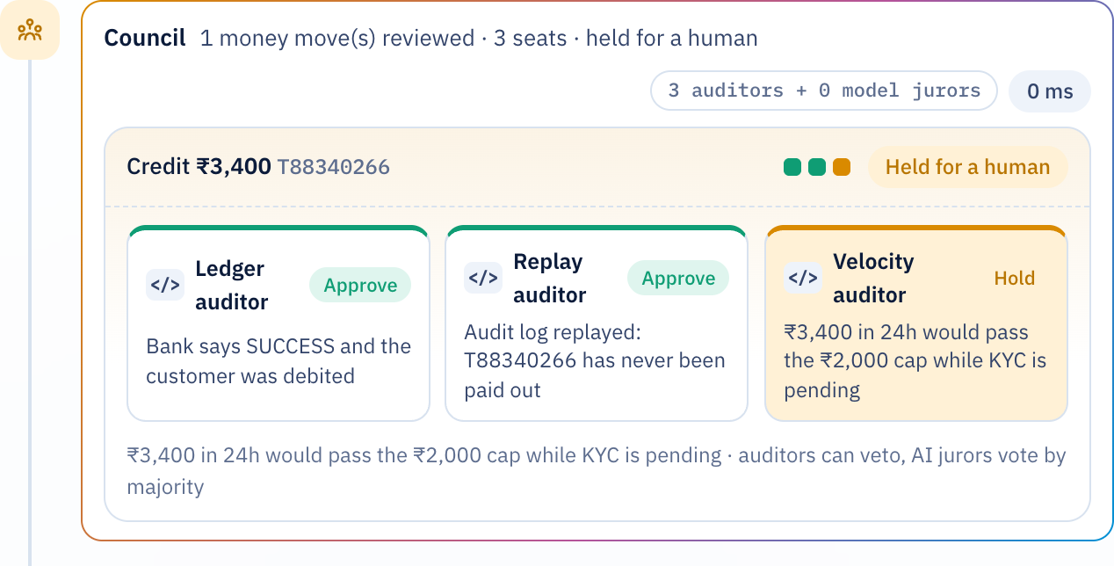
Demo 4: the council catches what the limit missed
1
₹3,400 is under the ₹5,000 limit
The guardrail allows it. A single-check system would pay out.
2
The velocity auditor objects
Gupta Medicals has KYC pending, so the autonomous cap is ₹2,000 a day.
3
Held, briefed, approved
The merchant gets a reply in Hindi; a specialist approves in one click.
Notes:
Switch to Gupta Medicals and tap Demo 4, in Hindi. The bank confirms a ₹3,400 payment. That is under our ₹5,000 limit, so a single guardrail would let it through. But the velocity auditor sees KYC is pending, where the cap is ₹2,000 a day, and holds it. The merchant gets an honest reply in Hindi and a specialist gets a full briefing.

Slide 7
Every major model, each on the job it’s best at
Agent | Job | Routing (first available wins)
Triage | Classify fast, pull out IDs | Groq Llama 3.1 8B → Gemini Flash → GPT-4.1 mini → Claude Haiku
Action | Plan and call tools in a loop | Claude Sonnet → GPT-4.1 → Gemini Pro → Groq Llama 70B
Reply | Warm Hindi / Hinglish / English | Gemini Flash → GPT-4.1 mini → Claude Haiku
Escalation | Two-sentence briefing | Claude Haiku → GPT-4.1 mini → Gemini Flash
Council | Independent votes on money | One juror per configured provider, all at once
6
providers: OpenAI, Anthropic, Gemini, Groq, OpenRouter, Ollama
2
adapters cover them all (OpenAI-compatible + Anthropic)
0
keys needed to demo: the rules engine is the safety net
Routing is configuration, so Paytm can swap in its own models without touching the agents.
Notes:
Each job suits a different model: fast and cheap for triage, the strongest tool-caller for actions, a good multilingual writer for replies. The council then uses every configured provider at once. If a provider fails, the trace shows the fallback and the ticket still closes.

Slide 8







Guardrails live in code, not in the prompt
Knows its limits
Money limit
Evidence first
Model Council
Below 60% confidence it escalates instead of guessing
Credits and refunds above ₹5,000 need a human
Credit only after the bank confirms
Auditors + cross-lab jurors on every money move
Stays in scope
Grounded replies
Private by default
Full audit log
Only the merchant it is serving
Every ₹ and ID must match tool results
Phones, UPI IDs, accounts masked before models
Who acted, and which rule allowed it
Notes:
What stops it from moving money it should not? These rules run in code before every tool call, whatever the model says. When a model tries to work around them, the call is simply blocked and turned into an approval request.

Slide 9

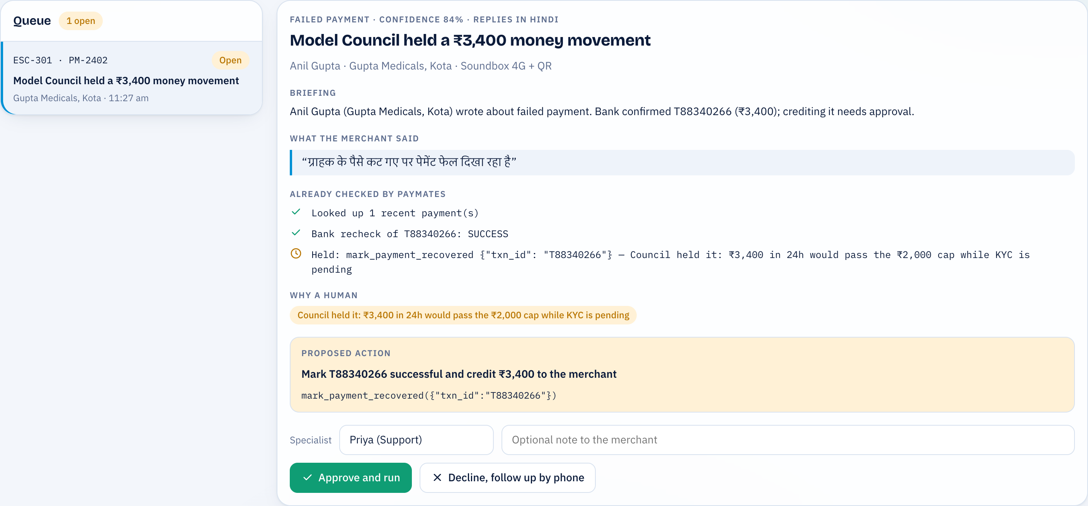
When a human is needed, they get a briefing, not a ticket
What the merchant said
In their own words and language
Already checked
Every tool call PayMates made, with results
Why a human is needed
The rule or council seat that held it
The exact action proposed
Approve and run executes it and messages the merchant
Notes:
Open the human console. Everything is pre-checked. Click Approve and run, then go back to the Live desk: the specialist’s update is already in the merchant’s chat, in their language.

Slide 10
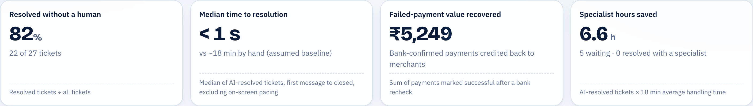
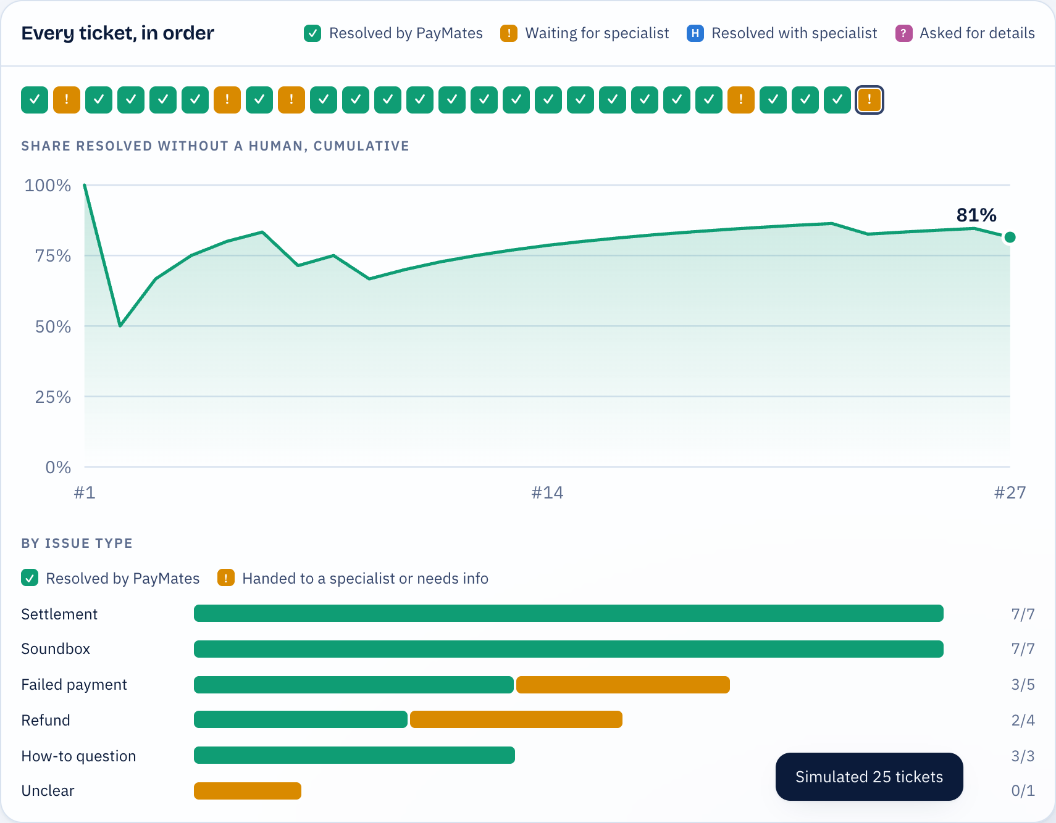
Measured on outcomes, not messages
Simulated traffic
25 tickets, six merchants, three languages, through the same agents, council and guardrails
All data is simulated; the method carries over to real tickets
The 18-minute manual baseline is an assumption, and labelled as one
Notes:
Ops dashboard, then Run 25 tickets. The ribbon and metrics fill live. Read the resolution rate off the screen; it changes slightly every run because the traffic is randomised. Be upfront that the data is simulated: the point is the method, and the same four metrics can be rerun on real tickets.

Slide 11








What we built it with
Agents & API
Models
Python 3, FastAPI, async orchestrator, Server-Sent Events
OpenAI, Claude, Gemini, Groq, OpenRouter, Ollama; native tool calling
Model Council
RAG
asyncio.gather jury, code auditors, abstain on timeout
TF-IDF vectors + cosine similarity; Hindi/Hinglish synonym expansion
Data
Web app
SQLite with plain SQL, ready to port to PostgreSQL
React 18, Vite, hand-built SVG charts, Web Speech API voice
Prototype
Quality
Same agent logic in JavaScript, runs fully in the browser
19 pytest end-to-end tests: demos, guardrails, council, fallbacks
Notes:
Python and FastAPI for the agents; two adapters cover six providers; React and Vite for the UI. The same agent logic is ported to JavaScript so the prototype runs entirely in a browser, and the app falls back to it automatically if the backend stops.

Slide 12



From prototype to Paytm in three steps
01
02
03
Connect the tools
Route Paytm’s models
Rerun the metrics on real tickets
Tools already mirror merchant-support APIs: transactions, settlements, refunds, KYC, devices. Point them at Paytm’s internal services.
Model routing is configuration. Swap in in-house or preferred models per agent and per council seat.
Resolution rate, time to resolve, value recovered and hours saved, computed the same way.
Notes:
How does this work with real Paytm systems? The tools have the same shape as merchant-support APIs, so in production they call internal services instead of the demo database. Routing is config. And the metrics are designed to be rerun on real tickets.

Slide 13
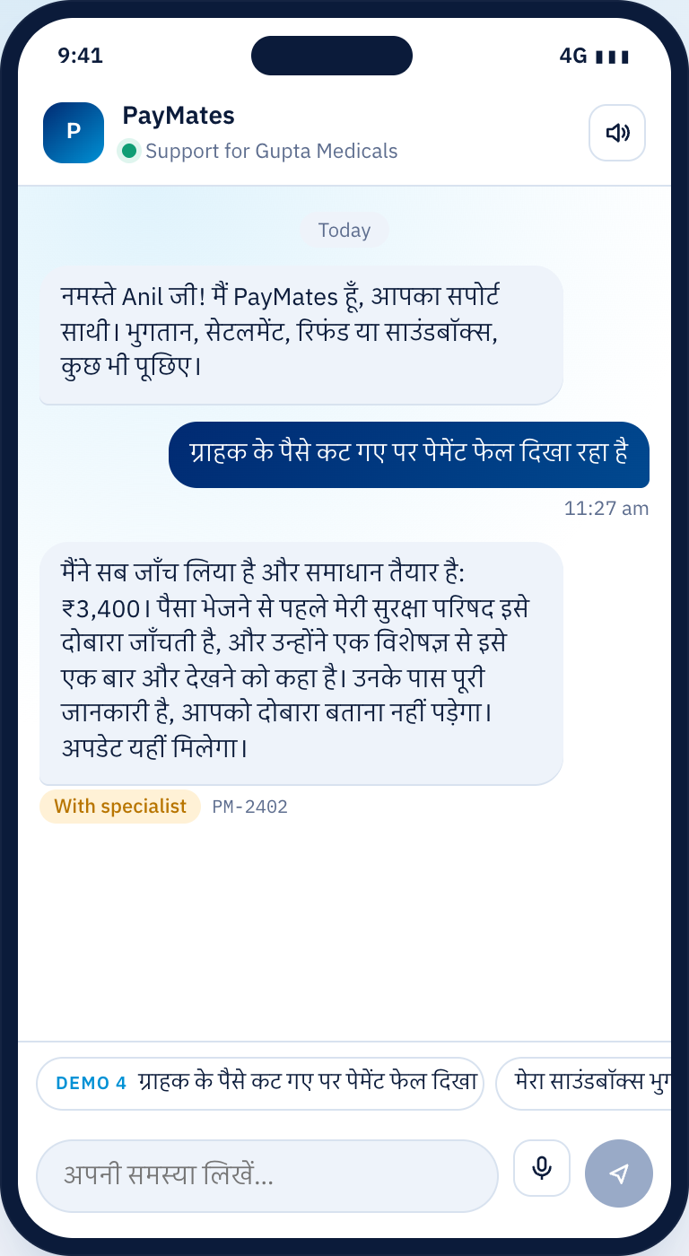
Support that feels like a teammate
THANK YOU
Not a ticket number. Let’s get Raju home on time.
Notes:
Close: support that feels like a teammate, not a ticket number. Then take questions. Likely ones: is it just a chatbot (no, open the trace), what stops it moving money (guardrails plus the council), what if the model hallucinates (grounding check), what if the LLM is down (rules fallback).

