Slide 1
SUPERSTORE SALES ANALYSIS
By Uchanma Igbokwe
22nd December, 2022.

Slide 2
CONTENT
Introduction----------------------------- 3
Business problem------------------------ 4
Sales Trend ----------------------------- 5
Product Performance --------------------- 6
Profit Analysis by Category --------------- 8
Shipping mode analysis------------------- 9
Customer Analysis ---------------------- 10
Insights -------------------------------- 11
Recommendations ---------------------- 12
Limitations ----------------------------- 13

Slide 3
INTRODUCTION
A superstore with operations across major cities of the world desires to understand certain features of their business and get vital information from its data to enable them plan or focus on what is selling with a full understanding of sales trend and forecasting for the future all things being equal.
The general aim is to reduce understocking and overstocking, also focus extremely on the selling products by taking into consideration, the demand and supply.

Slide 4
BUSINESS PROBLEM
Evaluation and analysis to predict daily sales and know what goods customers want at a particular time and what the trend would be every day, month, and year.
Complaints are:
a. The shipment of products is delayed. The agreed Service Level Agreement (SLA) is a maximum of three days from the order date.
b. The shop is unable to meet customers' demands on certain product line, as a result, market share is being lost to competition.

Slide 5
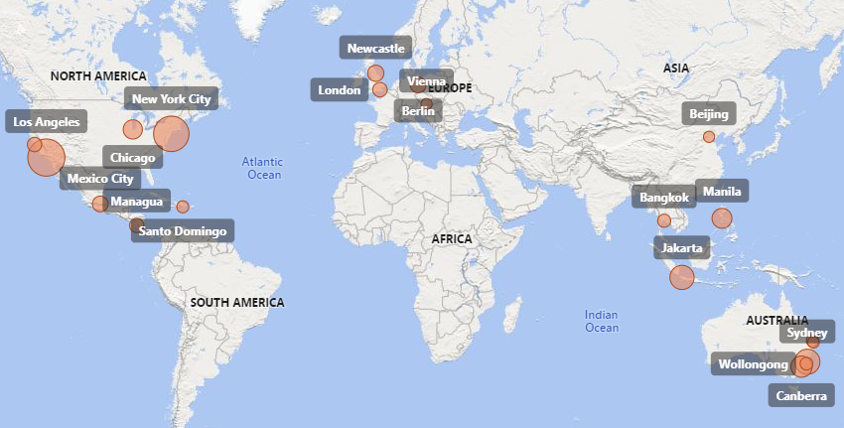
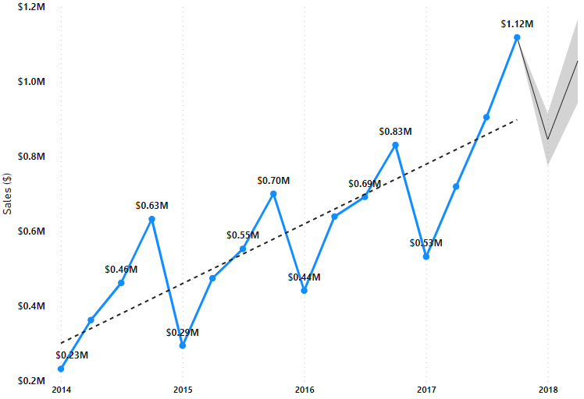
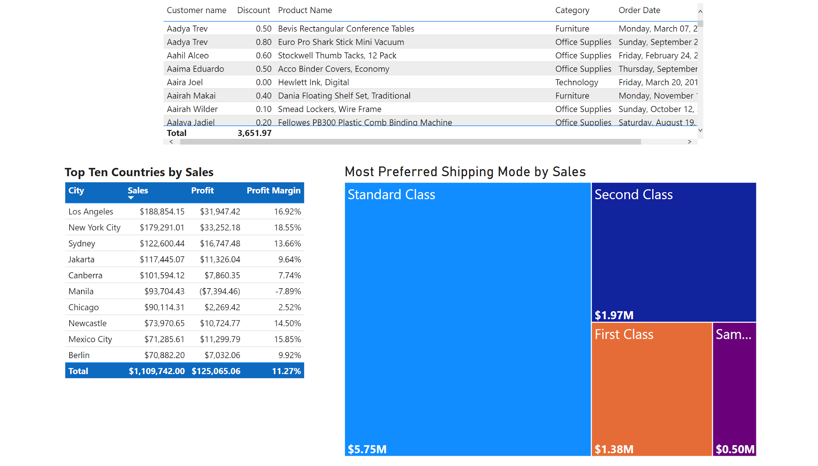
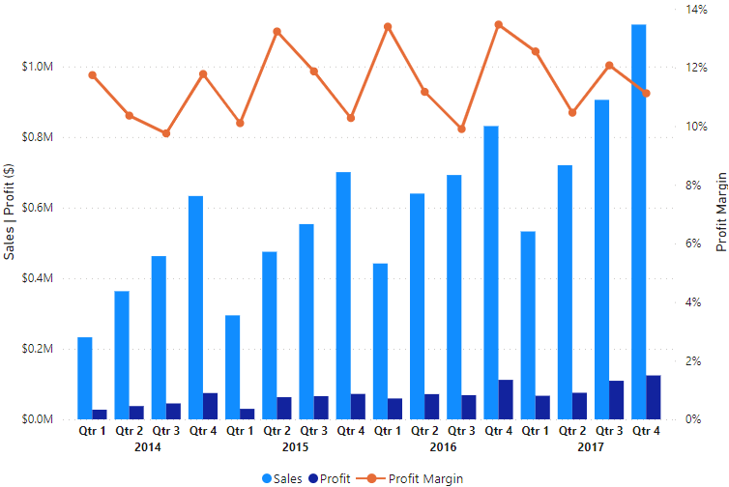
SALES TREND
TOP 20 CITIES BY SALES
REVENUE COMPARED ACROSS YEARS
$9.60M
SALES
25.73K
NUMBER OF SALES
TOP 10 CITIES BY SALES
REVENUE AND PROFIT TREND
4.23%
MONTHLY SALES GROWTH
$373.01
AVERAGE SALES
Notes:
Generally, there has been an upward trend in revenue generation over the years. The ‘Revenue Compared across Years’ chart shows that after every fourth quarter, there is a drop in revenue in the following quarter (first) of the next year. Though the revenue drop in the first quarter of the following years never got as low as that of the same quarter in the previous year, it is noteworthy that they were always lower than the amounts for the second and third quarters in the preceding year.
The top city by sales is Los Angeles, however, New York is the top city by profit.

Slide 6
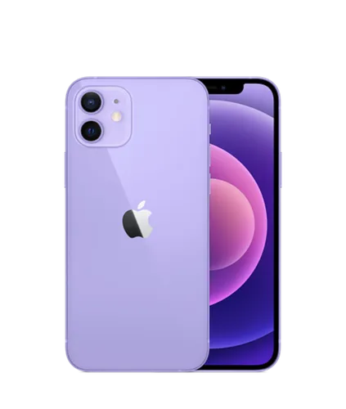
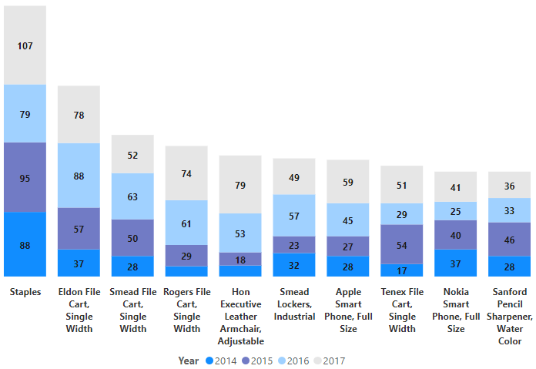
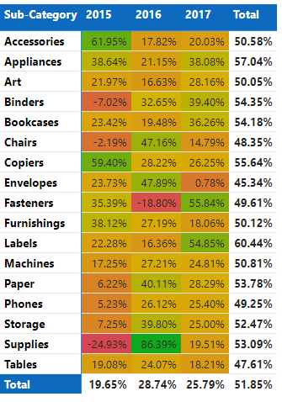
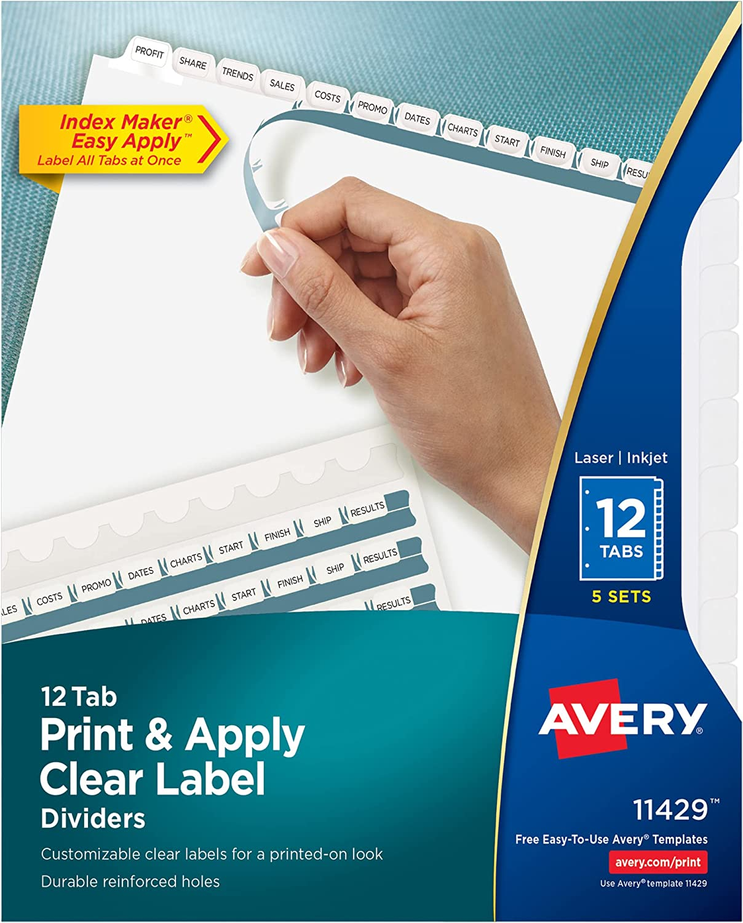
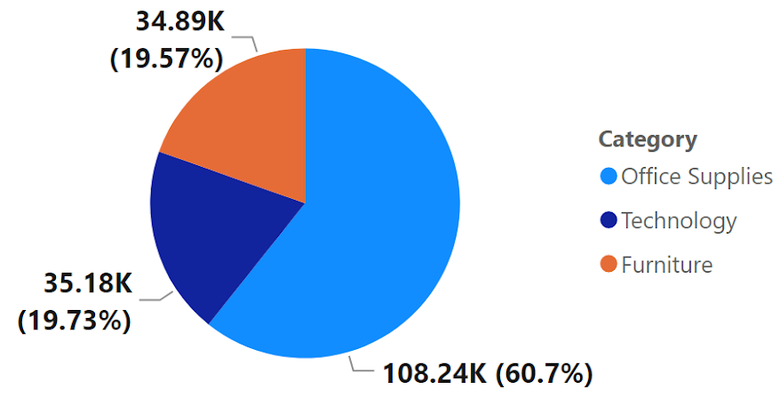
PRODUCT PERFORMANCE
3788
NUMBER OF PRODUCTS
17
NUMBER OF PRODUCT SUB-CATEGORY
3
NUMBER OF PRODUCT CATEGORY
MOST SELLING PRODUCT
TOP 10 SELLING PRODUCTS BY SALES NUMBER
YEAR OVER YEAR (YOY)% CHANGE IN PRODUCT SUBCATEGORY
MOST SELLING PRODUCT
Name: Apple Smart Phone, Full Size
Product ID:TEC-PH-3148
Sales Amount: $81,632.31
LEAST SELLING PRODUCT
Name: Avery Binder Labels
Product ID: OFF-BI-3250
Sales Amount: $1.17
NUMBER(QUANTITY) OF PRODUCTS SOLD BY CATEGORY
Notes:
More products were sold in the office supplies category than the other two. This might be expected considering that not only are office supplies used regularly, they come in small sizes that do not last as long home appliances or other electronic gadgets. Plus their prices can be as low as $1.

Slide 7
PRODUCT PERFORMANCE
TOP 2 PRODUCTS IN EACH REGION
S/N | Region | Top 2 Products, Product 1 | Top 2 Products, Product 2
1 | Canada | Motorola Smart Phone, Full Size| $3863.88 | Hewlett Wireless Fax, High-Speed | | $3783.90
2 | Caribbean | Samsung Smart Phone, VoIP | $4071.94 | Apple Smart Phone, Full Size | | $2972.42
3 | Central Afica | Cisco Smart Phone, Cordless | $3908.88 | Chromcraft Wood Table, Adjustable Height | | $3877.68
4 | Central America | Cisco Smart Phone, Full Size | $15309.34 | Nokia Smart Phone, Full Size | $14859.46
5 | Central Asia | SanDisk Memory Card, Bluetooth | $1124.10 | Motorola Headset, with Caller ID | $1116.36
6 | Central US | Canon image CLASS 2200 Advanced Copier | $17499.95 | Lexmark MX611dhe Monochrome Laser Printer | | $14279.92
7 | Eastern Africa | Samsung Smart Phone, Cordless| $3834.00 | KitchenAid Stove, White | | $3409.74
8 | Eastern Asia | Samsung Smart Phone, VoIP | $13361.04 | Bush Classic Bookcase, Traditional | $9450.37
9 | Easter Europe | Apple Smart Phone, Full Size | $5092.26 | Hamilton Beach Microwave, Red| $3955.14
10 | Eastern US | Canon imageCLASS 2200 Advanced Copier | $18899.95 | 3D Systems Cube Printer, 2nd Generation, Magenta | $14299.89
11 | North Africa | Canon Wireless Fax, Laser | $5301.24 | Sauder Classic Bookcase, Traditional | $3923.91
12 | Northern Europe | Nokia Smart Phone, Full Size | $16806.69 | Cisco Smart Phone, Cordless | $8404.09
13 | Oceania | Nokia Smart Phone, with Caller ID | $14950.49 | Motorola Smart Phone, Full Size | $14290.55
14 | South America | Dania Classic Bookcase, Pine | $6538.81 | Harbour Creations Executive Leather Armchair, Adjustable | $6493.83
15 | Southeastern Asia | Nokia Smart Phone, with Caller ID | $9979.77 | Motorola Smart Phone, Full Size | $9614.64
16 | Southern Africa | Apple Smart Phone, Full Size | $4461.21 | Canon Fax Machine, High-Speed | $3799.08
17 | Southern Asia | Apple Smart Phone, Full Size | $13060.37 | Motorola Smart Phone, with Caller ID | $10974.18
18 | Southern Europe | Hoover Stove, Red | $13074.81 | Hamilton Beach Stove, Silver | $11947.98
19 | Southern US | HP Designjet T520 Inkjet Large Format Printer - 24" Color | $11374.94 | Cubify CubeX 3D Printer Triple Head Print | $7999.98
20 | Western Africa | Apple Smart Phone, Full Size | $5481.73 | Cisco Smart Phone, Full Size | $5411.70
21 | Western Asia | Cisco Smart Phone, Full Size | $7165.29 | Motorola Smart Phone, Cordless | $5656.46
22 | Western Europe | Nokia Smart Phone, Full Size | $13268.37 | Office Star Executive Leather Armchair, Adjustable | $12894.52
23 | Western US | Canon imageCLASS 2200 Advanced Copier | $13999.96 | High Speed Automatic Electric Letter Opener | $13100.24
S/N | Region | Top 2 Products, Product 1 | Top 2 Products, Product 2
1 | Canada | Motorola Smart Phone, Full Size | $3863.88 | Hewlett Wireless Fax, High-Speed | $3783.90
2 | Caribbean | Samsung Smart Phone, VoIP | $4071.94 | Apple Smart Phone, Full Size | $2972.42
3 | Central Afica | Cisco Smart Phone, Cordless | $3908.88 | Chromcraft Wood Table, Adjustable Height | $3877.68
4 | Central America | Cisco Smart Phone, Full Size | $15309.34 | Nokia Smart Phone, Full Size | $14859.46
5 | Central Asia | SanDisk Memory Card, Bluetooth | $1124.10 | Motorola Headset, with Caller ID | $1116.36
6 | Central US | Canon image CLASS 2200 Advanced Copier | $17499.95 | Lexmark MX611dhe Monochrome Laser Printer | $14279.92
7 | Eastern Africa | Samsung Smart Phone, Cordless | $3834.00 | KitchenAid Stove, White | $3409.74
8 | Eastern Asia | Samsung Smart Phone, VoIP | $13361.04 | Bush Classic Bookcase, Traditional | $9450.37
9 | Easter Europe | Apple Smart Phone, Full Size | $5092.26 | Hamilton Beach Microwave, Red | $3955.14
10 | Eastern US | Canon imageCLASS 2200 Advanced Copier | $18899.95 | 3D Systems Cube Printer, 2nd Generation, Magenta | $14299.89
11 | North Africa | Canon Wireless Fax, Laser | $5301.24 | Sauder Classic Bookcase, Traditional | $3923.91
12 | Northern Europe | Nokia Smart Phone, Full Size | $16806.69 | Cisco Smart Phone, Cordless | $8404.09
13 | Oceania | Nokia Smart Phone, with Caller ID | $14950.49 | Motorola Smart Phone, Full Size | $14290.55
14 | South America | Dania Classic Bookcase, Pine | $6538.81 | Harbour Creations Executive Leather Armchair, Adjustable | $6493.83
15 | Southeastern Asia | Nokia Smart Phone, with Caller ID | $9979.77 | Motorola Smart Phone, Full Size | $9614.64
16 | Southern Africa | Apple Smart Phone, Full Size | $4461.21 | Canon Fax Machine, High-Speed | $3799.08
17 | Southern Asia | Apple Smart Phone, Full Size | $13060.37 | Motorola Smart Phone, with Caller ID | $10974.18
18 | Southern Europe | Hoover Stove, Red | $13074.81 | Hamilton Beach Stove, Silver | $11947.98
19 | Southern US | HP DesignJet T520 Inkjet Large Format Printer - 24" Color | $11374.94 | Cubify CubeX 3D Printer Triple Head Print | $7999.98
20 | Western Africa | Apple Smart Phone, Full Size | $5481.73 | Cisco Smart Phone, Full Size | $5411.70
21 | Western Asia | Cisco Smart Phone, Full Size | $7165.29 | Motorola Smart Phone, Cordless | $5656.46
22 | Western Europe | Nokia Smart Phone, Full Size | $13268.37 | Office Star Executive Leather Armchair, Adjustable | $12894.52
23 | Western US | Canon imageCLASS 2200 Advanced Copier | $13999.96 | High Speed Automatic Electric Letter Opener | $13100.24
Notes:
Smart phones constituted a large number of the top one selling product in each region. The United States was the only region that had office supplies as the best two selling products.

Slide 8
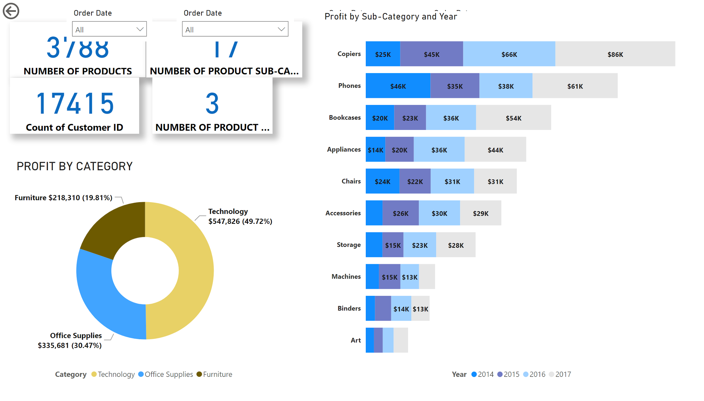
PROFIT ANALYSIS BY CATEGORY AND SUB-CATEGORY
$1.10M
PROFIT
PROFIT BY CATEGORY
PROFIT ($) BY SUB-CATEGORY AND YEAR
Notes:
Sale of items under the technology category constituted most of the profit generated in the store. This is expected since the top two products in most of the regions are technological products or electronic devices.

Slide 9
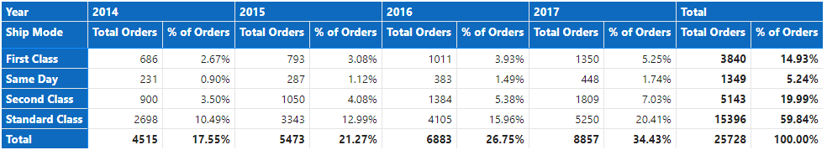
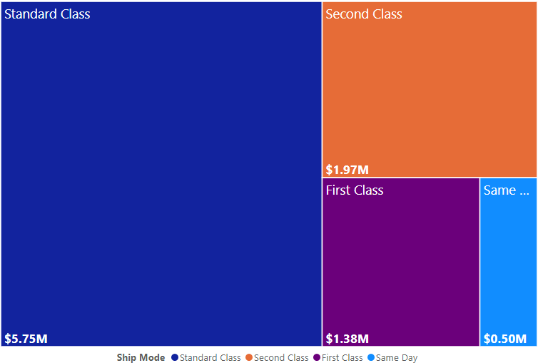
SHIPPING MODE ANALYSIS
ORDERS BY SHIPPING METHOD
MOST PREFERRED SHIPPING METHOD BY SALES
Notes:
Standard class shipping mode constitutes the most requested shipping method in all orders. Maximum stated Service Level Agreement(SLA) is three days. However, the product deliveries have taken as long as 8 days on five different occasions in 2016.

Slide 10
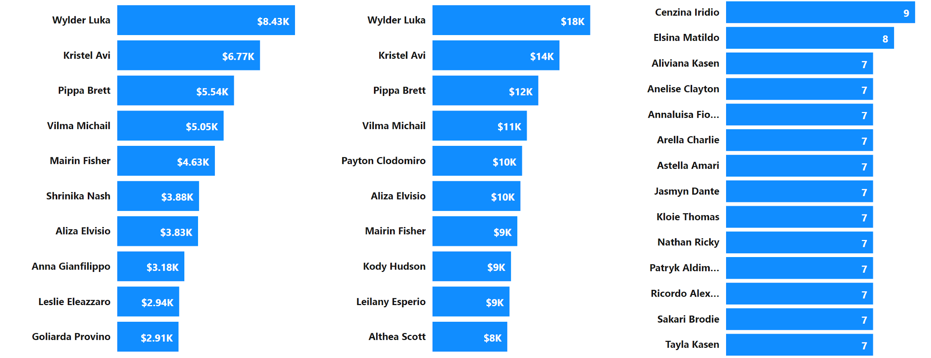
CUSTOMER ANALYSIS
17.42K
NUMBER OF CUSTOMERS
TOP 10 CUSTOMERS BY PROFIT
TOP CUSTOMERS BY SALES
TOP CUSTOMERS BY ORDER QUANTITY

Slide 11
INSIGHTS
Despite a yearly growth in sales, the first month of every quarter always sees a decline in sales, according to the sales pattern.
Smart phones constituted a large number of the top one selling product in each region. The United States was the only region that had office supplies as the best two selling products.
The top five customers for each of the four years in the dataset have varied. These top five have largely never been given a discount. However, for the top five customers in sales revenue overall, i.e., without yearly evaluation, 4 out of the five have received discounts in various years.
Concerning delivery timeline:
Maximum stated Service Level Agreement(SLA) is three days. However, the product deliveries have taken as long as 8 days on five different occasions in 2016.
For the most recent year, 2017, the standard class shipping mode has a minimum and maximum delivery window of 4 and 7 days, respectively. 59.28% of all orders were shipped using the standard class mode. Of the 59.28% (5250), delivery within 7 days made up 10.13% and delivery within 6 days comprised 20.42%.
Furthermore, the second-class shipping mode fell short of the promised SLA. The minimum and maximum delivery days were 2 and 5. Of the 1809 (42%) of total orders, second-class was the ship mode. Majority(20.56%) of these orders were delivered within 5 days and 19.85% were delivered within 4 days.
The category with the largest sales revenue and profit was technology. More products were sold in the office supplies category than the other two. This might be expected considering that not only are office supplies used regularly, they come in small sizes that do not last as long as home appliances or other electronic gadgets. Plus their prices can be as low as $1.
There is a weak negative correlation between sales and discount. Higher discounts did not necessarily result in higher sales amount.

Slide 12
RECOMMENDATIONS
As loyalty reward, the top 5 customers with the highest sales and profit can be give a gift or discount on certain purchases every year or loyalty points. These points can be redeemed during purchases.
Optimize delivery timelines for each shipping mode, especially standard class. This will ensure the 3 days SLA is met in all the shipping modes. Evaluate delivery companies or services used and discover the root of delays in deliveries. A number of same day orders were not delivered, this needs to be improved. And all same day orders were high priority orders. Resolution of this can give the company an edge over their competitions and drive sales.
Majority of the orders had their shipping mode as standard class. Orders by standard class shipping brought in the most sales and profit, therefore, there is need to make this shipping method more effective.
Develop a marketing strategy for customer acquisition and retention.
Set sales target that need to be met quarterly and yearly. At the end of each quarter and year, measure whether targets were met and by what percentage.
Capitalize on the top 2 products that sell the most in each region and cities responsible for these sales. Drive marketing campaigns on these products. And always ensure availability.
Conduct a customer satisfaction survey.

Slide 13
LIMITATIONS
It is difficult to make recommendations for order priority based on the data provided. The order priority data in the dataset indicates the level of importance of orders placed and not the priority given to each product in stocking or restocking.
Concerning loyalty rewards, it is not clear whether customers have been rewarded before and if so, what the rewards were. Also, the effect of the rewards given on sales.
Discounts cannot be explored further because it is not clear the reason for the discount given to some customers and not others.
The dataset does not provide information on how goods were shipped, i.e., whether by ship, freight or road. It also does not state if there were hindrances or challenges encountered during shipping. As a result, it is difficult to determine why certain shipping modes exceeded the stated SLA.
Customer lifetime value cannot be determined because we do not have data for customer acquisition cost. The longer existing customers are retained, the more they spend and the better sales revenue.
Sales target for the years preceding 2017 were not provided, this would help to show whether revenue target has been met or not.
There is no data on expenditure for staff and others, therefore we cannot determine the overall wellbeing of the company.
Would have liked to investigate further why there is a dip in sales in the first month of every new quarter. This will not be possible because of the unavailability of data for this analysis.
Certain variables are not clear. The segment variable has three possible values (consumer, corporate, & home office), and it is not clear what these mean.
There is no date for when each customer joined. Therefore, it is not possible to determine customer retention and activity.

Slide 14
THANK YOU
Uchanma Igbokwe
mmaadeola@gmail.com

