Slide 1
Spark简介

Slide 2
路线图
1、Java函数式编程；
2、Java Stream ＡＰＩ；
３、Ｓｐａｒｋ ＲＤＤ运算；
４、综合应用案例

Slide 3
Spark 生态圈
Spark 优势
Spark 架构及组件
Spark 核心概念

Slide 4
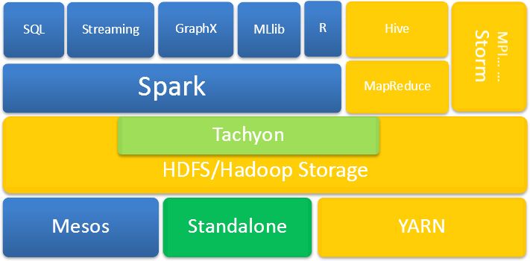
Spark 生态图

Slide 5
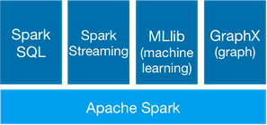
Spark 主要成员
Spark : Apache Spark is a fast and general engine for large-scale data processing
Spark SQL：Spark SQL is Spark's module for working with structured data
Spark Streaming ：Spark Streaming makes it easy to build scalable fault-tolerant streaming applications.
MLlib(machince learning) ： MLlib is Apache Spark's scalable machine learning library
GraphX(graph) : GraphX is Apache Spark's API for graphs and graph-parallel computation.

Slide 6
Spark 生态系统
Spark 优势
Spark 架构及组件
Spark 核心概念

Slide 7
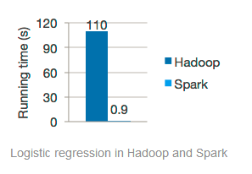
Spark 优势-快
Run programs up to 100x faster than Hadoop MapReduce in memory, or 10x faster on disk.

Slide 8
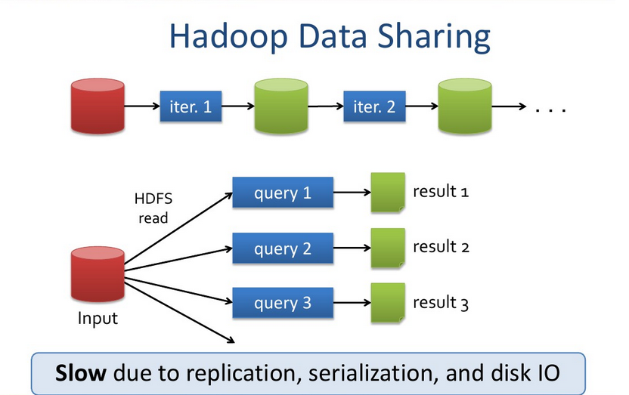
Spark 优势-Hadoop慢

Slide 9
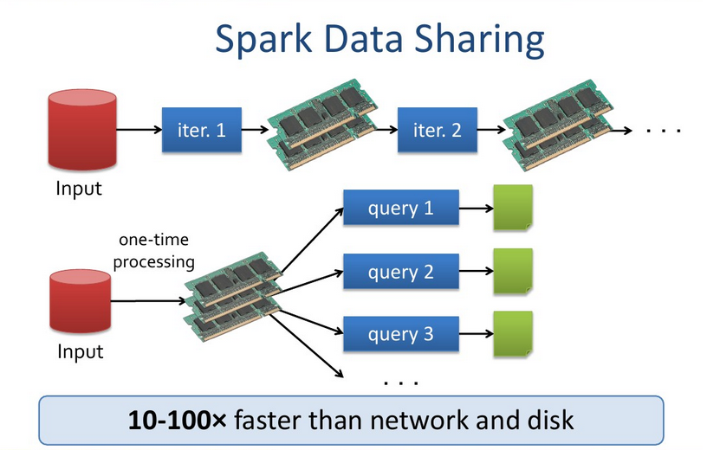
Spark 优势-Spark快

Slide 10
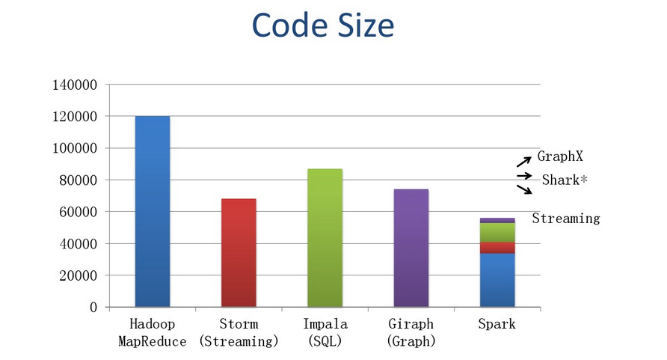
Spark 优势-轻

Slide 11
Spark 优势-轻
WorldCount示例
sc.textFile(“hdfs://…”).flatMap(_.split(“”)).map(_,1).reduceBykey(_+_). counts.saveAsTextFile(“hdfs://…”)
Hadoop Mapreduce worldCount示例有104行

Slide 12
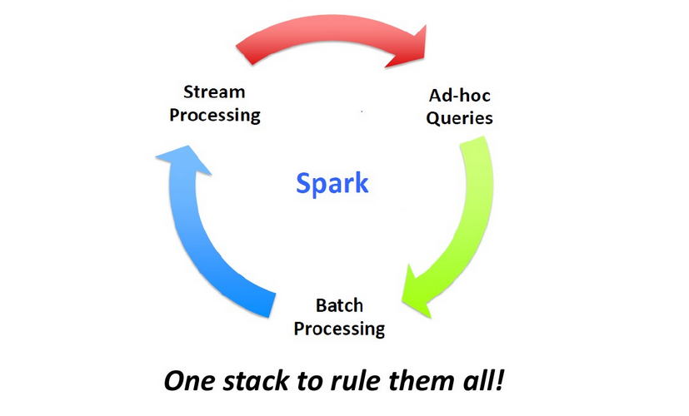
Spark 优势-通用

Slide 13
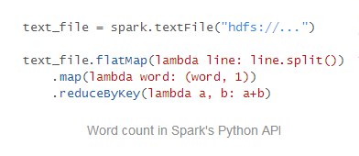
Spark 优势-易用
Write applications quickly in Java, Scala, Python, R.

Slide 14

Spark优势-多平台运行
Spark runs on Hadoop, Mesos, standalone, or in the cloud. It can access diverse data sources including HDFS, Cassandra, HBase, and S3.

Slide 15
Spark 生态系统
Spark 优势
Spark 架构及组件
Spark 核心概念

Slide 16
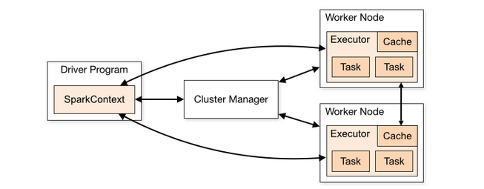
Spark 集群架构

Slide 17
Spark 常用术语
Term | Meaning
Application | User program built on Spark. Consists of a driver program and executors on the cluster.
Driver program | The process running the main() function of the application and creating the SparkContext
Cluster manager | An external service for acquiring resources on the cluster (e.g. standalone manager, Mesos, YARN)
Worker node | Any node that can run application code in the cluster
Executor | A process launched for an application on a worker node, that runs tasks and keeps data in memory or disk storage across them. Each application has its own executors.
Task | A unit of work that will be sent to one executor
Job | A parallel computation consisting of multiple tasks that gets spawned in response to a Spark action (e.g. save,collect); you'll see this term used in the driver's logs.
Stage | Each job gets divided into smaller sets of tasks called stages that depend on each other (similar to the map and reduce stages in MapReduce); you'll see this term used in the driver's logs.

Slide 18
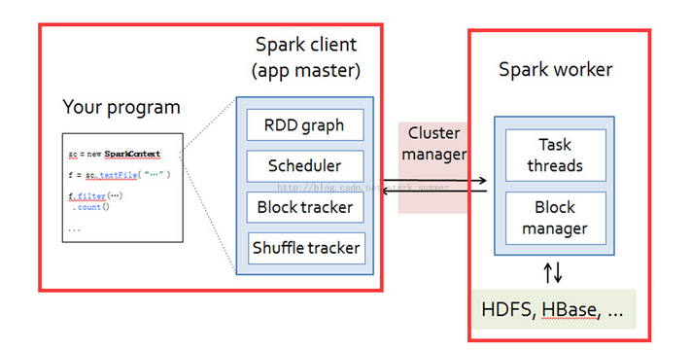
Spark 核心组件

Slide 19
Spark 生态系统
Spark 优势
Spark 架构及组件
Spark 核心概念

Slide 20
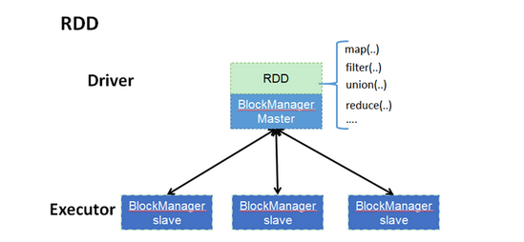
Spark 核心概念-RDD
RDD（Resilient Distributed Datasets)弹性分布式数据集：
是一个容错的、并行的数据结构，可以让用户显式地将数据存储到磁盘和内存中，并能控制数据的分区。同时，RDD还提供了一组丰富的操作来操作这些数据。在这些操作中，诸如map、flatMap、filter等转换操作实现了monad模式，很好地契合了Scala的集合操作。除此之外，RDD还提供了诸如join、groupBy、reduceByKey等更为方便的操作（注意，reduceByKey是action，而非transformation），以支持常见的数据运算。

Slide 21
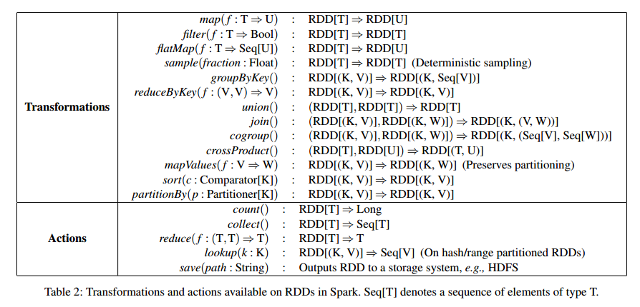
Spark 核心概念-RDD
RDD支持的常见操作:

Slide 22
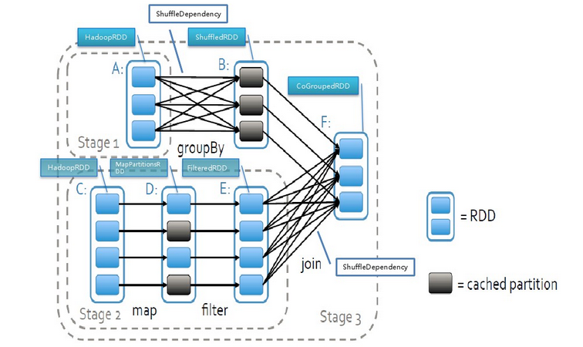
Spark 核心概念- DAG(有向无环图)

Slide 23
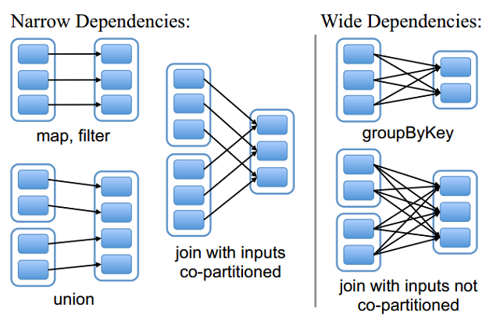
Spark 核心概念-宽窄依赖

Slide 24
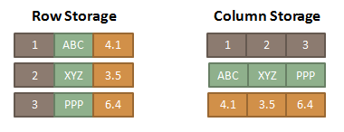
Spark 核心概念-内存表
将数据表以列式存储的方式保存到内存中
  可以只扫描需要的列
  更少的内存对象（less GC）
  自动选择最优的压缩算法

